Slide 1
An Unusual Case of Headache
Dr. Love Garg
JR – II Medicine Department

Slide 2
A 58 year old female, resident of Chinchwad
came with chief complaints of :
Headache since 4 months localised to left frontal & temporal region.
Not associated with nausea, vomiting, photophobia, phonophobia.
Not associated with loss of consciousness.
No H/O of blurring of vision.

Slide 3
Past History
She had no history of joint or bone pains, deafness, tinnitus, dental malocclusion, fractures, fatigue.
No H/O DM, HTN, TB, Bronchial Asthma.

Slide 4
General Examination
On examination :
Afebrile
Pulse- 82/min
BP- 110/70 mm Hg
Weight – 100 kg
Height – 145 cm
BMI – 47.56
Bilateral pedal pitting edema +

Slide 5
Her head looked larger than normal size with skull diameter – 58 cm (23 inches)

Slide 6
Systemic Examination
CNS – No focal neurological deficit
CVS - S1 , S2 +
RS- Bilateral vesicular breath sounds present
P/A- soft, non-tender

Slide 7
Lab Parameters
CBC :
Hb – 13.5
TLC-8500 (66/24/4/4)
P/C- 2.80
ESR-07
MCV-75.3
PBS – Microcytic , hypochromic

Slide 8
LFT :
-BIL (T) – 0.21 mg/dl
(D) –0.05 mg/dl
-SGOT – 17 U/L
-SGPT – 12 U/L
-ALP – 869 U/L (NR- 40-120)
-Serum protein – 7.32 gm/dl
-Sr. Albumin – 4.35 gm/dl
-Sr. uric acid – 7.4 gm/dl
-Sr. LDH-217 U/L (135-225)
-S.Ca – 9.2 mg/dl
S.Mg – 1.9 mg/dl

Slide 9
FLP :
Sr Triglycerides – 180 mg/dl (0-150)
Sr Cholesterol – 202 mg/dl (0-200)
HDL – 29.1 mg/dl (0-55)
LDL – 155 mg/dl (0-100)
Sr Na – 139 mm/l
Sr K – 4.2 mm/l
TFT- T3- 1.1 (0.8-2.0)
T4- 11.4 (5.1-14.1)
TSH- 5.3 (0.2-5.5)

Slide 10
RFTs :
Blood urea – 23 mg/dl
Sr. creatinine – 0.68 mg/dl
BSL (R) – 113 mg/dl
HbA1c – 6.4 %
Urine R/M – Albumin : nil
Sugar : nil
Pus cells : 0-1/hpf
Epi cells : 0-1/hpf
HIV – Negative
HbsAG – Negative

Slide 11
ECG – WNL
CXR – WNL
2D ECHO- Normal LV systolic function with EF- 60 %.
USG (A/P) – Hepatomegaly 17 cms with fatty infiltration of liver.
USG neck- Colloid goitre.

Slide 12
FURTHER INVESTIGATIONS
Intact PTH- 24.3 pg/ml (NR- 12- 88 pg/ml)
Bone specific ALP >120 (NR- 5.5 – 24.6)
In view of chronic headache, Xray skull and CT brain was done.

Slide 13
Xray skull showing marked thickening of calvarium with mixed lytic and sclerotic lesion giving cotton wool appearance

Slide 14
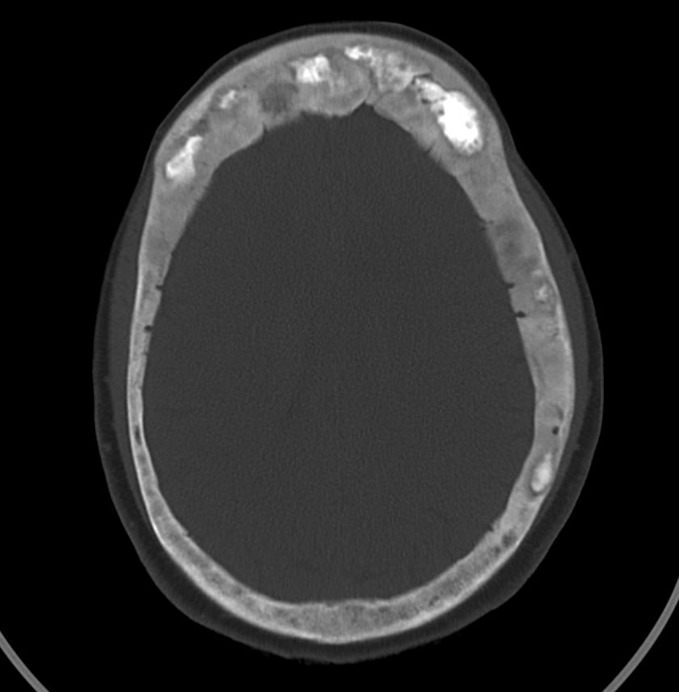
Non contrast CT brain
Axial view of computed tomography scan showing widened diploic space with sclerotic and lytic areas involving inner and outer tables of bony calvarium giving a cotton wool appearance.
Marked enlargement of frontal bones noted.

Slide 15
Saggital section of skull showing widening of diploic space (Tam O’Shanter sign)

Slide 16
Xray long bones

Slide 17
Considering these features, our differential
diagnosis were :
Paget’s disease of bone.
Metastatic deposits.
So, PET CT scan was done to confirm the diagnosis.

Slide 18
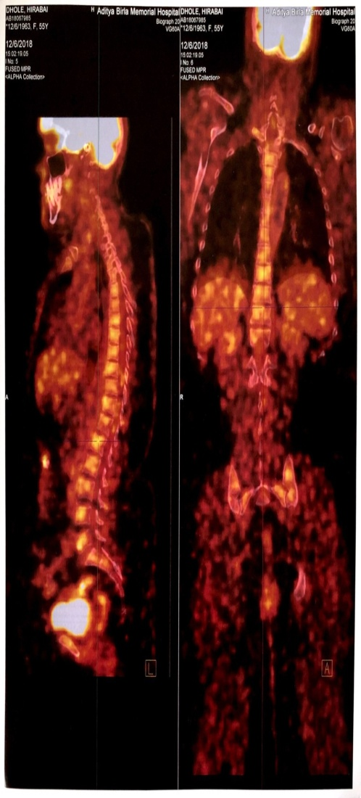
PET-CT SCAN
Evidence of diffuse FDG avid calvarial thickening with widening of interdiploic spaces with multiple lytic/sclerotic changes highy suggestive of Paget’s disease.
Multinodular goiter with few FDG avid thyroid nodule.

Slide 19
Final Diagnosis :
Paget’s disease of bone

Slide 20
Treatment
Patient was given :
Inj. Zolendronic acid 5mg i/v over 15 mins.
Calcium and Vitamin D supplementation.
Precaution :
Before giving Inj. Zolendronic acid, adequate calcium and Vitamin D supplementation should be given.

Slide 21
Discussion
Paget’s disease is a localized bone-remodeling disorder that affects widespread, non-contiguous areas of the skeleton.
The pathologic process is initiated by overactive osteoclastic bone resorption followed by a compensatory increase in osteoblastic new bone formation, resulting in a structurally disorganized mosaic of woven and lamellar bone.
Most patients are asymptomatic, symptoms resulting directly from bony involvement (bone pain, arthritis, fractures) or secondarily from the expansion of bone causing compression of surrounding neural tissue are common.

Slide 22
Diagnosis is often made in asymptomatic patients because they have elevated ALP levels on routine blood chemistry testing or an abnormality on a skeletal radiograph obtained for another indication.
The skeletal sites most commonly involved are the pelvis, vertebral bodies, skull, femur and tibia.
Familial cases with an early presentation often have numerous active sites of skeletal involvement.

Slide 23
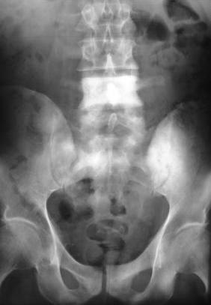
The diagnosis may be suggested on clinical examination by the presence of an enlarged skull with frontal bossing, bowing of an extremity or short stature with simian posturing.
Vertebral cortical thickening of the superior and inferior end plates creates a “picture frame” vertebra. Diffuse radiodense enlargement of a vertebra is referred to as “ivory vertebra.”

Slide 24
Treatment
Bisphosphonates are the mainstay of pharmacologic therapy of Paget’s disease.
Among them, Zoledronic acid is currently recommended as the first choice particularly for those who have severe disease or need rapid normalization of bone turnover.
Oral bisphosphonates, alendronate and risedronate, can be used in subjects who have mild disease or some degree of renal impairment.
The subcutaneous injectable form of salmon calcitonin is approved for the treatment of Paget’s disease but is rarely used.

Slide 25
References
1.Eversole R, Su L, ElMofty S. Benign fibro-osseous lesions of the craniofacial complex. A review. Head Neck Pathol. 2008;2:177–202.
2. Bastin S, Bird H, Gamble G, Cundy T. Paget's disease of bone: Becoming a rarity? Rheumatology (Oxford) 2009;48:1232–5.
3. Bae KB, Kwon JH, Kim YH, Jung TY, Cho JH. Juvenile Paget's disease with paranasal sinus aplasia. Clin Exp Otorhinolaryngol. 2008;1:224–6.
4. Karunakaran K, Murugesan P, Rajeshwar G, Babu S. Paget's disease of the mandible. J Oral Maxillofac Pathol. 2012;16:107–9.
5. Sekar B, Augustine D, Murali S. Paget's disease of mandible: A case report and review of literature. J Orofac Sci. 2010;2:13–17.

