Slide 1
DEPARTMENT OF PAEDIATRICS
DR. D.Y. PATIL MEDICAL COLLEGE
A CASE OF REFRACTORY EPILEPSY
DR. PALAK JAIN (JR - III)
Dr SANDEEP PATIL (Pediatric Epileptologist & Neurologist)
Dr NILESH KURWALE (Epilepsy Surgeon)

Slide 2
CASE REPORT
A 5 year old female child, resident of Chikhali, is a second order child of a non consanguineous marriage.
Chief Complaints –
1) Drug resistant Epilepsy for 4 and ½ years
2) Global Developmental Delay
3) Behavioural Issues

Slide 3
CASE REPORT
Semiology of seizures – GTCS and right focal seizures
GTCS – unprovoked, associated with tonic posturing of all 4 limbs, uprolling of eyeballs and loss of consciousness, lasting for 1-2 minutes
Rightt focal seizure – unprovoked, tonic-clonic movement in right upper and lower limb and deviation of angle of mouth towards rightt side, lasting for one minute
Frequency of GTCS – once in every 15-20 days
Frequency of Focal seizure – 4-5times/day

Slide 4
CASE REPORT
MILESTONES – global developmental delay involving all the four domains along with behavioural issues
GROSS MOTOR MILESTONES Neck holding – 8 months Rolling over – 11 months Sit without support – 2 years Walk without support – 3 years Climbs upstairs and downstairs with 2feet/step – 4 years GROSS MOTOR AGE = 3-4 YEARS
FINE MOTOR MILESTONES Bidextrous reach – 7 months Palmar grasp – 11 months Immature pincer grasp – 18 months FINE MOTOR AGE = 9 MONTHS

Slide 5
CASE REPORT
SPEECH &LANGUAGE MILESTONES Alerts to sound – 1 month Cooing – 6 months Monosyllables – 1 year EXPRESSIVE > RECEPTIVE SPEECH – delayed
SOCIAL & ADAPTIVE MILESTONES Recognizes mother – 9 month Social smile – not achieved Poor eye contact No social reciprocity No finger pointing No group play Behavioural issues – aggressive, head banging, repetitive hand movements

Slide 6
CASE REPORT
ANTENATAL HISTORY – spontaneous conception; mother was a registered case, underwent 4 antenatal scans and took iron and folic acid tablets. No H/o anaemia, TB, DM, HTN, asthma, thyroid dysfunction or fever with rash with arthralgia during pregnancy.
NATAL HISTORY – full term, NVD, 2.4 kg birth weight, cried immediately after birth, No H/o NICU admission
POSTNATAL HISTORY – uneventful

Slide 7
CASE REPORT
FAMILY HISTORY -
8 years
5 years
2 years
No H/o epilepsy/mental retardation/any other significant medical illness in family.

Slide 8
O/E –
Conscious and alert
Lean and thin child
Fails to maintain an eye contact
Vitals – normal
Pallor, Icterus, Clubbing, Cyanosis, Lymphadenopathy, Edema – absent
Head – normal in shape and size
No facial dysmorphism seen.
Spine – normal
No obvious skeletal deformities or joint contractures seen

Slide 9
O/E
One ash leaf macule (well defined hypopigmented patch) is present in front of the left ear.
One shagreen patch is present over left lower parasternal region.
Multiple hypopigmented spots are present over scapular region.
One café-au-lait spot is present on left lower chest.

Slide 10
CNS EXAMINATION:
Conscious and alert child with autistic features
Cranial nerve examination - normal
Bulk of muscles – normal; no wasting or hypertrophy of any muscle group seen
Tone – normal
Power – more than or equal to 4/5
Reflexes (superficial and deep) - normal
Sensory system examination – normal
RS EXAMINATION – WNL
CVS EXAMINATION – WNL
PA EXAMINATION - WNL

Slide 11
CLINICAL DIAGNOSIS
TUBEROUS SCLEROSIS

Slide 12
INVESTIGATIONS
All routine investigations including metabolic screen – WNL
Ophthalmologic evaluation – WNL
BERA – bilateral hearing sensitivity within normal limits.
CxR (13/9/14) – enlarged left atrial appendage
ECG – WNL

Slide 13
INVESTIGATIONS
2D Echo (10 months of age)– Huge intra-pericardial mass seen in LV anterior free wall measuring 36mm*12mm, homogenous, smooth in appearance. Likely to be rhabdomyoma. No inflow/outflow obstruction. Intact septae.
Cardiologist opinion – no active intervention required; follow up 2D echo after 3 months.
Serial 2D Echo - initially showed no change in the mass or in the hemodynamic status; later showed regression in size of rhabdomyoma.
2D Echo (22/10/18) (at 5yrs of age) – normal study

Slide 14
EEG – initially normal, but after 4 years of age fronto-centro-parieto-temporal IEDs were seen.
VIDEO EEG – done at 5 years of age –
Interictal –
1. Continuous fronto-temporal slowing over left side.
2. Left Fronto-temporal epileptiform activity
3. Secondary Generalised Epileptiform activity
4. Paucity of Sleep ontogeny

Slide 15
Ictal
Semiology – Initial tonic extension of right UL and LL with deviation of angle mouth to right side, lasting for 1 Minute
EEG – Change in background rhythm with evolving spike and waves from Left fronto-polar region which spreads to left frontal contact at F3.

Slide 17
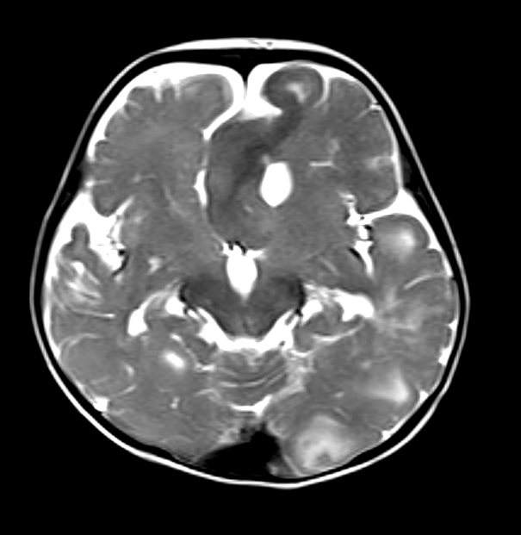
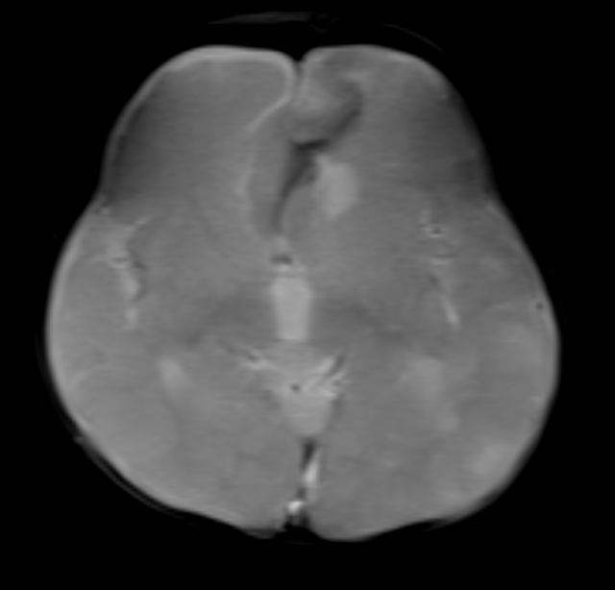
MRI Brain plain done on 5th September 2014.
T2 Axial.
GRE Axial.

Slide 18
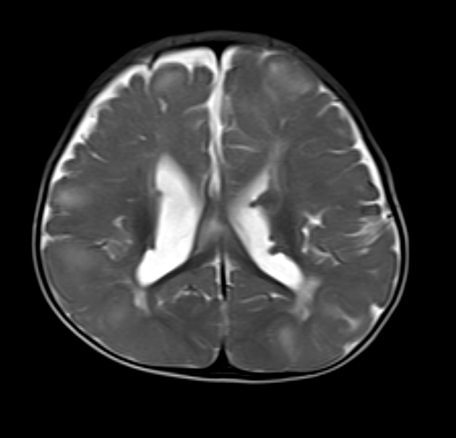
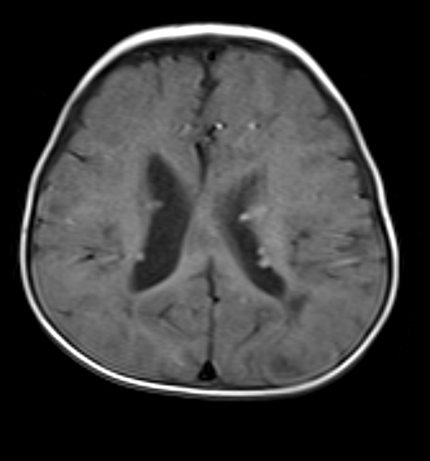
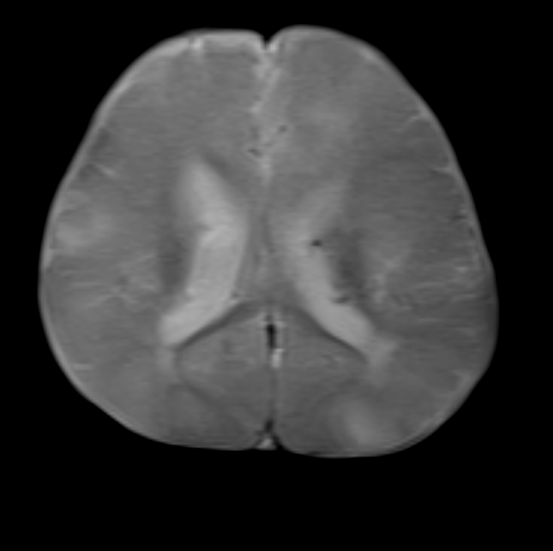
T1 Axial.
GRE Axial.
T2 Axial.

Slide 19
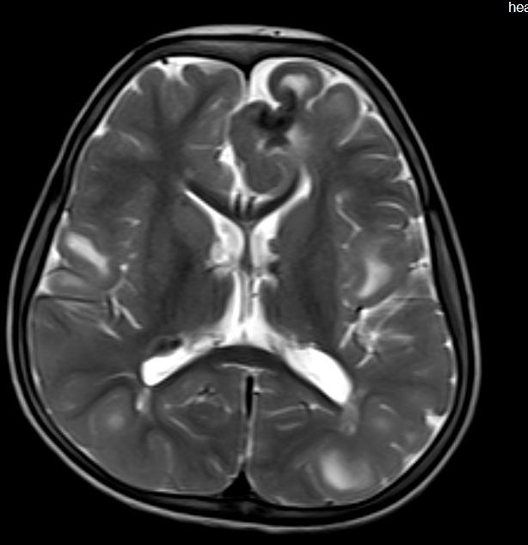
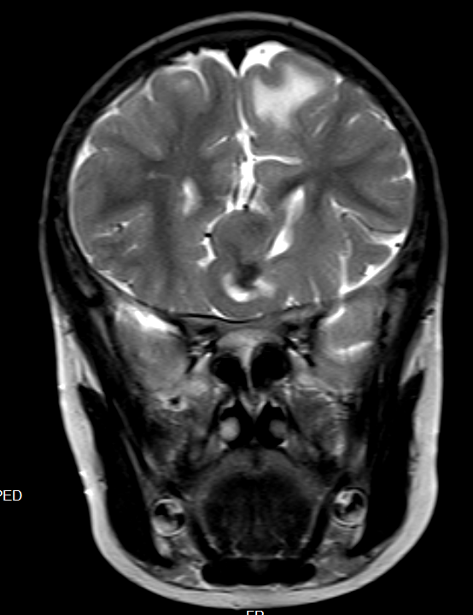
MRI Brain plain done on 21st October 2018.
T2 Axial.
T2 Coronal.

Slide 20
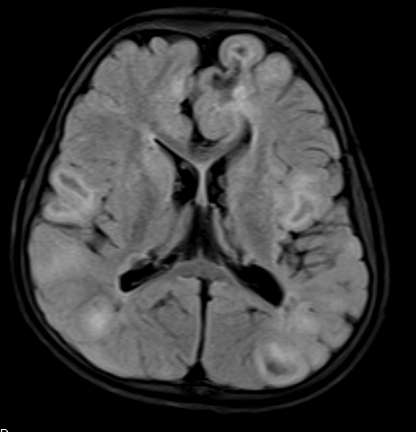
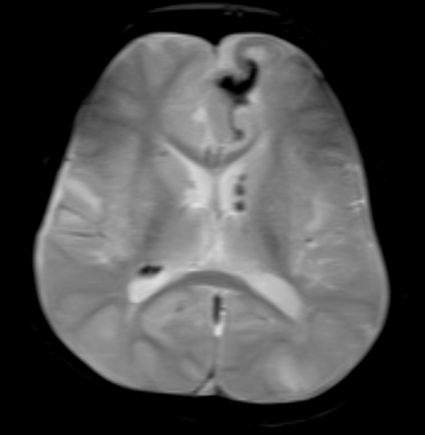
FLAIR Axial.
GRE Axial.

Slide 21
FINAL DIAGNOSIS
TUBEROUS SCLEROSIS COMPLEX

Slide 22
MANAGEMENT
Epilepsy Surgery Meeting Discussion
1. DRE
2. Seizure Semiology – Left frontal Seizures
3. Interictal – no concordance
4. Ictal – Concordant
5. MRI Brain – Concordant
Plan – ECOG Guided Left frontal lesionectomy.

Slide 23
An informed consent was taken from the parents
After getting anaesthetic clearance, the child underwent LEFT FRONTAL LESIONECTOMY at our Institute.

Slide 24
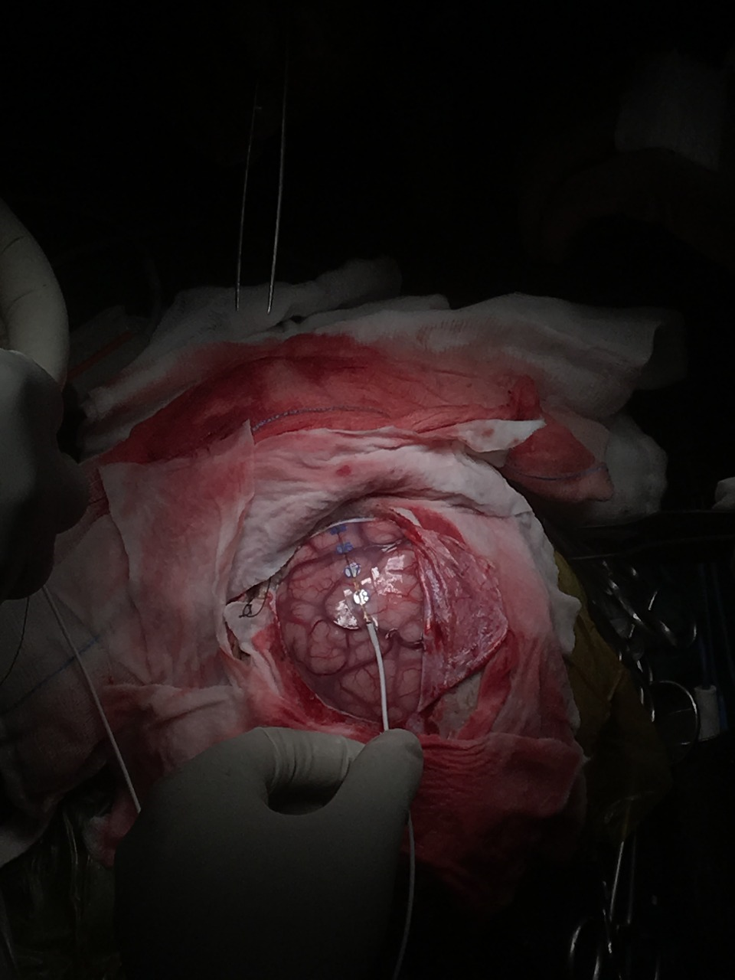
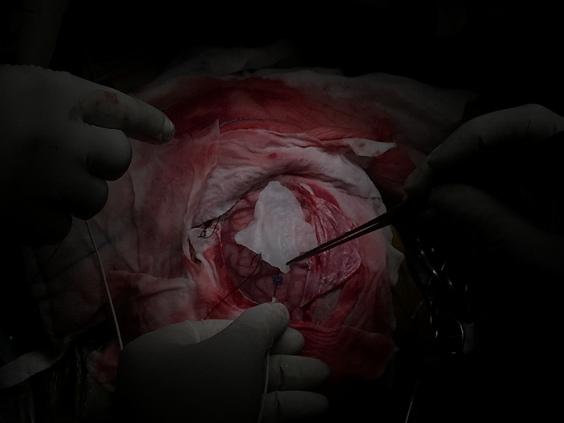

Slide 25
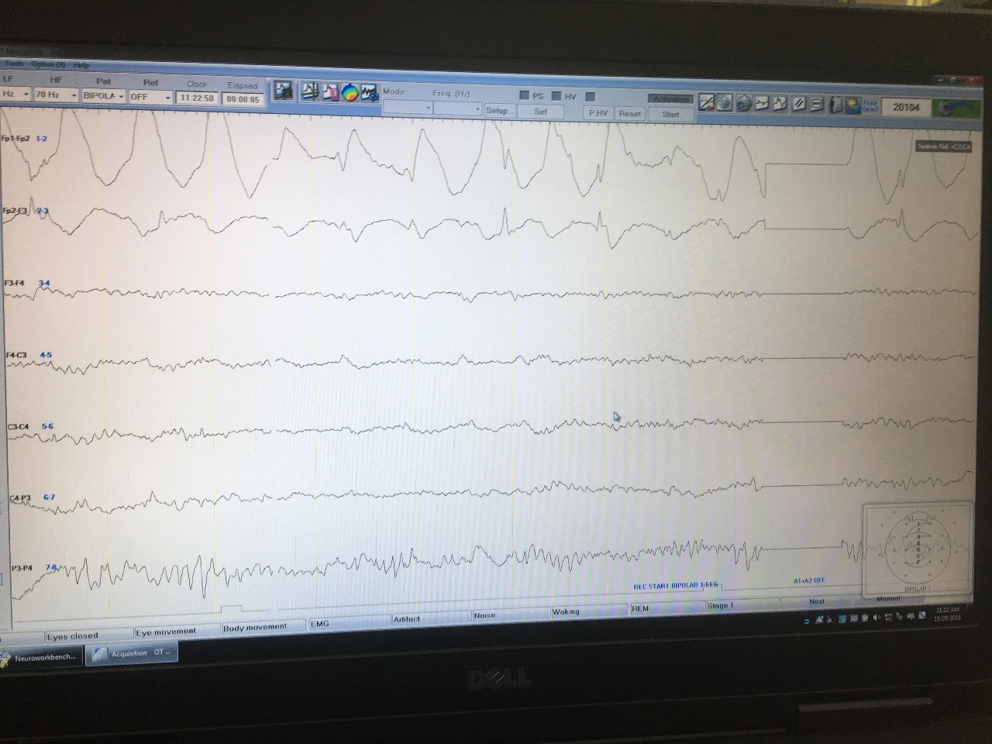
ELECTROCARDIOGRAPHY

Slide 26
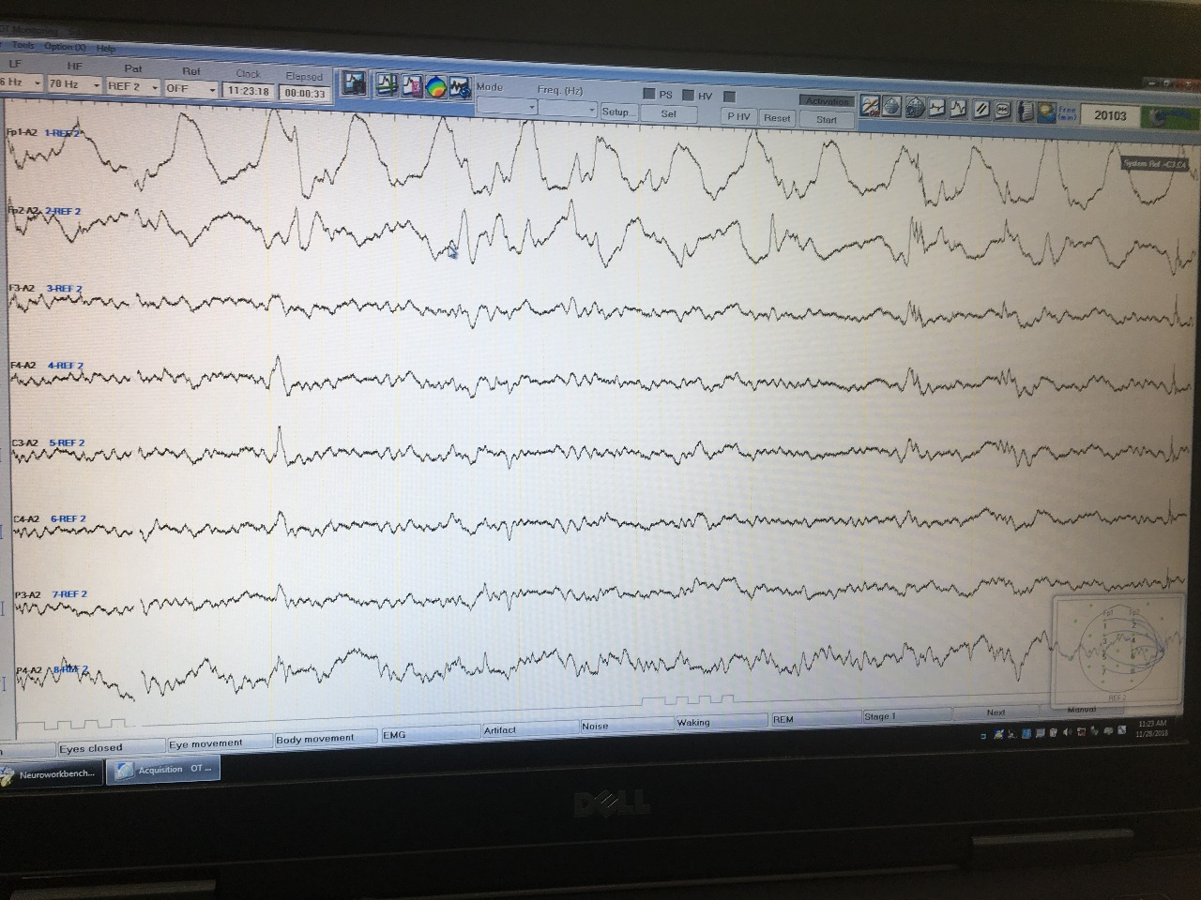

Slide 27
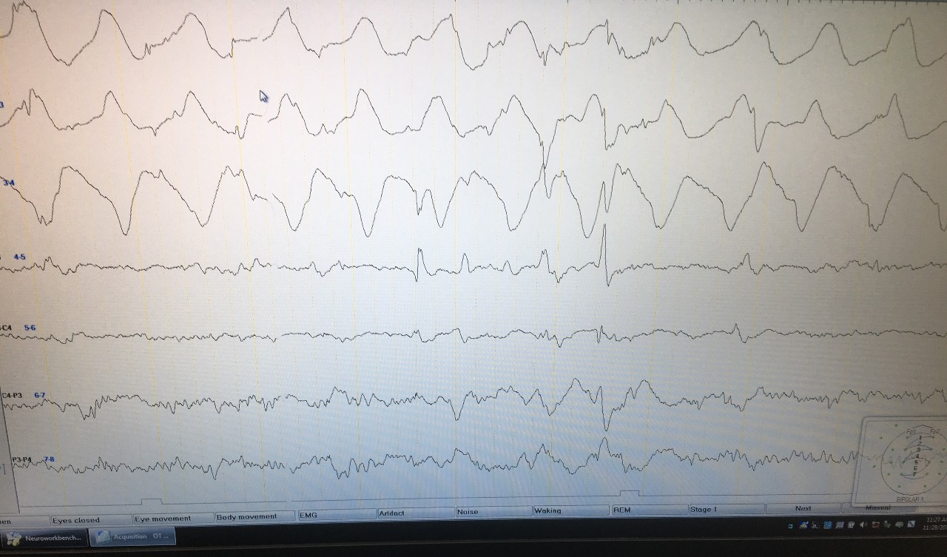

Slide 28
POST OPERATIVE MANAGEMENT
Child was kept in PICU for 1 day
Discharged on POD- 8
AEDs were Continued
No seizures post surgery

Slide 29
DISCUSSION
EPILEPSY CARE
Seizure
Epilepsy diagnosis
Medication trials
Imaging for pathology
Medical intractability
Surgical Consideration
Surgical workup
Surgery

Slide 30
Outline
1. What is Epilepsy Surgery ? Aims / Candidates
2. How it is done ? Presurgical / Surgery
3. Seizure Outcome
4. Neurodevelopmental outcome
5. Examples

Slide 32
AIMS of EPILEPSY SURGERY
Primary Outcome or Aims
§ Seizure freedom / Reduction
Secondary Outcome or Aims § Neurodevelopmental gains § Behavioral Improvement

Slide 33
Treatment
4th
drug
5th
1%
drug
And so
on
First drug 60%
Third
Second
4 %
drug
15%

Slide 34
Candidates for Epilepsy Surgery
1. Persistent seizures despite appropriate pharmacological treatment
a. Usually at least two drugs, appropriate to seizure type, at adequate doses, with adequate compliance.
b. Two monotherapy trials with first line AEDs, and possibly one trial with dual therapy (combination of two AEDs).

Slide 35
Candidates for Epilepsy Surgery
2. Impairment of quality of life due to ongoing seizures.
a. Developmental regression, delay
b. Learning disability / Scholastic difficulties
c. Side effects of medications
c.
d. Injuries, accidents

Slide 36
Stage I
1.
2.
3.
4.

Slide 37
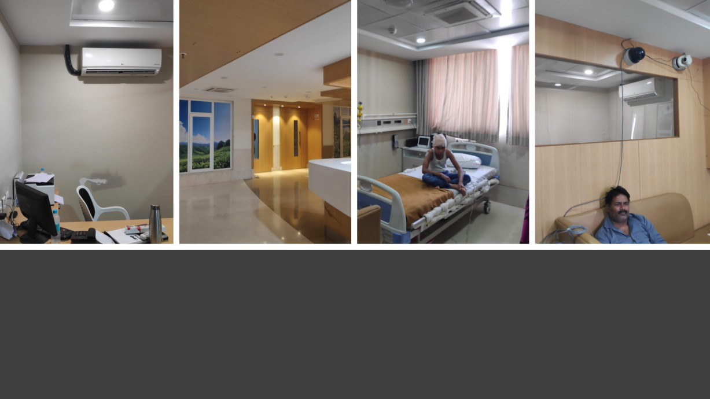
VEEG Lab @ Dr. D. Y. Patil Medical College, Pune

Slide 38
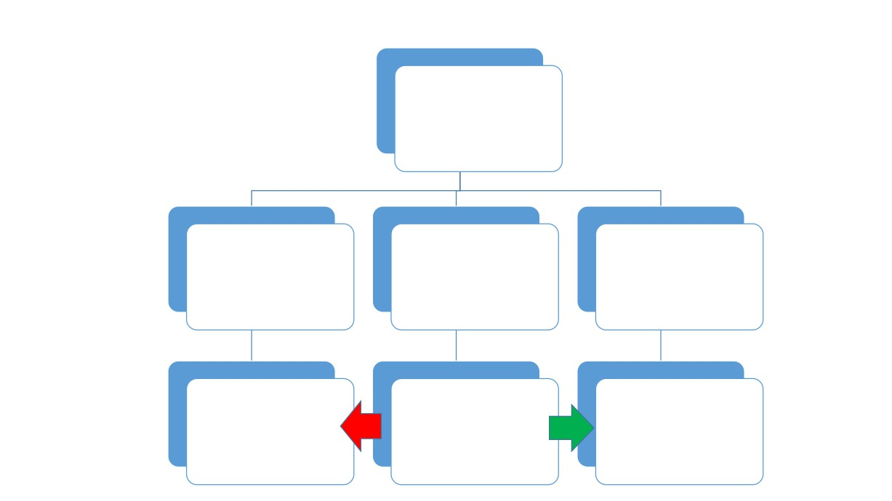
Epilepsy Meeting
Surgery will not help
Surgical Plan Not clear
Surgical Plan - Clear
Stage 2 Evaluation
No Surgery
Surgery

Slide 39
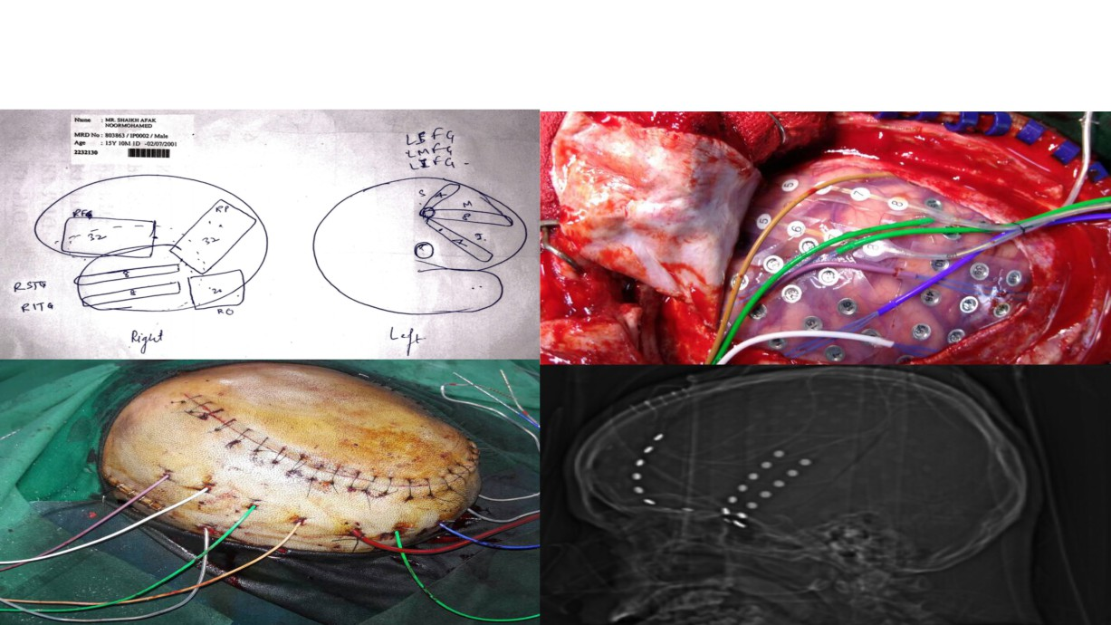
Stage 2 - Intracranial EEG

Slide 40
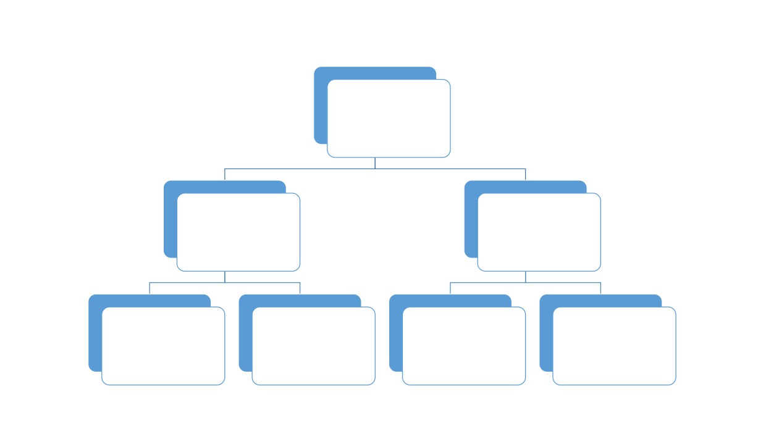
Surgical Plan
Epilepsy Surgery
Curative
Palliative
Callosotomy , Neuromodulation
Lesional
Disconnection
MST (VNS, RNS, DBS)

Slide 41
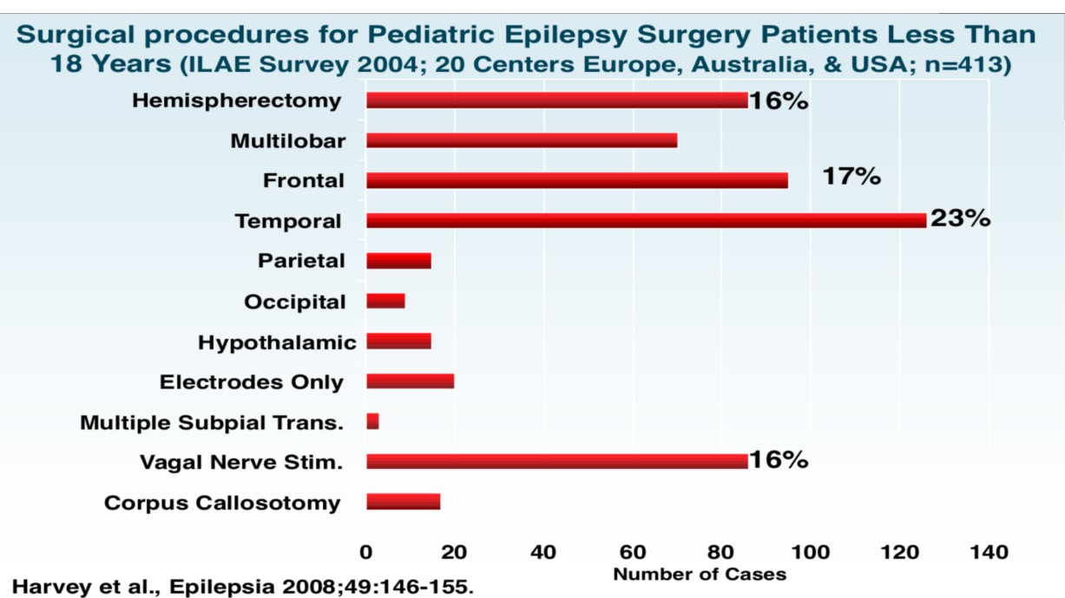
T

Slide 42
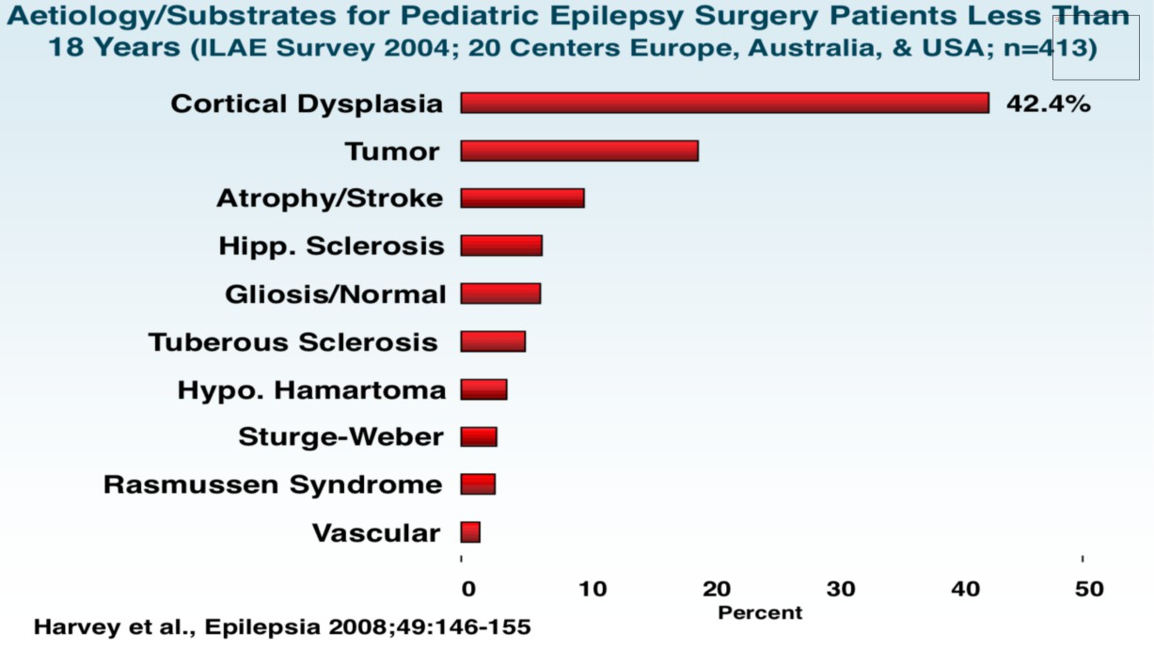
The picture can't be displayed.

Slide 43
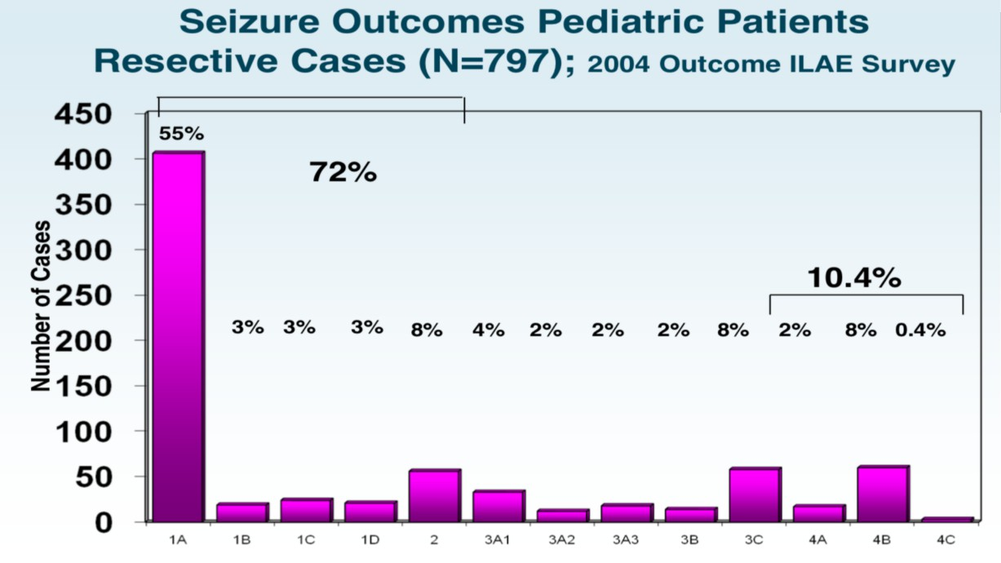
T

Slide 44
T

Slide 45
T

Slide 46
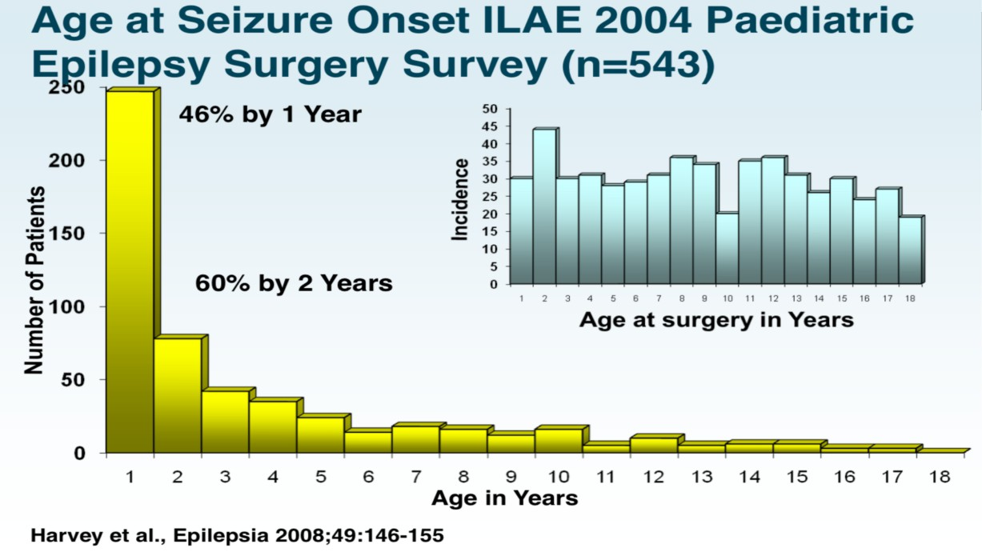
T

Slide 47
T

Slide 48
T

Slide 49
T

Slide 50
T

Slide 51
T

Slide 53
Epilepsy Surgery -Loss and Benefit
• Better Seizure Outcome
• Chance of AED Withdrawal
• Better Neurodevelopmental Outcome
• Better Behavior

Slide 54
POST OPERATIVE after 3 Months
• Continued to be seizure Free
• Behaviour improved
• Still on two AED’S
• Ongoing Physiotherapy and Speech Therapy

