Slide 1
Ticking Time Bomb!
By Dr. Avinav Luthra
2nd Year Junior Resident
(Department of Emergency Medicine)

Slide 2
CASE 1 | CASE 2 | CASE 3
33Y/Female Brought with Active convulsions H/o Use of OCPs. | 29Y/Male C/O Headache x 3 days Altered Mental Status x 1day | 50Y/Female C/O Generalised weakness Tingling sensation in the left upper and lower limb x 5 days multiple episodes of vomiting and loose motions x 5 days. Left Sided weakness x 1 day
Notes:
patient brought to us in state of active convulsions by relatives with H/O a similar episode 7:30pm the previous night following which she was unconscious but continued to keep having multiple episodes throughout the night.
29Y/Male patient was brought to us by relatives with C/O headache since 3 days and Altered Mental Status since last night
50Y/F brought to the EM with complains of generalised weakness and tingling sensation in the left upper and lower limb since 5 days and reduced power in the left upper and lower limb since 1 day
Also C/O multiple episodes of vomiting and loose motions since 5 days.
An i.v. Access was taken and Midazolam 2mg was given f/b another dose of midazolam 2mg

Slide 3
 | CASE 1 | CASE 2 | CASE 3
Airway: Breathing: RR: SpO2: Circulation: Pulse: B.P.: Disability: Temperature | Secured 20cpm 99% at RA 120/min, reg. 140/90 mm of Hg GCS:E1V1M1 (3/15) Pupils :B/l Pinpoint 101⁰ F | Patent 18cpm 99% at RA 82/min, reg. 110/70 mm of Hg GCS:E4V2M4 (10/15) Pupils: BERL Afebrile | Patent 16cpm 99% at RA 90/min, reg. 100/70 mm of Hg GCS:E4V5M6 (15/15) Pupils: BERL Afebrile

Slide 4
Differentials ??
Meningitis
Infarct
Encephalitis
IC Bleed
Stroke
CVST
Toxins
Notes:
Samples for TLC, CBC , LFT , RFT and Viral Markers were sent

Slide 5
Systemic Examination
 | CASE 1 | CASE 2 | CASE 3
CNS CVS RS PA | Unconscious GCS: 3/15 Reflexes: absent Tone : absent WNL WNL WNL | Conscious, disoriented GCS:10/15 Reflexes: normal Power : normal moving all four limbs WNL WNL WNL | Conscious, oriented GCS:15/15 Reflexes: normal Power : Left upper and lower limb 4/5 and facial deviation to left , rest normal WNL WNL WNL

Slide 6
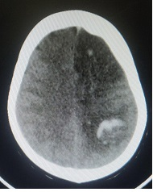
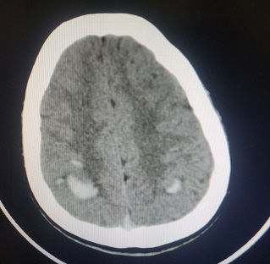
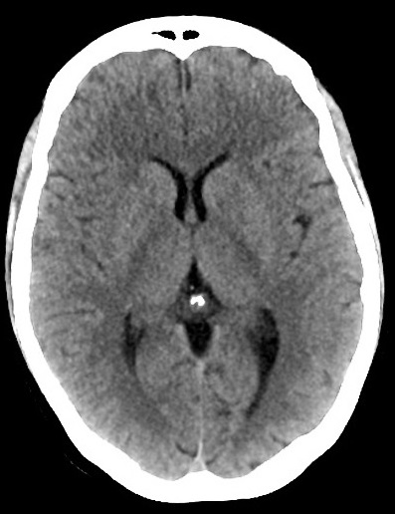
CT findings
CASE 1 | CASE 2 | CASE 3
Notes:
S/O haemorrhagic transformation of infarct
S/O multiple hyperdense parenchymal haemorrhages in B/L high fronto parietal lobes.
S/O normal CT appearance

Slide 7
Blood Reports
CASE 1 | CASE 2 | CASE 3
TLC count 14000. Rest –WNL | All routine blood reports normal | All routine blood reports normal

Slide 8
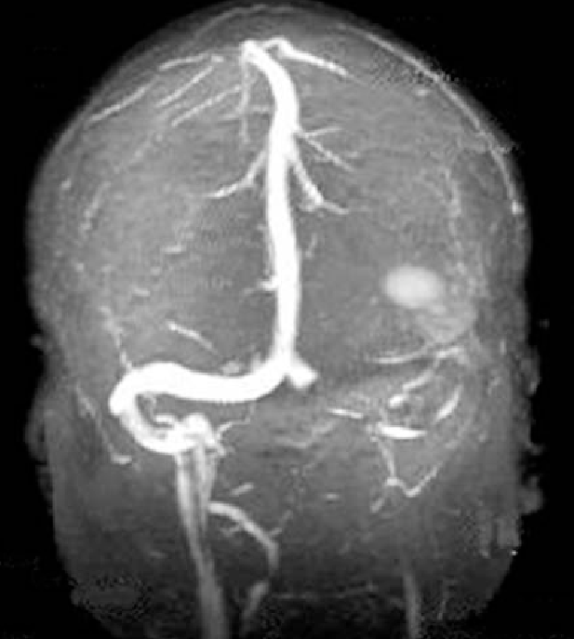
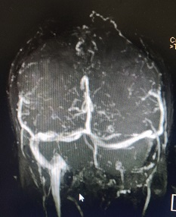
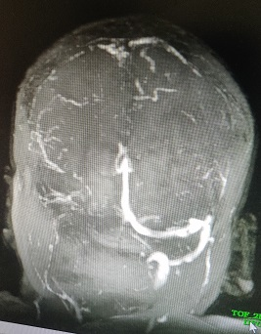
MRI findings
CASE 1 | CASE 2 | CASE 3
Notes:
Case 1 - Venous thrombosis involving left sigmoid and left transverse sinus.
Case 2 - Extensive sinus thrombosis involving superior sagittal sinus cortical veins and left sigmoid sinus.
Case 3-Superior saggital , right sigmoid and right transverse sinus show thrombosis and no flow.

Slide 9
Disposition
All these patients were started on Enoxaparin*
Once stabilised the patient was shifted to Medicine for further management.
Notes:
*Even though two patients had IC bleeds they were started on thrombolytics as research guidelines clearly state that CVST is the bigger threat and needs to be managed while keeping in check that the bleed does not increase in size.

Slide 10
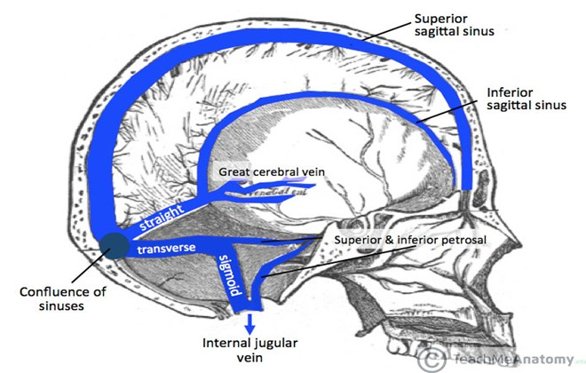
Discussion
Cerebral vein and venous sinus thromboses are blood clots that are formed in the veins that drain the blood from the brain called the sinuses and cerebral veins.
Notes:
They can lead to severe headaches, confusion, and stroke-like symptoms.
They may even lead to bleeding into the surrounding brain tissues.

Slide 12
Symptoms and Signs
Notes:
*often the worst headache that a patient has ever had.
*Headache- sudden onset, develop over a few hours, or develop over a few days.

Slide 13
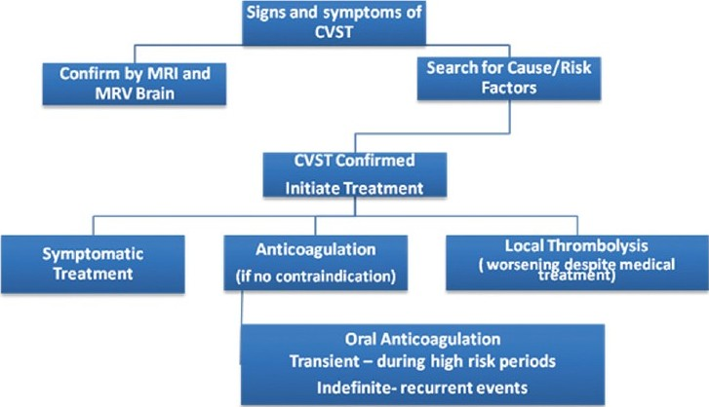
Management
Notes:
The routine CT or MRI tests that are often done to evaluate a stroke or brain bleeds are often normal in cases of cerebral vein and cerebral venous sinus thrombosis.
The appropriate test to do is an MRI venogram (=MRV) or CT venogram (=CTV).
The purpose of giving blood thinners is to prevent the existing clots from getting bigger and prevent new clots from forming. The body’s own clot-dissolving system then slowly, over weeks and months, works on dissolving the existing clots.

Slide 14
When to suspect CVST?
1.The worst headache ever.
2.Risk factors for hypercoagulability , such as use of OCPs, pregnancy or post-partum (upto 3months).
3.Personal or family history s/o hypercoagulable states
4.Stroke like symptoms

Slide 15
Take Home Message
Not to take headaches lightly.
Consider CVST as one of the differentials while evaluating a case of headache or in a case of stroke with unusual presentation.
Look for cause of hypercoagulable state & treat.
Familial cause – Evaluate family members.
Notes:
Your siblings, children and parents need to know they have a slightly higher risk for blood clots, because you had a clot. They do not need screening (with MRV or CTV scan and blood work) unless you were found to have a strong inherited clotting disorder. In that case it might be appropriate to consider testing them for the same clotting disorder.

Slide 16
Thank you...

