Slide 1
Anaesthetic management of 11 years old female child with end stage renal disese (ESRD) posted for renal transplant and ileal conduit .
Presentor – DR.Smruti Govekar (JRIII)
Dept.of Anaesthesiology

Slide 2
A 11 year old female child was referred from nephrology OPD for renal transplant surgery for pre anaesthetic evaluation.
Patient was a known hypertensive since 1 year, on tablet nifedipine 10 mg BD.
Had a chronic kidney disease since 1 year and on dialysis twice a week cycles.
Known case of neurogenic bladder and urinary incontinence since age of 5 years .
Normal birth history , vaccinated properly.

Slide 3
Patient underwent multiple surgeries.
Spine surgery was done for tethering of spinal cord with transitional conus lipoma 6 yrs ago.
Rt CTEV soft tissue release 4 years ago,
Rt nephrectomy 1 month ago
Permcath insertion under general anaeathesia in 4 months back
Patient had multiple times blood transfusion i/v/o anaemia .

Slide 4
General examination:
Afebrile
pallor ++ no icterus , clubbing , cyanosis ,lymphadenopathy , edema present.
Patient was thin build
Weight – 18 kgs
HR- 108bpm
BP- 132/90 mmhg
Airway examination :
Mallampatti grade – 1
Spine examination : normal in curvature
scar mark from previous surgery
present at L1-L3 level

Slide 5
Systemic examination :
CVS – S1S2 +, no murmur
RS – air entry was bilaterally equal.
CNS- concious and oriented
PER ABDOMEN- soft , no tenderness present .

Slide 6
Investigations
Hb- 8gm%
Platelet counts – 2.34 lakhs
TLC-3500
Serum urea-36
Serum creatinine-5.5
Electrolytes NA/K- 141/4.7
BT/CT-1 min 28 sec/4 min 45 sec
Bilirubin – 0.33/0.05
PT/INR – 13.4/1.0
Others :
2d echo- normal study
Ecg- normal
CXR- normal

Slide 7
Case Details
In view of the high grade Rt.Vesicouretric reflux and anticipated risk of post transplant recurrent UTI , pre transplant Right Nephroureterectomy was done.
Patient was planned for Live related donor renal transplantation with ileal conduit after 6 weeks once she had recovered from first surgery
Donor – maternal grandmother

Slide 8
Surgery plan
Live Related donor Renal transplantation with urinary diversion using ileal conduit and implantion of transplanted kidney ureter into the conduit
Donor kidney be placed into the Rt. Iliac fossa with vascular anastamosis done to the iliac vessels (Rt).
Patient was accepted for surgery under ASA grade 3 with high risk consent
adequate blood (leucodepleted )and blood products were booked.

Slide 9
Anaesthetic management
Pre operative optimisation :
5 days prior to surgery imunosupressant drugs were started
Anti hypertensive medication tb. Nifedipine 10 mg was continued on day of surgery.
Heparin free dialysis was done 1 day prior to surgery .
1 pint PCV was given during dialysis .
Pre operative vitals :
HR – 124 bpm
BP-170/100mmhg( on tb Nifidipine 10 mg )
SPO2 – 100% on room air
Plan of anaesthesia : General anaesthesia

Slide 10
All routine monitors were attached – ECG, NIBP, SpO₂,CVP monitor,IBP were attached
Premedications- inj.gylcopyrrolate 0.004mg/kg, inj.midazolam 0.02mg/kg and inj.odansetron 0.1mg /kg was given and inj.fentanyl 40 mcg i.v.
Patient was pre oxygenated with 100% O2 for 3 minutes.
Induced with inj.propofol 40 mg and Inj atracurium 9 mg given as a relaxant.
10% lignocaine sprayed at vocal cords – pressor response .
Intubated with 5.5 cuffed endotracheal tube.
Maintained on oxygen, Nitrous oxide and isoflurane in range of 0.6-1%

Slide 11
Arterial line was inserted in right radial artery for meticulous blood pressure monitoring .
Intra operative fluid management was done cvp guided with target cvp of 10-12 mmhg
Intra operatively blood pressure was maintained in range of 130-140 mmhg systolic and 85-90 mmhg diastolic.
There was once drop in BP to 110/80 mmhg for which 150 ml colliod was given .
Rest surgery was uneventful .

Slide 12
Inj.Anti thymocyte globulin was started 1 hour after induction at the rate of 9ml/hour and maintained throughout the surgery .
Inj . Methylprednisolone 500 mg in 100 ml Normal saline was started slowly .
external warming device was use with continuous temperature monitoring probe .
Patient was reversed with inj neostigmine 0.5mg/kg and inj.glycopyrolate 0.008mg/kg.
Patient was extubated and shifted to kidney transplant icu.

Slide 13
Intraoperative total I.V. fluids – 1500 ml crystalloids(NS 0.9%) and 150 ml colloids .
Intraoperative blood loss-350 ml
Intraoperative urine output- 220 ml (post renal vascular anastomosis )
Cold ischemia time -11 mins 30 seconds
Warm ischemia time -57 mins 41 seconds
Total surgical time – 9 hours

Slide 14
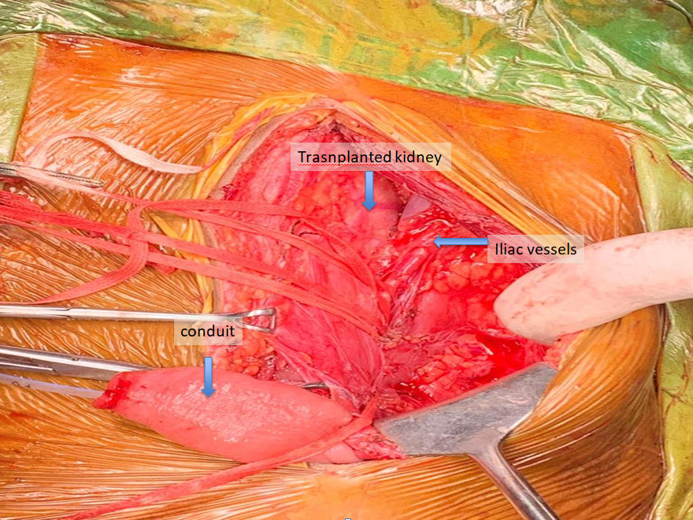

Slide 15
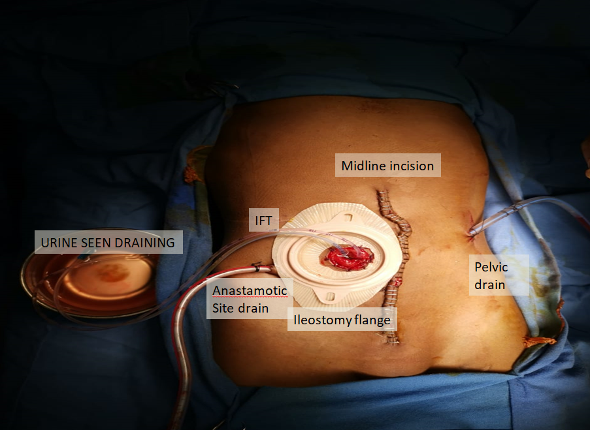

Slide 16
Anaesthetic challenges
Patient was of paediatric age group with low weight for her age and also history of previous multiple surgeries
Patient with end stage renal disease with hypertension
Patient was known anaemic and raised creatinine , hyerkalemia .
Two major procedures to be done in same setting –RENAL TRANSPLANT AND ILEAL CONDUIT .
Prolong nature of surgery and prolong use of mechanical ventilation with risk of hypothermia .
Altered fluid distribution , reduced protein binding , acidemia to affect bioavailability of drugs.

Slide 17
Discussion
The multiple co morbidity associated and complexitity of surgical procedure make the transplant the high risk procedure .
Chronic CKD in children has different aetiologies than in adults which are :
Renal dysplasia with / without vesicouretric reflux
Congenital nephrotic syndrome
Polycystic kidney

Slide 18
In children hypervolemia is major cause of hypertension .
It can cause pericardial effusion and cardiac dysfunction .
Anti hypertensive medication should be continued in peri operavtive period for hemodynamic stability – except ACE inhibitors .
Pre operative investigations : Routine blood tests (CBC)
Sr creatinine , blood urea level , BUN, sr electrolytes , Coagulation profile
There is possibility of overhydration and hypervolemia , for child’s volume status weight of child should be measured before and after hemodialysis .
Cardiac evaluation :
2D ECHO – impaired LV function (hypervolemia ) before they require dialysis and to know severity of cardiac impairement .

Slide 19
Patients with CKD exhibit reduced protein binding (due to hypoalbuminaemia) and a prolonged half-life of drugs which rely on renal metabolism or elimination.
Anaesthetic drugs safe to use in renal impairement inlcude – Propofo , Atracurium , Cis atracurium, isoflurane
Drugs to be avoided – Succinylcholine

Slide 20
The main anaesthetic goal is to maintain renal perfusion pressure of the donated kidney by avoiding hypovolemia, hypotension and avoiding nephrotoxic drugs.
This is achieved mainly by :
maintaining target CVP of >/= 10-12 mmhg
Use of diuretics like inj . Mannitol 0.5-1 mg/kg or inj . Furosemide 2mg/kg .
Steroids and immunosuppressive agents are administered intraoperatively to decrease the chances of graft rejection.
Maintain normothermia.
Cold ischemia time to be kept minimal

Slide 21
Pediatric renal transplantation
Transplant is not usually undertaken until a weight of 10 kg has been reached due to :
increased technical difﬁculty
discrepancy between the sizes of the donor and recipient vasculature
an inability for the cardiac output of such a small recipient to cope with the additional demands of a relatively large transplanted kidney.
In children under 20kg , this may pose difﬁculties with ventilation and wound closure due to size of kidney .
Smaller children who have received a large kidney relative to their size are usually extubated in the paediatric intensive care environment after a period of stabilization.

Slide 22
Summary
Children with CKD requiring surgery or undergoing renal transplantation are considered complex and high risk.
Meticulous monitoring of cardiovasular status and fluid management are corner stones of the anaesthetic management.
Renal transplant in children poses the speciﬁc challenges of haemodynamic alteration, prolonged ventilation, and anaesthetic agents to be used keeping in mind their pharmacokinetic profile in anephric state.
The success of renal tranplant is team work and good cordination between anaesthetist , the nephrologist and the urosurgeon .

