Slide 1
A Case OF 1 year child posted for CT cisternography
PRESENTER - Dr. Amey Ajit Sable
(JRIII)
DEPARTMENT OF ANAESTHESIA

Slide 2
CHIEF COMPLAINTS
Informant - Mother,1 year old complaints of- head injury 2 days back. female child presented with chief
HOPI: History of head injury two days back when baby had fall the from bed .

Slide 3
History of rhinorrhea since two days .
No history of ENT bleed , unconsciousness.
No h/o seizures, excessive crying, irritability, no muscle weaknesses.

Slide 4
Birth history : full term normal vaginal delivery, cried
immediately after birth , completely immunized.
Past history: not significant.
Family history : not significant.

Slide 5
GENERAL EXAMINATION
Female child conscious, un co-operative
Weight- 6 kg.
Afebrile
PR-120 min
RR- 20/min
No pallor, icterus, cyanosis, oedema or lymphadenopathy.

Slide 6
SYSTEMIC EXAMINATION
CVS – S1S2 normal , no murmur
RS – Air entry bilaterally equal, no abnormal sounds.
P/A – soft, bowel sounds present .
CNS - conscious

Slide 7
Anaesthesia Management
Baby was NBM was since mid night confirmed with mother and consent checked.
Patient taken for CT guided cistrenography .
Standard anesthesia monitoring attached in the form of ECG, pulse oximeter, non-invasive blood pressure monitor.
IV fluid connected.

Slide 8
PROVISIONAL DIAGNOSIS
1 year child posted for CT cisternography under general
anesthesia in Radio-diagnosis department as advised by neurosurgery department.

Slide 9
INVESTIGATIONS
Hb- 10.9 g% | TLC- 5,000 / cmm | Platelets- 2.6 lakh/cmm | Blood group- B positive
LFT | S . bilirubin | TOTAL | 0.5 mg%
 |  | DIRECT | 0.3 mg %
 | SGPT | 17 IU/L | [ 0-40 IU/L]
 | SGOT | 8 IU/ L | [5-35 IU/L]
 | S.ALP | 92 IU/ L | [15-112 IU/L]
RFT | Blood urea | 17 mg%
 | S. creatinine | 0.2 mg %
Na+ -139 m mol / L | BT- 2 min , 00 sec
K+ - 4.8 m.mol /L | CT – 4 min . 15 sec
CXR- WNL
2DECHO – Normal
study
RBS | 98 mg %
INR | 1.0
PT | 13.6 secs

Slide 10
Pre-med: Inj.GLYCOPYRROLATE 0.02mg given IV, Inj.Midaz 0.12mg given IV, Inj fentanyl 10mcg given.
Patient preoxygenated with 100% oxygen.
Induced with 20mg propofol IV after loss of reflexes
Immediately after bag and mask Thick white milky content seen per orally and nasally.
Laryngoscopy done and intubated with number 4.0 uncuffed tube.
Inj. atracurium 3mg given.

Slide 11
Infant feeding tube number(IFT) 8 inserted nasally with immediate effects.
Though we are not suppose to do nasal suctioning in CSF rhinorrhoea but nasal cavity was filled so Intratubal suctioning done. Placement of the tube confirmed with auscultation.
Crepts on right lung with Conducted sounds present over right lung.
Suctioning done from IFT , oral and nasally.
Salbutamol puff 100ug was given.
Patient was given Inj.Hydrocortisone 12 mg IV, Inj . Dexamethasone 0.6 mg IV.

Slide 12
Four times Intratubal suctioning was done.
Crepts subsided , Conducted sounds reduced on auscultation.
Maintenance on oxygen, Nitrous oxide, sevoflurane ,IPPV.
Even after aspiration we continued with procedure and given baby left lateral position .
Lumbar puncture was done with 26G hypodermic needle.
Iomerol ( iodinised non ionic low osmolar ) contrast 3.00cc given after dilution with CSF.
After that CT cisternography was done.

Slide 13
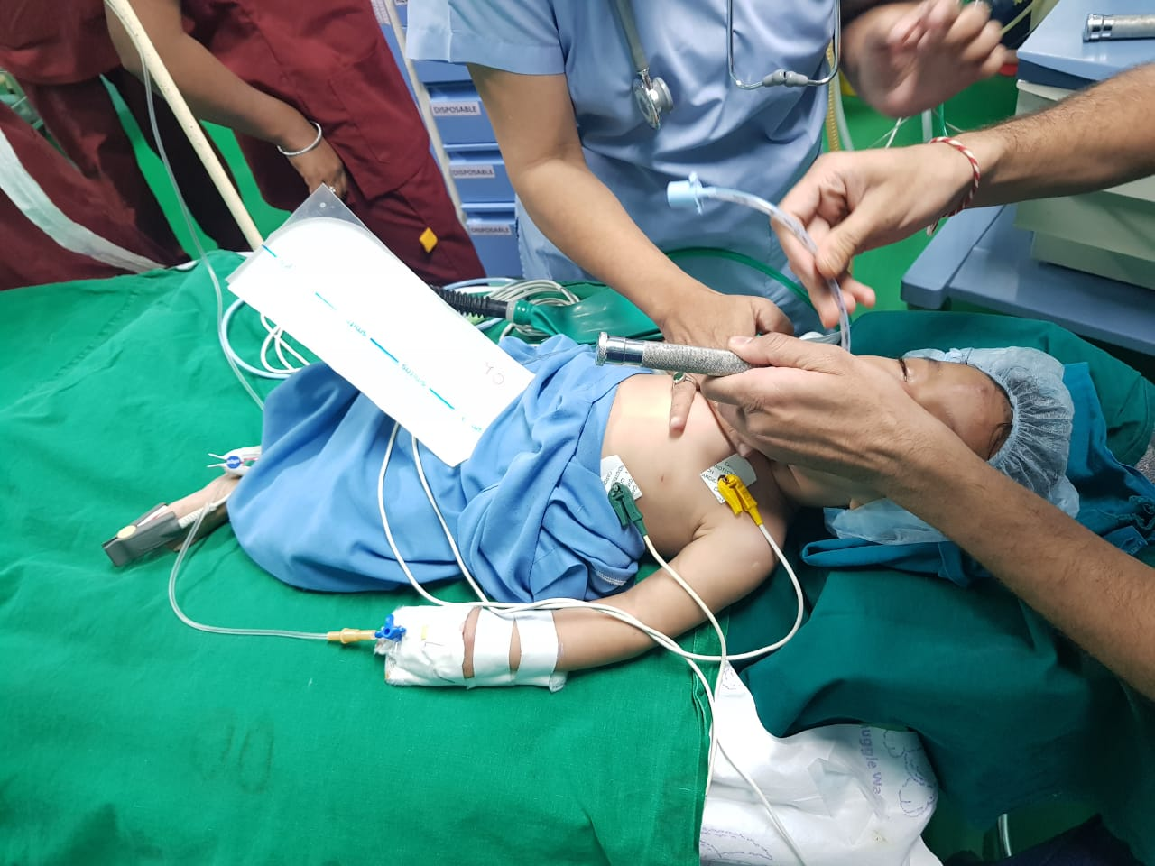
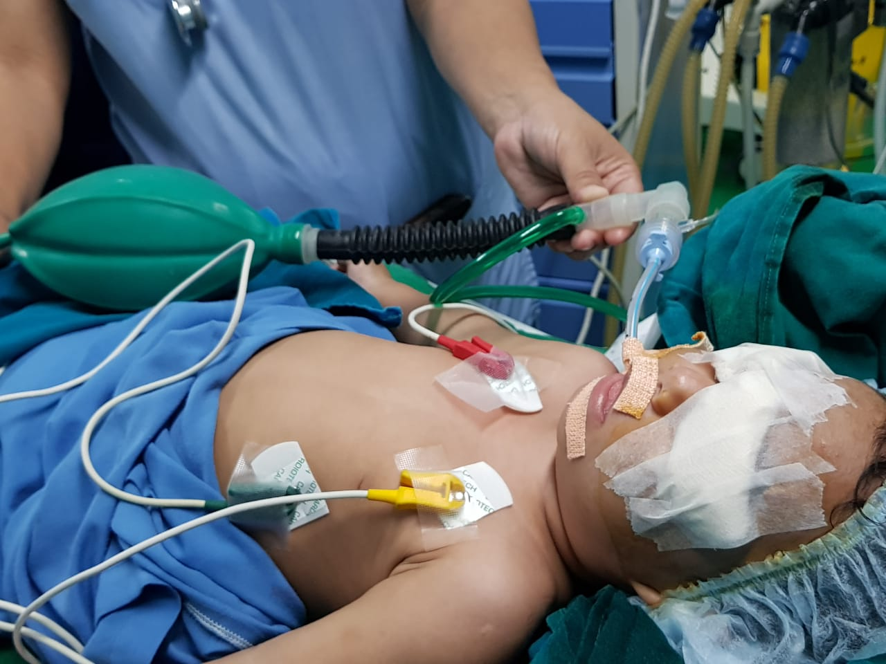

Slide 14
Aspiration

Slide 15
No intraoperative hemodynamic variation or variation in saturation.
Reversed with Inj.Neostigmine 0.3 mg plus Inj.glycopyrrolate 0.04mg.
Eye opening present and not maintaining without Oxygen.

Slide 16
100% oxygen was given for 20 minutes
Patient started maintaining saturation without Oxygen after 20 minutes.
Endotracheal tube removed after suctioning.
Patient was kept on steroids for 24 hours and on higher antibiotics.
Patient kept on oxygen mask for 24 hours.

Slide 17
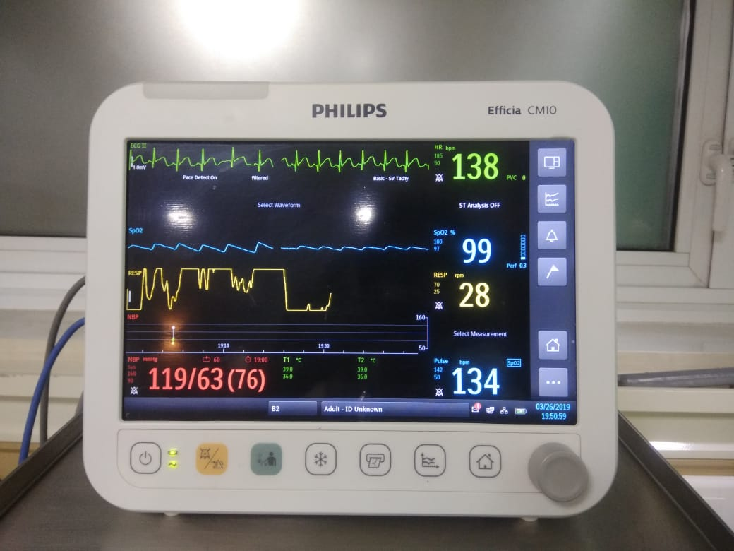
Discussion

Slide 18
Gastric acid aspiration
One of the most dangerous and challenging situation is while anaesthetising pediatric age group is gastric acid aspiration.
fasting guidelines :
Clear fluids : 2 hours
Breast milk: 4 hours
Infant formula : 6 hours
Solid (fatty fried food): 8 hours

Slide 19
Breast milk has very high variable fat content (determined by material diet) delays gastric emptying.
Pre disposing factors for regurgitation aspiration
Decreased competence of lower esophageal sphincter
Air swallowing while crying during pre induction period
Strenuous diaphragmatic breathing.

Slide 20
Management of aspiration
Aim is to reverse pulmonary functions and gases exchange.
Oxygen face mask to maintain saturation(>96%on room air)
Endotracheal intubation and general anaesthesia given additional sedation and muscle relaxation.
Examination of airway with bronchoscope and removal of solid particles.

Slide 21
Take home message
For day care procedures we can't expect morbidity and mortality.
So strict NBM guidelines should be followed.

