Slide 1
Menstrual Hygiene
By Dr. Biswajit Chaklader
JR-1 Community Medicine

Slide 2
Introduction
Menstrual Hygiene is the road to empowerment and
well–being of women and girls worldwide .
Gives importance to the environment around women and girls, that values and supports their ability to manage menstruation with dignity.
Realising the importance of menstrual hygiene , Saumya Verma a 7th semester student took the above topic as ICMR project under the guidance of Dr.S.L. Jadhav (Prof) Dept of Community Medicine.

Slide 3
Aim and Objectives
Aim :- “to study Menstrual Hygiene among rural school going adolescent girls”.
Objectives :-
a) Assess the awareness about menarche and their sources of information before it’s onset.
b) Find out the prevailing practices for menstrual hygiene among adolescent girls.
c) Ascertain the association of awareness and practices of menstruation hygiene with certain socio-demographic characteristics.
d) Carry out toilet assessment as regards menstrual hygiene.

Slide 4
Material and Methods
Type of study:- Observational
Study design:- Community based Cross-sectional analytical study
Place of study and study population:- Government Higher Secondary School and study done on adolescent girls.
Sample size:- 200
Toilet Assessment done.
Ethical considerations-
Confidentiality was ensured.
Informed consent/ Ascent was taken.
The approval of institutional ethics committee was obtained.

Slide 5
Main Findings

Slide 13
Recommended options for disposal of different materials Menstrual hygiene management National Guidelines

Slide 14
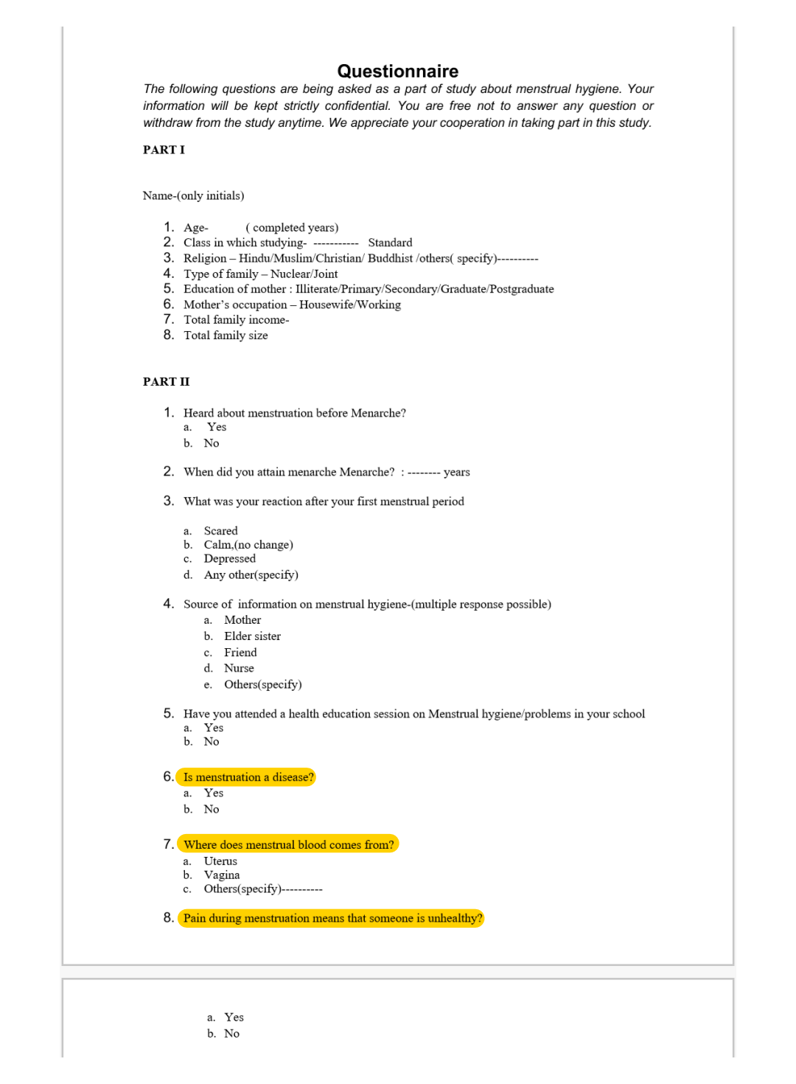
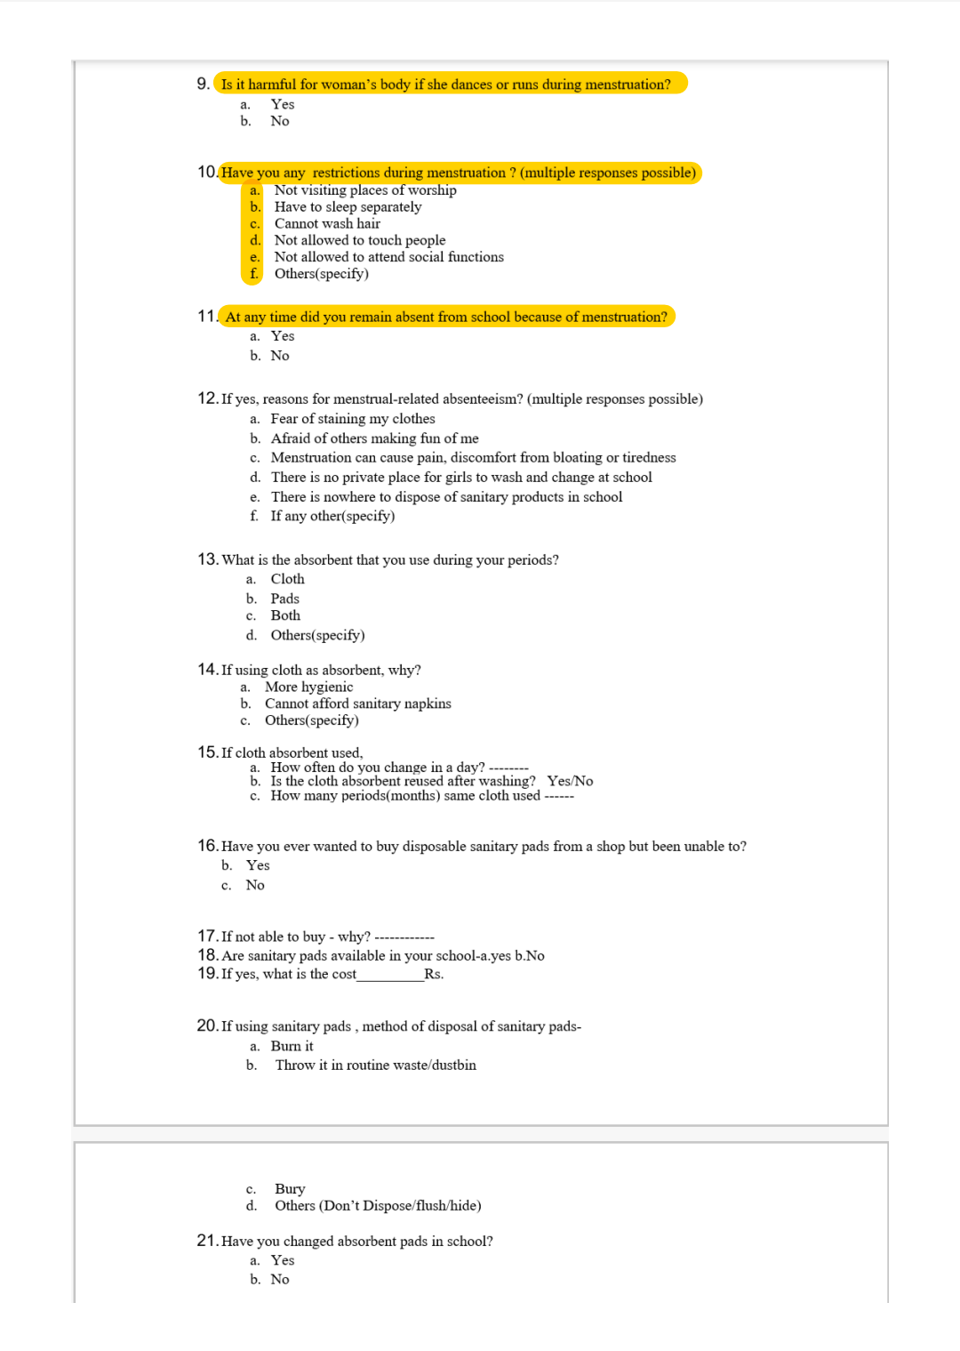

Slide 15
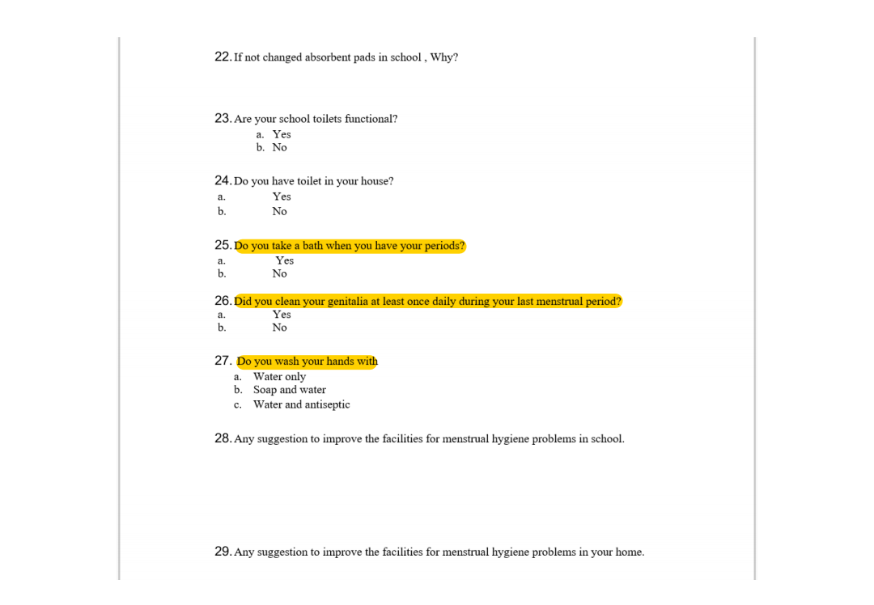

Slide 16
Menstrual hygiene score
Statistic | Score
Mean | 11.1
Median | 12.0
Minimum | 4.0
Maximum | 14.0

Slide 17
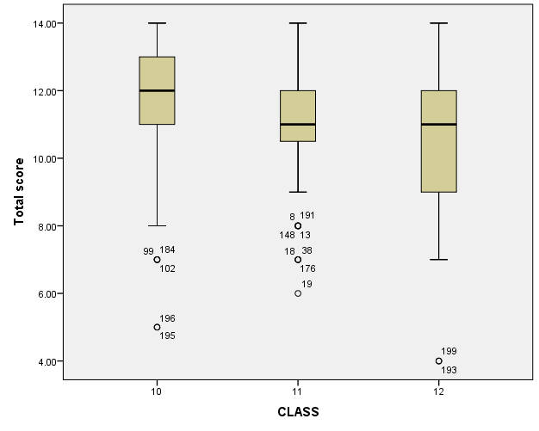

Slide 18
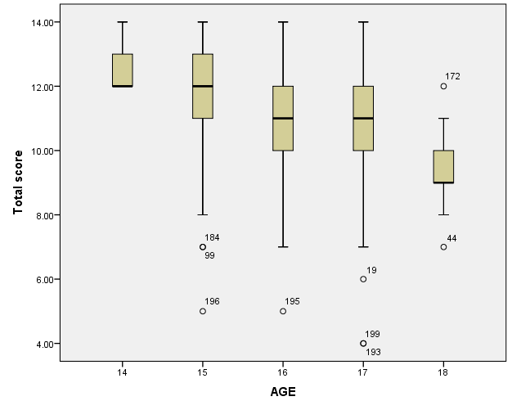

Slide 19
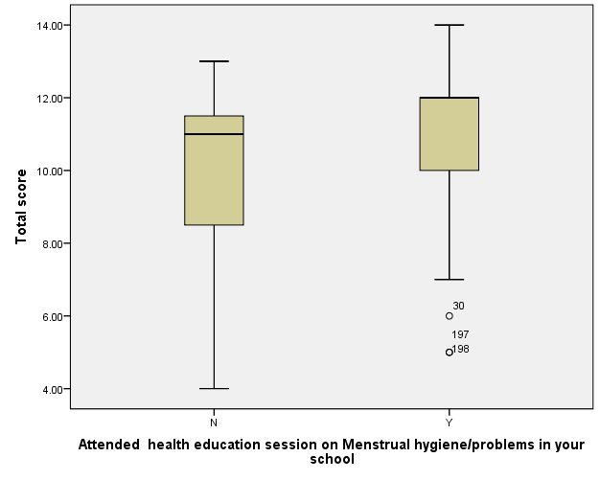

Slide 22
Toilet Assessment
The school had 4 separate toilets for girls.
Each toilet had 7 cubicles; 5 open and 2 closed cubicles.
No sanitary bin.
Tap water :- clean and available.

Slide 23
Toilet Assessment (Contd..)
No hand washing soap.
No facility for washing cloth stains.
Cleanliness not maintained.
100% students have toilet in home.
According to National Guidelines number of toilets were adequate but it fall short in area of hygiene.

Slide 24
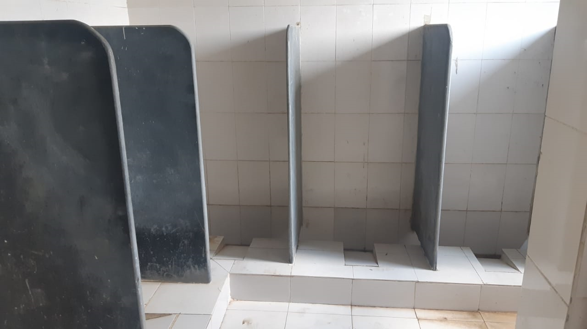

Slide 25
Effective Menstrual Hygiene Management Menstrual hygiene management National Guidelines

Slide 26
Take Home Message
Health Education for Children
Pre-menarche awareness about MHM.
Health Education for Mothers on practical aspects of MHM.
Menstrual related absence in School
Pain management
Proper support
Proper Toilet facilities

