Slide 1
MR Campaign-Lessons from the field
Dr.Kajal Srivastava
Associate Professor
Community medicine department
Ex-RRT member for WHO-MR Campaign for Sangli District

Slide 2
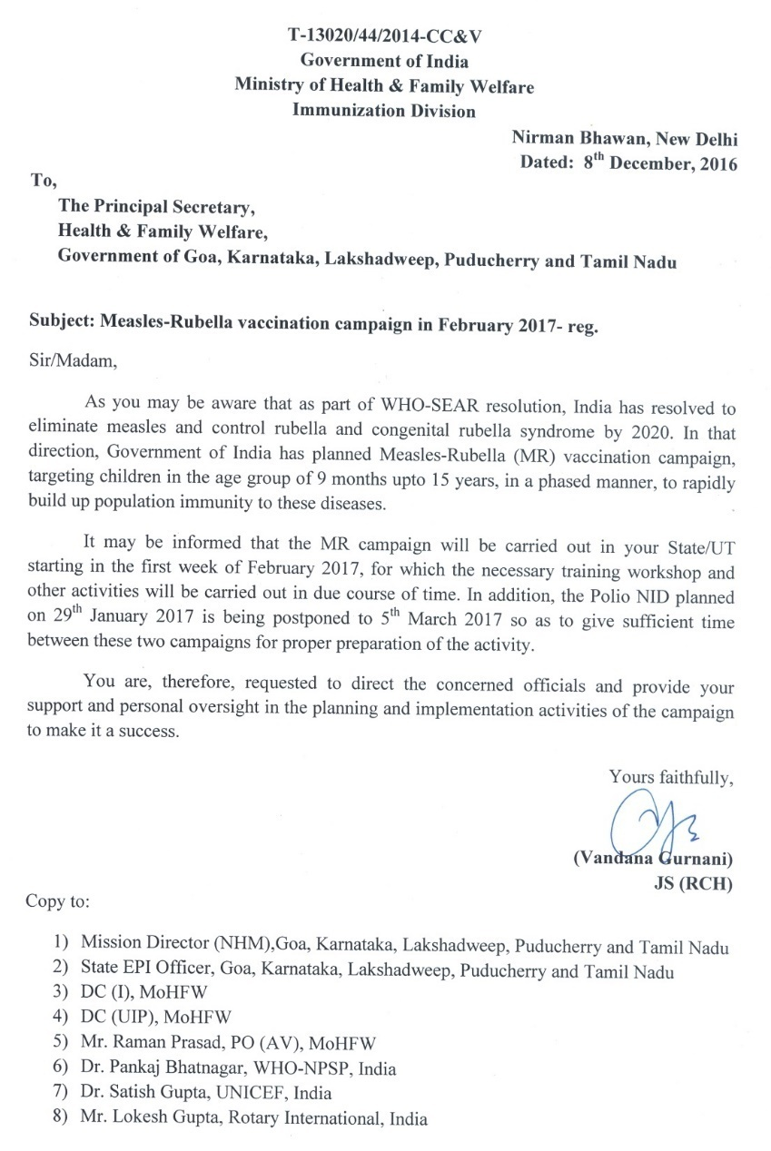
MR Campaign: Decision Letter
States/UTs intimated regarding Measles-Rubella campaign in February 2017

Slide 3
MR campaign: Basic vaccination strategy
Target age group: 9 months to <15 years (regardless of prior M/R immunization status or Measles/Rubella disease history)
Target 100% coverage
Evaluated coverage should be more than 95 %

Slide 4
MR Vaccine Campaign: Implementation Strategy
Schools
Community
Last week sweeping in low performing areas
4 weeks activity
1 week sweeping
Implementation of Session Sites
Fixed in-facility sites Hospitals, CHCs, PHCs, SC
Outreach session sites Villages, resettlement areas (one village, one day)
Mobile sessions For far flung areas
Continuous sessions in some facilities with high vaccination load to function throughout campaign period.
Notes:
Total duration of campaign 4 weeks (first in schools and then in community) and 1 week sweeping activity in low performing areas
Vaccination will be provided at: schools, health facilities and routine immunization session sites. Migratory sites to be approached through mobile teams
Regular RI sessions will be conducted as per usual planning

Slide 5
Planning with district health officials for MRC

Slide 6
Conduction of MRC workshop for WCD

Slide 7
Sensitization workshop for education deptt

Slide 8
Meeting of all important stake holders in front of commissioner to take all on board

Slide 9
PTMs attended by mostly females in large numbers- giving optimistic picture of campaign

Slide 12
Students enthusiastic participation

Slide 14
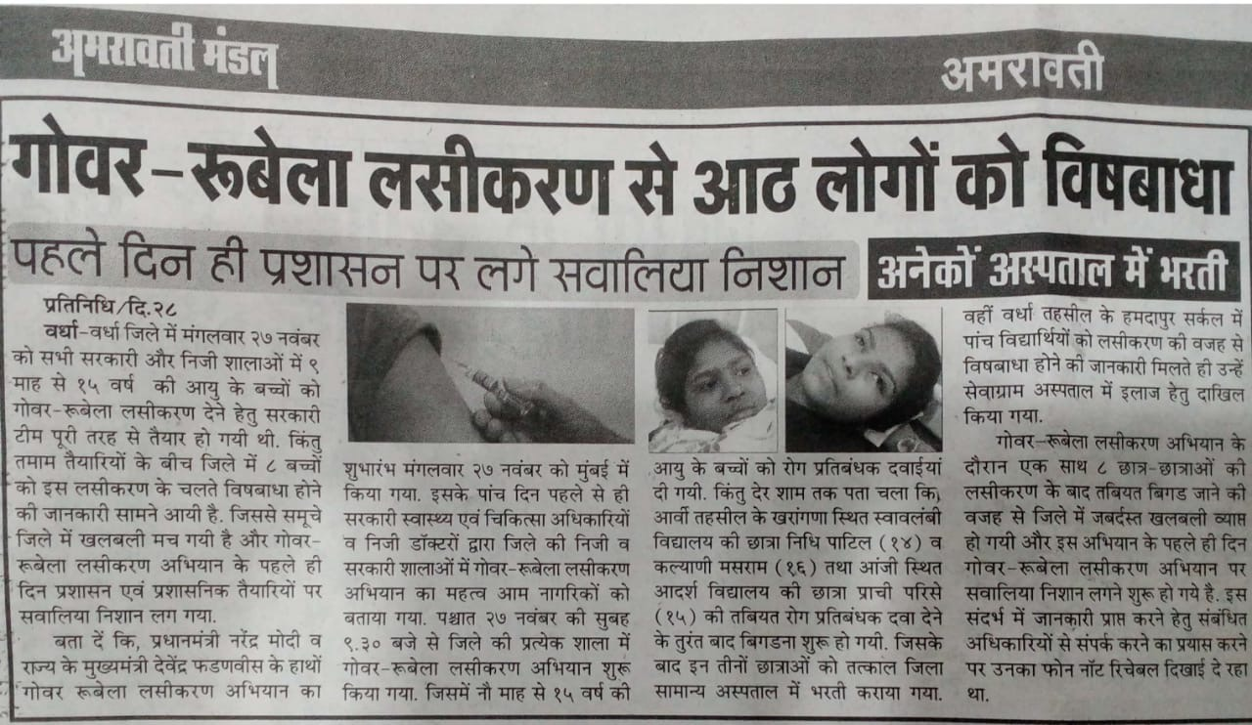
Negative Media coverage-adversely affecting MRC

Slide 15
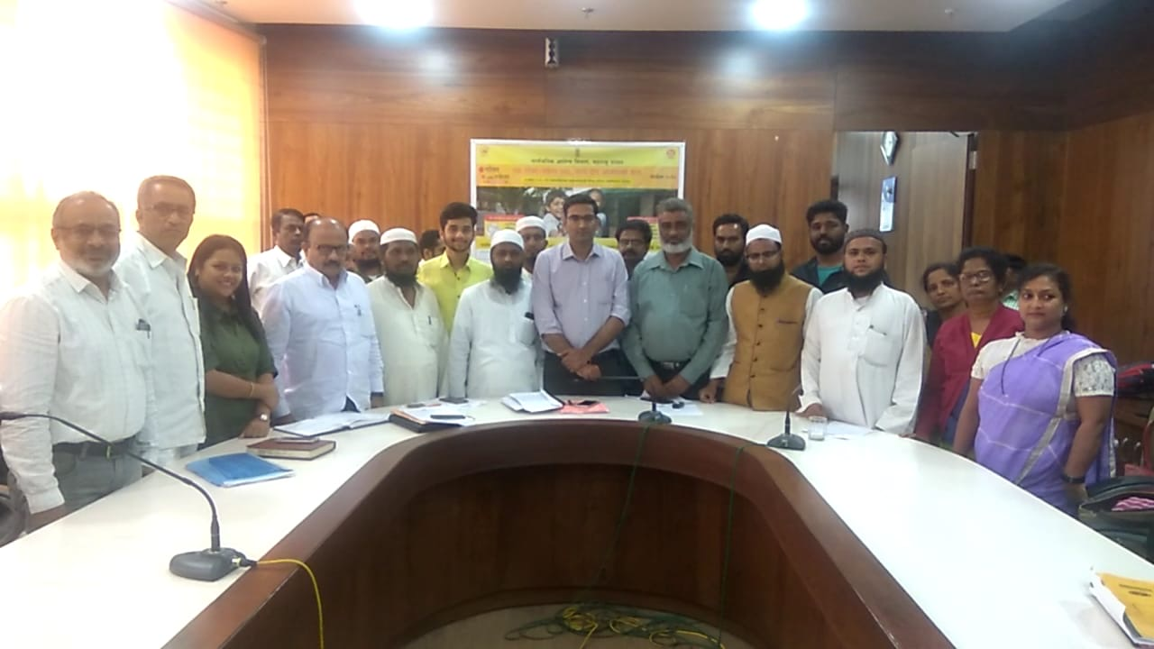
Immediate crisis management

Slide 16
(May Peace and Mercy and Blessings of Allah be Upon You).

Slide 17
Positive media reporting in local news paper

Slide 18
Refuting false political association

Slide 19
Community leaders

Slide 20
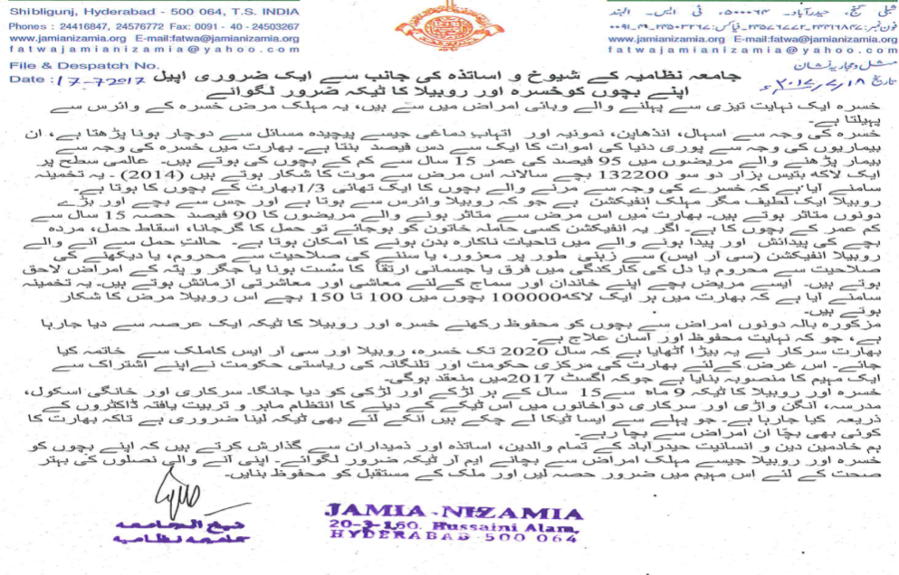
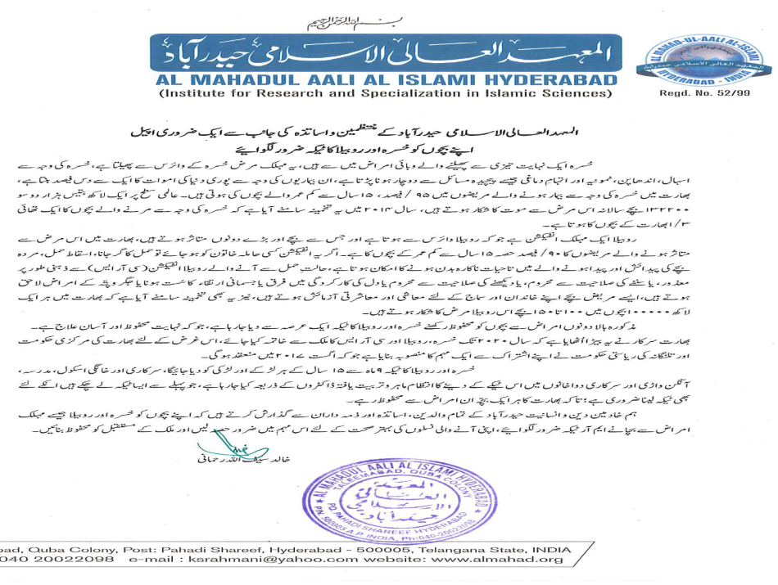
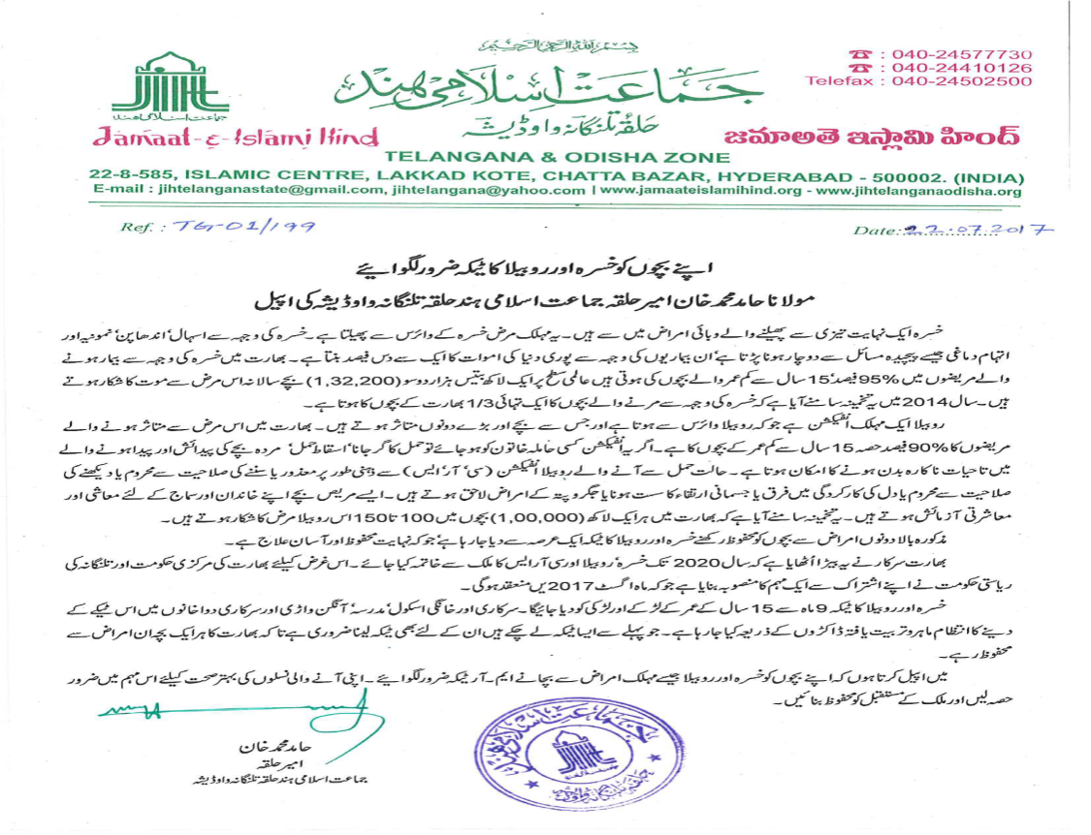
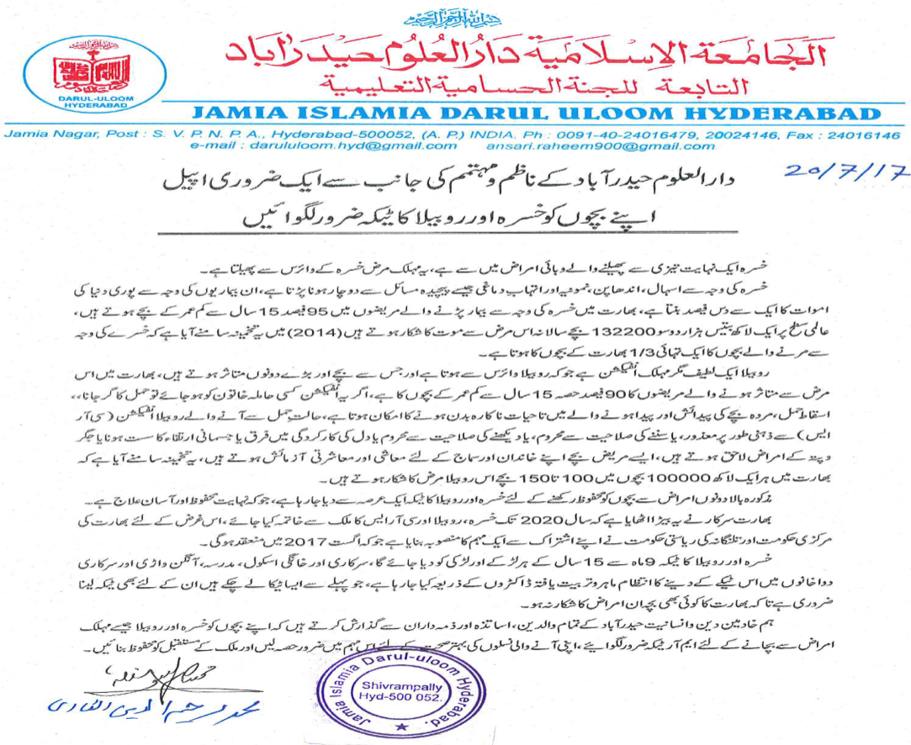
Involvement of top level religious heads/Institutes – Written appeals

Slide 21
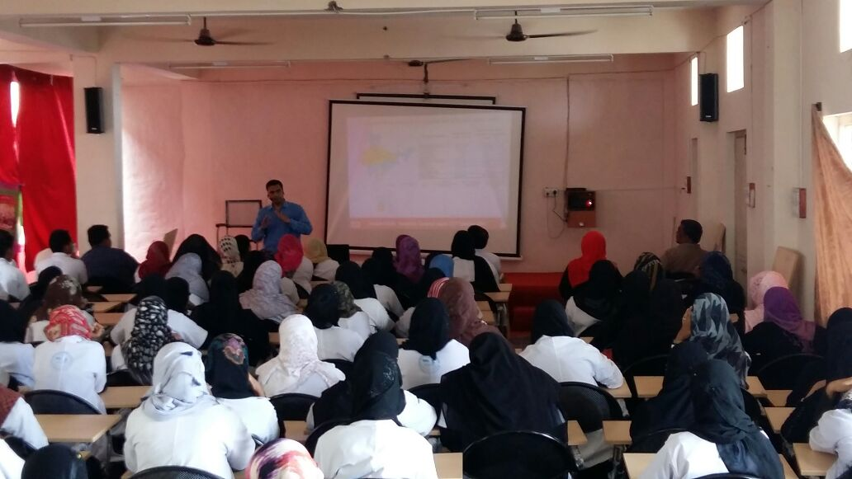
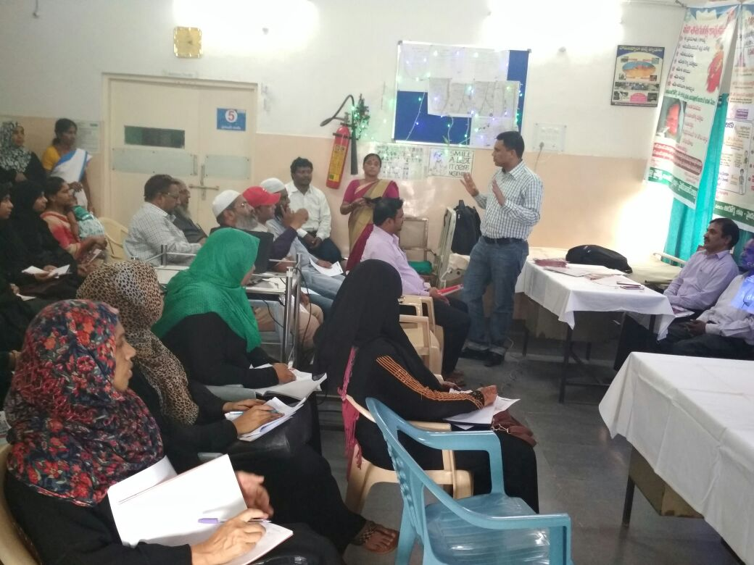
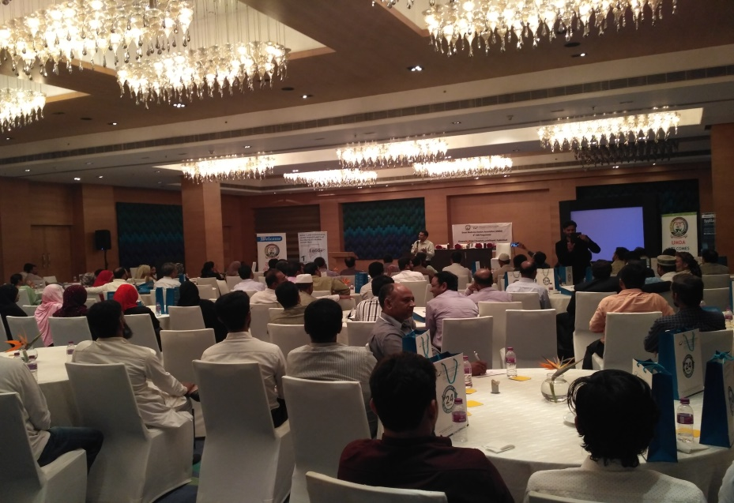
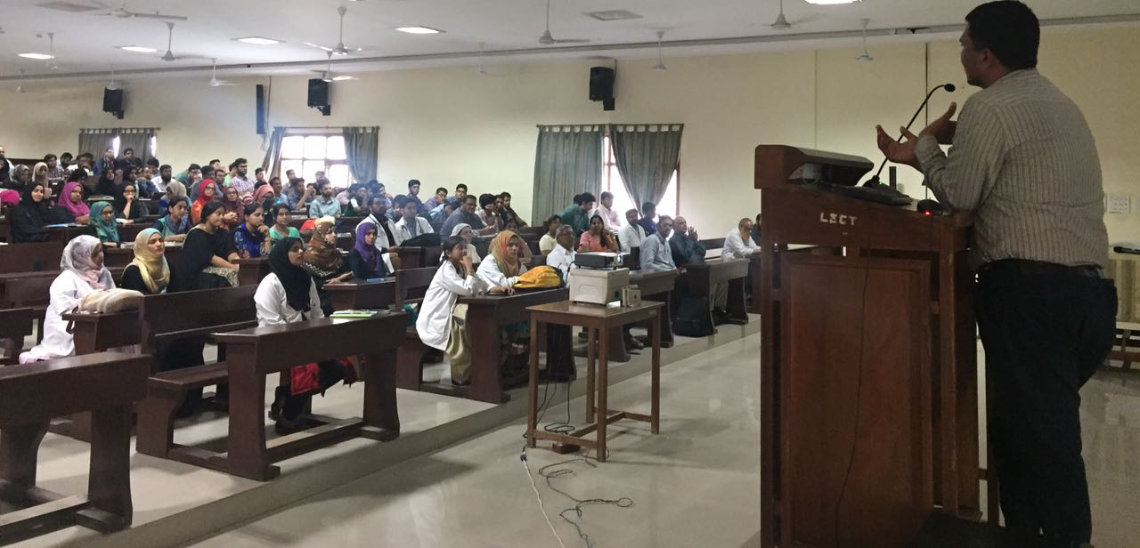
Tapping & engaging Unani Practitioners

Slide 23
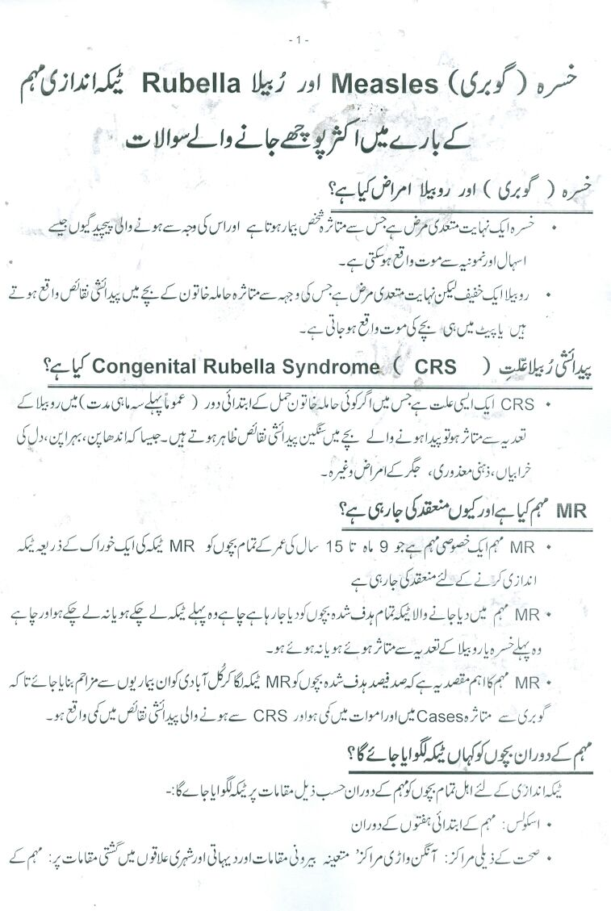
FAQs in Urdu language

Slide 24
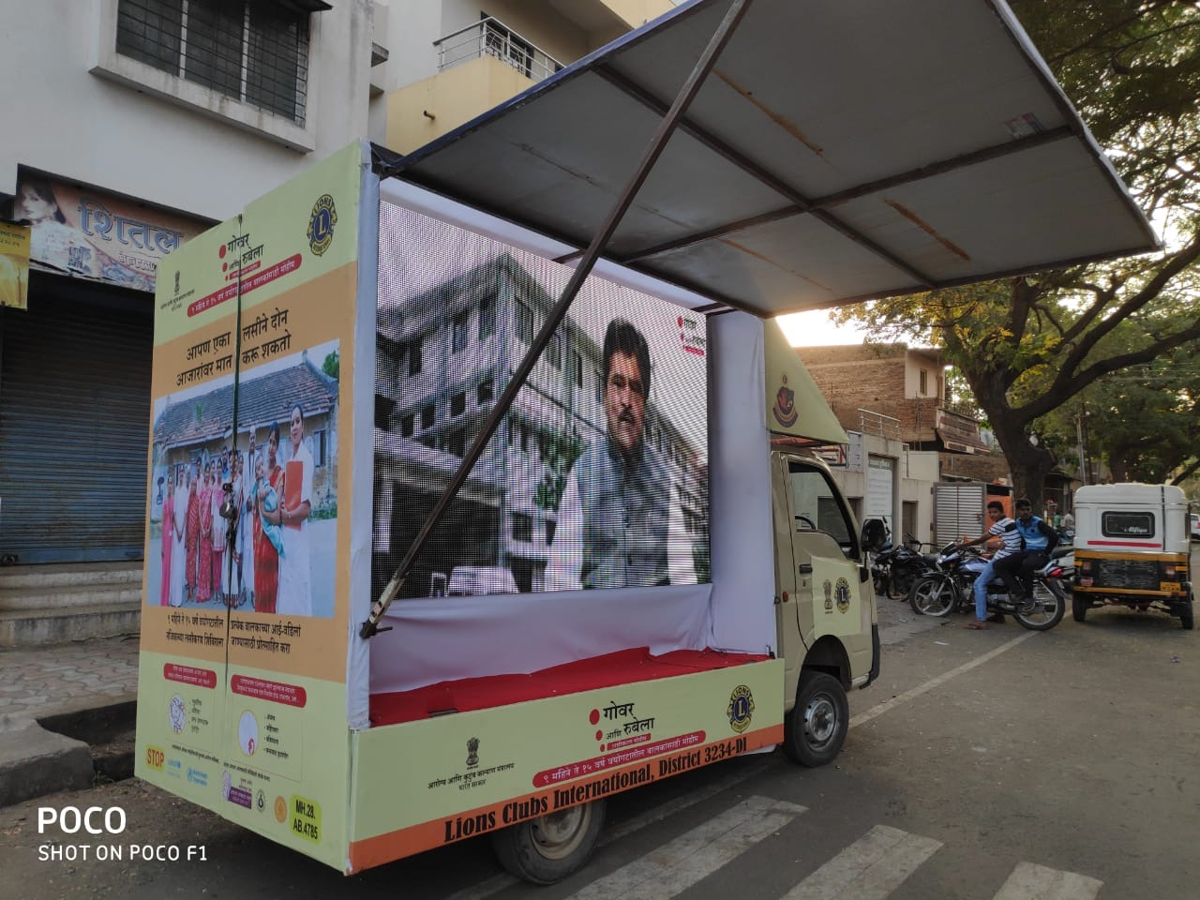
Example of strong Political will

Slide 25
Finally after all these efforts Sangli achieved 100% coverage
Maharashtra state achieved 96% evaluated coverage.
MRC was great example of coordination among different stake holders and actual Public health.

