Slide 1
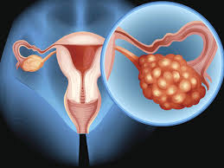
OVARIAN CANCER :CHALLENGES IN MANAGEMENT OF YOUNG WOMAN
Dr.Sailaja Medam[JR1]
Dr.Amrita Bhola[JR3]
Dept. of Obst& Gyn
UNIT-III

Slide 2
CASE HISTORY
27 year old young female, P1L1, DOA: 26 june 2019
Chief complaints
Lump in abdomen since 1.5yrs
Low back ache since 6 months

Slide 3
HISTORY OF PRESENTING ILLNESS
Lump in abdomen noticed 1.5yr back
Onset- insidious
Progression- slow growing
Present size of 28weeks
Low back ache since 6 months

Slide 4
MENSTURAL HISTORY:
Age of menarche 13 year
L.M.P:-23/3/19
Irregular cycles since 2 years
OBSTETRIC HISTORY :
Married since 6 years
P1L1-Fch/6years/FTND
Healthy and immunized
Post partum period was uneventful

Slide 5
PAST HISTORY
No h/o significant medical illnesses or surgeries in past
FAMILY HISTORY
No h/o medical disorders like diabetes mellitus & hypertension
No h/0 ovarian cancer in family

Slide 6
PERSONAL HISTORY
Adequate sleep
Normal bowel and bladder habits
Mixed diet- no h/o decreased appetite
consumes 2200kcal/day

Slide 7
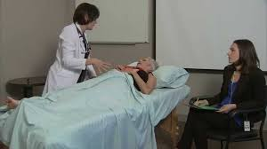
General examination
Patient was conscious and oriented, well nourished with average built
PR- 80/min
BP-110/70 mm of Hg
Weight -52kg
BMI-22.6
No pallor, icterus, lymphadenopathy,edema
Breast and spine examination was with in normal limits

Slide 8
Systemic examination
CVS:
S1 S2 heard, no murmur
R/S:
AEBE , no added sounds

Slide 9
PER ABDOMEN EXAMINATION
INSPECTION:-
Abdomen is uniformly distended
Mass of approx 26 to 28 wks seen
more towards right side of abdomen.
No scar marks or dilated veins were seen
Hernial sites were normal.

Slide 10
PALPATION
Size:- 28 weeks
Consistency:- firm to hard
Surface:- irregular
Mobility:-immobile
Location:- arising from pelvis
Lower border of the mass cannot be reached

Slide 11
PERCUSSION
Dull note through out the mass, with tympanic note near the peripheries s/o ascites
Fluid thrill- absent

Slide 12
PER SPECULUM EXAMINATION
Cervix - taken up
Vagina- healthy
No significant findings on local examination

Slide 13
PER VAGINAL EXAMINATION
Uterus: -normal sized, felt separately from mass
Right adnexal mass felt which is firm to hard in consistency, immobile, nontender
Left fornix free and non tender

Slide 14
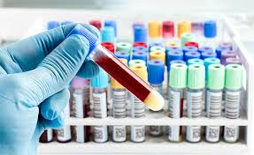
Routine investigations:
Hb-12.4g%
TLC-9100/cmm
PLT- 2.6lakhs
BSL-80mg/dl
S.Na: 144 mmol/l
S. K: 3.2/mmol/l
S creatinine:0.6mg/dl
S urea-16mg/dl
UPT-negative
CXR- WNL

Slide 15
RADIOLOGICAL FINDINGS
USG
MRI

Slide 16
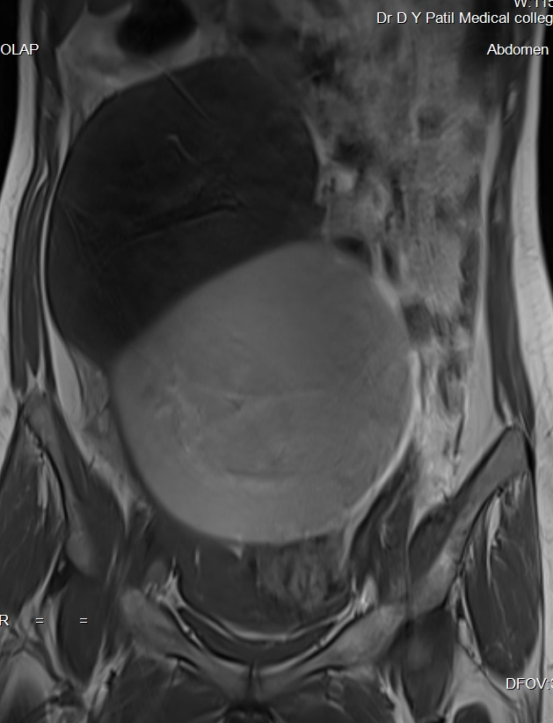
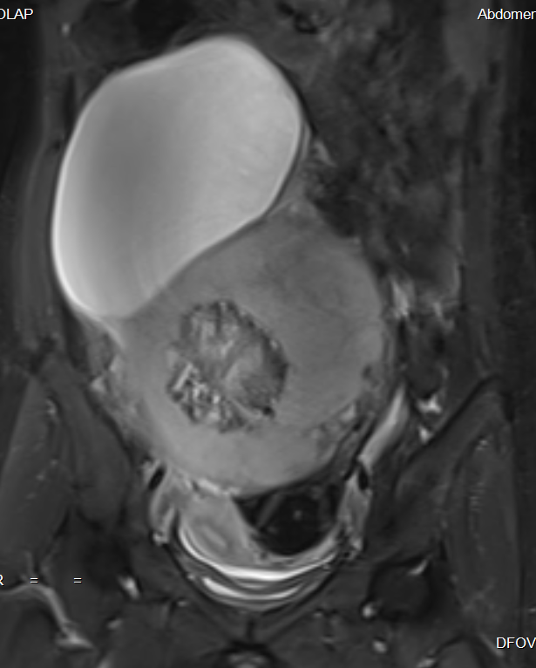
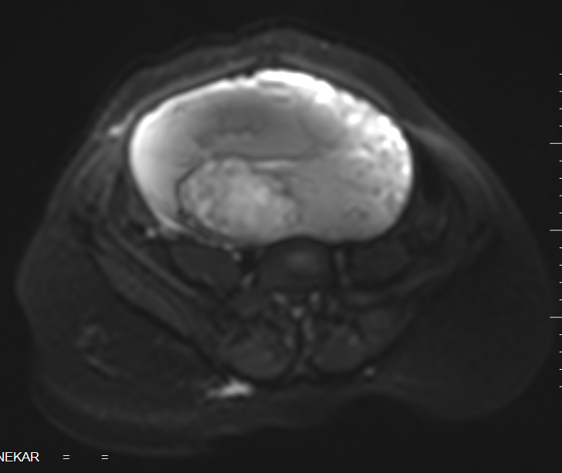
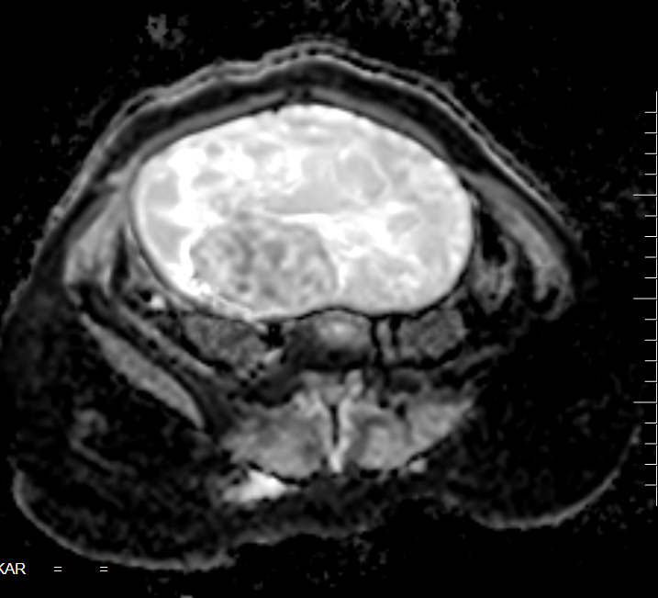
MRI
T1
STIR
DWI
ADC
Notes:
We see a large well defined multiseptated cystic lesion appearing hypointense on T1, hyperintense on T2-STIR, in the midline in the pelvis and abdomen extending upto the right hypochondrium (23x10x16 cm). Inferiorly it is reaching upto the fundus of the uterus. It contains a solid component in the inferior aspect which shows mixed signal intensity on these sequences. It shows few foci of diffusion restriction with corresponding low ADC values. The mass is displacing the bowel loops laterally but is not invading any adjacent structures.
As a general rule, malignant tumors present restricted diffusion, whereas benign tumors do not. Nevertheless, radiologists should be aware of some lesions that constitute exceptions to that rule: teratomas, endometriomas, hemorrhagic cysts, ovarian abscesses, ovarian infarction, and some benign sex cord-stromal tumors.

Slide 17
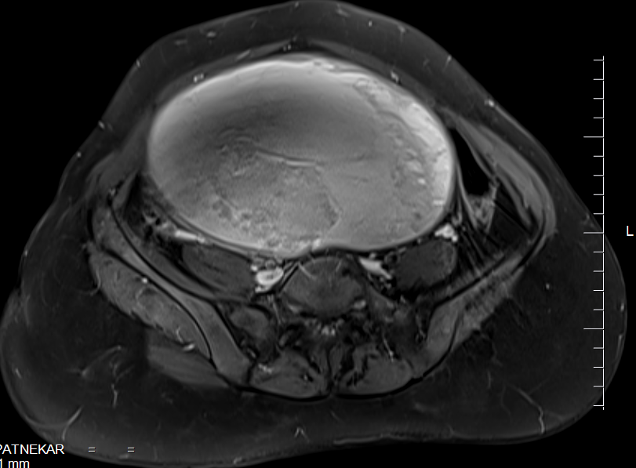
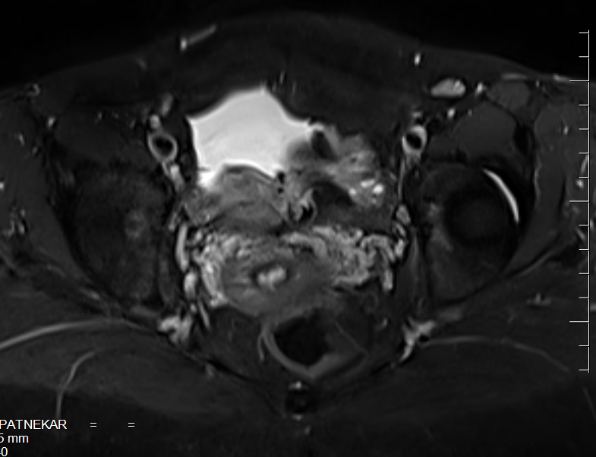
POST CONT T1FS
POST CONT STIR
POST CONT STIR
Notes:
On post contrast study there is mild enhancement of solid component and peripheral rim enhancement is also seen. Mild free fluid is noted in the pelvis. The normal left ovary is seen with MSF.
The uterus however is normal. No evidence of any focal lesion. Endometrium and the junctional zone is also normal. The periuterine soft tissue appears normal.

Slide 18
USG guided biopsy
Patient was taken for USG guided biopsy..and report was INCONCLUSIVE

Slide 19
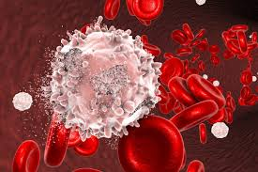
Tumour markers
CA 125 - 5.4U/ml
HCG -4.05 mIU/ml
S.LDH -378 U/L
AFP - 1.26 IU/ml
Inhibin B- 424ng/dl

Slide 20
Risk Malignancy Index: 1272
Menopausal * score by USG findings * tumor marker
Score[M] [U]
1 * 3 *424 =1272

Slide 21
PROVISIONAL DIAGNOSIS
MALIGNANT OVARIAN TUMOUR

Slide 22
Preoperative counselling
Tumour is possibly malignant
Radical surgery required
Fertility is the major concern
Consent taken for laparotomy
for the surgery

Slide 23
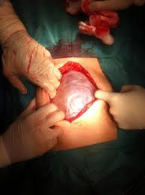
Operative management
exploratory laprotomy

Slide 24
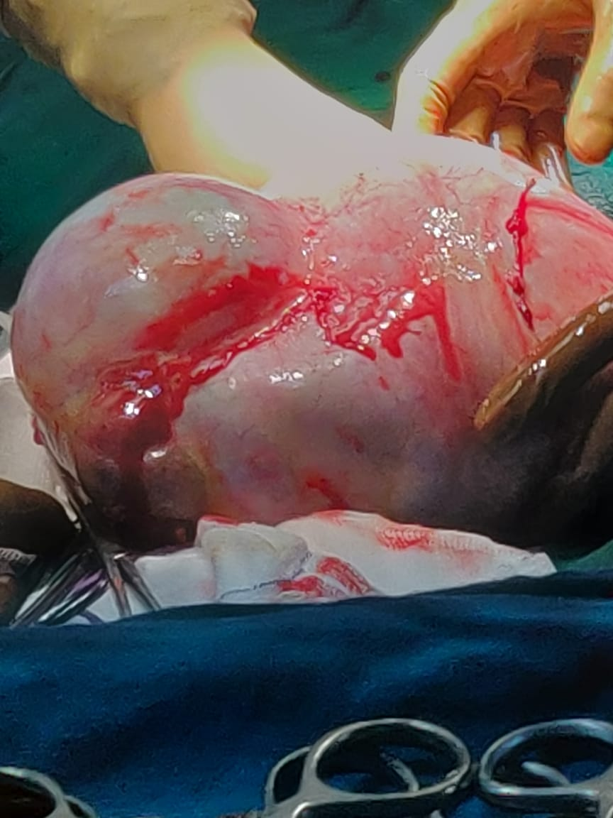
INTRAOPERATIVE FINDINGS
Liver, under surface of diaphragm and bowel were normal
Right ovarian mass of 30*20cm, with papillary excrescences, ruptured capsule, irregular and bosselated surfaces
Omental adhesion to upper part of mass
Left tube and left ovary were normal
No enlarged lymph nodes

Slide 25
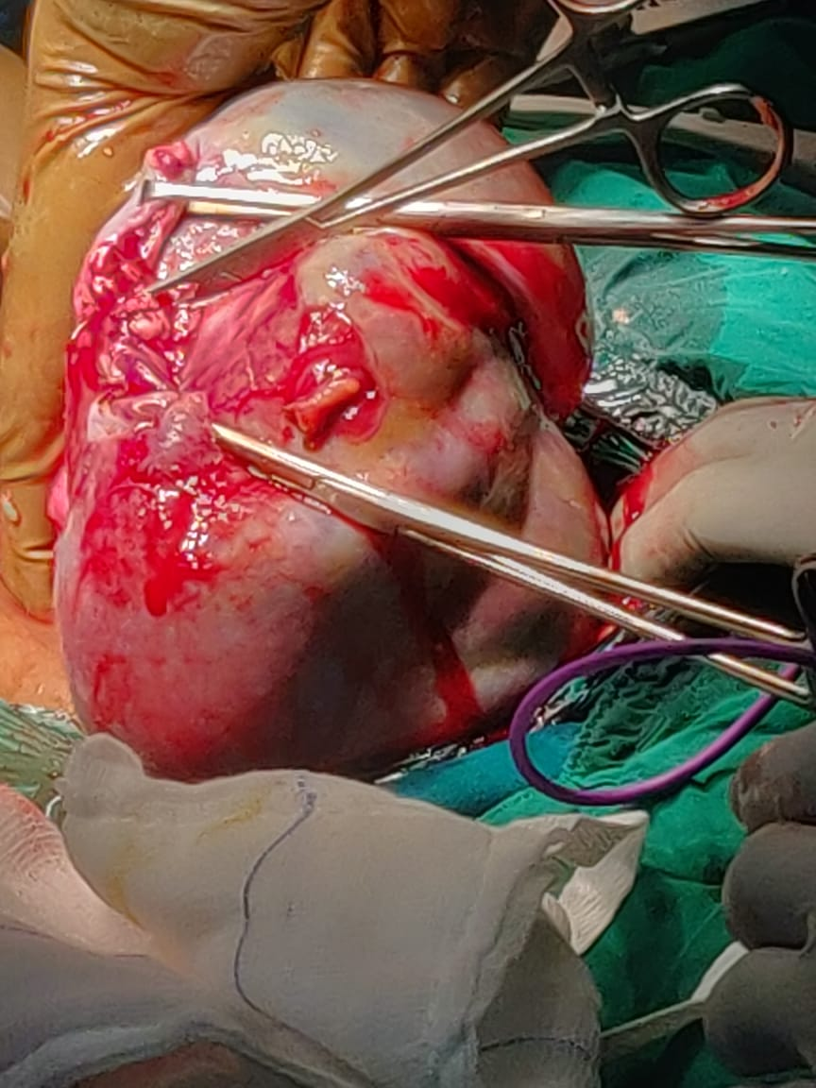

Slide 26
POST OPERATIVELY
Patient tolerated the procedure well…and was advised to follow up

Slide 27
LOW POWER [100X]

Slide 28
HIGH POWER [400X]

Slide 29
CALRETININ[400X]

Slide 30
FINAL DIAGNOSIS
STAGE 1C GRANULOSA CELL TUMOR

Slide 31
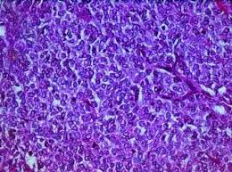
GRANULOSA CELL TUMOUR:
Subtype of sex cord stromal tumour
Rare form , incidence less than 5%
Hormone producing tumour: mostly Estrogen
Commonly unilateral
Rapidly growing
Of adult and Juvenile type
Tumor marker: Inhibin B

Slide 32
PROGNOSIS
5 Year survival rate:
Stage 1 :90-95%
Advanced stage: 30-50%

Slide 33
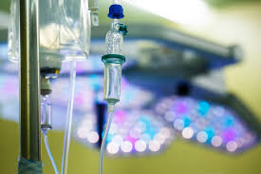
ROLE OF CHEMOTHERAPY
Chemotherapy :for advanced stage disease
BEP:3 cycles
BLEOMYCIN
ETOPOSIDE
PACLITAXEL

Slide 34
CHALLENGES IN YOUNG WOMEN:
YOUNG AGE
CONSIDERATION FOR REPEAT RADICAL SURGERY: TAH BSO
NEED FOR FERTILITY PRESERVATION
EARLY SURGICAL MENOPAUSE

Slide 35
COUNSELLING:
NEED FOR RADICAL SURGERY
CONSTANT THREAT OF CARCINOMA IN THE OTHER OVARY
DECREASE SURVIVAL RATE
6 MONTHLY FOLLOWUP

Slide 36
CHALLENGES OF MANAGEMENT
ADDRESSING FERTILITY ISSUES
EARLY MENOPAUSE
RISK OF RECURRENCE

Slide 37
ADDRESSING FERTILITY ISSUES
Young female desirous of fertility preservation:
Following options were given to her:
Ovum preservation(egg banking)
Uterus transplant
Adoption

Slide 38
EARLY MENOPAUSE
Menopause is a hormone deprived state of life:
Psychological aspect
Lack of libido
Mood swings
Bone damage
Calcium deficiency
Risk of cardiac diseases
Increased risk of IHD
Increased risk of thromboembolism
osteoporosis

Slide 39
MANAGEMENT AFTER SURGICAL MENOPAUSE
Iso flavones
Calcium supplementation
Vitamin D3 supplementation

Slide 40
RISK OF RECURRENCE OF MALIGNANCY
Patient needs to be regularly screened for the risk of recurrence by following methods:
Tumour markers
Chest X ray for metastasis
USG
clinical examination to rule out spine and breast metastasis

