Slide 1
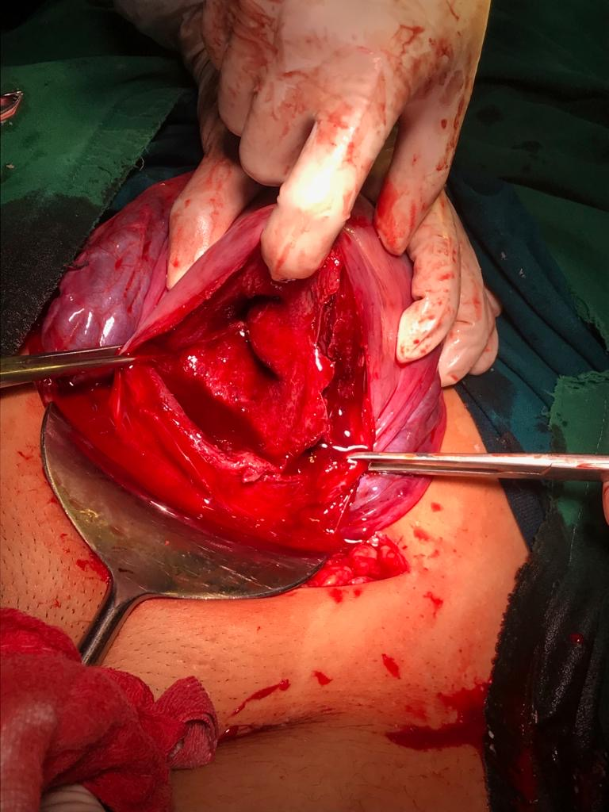
“ OBSTETRIC OUTCOME IN
UTERINE SEPTUM ”
- Dr. Aishwarya Srivastav (JR II )
Department of obstetrics and gynaecology

Slide 2
CASE REPORT - 1
19 year old , unregistered
Primigravida , married since 1 yr , came with c/o labour pains since 2hrs
Menstrual history : LMP = not known ; cycles regular
Gestational age = 36.3 wks ( calculated from 1st trimester scan done at 8 wks ) ; Scan showed septate uterus with septum extending upto lower cavity

Slide 3
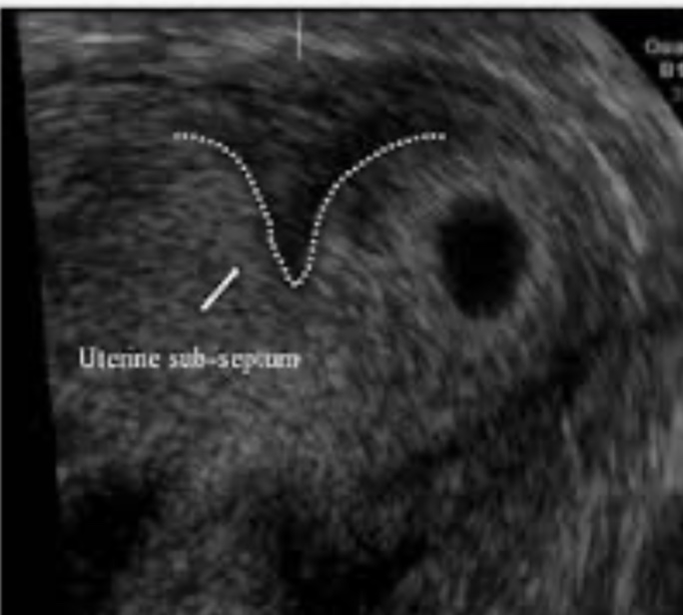
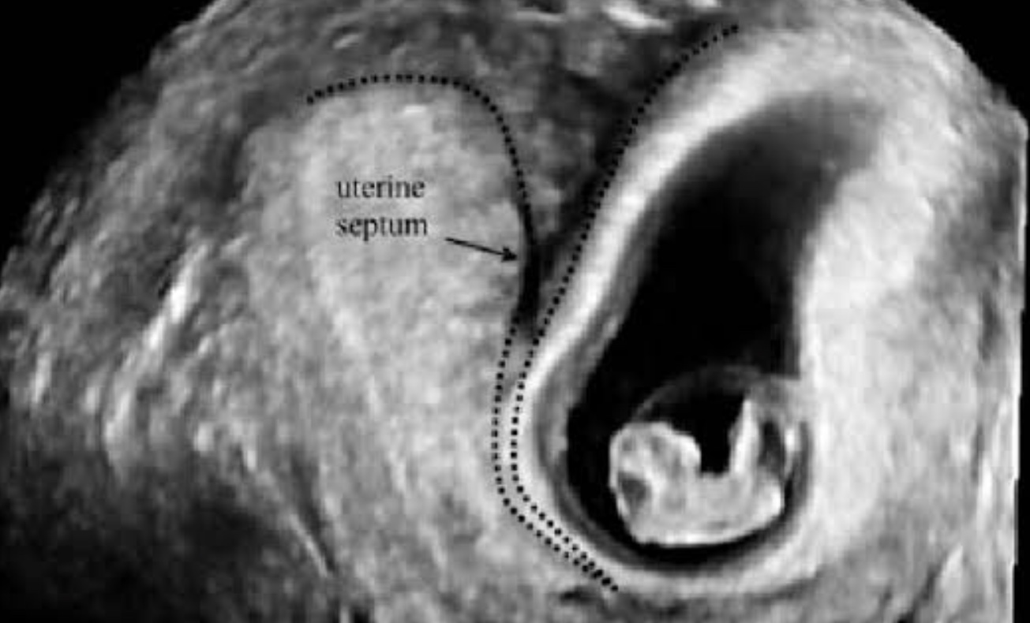
Scans showing pregnancy in septate uterus

Slide 4
Obstetric History : Primigravida
Past history/ Personal history/ Family history: Not significant
General examination: Mild pallor present and all other parameters- WNL, pulse- 92bpm, blood pressure- 124/80 mmhg, resp. rate- 14 breaths/min
Systemic examination: CVS/RS =NAD
On obstetric palpation: Uterine height 32-34 weeks ( fundal height was less than period of gestation) , breech ,clinically liquor was less , uterus full of foetus mild contractions present , fhs 140 bpm (regular)

Slide 5
On per speculum examination: No signs of leaking/ bleeding
On per vaginal examination: os closed, long and uneffaced
Diagnosis : Primigravida with 36.3 wks gestation with IUGR with breech presentation with sub septate uterus with threatened preterm labour
Investigations : CBC , liver and renal function tests were sent and the reports - WNL , HIV /HbsAg /VDRL status - Negative
Last scan dated 17/8/19 = single live foetus of 31.4 wks with Breech presentation, placenta-fundopost., Liquor Less (6.1 cm), EFW = 1.67 kg approx. with severe growth retardation ( growth less than 10th percentile) , Doppler showed increased fetoplacental and uteroplacental resistance without brain sparing effect
Admission test ,was done which revealed spontaneous decelerations upto 90 bpm
So, she was taken for Emergency lower segment Caesarean section

Slide 6
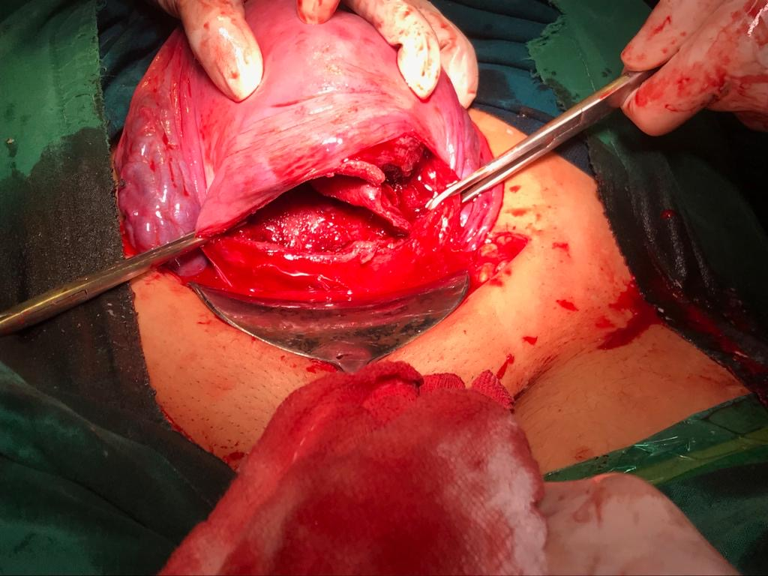
Baby details : Male child/ 1.9 kg/ good APGAR score / shifted to NICU in view of low birth weight

Slide 7
CASE REPORT - 2
26 year old , 4th gravida , registered case
Patient admitted in labour room with c/o labour pains since 4-5 hours
Menstrual history : LMP= 9/1/19 ; cycles regular
Expected date of delivery: 16/10/19
Gestational age = 39.3 wks

Slide 8
G1 spontaneous abortion at 10-12
G2 weeks gest. age - required
G3 evacuation; Rh neg preg – Anti- D GIVEN
Obstetric history: 4th gravida
Antenatal history : uneventful
This was a case of recurrent pregnancy loss (RPL) with secondary infertility for which she was evaluated 1 yr back ; Diagnostic hysterolaparoscopy done which showed subseptate uterus and the septum was incised .
Following which she conceived and the current pregnancy (G4 ) = after septum resection
Past / Personal / family history: not significant
General examination: mild pallor present and all other parameters - WNL , pulse- 82 bpm, blood pressure- 110/80 mmhg, resp. rate- 14 breaths/min
Systemic examination: CVS/RS =NAD
On obstetric palpation: Uterine height term size , vertex floating, clinically liquor adequate , mild contractions present , fhs 140 bpm (regular)

Slide 9
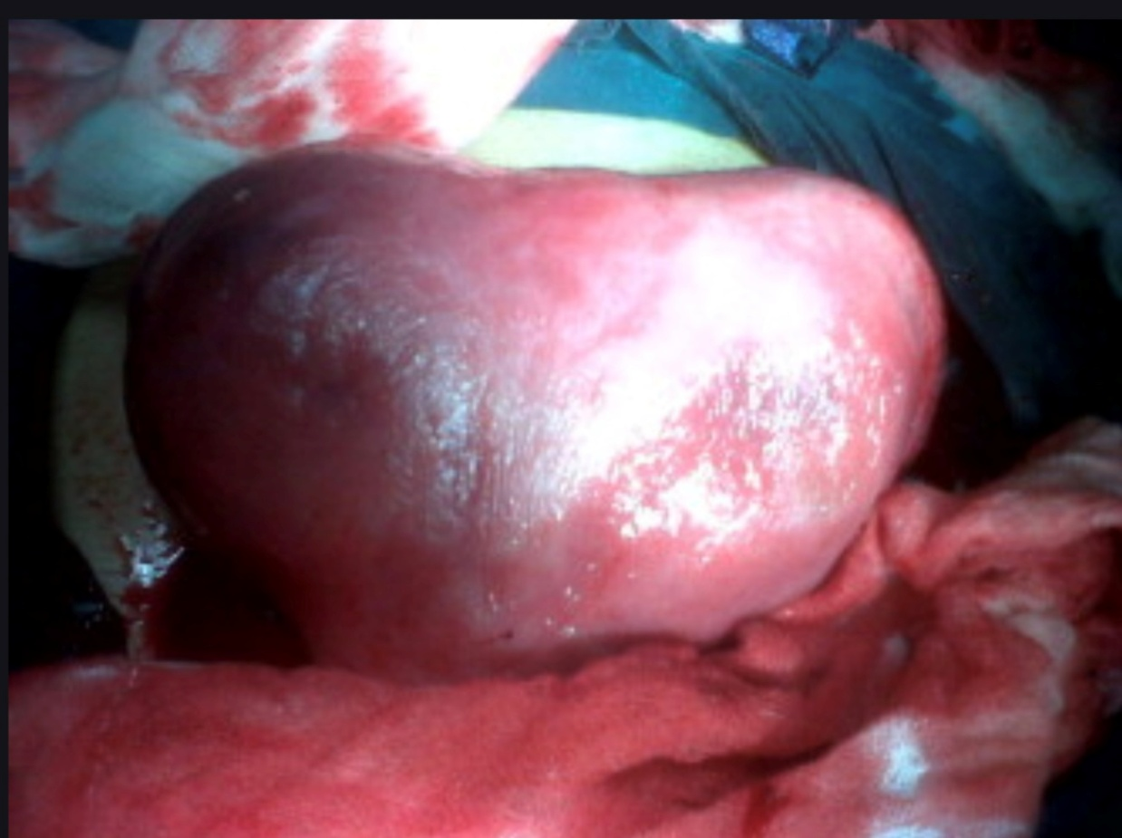
On per speculum examination: No signs of leaking/ bleeding
On per vaginal examination: cervical os 0.5-1cm dilated , minimally effaced , show present
Diagnosis : 4th gravida with 39 .3 wks gestation with Rh negative pregnancy with recurrent pregnancy loss in latent labour
Investigations : CBC , liver and renal function tests were sent and the reports - WNL , HIV /HbsAg /VDRL status – Negative
From her scan dated 1 month back ; showed - single live foetus with 38 weeks+1 day gestation, liquor adequate , placenta -anterior, EFW= 2.5 kg approx, with normal obstetric Doppler study
Admission test was reactive with normal beat to beat variability
Later, she was taken for Emergency lower segment Caesarean section for non progression of labour
Baby details : Male child/ 3.4 kg/ good APGAR score / shifted to mother side.

Slide 10
In 1st case ; patient conceived with a sub septate uterus and obstetric outcome was foetal growth restriction with birth weight of 1.9 kg , requiring NICU admission
As compared to 1st case ; in second case , patient had recurrent 1st trimester abortion due to septate uterus , obstetric outcome after septum resection was a full term baby weighing 3.4 kg

Slide 11
On comparing the two case scenarios
Pregnancy in septate uterus
Breech presentation (malpresentation)
Foetal growth restriction
Preterm labour
Low birth weight baby
Perinatal hypoxia ( NICU admission)
Pregnancy after septal resection
Vertex presentation
Normal growth interval
Term labour
Adequate birth weight baby
Baby cried immediately (shifted to mother side)

Slide 12
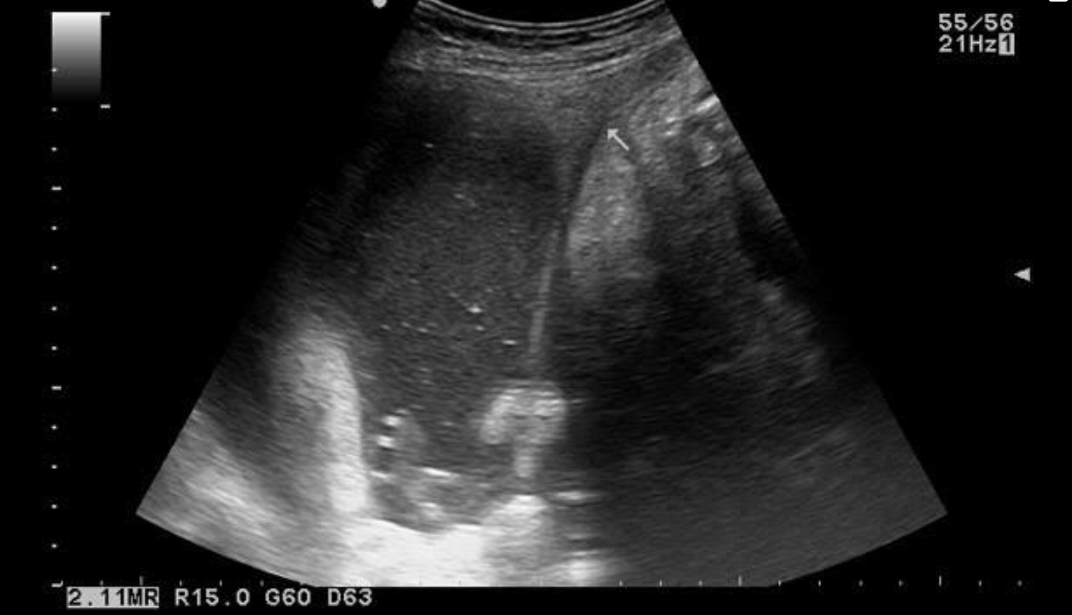
Obstetric outcomes in septate uterus
Higher rates of spontaneous abortions. (Miscarriage rates 70-90% > Pregnancy rates 5-40% ). Pregnancy losses usually occur between 8-16 weeks of gestation as a result of poor blood supply to septum and thus poor Implantation dynamics .
Preterm labour due to increased intrauterine pressure with cervical incompetence along with ER/PR receptor deficiency leading to abnormal uterine contractions.
Foetal growth restriction due to inadequate surrounding space of uterine cavity.
Malpresentations
Higher rates of caesarean delivery

Slide 13
SEPTATE UTERUS
Septate uterus is the most common mullerian anomaly with highest incidence of reproductive failures. However it is the most amenable to hysteroscopic treatment.

Slide 14
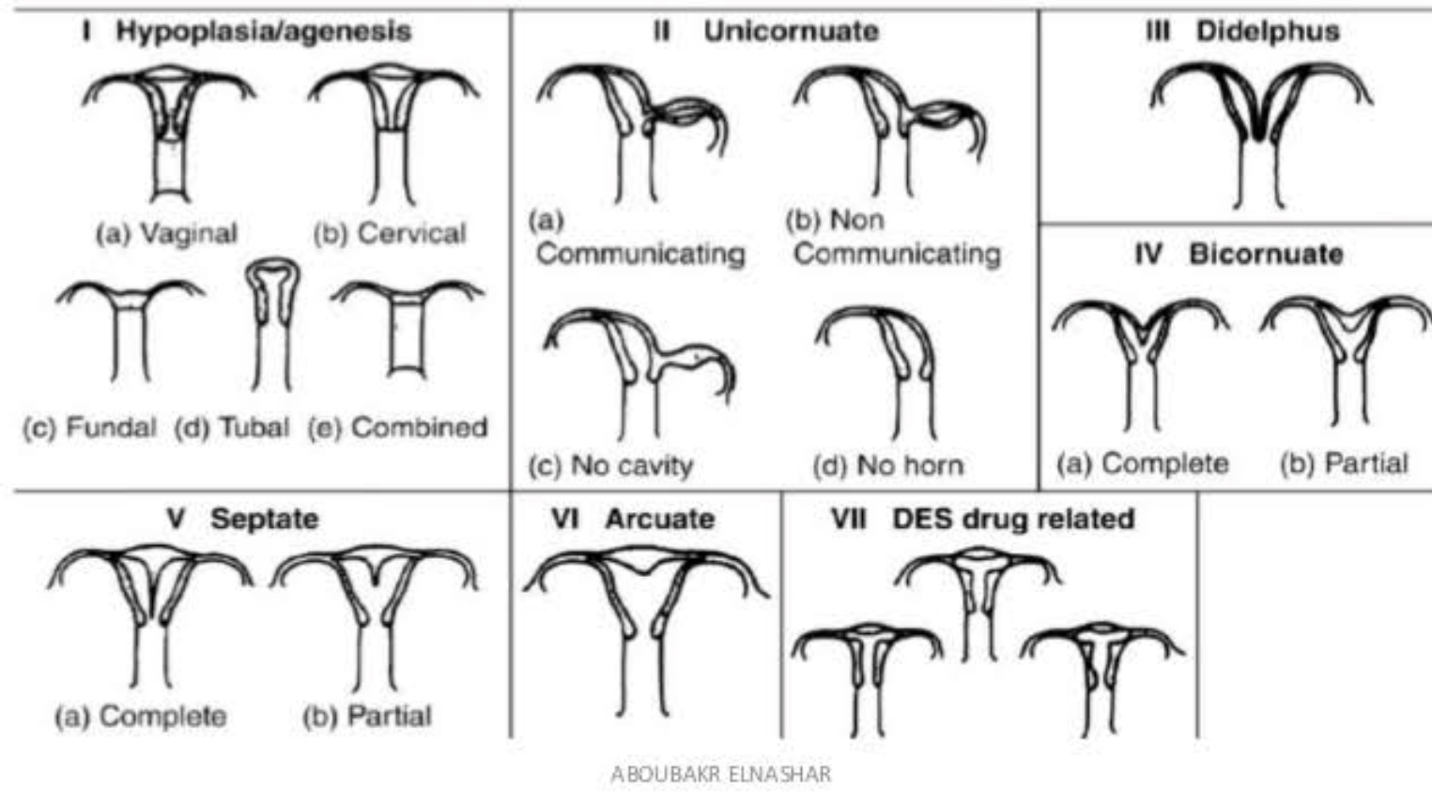
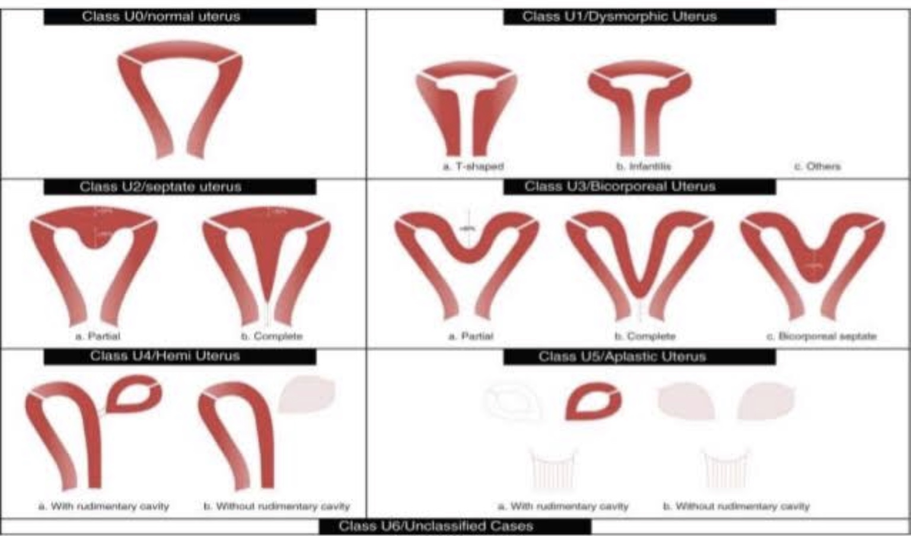
ASRM CLASSIFICATION
ESHRE CLASSIFICATION

Slide 16
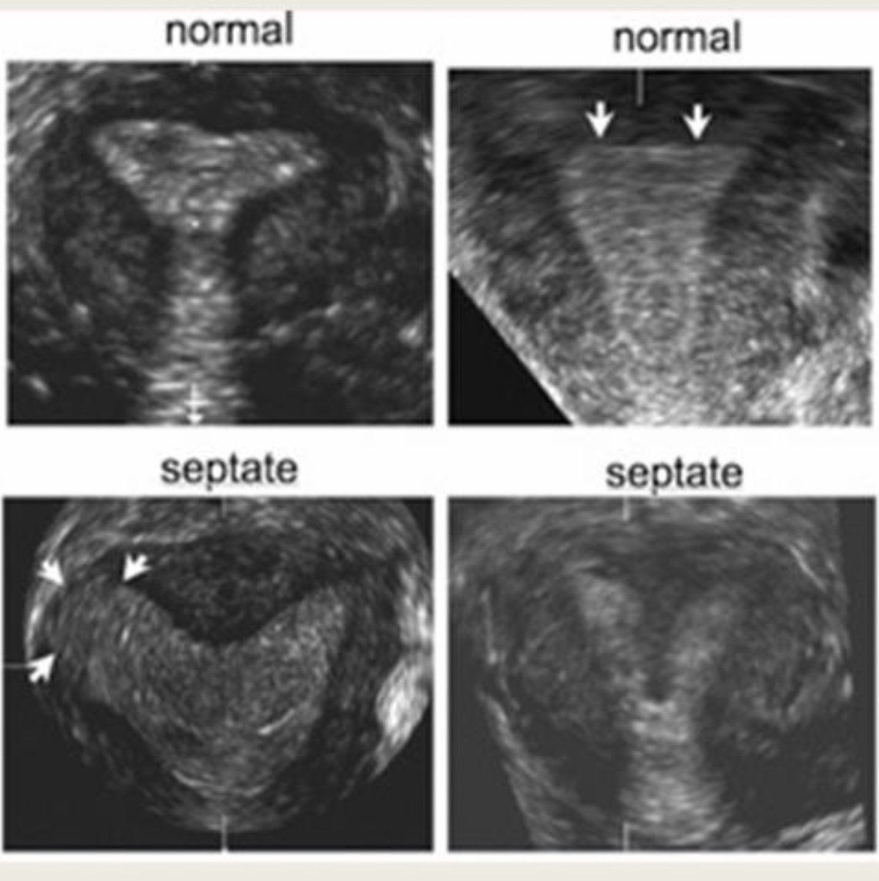
The modalities to diagnose and differentiate septate uterus with bicornuate uterus are:
3D USG combined with saline infusion sonography (SIS) gives 100% accuracy and also 3D USG without SIS found to be over 88% accurate for diagnosing uterine septa.
MRI - accurate but expensive
combined laparoscopic and hysteroscopic examination is the GOLD STANDARD

Slide 17
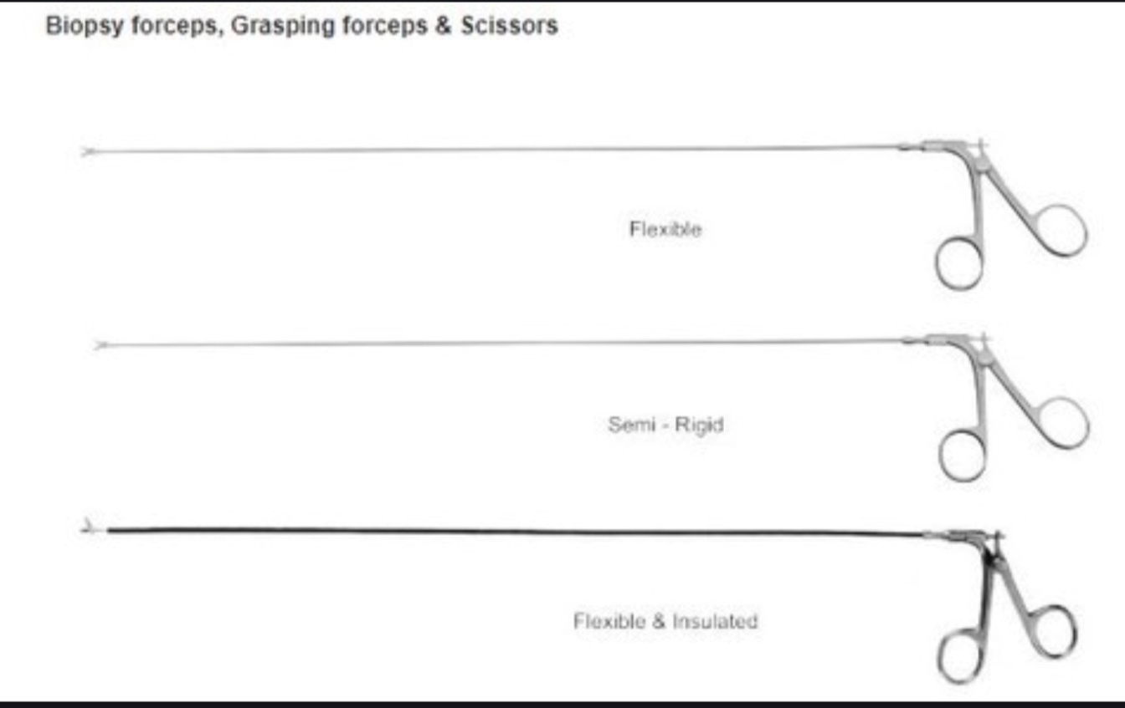
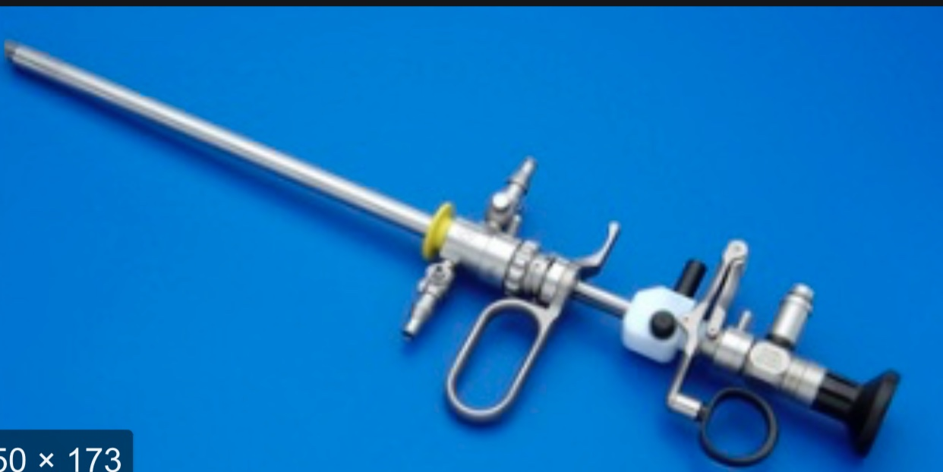
MANAGEMENT
Hysteroscopic septal incision using the microscissors, electrosurgery, or fiberoptic light laser energy (neodymium:yttrium-aluminum-garnet, KTP/532, argon, or krypton lasers).
Resectoscope

Slide 18
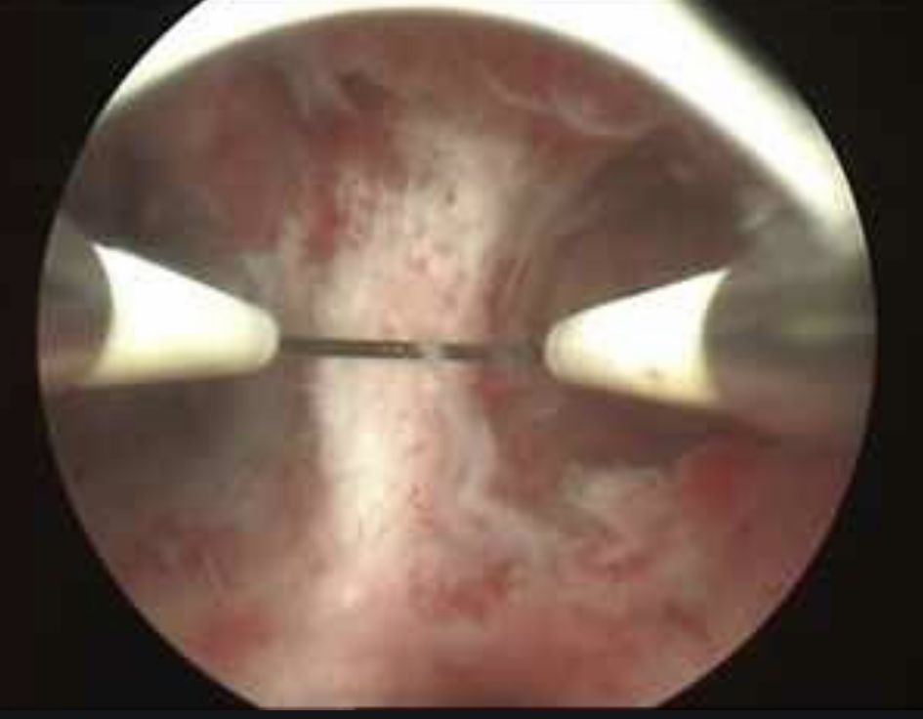
Hysteroscopic metroplasty has been shown to be a safe, simple, and expeditious method of treating the septate uterus.

Slide 19
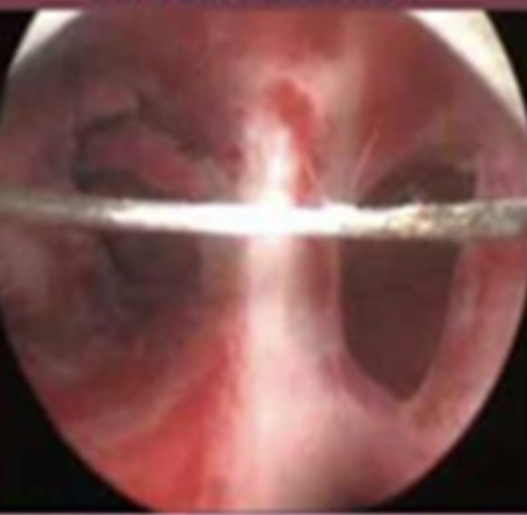
CONCLUSION
Hysteroscopic septum incision is associated with improved clinical pregnancy rates in women with infertility.
Septum incision is also associated with a reduction in subsequent miscarriage and improvement in live-birth rates in patients with a history of recurrent pregnancy loss.

Slide 20
THANK YOU

