Slide 1
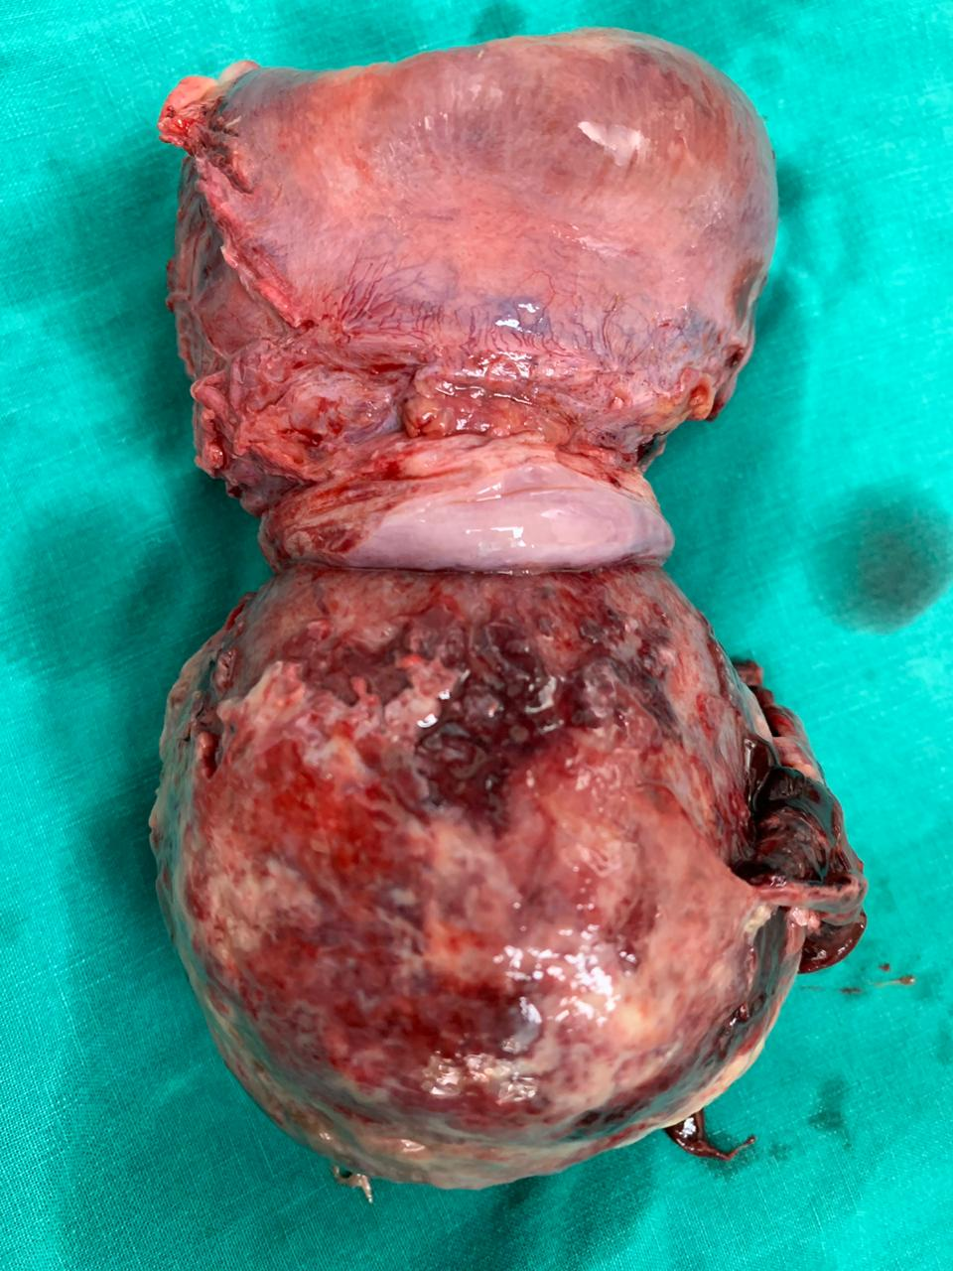
A case of large submucous pedunculated myomatous polyp with chronic partial uterine inversion
By Dr Alisha Das
Under guidance of Dr Hemant Deshpande,
Dept. of Obstetrics & Gynaecology,
Dr D. Y. Patil Medical College and Research Centre, Pimpri, Pune.

Slide 2
HISTORY OF PRESENTING COMPLAINTS
A 41 year old female Para 1 living 1 with previous LSCS came on 16th August 2019 with complaint of
Bleeding P/V since 1 day
Foul smelling discharge P/V since 1 month
Pain in abdomen and genital region since 3 months
Menorrhagia associated with dysmenorrhea since 1 year
No H/O –
white discharge
Bladder bowel complaints , urinary frequency or urgency
Fever , nausea , vomitting
Mass coming out PV
Menstrual history
Menarche attained at 14 years of age
Last menstrual period – 8th August (1 week prior)
Bled for 5 days. 3 pads soaked per day associated with passage of clots and dysmenorrhea
Past menstrual history since 1 year: 5-7 days / 28-32 days / increased menstrual flow . Associated with clot passage and dysmenorrhoea

Slide 3
Past menstrual history prior to 1 year: 4 to 5 days / 28-32 days / normal flow (2 to 3 pads per day).
Obstetric history
Married life 16 years
P1L1 – 14 year old female child . LSCS done in view of non progress of labour
Puerperal period uneventful
PAST MEDICAL AND SURGICAL HISTORY:
No history of Diabetes mellitus , hypertension, tuberculosis , thyroid disorder.
No history of intake of OC pills routinely
No major surgery in the past and no prior blood transfusion.
Personal history
Normal sleep and bowel bladder habits
No history of smoking or alcohol consumption

Slide 4
GENERAL PHYSICAL EXAMINATION
Moderately built and nourished
Comfortable and co-operative at the time of examination
Height-165 cm
Weight- 51kg
BMI – 18.7 kg/m²
Skin – normal in texture and colour
Pulse – 76 bpm regular in rate, rhythm and normal volume measured in left radial artery. No apex pulse deficit and radio radial delay
BP – 110/70 mmHg taken in left brachial artery in supine position
Breasts - clinically normal
Thyroid - clinically normal
Spine - clinically normal
No pallor, icterus, edema, cyanosis, lymphadenopathy, clubbing
CVS – S1 S2 normal . No murmurs
RS air entry bilaterally equal . No crepts , rales , rhonchi or abnormal breath sounds
No cervical lymphadenopathy

Slide 5
ABDOMINAL EXAMINATION
Inspection:
Umbilicus central and inverted
All quadrants move equally with respiration
Scar of previous LSCS noted on lower abdomen. Well healed
No striae , dilated veins, sinuses
Palpation :
Soft , scaphoid
No tenderness guarding and rigidity
No organomegaly (hepatomegaly and splenomegaly)
Uterus just palpable in suprapubic region (12 to 14 weeks size)
Consistency firm , no tenderness , mobility present from side to side(no fixity to skin and underlying structures) and lower pole could not be reached

Slide 6
GYNAECOLOGICAL EXAMINATION
Per speculum examination : large bosselated heterogenous mass noted of size about 8x8 cm stretching the vaginal walls . Foul smelling necrotic areas with hemorrhage and ulceration suggestive of infection noted on the mass. No active bleeding noted
Cervix not visualized as vision was obscured by the lesion
Per vaginal examination :
Large mass noted protruding through cervix and extending into the vagina
Fornices obliterated due to stretching effect of the mass
Cervix was not palpable as the mass was impacting the vaginal walls
Uterus size not assessed as bimanual examination was not possible due to mass
PROVISIONAL DIFFERENTIAL CLINICAL DIAGNOSIS
? Submucous pedunculated myomatous polyp
? Hypervascular endometrial polyp
? Cervical polypoidal growth

Slide 7
INVESTIGATIONS
Hemogram, blood sugar levels and liver and renal function test with blood electrolytes : WNL
HIV , HbsAg – negative
USG : Bulky uterus 10x6x6 cm with thickened Endometrial echo complex of 2.7 cm . Large mass of 7.3x6.9x6.9 cm noted extending upper vagina shows vascular pedicle continuous with thickened endometrium . Suggestive of fibrovascular endometrial polyp or submucous fibroid prolapsing through cervical canal into upper vagina.

Slide 8
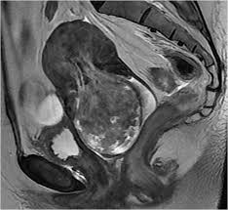
MRI findings suggestive of Bulky uterus 10x7x8 cm with large well defined lobulated solid enhancing pedunculated hypervascular mass projecting inferiorly from endometrial cavity, through cervical canal of 10x8.7x8.5 cm with extensive areas of hemorrhage and necrosis. No myometrial involvement . Parametrial planes are intact . Vagina is stretched and patent.

Slide 9
MANAGEMENT
In view of the bleeding, malignancy was considered and a core biopsy of the vaginal mass was done. Histopathological study revealed fragments composed of spindle cells with areas of haemorrhage and edema .There was no evidence of malignancy. The pathological diagnosis was “fibroid polyp- leiomyoma with secondary changes.”
The patient was taken up for definitive surgery.

Slide 10
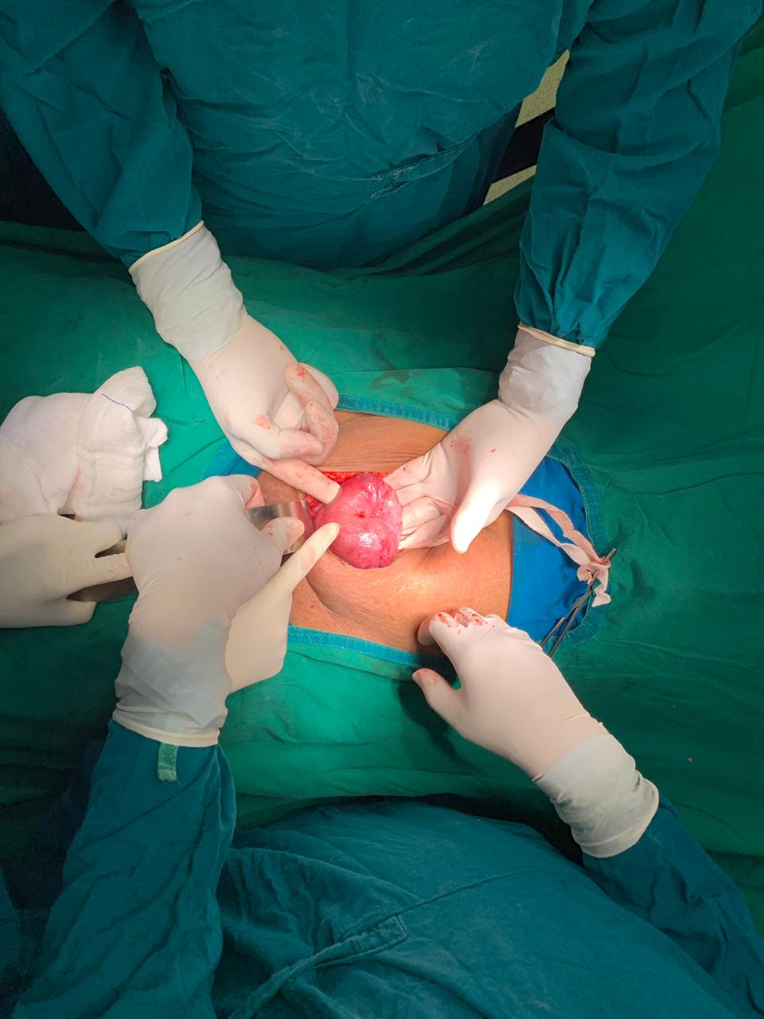
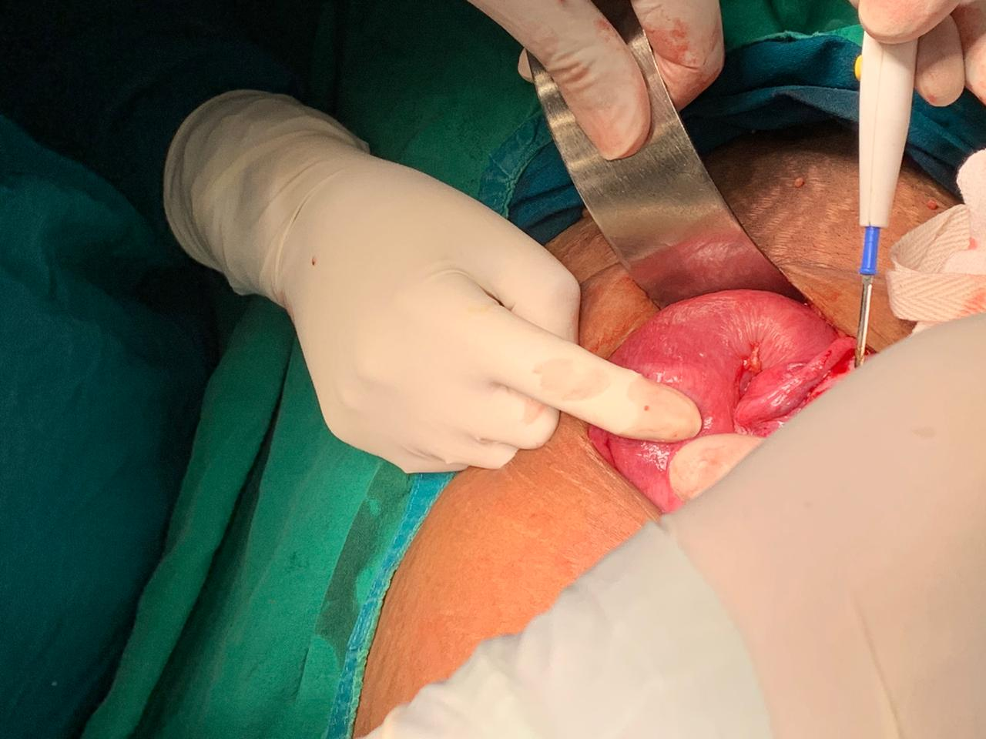
Patient was taken for total abdominal hysterectomy with preservation of bilateral ovaries.
Fundal dimpling due to the mass with chronic inversion of uterus was noted intra operatively (Flower vase appearance of uterus and adnexa)

Slide 11
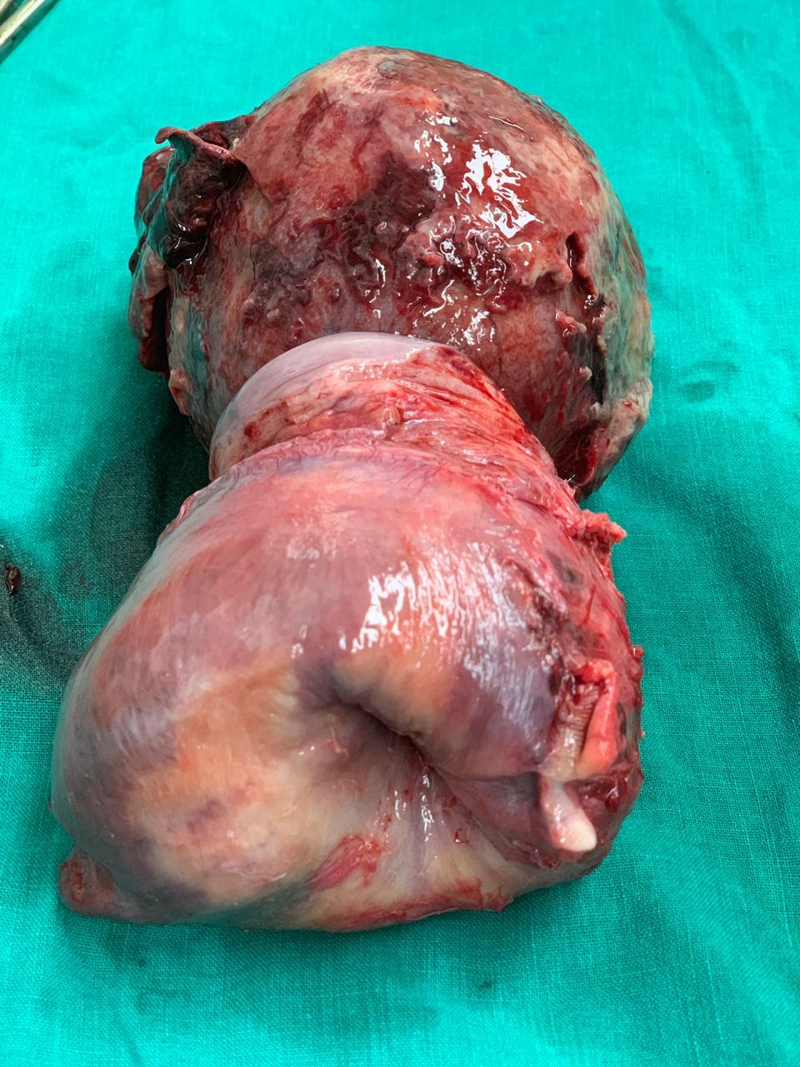
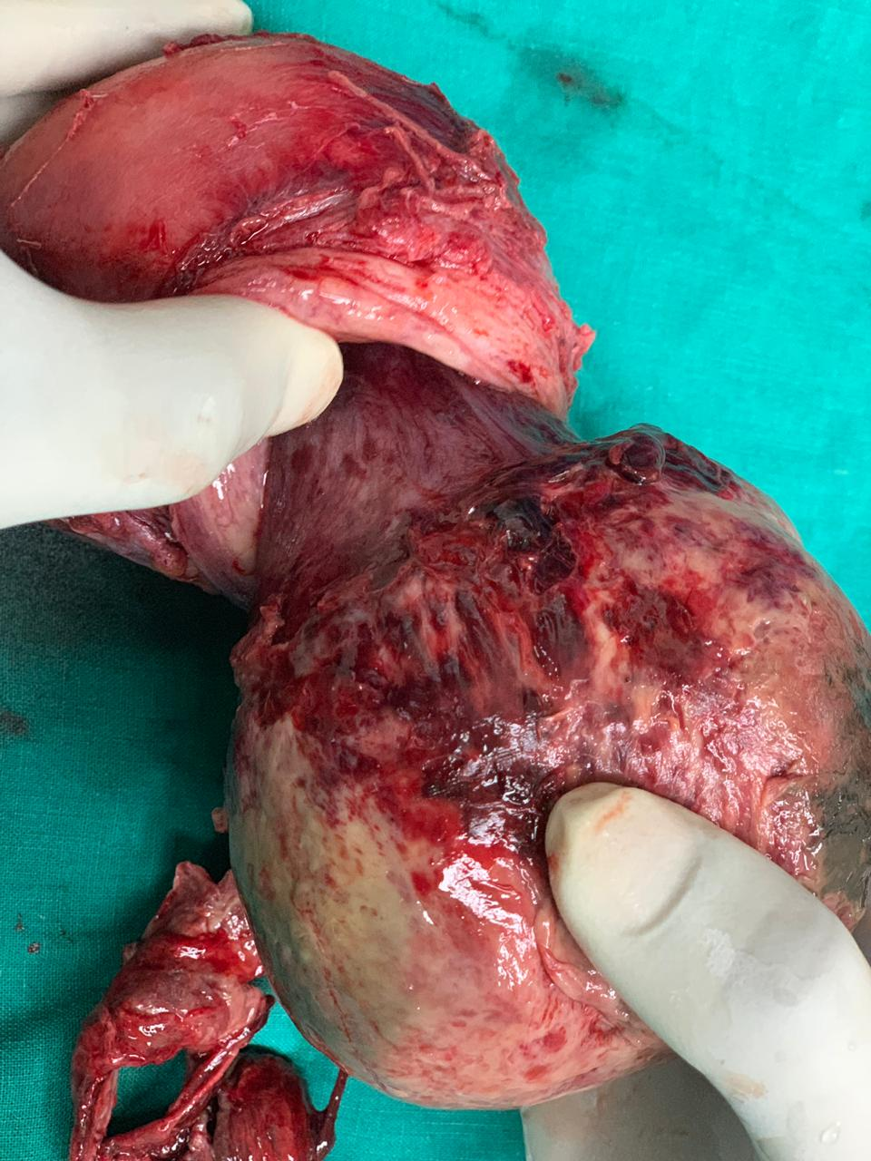
Specimen was resected en bloc
Vascular stalk extending from endometrium was noted
Specimen was sent for histopathological examination

Slide 12
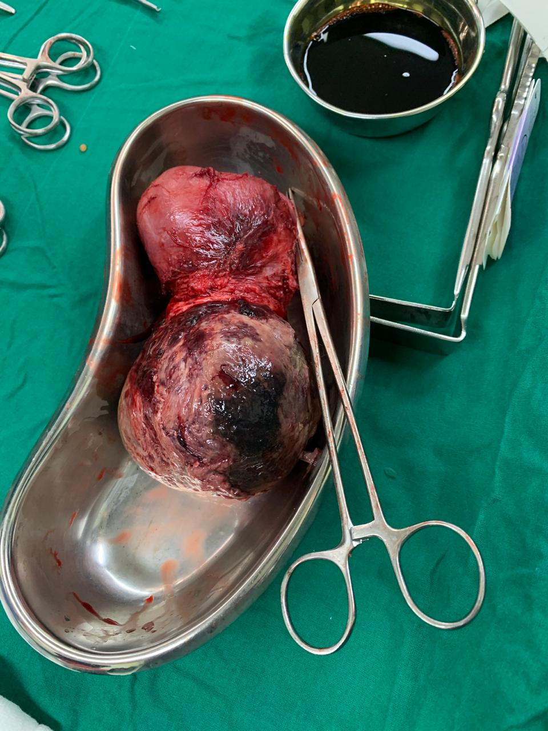
The patient had an uneventful post-operative period and was discharged after 15 days with full recovery.
Histopathology report was suggestive of leiomyoma

Slide 13
DISCUSSION
A leiomyoma, also known as fibroids, is a benign smooth muscle tumour.
Uterine fibroids are leiomyomata of the uterine smooth muscle. As other leiomyomata, they are benign, but may lead to excessive menstrual bleeding (menorrhagia), often cause anaemia and may lead to infertility.
They are usually slow growing tumors and take a few years to become clinically palpable.
Each leiomyoma is derived from smooth muscle rests from either vessel walls or uterine musculature.
Evidence suggests that the steroidal sex hormones (estrogen and progesterone) play a vital role in growth of fibroids.
They are usually seen in women of reproductive age group and cease to grow after menopause.
They are associated with hyperestrogenism and may be diagnosed along with endometrial hyperplasia, abnormal uterine bleeding and carcinoma.

Slide 14
A typical leiomyoma is a well circumscribed tumour with a pseudocapsule. Cut surface has a pinkish white appearance with whorled pattern. Consistency is generally firm and blood vessels are found in the periphery and supply blood to the fibroid radially.
Microscopically they demonstrate spindle shaped muscle cells seperated by fibrous strands.
Degenerative changes like necrosis begin centrally while calcification begins peripherally and spreads inwards.
Leiomyomas are classified based on their anatomic location
Intramural 75% – They grow symmetrically lying within the myometrial wall
Subserous 10% - They grow outward and may present as a bosselated growth from uterus towards peritoneum
(they may also be pedunculated and may form parasitic fibroids)
Submucous 15% - They grow towards the uterine cavity and may be covered by only a thin layer of endometrium (they may grow towards the vagina also and be suspended by a pedicle as was seen in the present case wherein they are called submucous myomatous polyp)

Slide 15
The occurrence of chronic inversion of uterus in a non pregnant woman is rare.
Non gravid uterine inversion is usually associated with uterine pathology.
Prolapse and extrusion of fibroids especially a sub mucous myoma of the fundus tends to be the most common factor inciting the inversion.
Other less common causes are endometrial polyps and inversion associated with uterine neoplasm.
Leiomyoma, leiomyosarcoma, rhabdomyosarcoma, endometrial carcinoma, all have been known to be the preceding factors .

Slide 16
The underlying cause of uterine inversion in 80%-85% of cases is uterine leiomyoma making it the most common cause.
The proposed factors thought to contribute to uterine inversion are
(a) a uterus previously distended by a tumor undergoing sudden emptying;
(b) Intra uterine tumor causing thinning of uterus;
(c) dilatation of the cervix.

Slide 17
The present case report is that of a woman presenting with nonpuerperal partial chronic uterine inversion secondary to a prolapsed necrotic sub mucous fibroid. In our patient hysterectomy was carried out as there was extensive necrosis with secondary degenerative changes.

Slide 18
CONCLUSION
The occurrence of chronic inversion of uterus in the non puerperal state is a rarely encountered entity.
On encountering a large prolapsed fibroid one should suspect the presence of chronic nonpuerperal uterine inversion.
It is advisable to perform biopsy of the mass in view of its association with uterine malignancy.
In chronic inversion secondary to a fibroid, the clinician should suspect infection of the fibroid and uterus. Vaginal restoration and removal is difficult.

Slide 19
THANK YOU

