Slide 1
SURGICAL REVASCULARIZATION IN DEPRESSED CARDIAC FUNCTION: A CHALLENGE
Dr Smruti Hindaria
Assistant Professor
CVTS

Slide 2
Coronary Artery Disease:Epidemiology
Ischemic heart disease (prevalence 35 - 40%)
CHD may manifest itself in many presentations:
angina pectoris of effort
myocardial infarction
irregularities of the heart
cardiac failure
sudden death
LV dysfunction – 60-70%

Slide 3
The pattern of CHD in India has been reported to be as follows:
CHD appears a decade earlier compared with the age incidence in developed countries. The peak period is attained between 51-60 years
males are affected more than females
hypertension and diabetes account for about 40 per cent of all cases
heavy smoking is responsible aetiologically in a good number of cases.

Slide 5
LV Systolic Dysfunction
LV systolic dysfunction was graded as mild (LVEF 41–45%), moderate (LVEF 36–40%), or severe (LVEF ⩽ 35%)
The study of highest quality is the registry for the TRACE study, a randomised controlled trial comparing placebo and trandolapril in Denmark, predominantly (76%) in patients with a first MI.Of 6526 patients in whom the wall motion index could be determined, 2606 patients (40%) developed major LVSD. Among those who had LVSD, 74% developed features of heart failure and 30% of all patients had both LVSD and heart failure. However, 24% of patients had features of heart failure but did not have LVSD. Overall, about two thirds of patients had either heart failure or LVSD

Slide 6
Proportion of patients with heart failure and left ventricular systolic dysfunction within the first few days after a myocardial infarction in the TRACE study.²

Slide 8
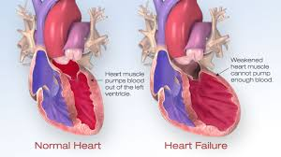
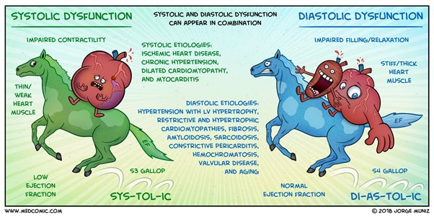

Slide 9
Our Centre Experience: Sept 2017-Sept 2019
Total CABG – 123
Total patients with LVEF < 40% - 46
LVEF < 30% - 19, LVEF 30-40% - 27
Male – 32, Female – 14
Age – youngest – 38 years, oldest – 78 years
LMCA – 12, TVD – 24 , DVD – 10
IABP – Preop – 2, Postop – 4
Emergency – LM – 8

Slide 10
Our Centre Experience: Sept 2017-Sept 2019
Presenting complaints – angina+HF – 32
HF only – 14
NYHA class – II – 22 , III – 20 , IV – 4
Deaths – early – 3 , late – 3
Endarterectomy – LAD – 4, PDA – 6
Mitral regurgitation – mild – 26 , mod – 18 , severe – 2
Mitral annuloplasty ring -2
SVR – 1
Significant improvement in NYHA class on follow – up at 3 months

Slide 11
Strategy
Detailed preop assessment
2D ECHO – EF,MR,LV aneurysm
CAG
Myocardial viability scan (cardiac MRI,Thallium scan )
Renal function
PFT
IABP
Intraop monitoring – PA catheter , inotropes
ON PUMP/OFF PUMP
Choice of conduit
Post op care and follow - up

Slide 12
Challenges
Concerns over the revascularization of patients with severely impaired left ventricular (LV) function are-
poor prognosis,
severe coronary artery disease,
suboptimal graft longevity because of poor distal runoff in patients with severe LVD
considerable myocardial scar burden.

Slide 13
Intraoperative difficulties
Enlarged heart
Grossly diseased and calcified vessels requiring endarterectomy
Arrhythmias
Mitral valve regurgitation
LV aneurysm

Slide 14
Studies from different cohorts assessing the efficacy of surgical revascularization have demonstrated that these patients benefit the most from CABG, particularly if symptoms of angina — rather than heart failure — are evident.
(Surgical survival benefits for coronary disease patients with left ventricular dysfunction.Bounous EP, Mark DB, Pollock BG, Hlatky MA, Harrell FE Jr, Lee KL, Rankin JS, Wechsler AS, Pryor DB, Califf RM
Circulation. 1988 Sep; 78(3 Pt 2):I151-7).

Slide 15
CABG in patients with severe myocardial dysfunction –
preserves the remaining viable myocardium,
prevents additional myocardial deterioration,
induces the recovery of the systolic function of hibernated and ischemic myocardial segments.

Slide 16
Because alternative surgical treatments (i.e., transplantation and cardiomyoplasty) are limited and the results of medical therapy are often unsatisfactory, coronary artery bypass grafting (CABG) is often the only available treatment that will improve symptoms and longevity.
In a cohort of patients with ischemic cardiomyopathy, the rates of death from any cause, death from cardiovascular causes, and death from any cause or hospitalization for cardiovascular causes were significantly lower over 10 years among patients who underwent CABG in addition to receiving medical therapy than among those who received medical therapy alone.
(Funded by the National Institutes of Health; STICH [and STICHES] ClinicalTrials.)

Slide 17
Surgical Anatomy
From surgical point of view, coronary system is divided into 4 parts:
1-Left main coronary artery
2-Left anterior descending artery (LAD)(and its diagonal branches)
3-Left circumflex artery (and its marginal branches)
4-Right coronary artery (and its posterior descending branch [PDA])

Slide 19
Aim of CABG
Complete revascularization of myocardium; to:
Relieve symptoms (angina, heart failure)
Improve quality of life,
Increase life expectancy

Slide 31
IABP

Slide 34
Swan Ganz catheter

Slide 36
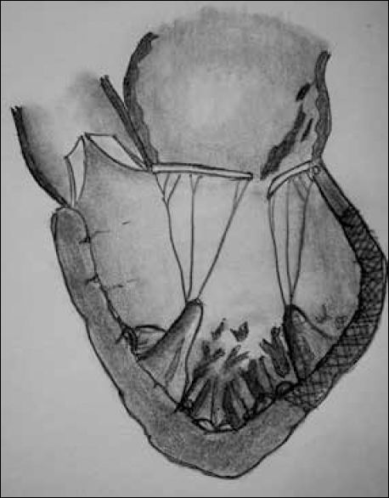
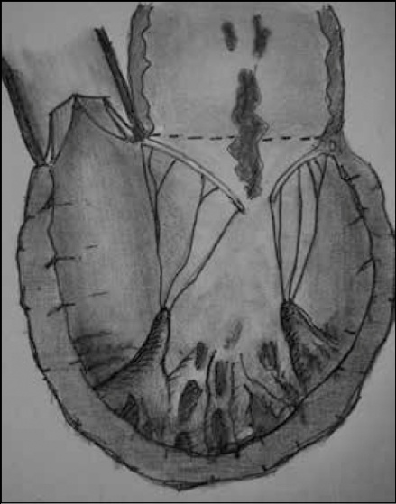
IMR
complication of left ventricular (LV) global or regional pathological remodeling due to chronic coronary artery disease - valvular consequences of increased tethering forces and reduced closing forces.

Slide 37
Surgical ventricular restoration

Slide 38
Post op care
Medical therapy
Beta blockers
ACE inhibitors
Diuretics- Aldosterone antagonists
Aspirin, Clopidogrel
Statins
Physiotherapy, general care

Slide 39
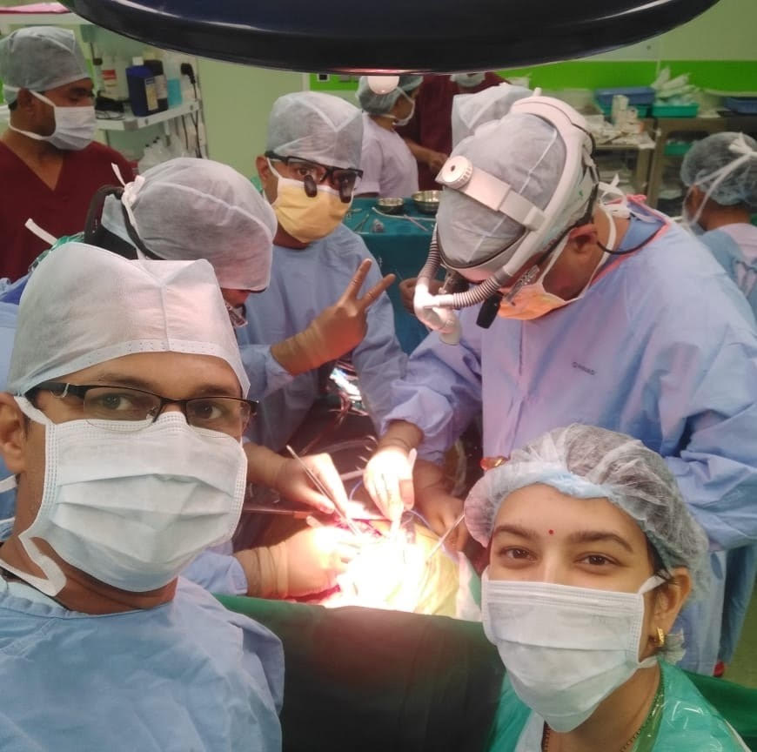
Conclusion
CABG can be performed in patients with severe LV dysfunction with good results.
Requires the team work of cardiac surgeons, cardiologists, cardiac anaesthetist , nursing staff and the Perfusionist.

Slide 40
Thank you!

