Slide 1
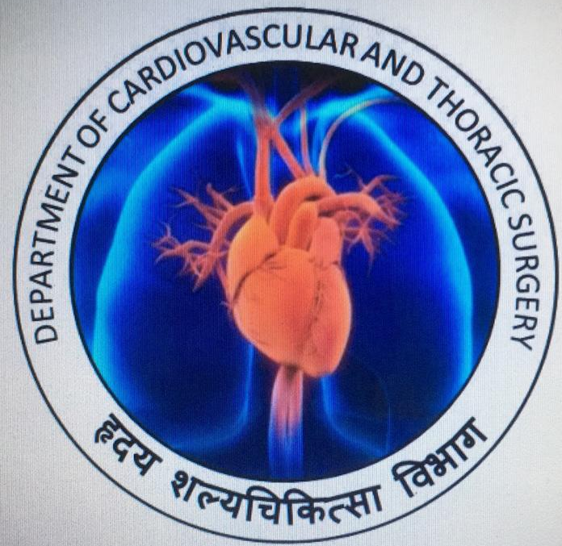
DEPARTMENT OF CARDIOTHORACIC SURGERY
Dr. D Y Patil Medical College, Hospital & Research Centre, Pimpri Pune

Slide 2
Emerging pediatric cardiac surgery horizons @ dpu: a team cvts initiative
DR ASHISH DOLAS
ASSOCIATE PROFESSOR
DEPT OF CARDIOVASCULAR THORACIC SURGERY

Slide 3
CONGENITAL HEART DISEASE SURGERY PROGRAMME
Started in Oct 2017
Year | 2018 | 2019
No. Of cases | 35 | 35 till date…

Slide 4
DEMOGRAPHIC PROFILE
Age Group | 2018 | 2019 | Total no. of Cases
0-1 yr (INFANTS) | 0 | 8 | 08
> 1- 5yr (PRE- SCHOOL) | 10 | 13 | 23
> 5-16 Yr (SCHOOL & ADOLOSCENTS) | 9 | 5 | 14
> 16 yr (GUCH) | 16 | 9 | 25
Youngest- 15 days
Eldest- 59 years

Slide 5
DISEASE SPECTRUM
Diagnosis | 2018 | 2019 | Total Cases
Atrial Septal Defect | 19 | 15 | 34
Ventricular Septal Defect | 10 | 9 | 19
Tetrology of Fallot | 3 | 1 | 4
Patent Ductus Arteriosus | 1 | 3 | 4
TAPVC’S | - | 1 | 1
AV CANAL DEFECT’S | - | 1 | 1
Others | 2 | 9 | 11

Slide 6
ATRIAL SEPTAL DEFECT
Secundum ASD- 17
Sinus Venosus ASD with Partial Anomalous Pulmonary Venous Connection (PAPVC)
8 (Requires Re-routing of PV to LA along patch)
ASD with PS - 2 (Additional Open Pulmonary valvotomy done)
ASD with LPA PLASTY (Patch Plasty of the left pulmonary artery)-1
ASD with Significant Tricuspid Regurgitation
6 (Additional Tricuspid valve repair done)

Slide 7
VENTRICULAR SEPTAL DEFECT
Isolated VSD- 10
Swiss cheese (Multiple VSD’S) -1
VSD’s With associated lesions: 8
ASD- 3
PDA- 2
AR- 3
PS- 2
TR/MR- 2/ 1

Slide 8
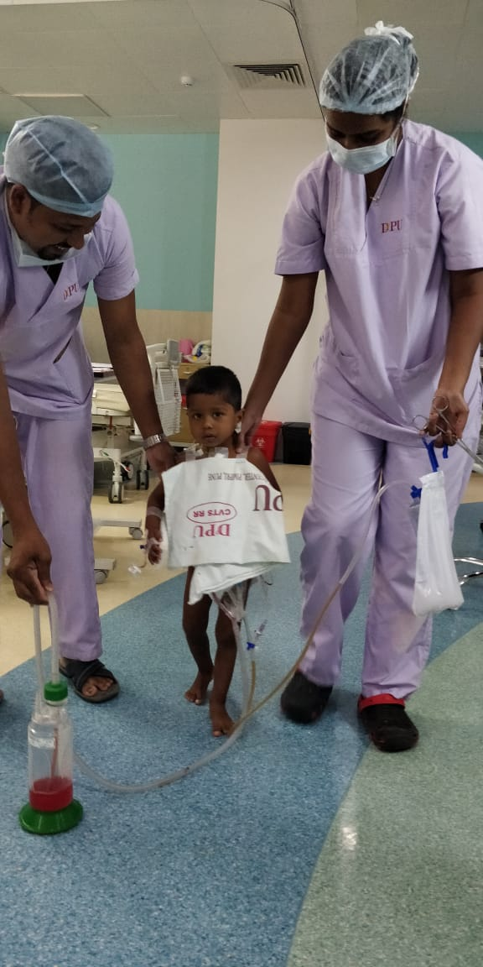
TETRALOGY OF FALLOT
RVOT Resection- 4
With Transannular patch- 3
Monocusp valve – 1
Sung Valve augmentation of PV- 1
PV replacement- 1
(19 Epic Bioprosthesis)

Slide 9
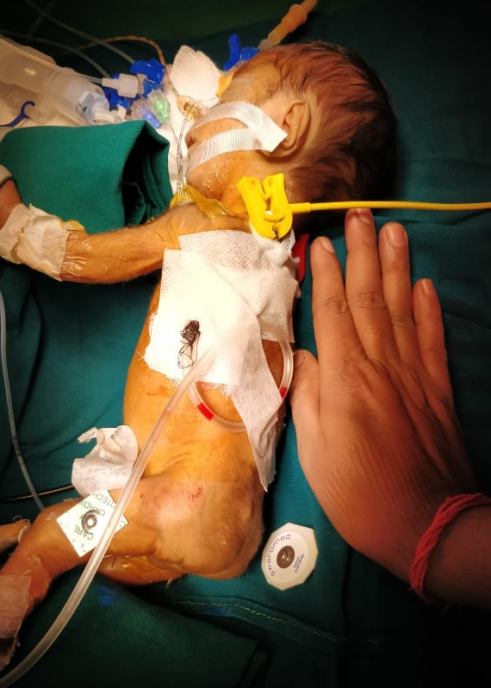
PATENT DUCTUS ARTERIOSUS
Youngest –
24 days (Preterm):
800 GMs
Eldest-
45 Yr female Severe Mitral stenosis + Tricuspid regurgitation, PDA with moderate PAH
PDA ligation with MVR & TV repair was done

Slide 10
Total anomalous pulmonary venous Connection( TAPVC)
5 Month old child , 5.5kgs weight was having complaints of recurrent LRTI and Pneumonia.
Diagnosed with unobstructed supra-cardiac TAPVC.
Operated : Rerouting of common chamber -→ Left atrium, and closure of ASD and Ligation of vertical vein.
Post op Day 4 -→ Discharged on post op Day 6.

Slide 11
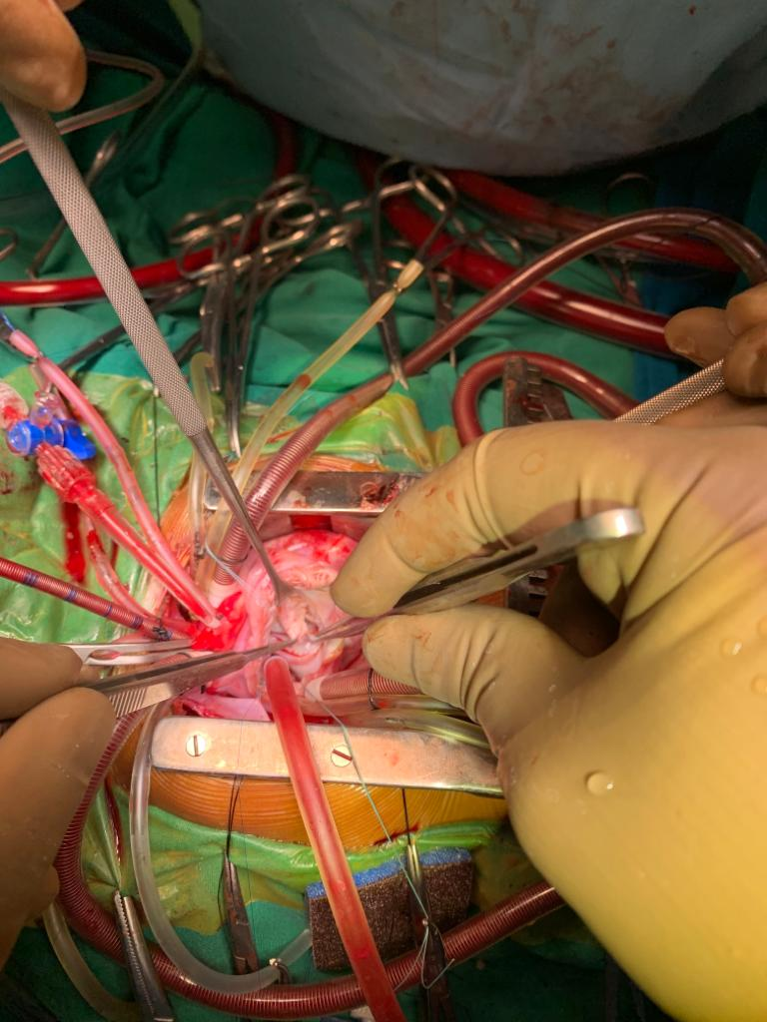
AV- CANAL DEFECT
1 year 8 months old kid, 8 kgs came with recurrent LRTI.
Diagnosed to have Transitional AV- CANAL defect.
Closure of the atrial and ventricular septal Defect with a patch or patches, and reconstruction of the common atrioventricular valve.
Patient had excellent post op recovery and discharged on Day 6.

Slide 12
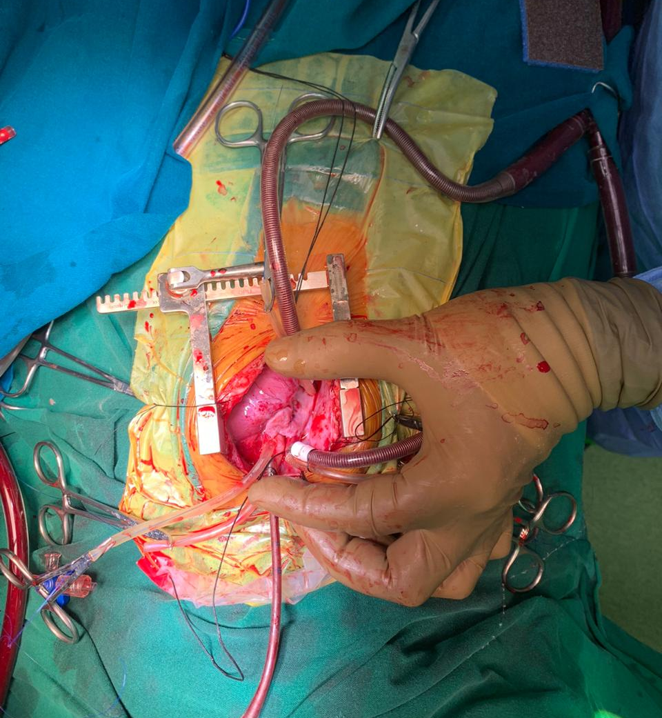

Slide 13
OTHERS
Isolated Pulmonary stenosis- 2
Subaortic Membrane with Subvalvar aortic stenosis- 2 (Excision of subaortic membrane done)
5 Yr
11 Yr

Slide 14
MISCELLANEOUS CASES
7 mth female child, RV inflow obstruction due to large RA Myxoma, severe low cardiac output with near cardiac arrest, severe Acidosis
Taken for Emergency surgery- RA mass Excision

Slide 15
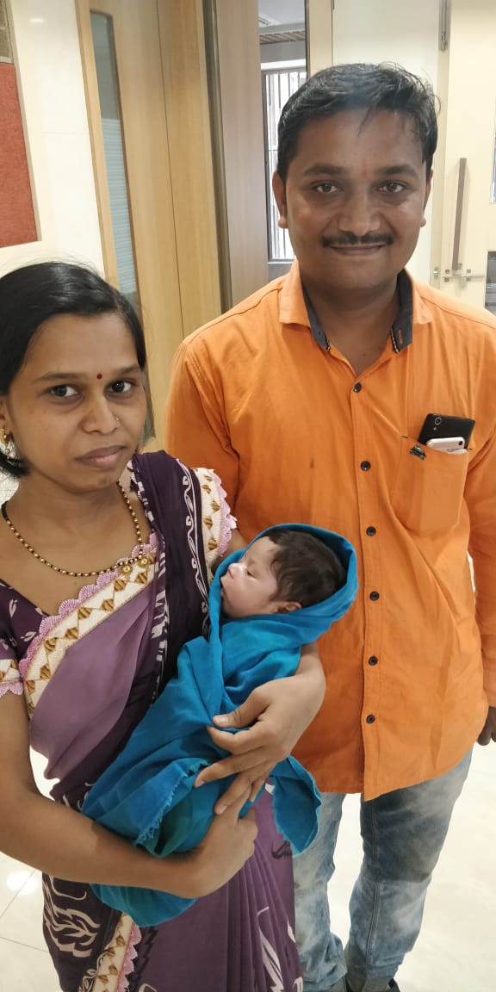
26 Days male child c/o TGA, VSD, PS recurrent cyanotic spells- Emergency BT Shunt surgery done

Slide 16
1 yr male child TA, VSD, PS (s/p BT Shunt) – BT shunt takedown + Bi Directional Glenn Shunt done

Slide 17
GROWN UP CONGENITAL HEART DISEASE (GUCH)
“GUCH” includes presence of unrepaired or repaired congenital heart disease in grown up patients
No specific age limit distinguishing adult & non adult, as physical & emotional maturity varies
No longer fitting in traditional definition of adult or pediatric cardiac surgical care group, requires specialist care
Age limit: > 16 yrs

Slide 18
GUCH SPECTRUM
ASD- 21
Coarctation of aorta- 2
TOF- 1 : ICR with PV replacement done
PDA- 1
Pulmonary stenosis- 1

Slide 19
RESULTS:
NO mortality till date

Slide 20
CHALLENGES FACED
Starting a new unit-
Team and training
Slow and steady- start with > 10kg
No compromise on infrastructure
Cost control
Affordable cost- an oxymoron!
Packages barely cover expenses, no ROCE
Crying need for extramural funding
Institutional practice
“ Nothing matters more than the team”

Slide 21
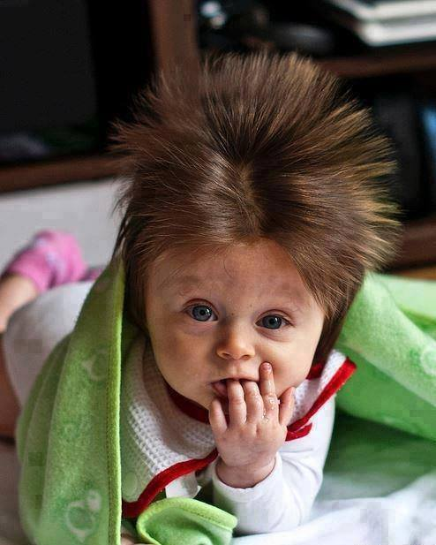
QUESTIONS…?

Slide 22
THANK YOU…

