Slide 1
Paraplegia in Spinal Tuberculosis: A Case Report
DR CLEVIO DESOUZA

Slide 2
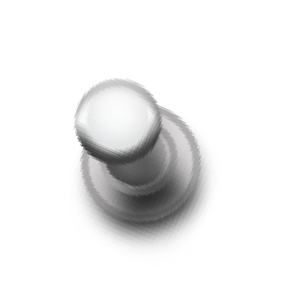
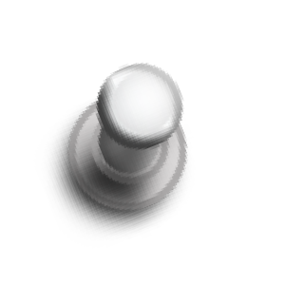



O A 48-year-old male patient factory supervisor by occupation had a brief-history of fever and cough, which subsided after a standard one week therapy of antibiotics, paracetamol but his cough persisted for more than 2 months.
O After few weeks, he felt pain in the ribs initially, which radiated to the back. He complained of continuous pain in the back, for which he was given analgesics and was advised rest by a local doctor.
O The pain reduced after the use of analgesics, but they did not give total relief. It persisted even after rest and, it would become worse after a night’s sleep.

Slide 3
O There was low-grade fever in the evenings and a gradual weight loss, from 65 to 55 kg in the span of 2 months.
O Doctors advised an X-ray of Chest , Tubercular IgA and Mantoux test.
O X-ray was clear and both the other tests were negative.
O The complete blood picture was also normal.
O Patient was started by his local doctor on four drugs Anti Tubercular Therapy (ATT):
O Isoniazide 300mg
O Rifampicin 450 mg
O Pyrizinamide 1500 mg
O Ethambutol 800 mg

Slide 4
O The patient was on Anti-TB medication for a month,
inspite of which the condition of the patient worsened.
O The patient came to us with inability to walk since 20
days.

Slide 5
EXAMINATION FINDINGS
O Gibbus deformity +
O Paravertebral Spasm +
O On Palpation, Local
tenderness +
rise of temperature and
O B/L Sensations were absent in the lower limbs
O Power was 0/5 in B/L lower limbs
O Deep Tendon Reflexes were exagerrated.

Slide 6
O B/L Ankle clonus +
O Babinski sign was positive
O There was incontinence of bladder and bowel
O Patient was spastic paraplegia with bowel and bladder
involvement below level D10.

Slide 7
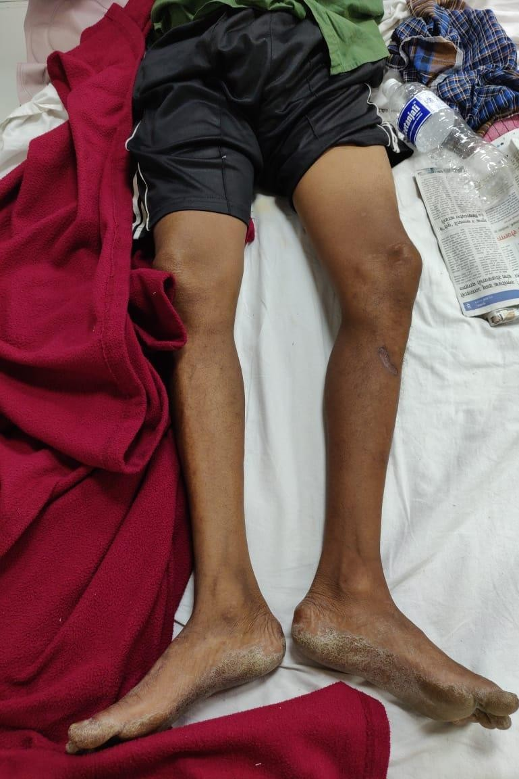
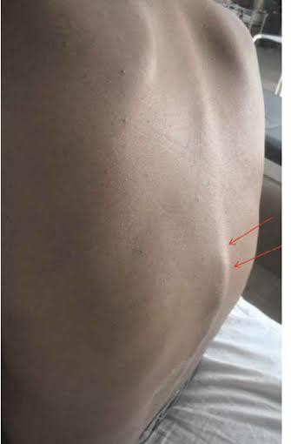
GIBBUS
DEFORMITY

Slide 8
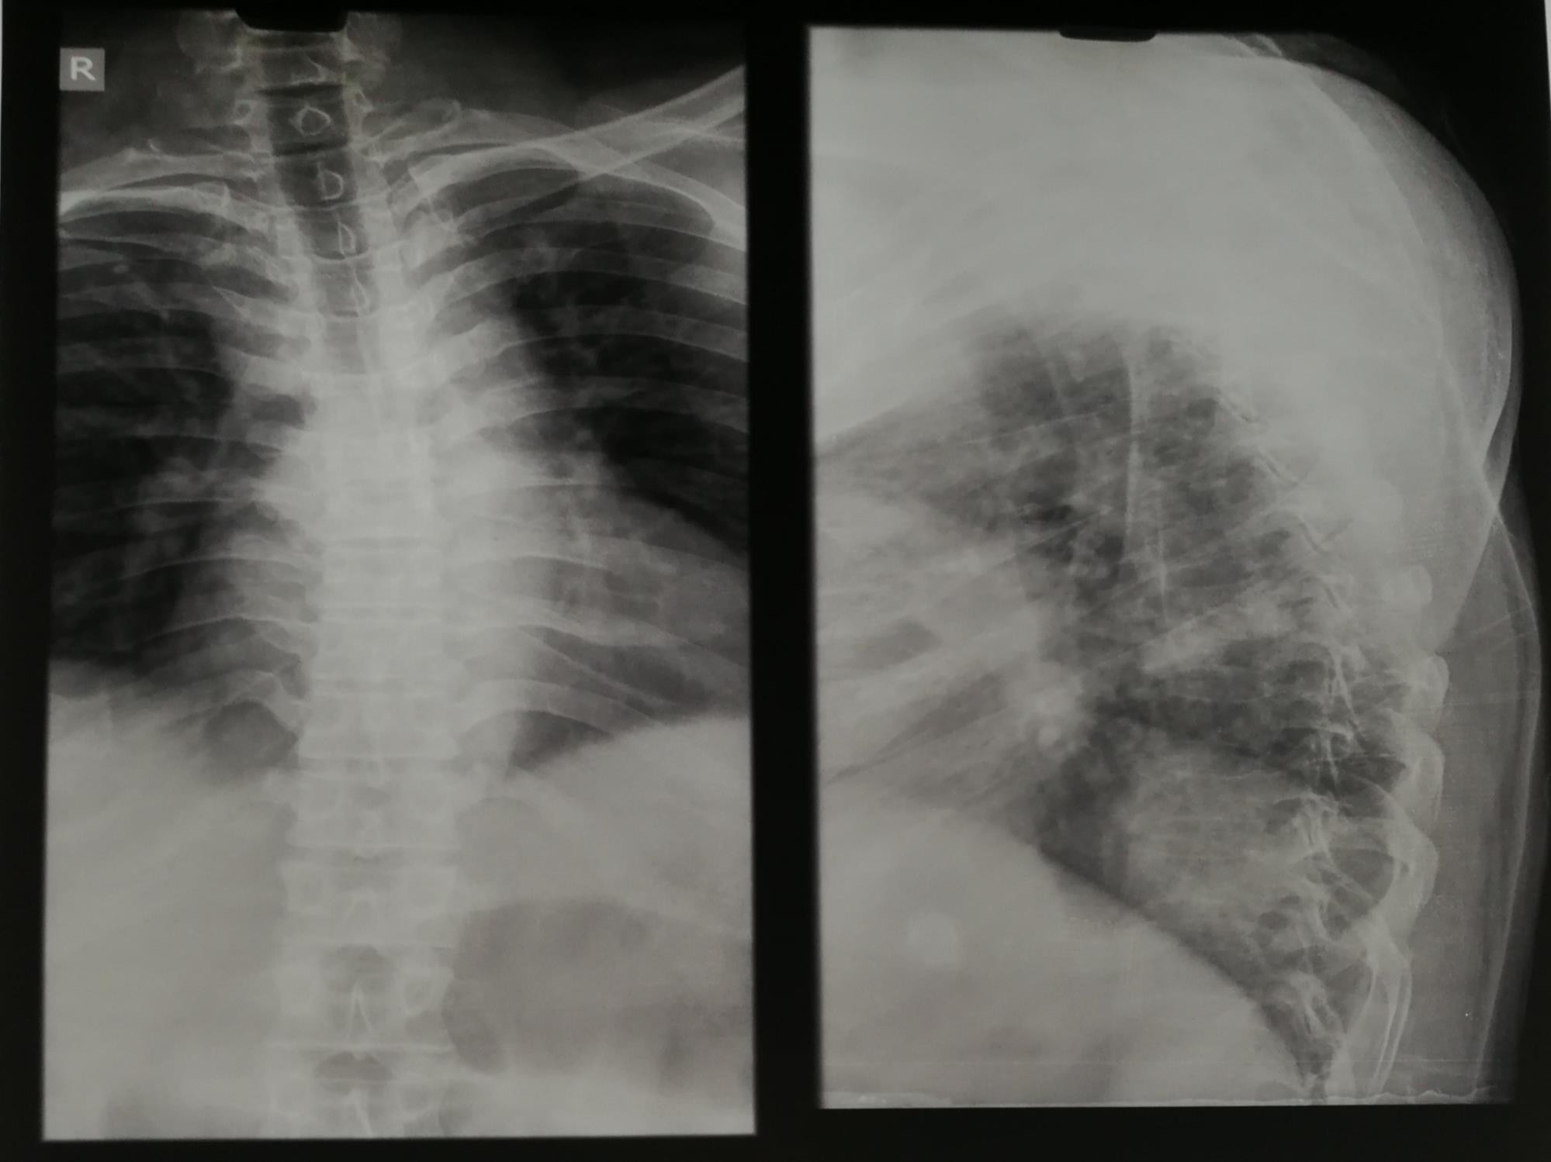
LESIONS
D5-D7

Slide 9
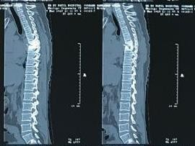
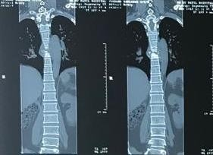
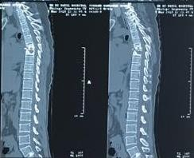
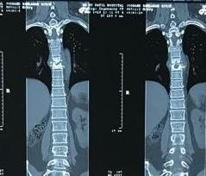
LESIONS D5- D7
LESIONS D5-D7

Slide 10
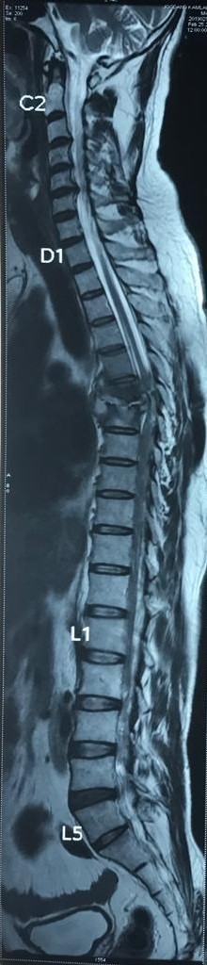
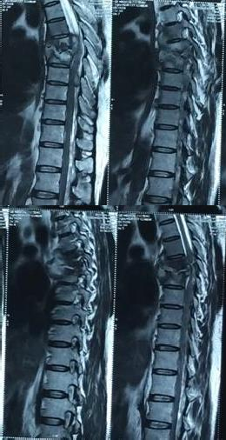
DISC
CORD
CSF
LYTIC ARES OF BONE DESTRUCTION D5-D7 VERTEBRAL BODIES WITH MARROW OEDEMA AND REDUCTION IN HEIGHT
COLLECTION WITH BONY DEBRIS EXTENDING INTRA-SPINALLY COMPRESSING THE THECAL SAC
AND SPINAL CORD

Slide 11
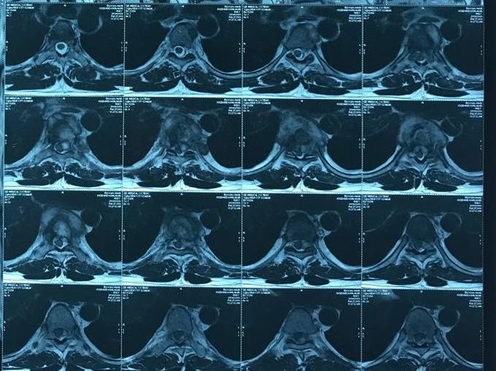
LYTIC AREAS OF
BONE DESTRUCTION
BONY DEBRIS EXTENDING INTRA- SPINALLY COMPRESSING THE THECAL SAC AND SPINAL CORD
CENTRAL
CANAL
THECAL
SAC

Slide 12
AIM OF SURGERY
O Decompression of canal and debridement
O Stabilization of spine
O Improvement of neurological Outcome
O Confirmation of diagnosis : TB/MDR- TB/Metastasis

Slide 13
WHAT DID WE DO?
O Decompression with Posterior Stabilization with Pedicle Screw fixation D4-D9 levels and anterior reconstruction with cage and bone graft

Slide 14
SURGICAL TECHNIQUE
O After hypotensive anaesthesia in prone position,
Posterior approach taken.
O Pedicular screw fixation done from D4 to D9.
O Laminectomy done from D6-D9
O Epidural cuff removed
O Left side trans pedicular decompression and
debridement done.
O Anterior reconstruction done with cage and bone graft.

Slide 15
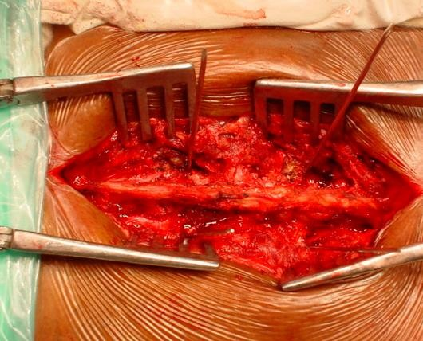

Slide 16
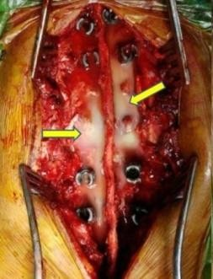
Intra-op clinical picture: Shows pus coming out through the tract created after transpedicular curettage and decompression, which was drained out totally (left). The pus was sent for culture and sensitivity and the caseous material was sent for biopsy, which confirmed it to be tuberculous material.

Slide 17
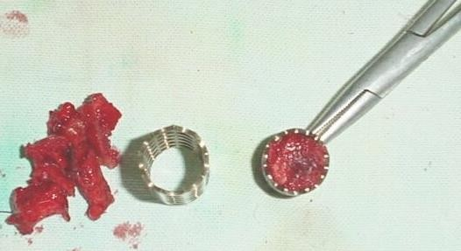
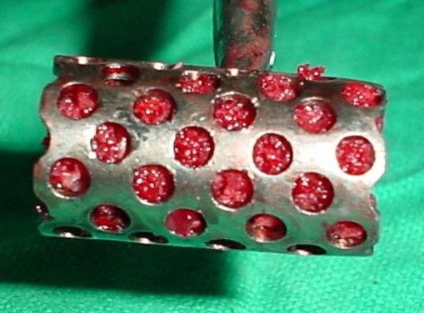


CAGE
BONE
GRAFT

Slide 18
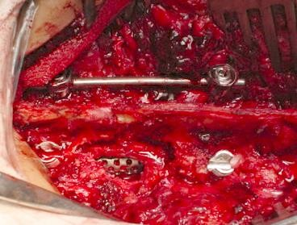

CAGE with BONE GRAFT

Slide 19
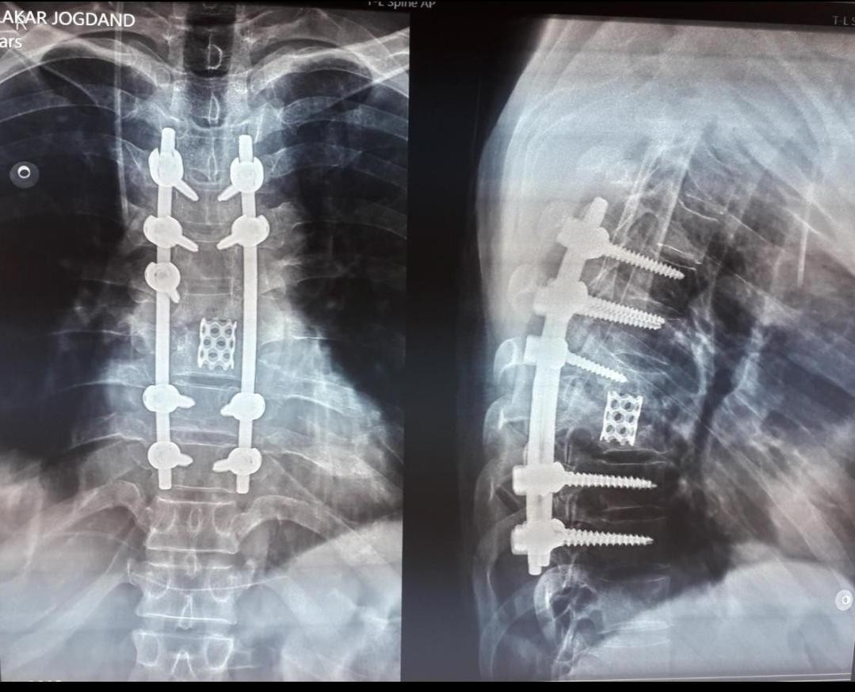

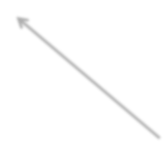




PEDICLE SCREWS
CONNECTING RODS
CAGE with BONE GRAFT

Slide 20
O TB-PCR (GENE XPERT) confirmed to be Multi drug Resistant TB resistant to Rifampicin and INH.
O Patient was registered at Maharashtra State Tuberculosis Centre, Aundh, Pune.
O Second line drugs were started – Levofloxacin, Kanamycin, Ethionamide, Cycloserine, Ethambutol, and Pyrazinamide as per RNTCP criteria of MDR-TB.

Slide 21
POST OPERATIVE MANAGEMENT
O Early mobilisation from the bed with Taylor brace.
O Passive limb exercises started from 2nd week onwards. O Clinical improvement was noticed within three weeks. O Neurological recovery from grade 0 to grade 3 with
residual spasticity and complete recovery of bowel and bladder function.

Slide 22
O On Follow-up, after 2 months of surgery and initiation of second line of Anti-TB treatment, he could move his toes, feet and could sit up straight, in the bed.
O The patient gained around 10 kg during this period.
O The fixation was stable, and no fresh complaints.
O Physiotherapy was continued.
O Patient was asked to stand with brace and walker.

Slide 23
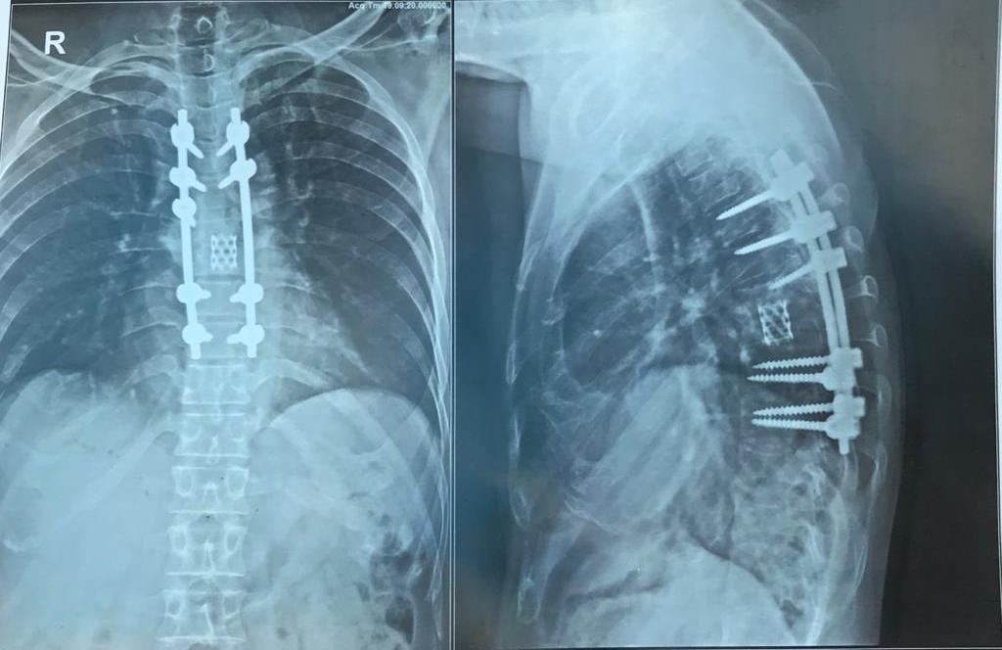
2 MONTH FOLLOW UP

Slide 24
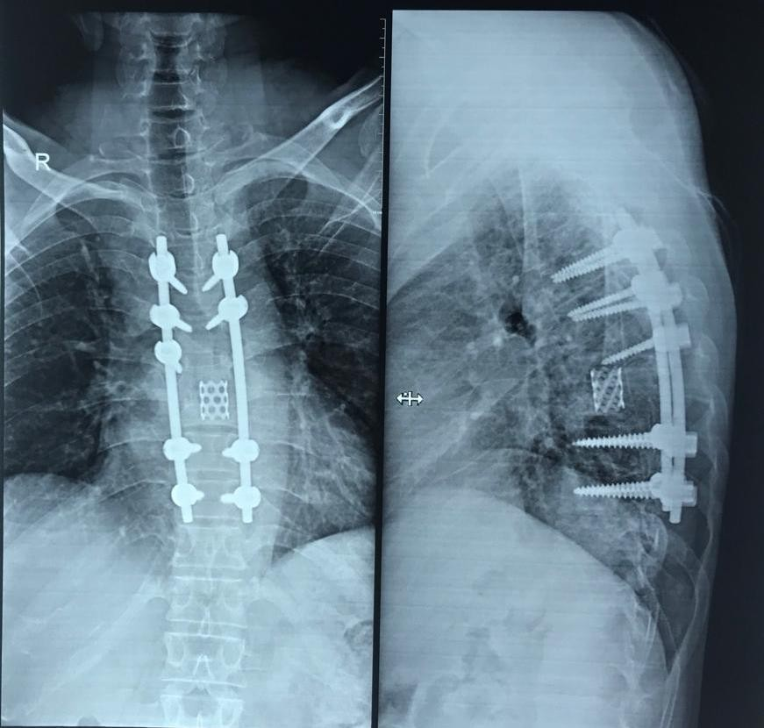
4 MONTH FOLLOW-UP

Slide 25
O Patient was advised to continue Anti-Tb Medications for a period of 24 months as per guidelines for Musculoskeletal TB and have regular follow-up.

Slide 26
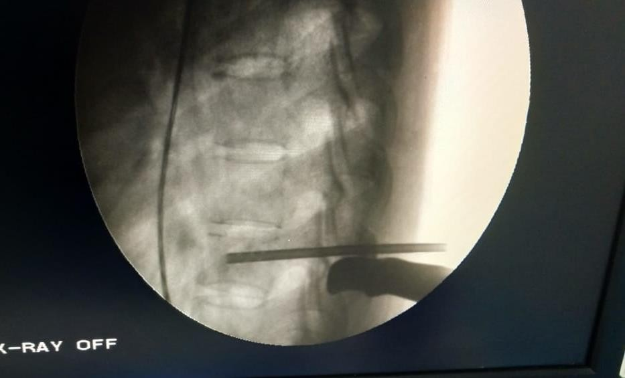

SAGE
TAKE HOME MES
O RED FLAG SIGNS:
O Thoracic Pain
O Back pain > 6 weeks of a continuous n
cries should be investigated with MRI.
O Fever and Unexplained weight loss
O In all suspected spondylo-discitis case transpedicular biopsy under local anae taken when possible either paediatric o
TRANSPEDICULAR BIOPSY
ature and night
s, a
sthesia must be
r adult.

Slide 27
LEARNING POINTS
O Consider the ‘RED FLAG’ signs for every patient with
chronic back pain.
O The incidence of TB is high in our country, so never
rule that out and always investigate.
O Spinal TB is characteristically diagnosed late but that
does not mean it has to be.
O Early detection of spinal TB could prevent permanent
disability and deformity.
O Anti-tuberculosis treatment, along with good nutritional support, bed rest and braces are essential, for complete recovery of patients with Potts disease.

Slide 28





Slide 29
REFERENCES
O 1] ES Nussbaum, GL Rockswold, TA Bergman. Spinal tuberculosis: a diagnostic and management challenge. J. Neurosurg. 1995;83:243–47.
O [2] MS Moon. Tuberculosis of the spine. Controversies and a new challenge. Spine. 1997;22(15):1791–97.
O [3] SM Tuli, TP Srivastava, BP Varma, GP Sinha. Tuberculosis of the spine. Acta Orthop. Scand. 1967;38:445–58.
O [4] L Huelskamp, S Anderson, M Bernhardt. TB of the spine: Pott’s disease. Orthop. Nurs. 2000;19:31–35.
O [5] JP Janssens, R de Haller. Spinal tuberculosis in a developed country. A review of 26 cases with special emphasis on abscess and neurologic complications. Clin. Orthop. Rel. Res. 1990;257:67–75.
O [6] HS Sharif, JL Morgan, MS Al Shaled. Role of CT and MR imaging in the management of tuberculosis spondylitis. Radiologic Clinics. of. North America. 1995;33:787–804.

Slide 30
O [7] DJ Shanley. Tuberculosis of the spine: imaging features. Am. J. Res. 1995;164:659–64.
O [8] SM Tuli. Results of treatment of spinal tuberculosis by
“Middle Path” Regime. J Bone and Joint Surg. 1975;57(B):13–23.

