Slide 1
ENCHONDROMA OF
LEFT GREAT TOE
Dr Harsh Kumar
Resident
Dept Of Orthopaedics

Slide 2
17 year old male came to the OPD with swelling in his left great toe since 6 months
Swelling was associated with intermittent pain which was dull aching type, no aggreviating or relieving factors
Swelling was insidious in onset and gradual in progression

Slide 3
PHYSICAL EXAMINATION
Mild restriction of motion of left great toe and a regular swelling over the dorsal aspect of left great toe,hard in consistency without any neurovascular impairement
No presence of scars,sinuses,pigmentation or any ulceration over the swelling

Slide 4
Palpation of the swelling confirmed the presence of a bony hard swelling,non pedunculated,smooth surface of size 3 x 3 x 2.5cm with ill defined margins
Swelling was expansile and fixed to skin

Slide 5
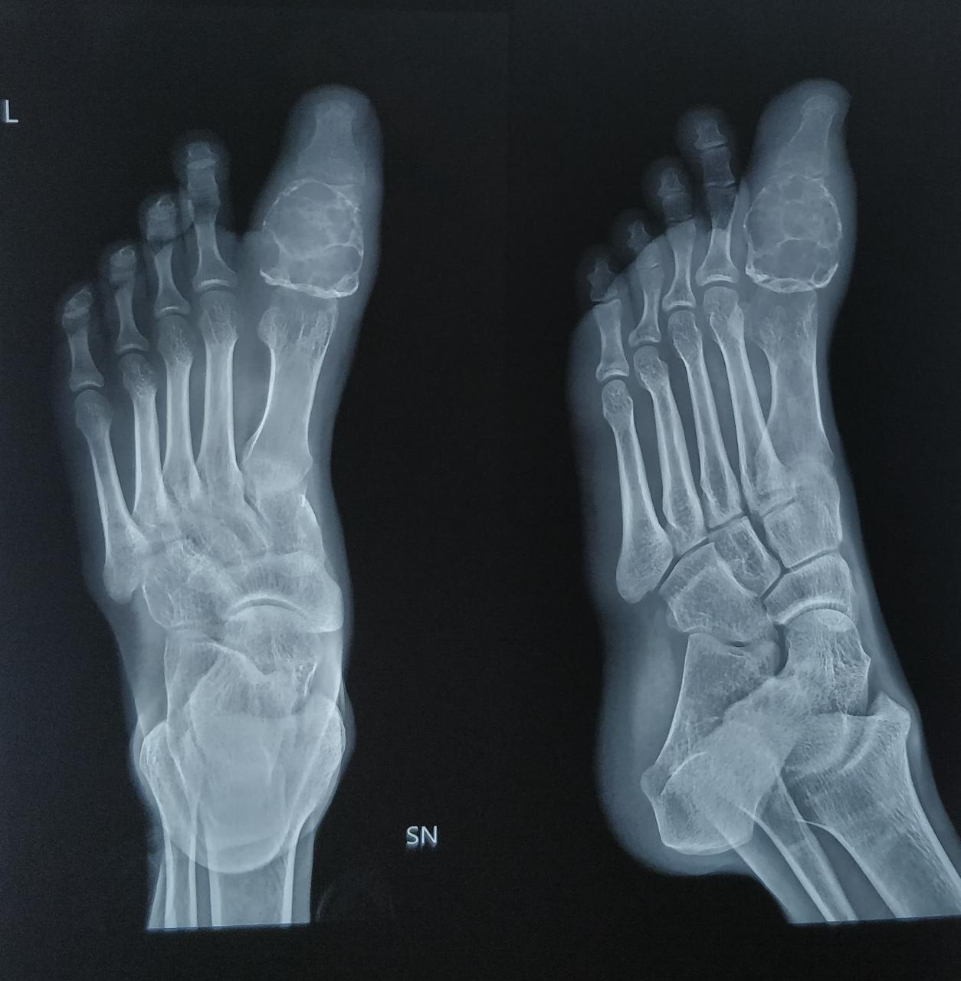
X-ray s/o Lytic lesions,scalloping of the cortex and whorls of calcification

Slide 6
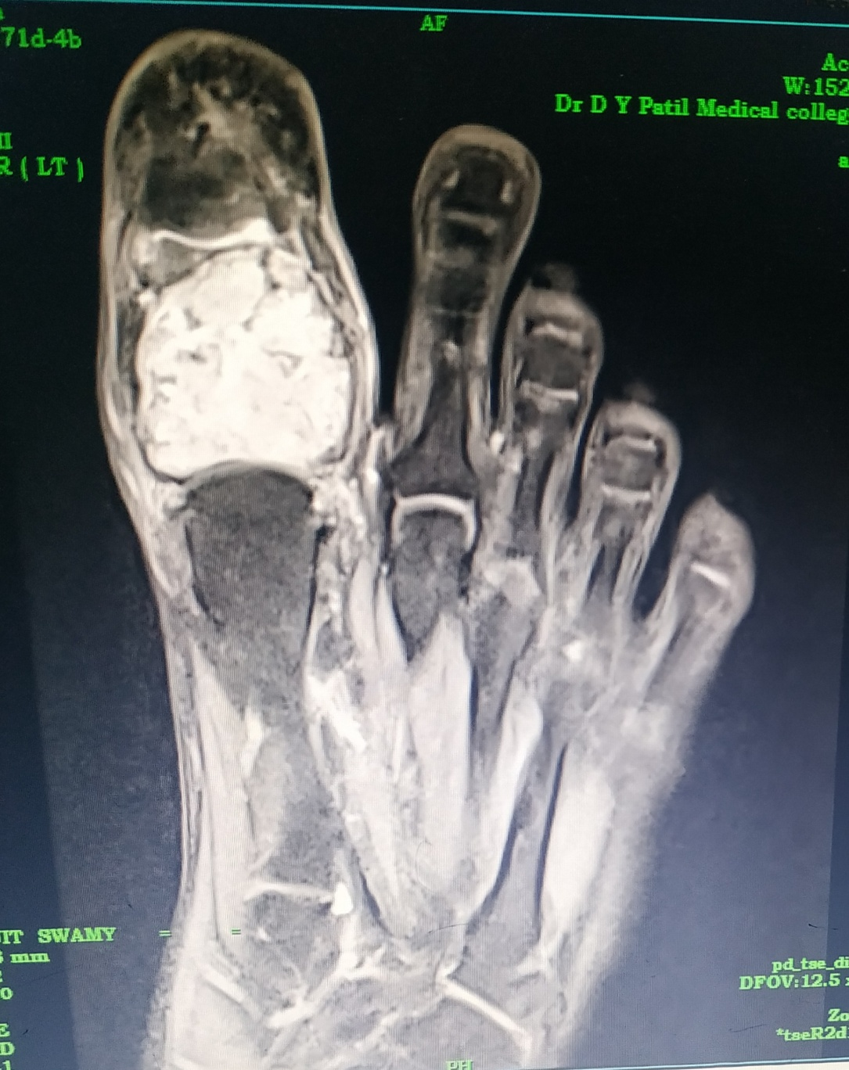
Hyper intense on PDFS
Lesion involving the proximal and distal end of phalanx
Stippled Calcifications

Slide 7
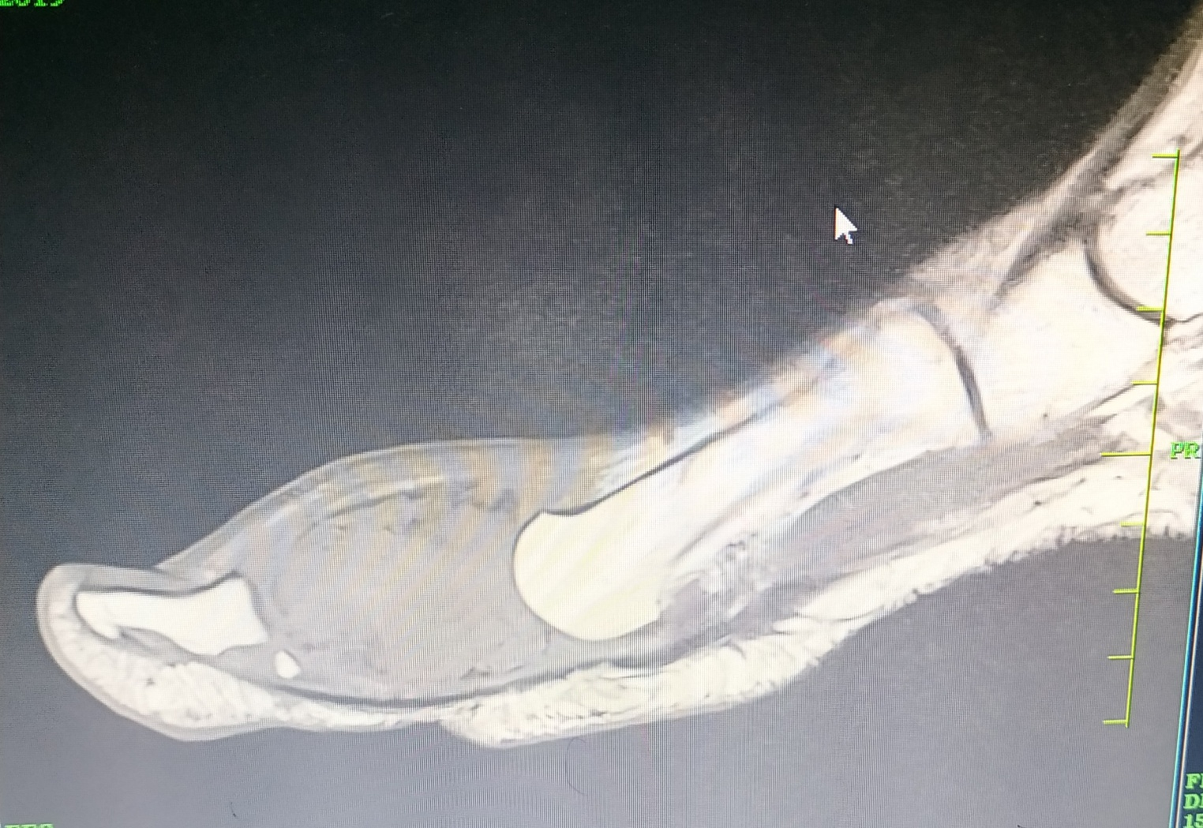
Expansion of the proximal phalanx of great toe
Hypointense on T1
Soft tissue edema and swelling around the proximal phalanx

Slide 8
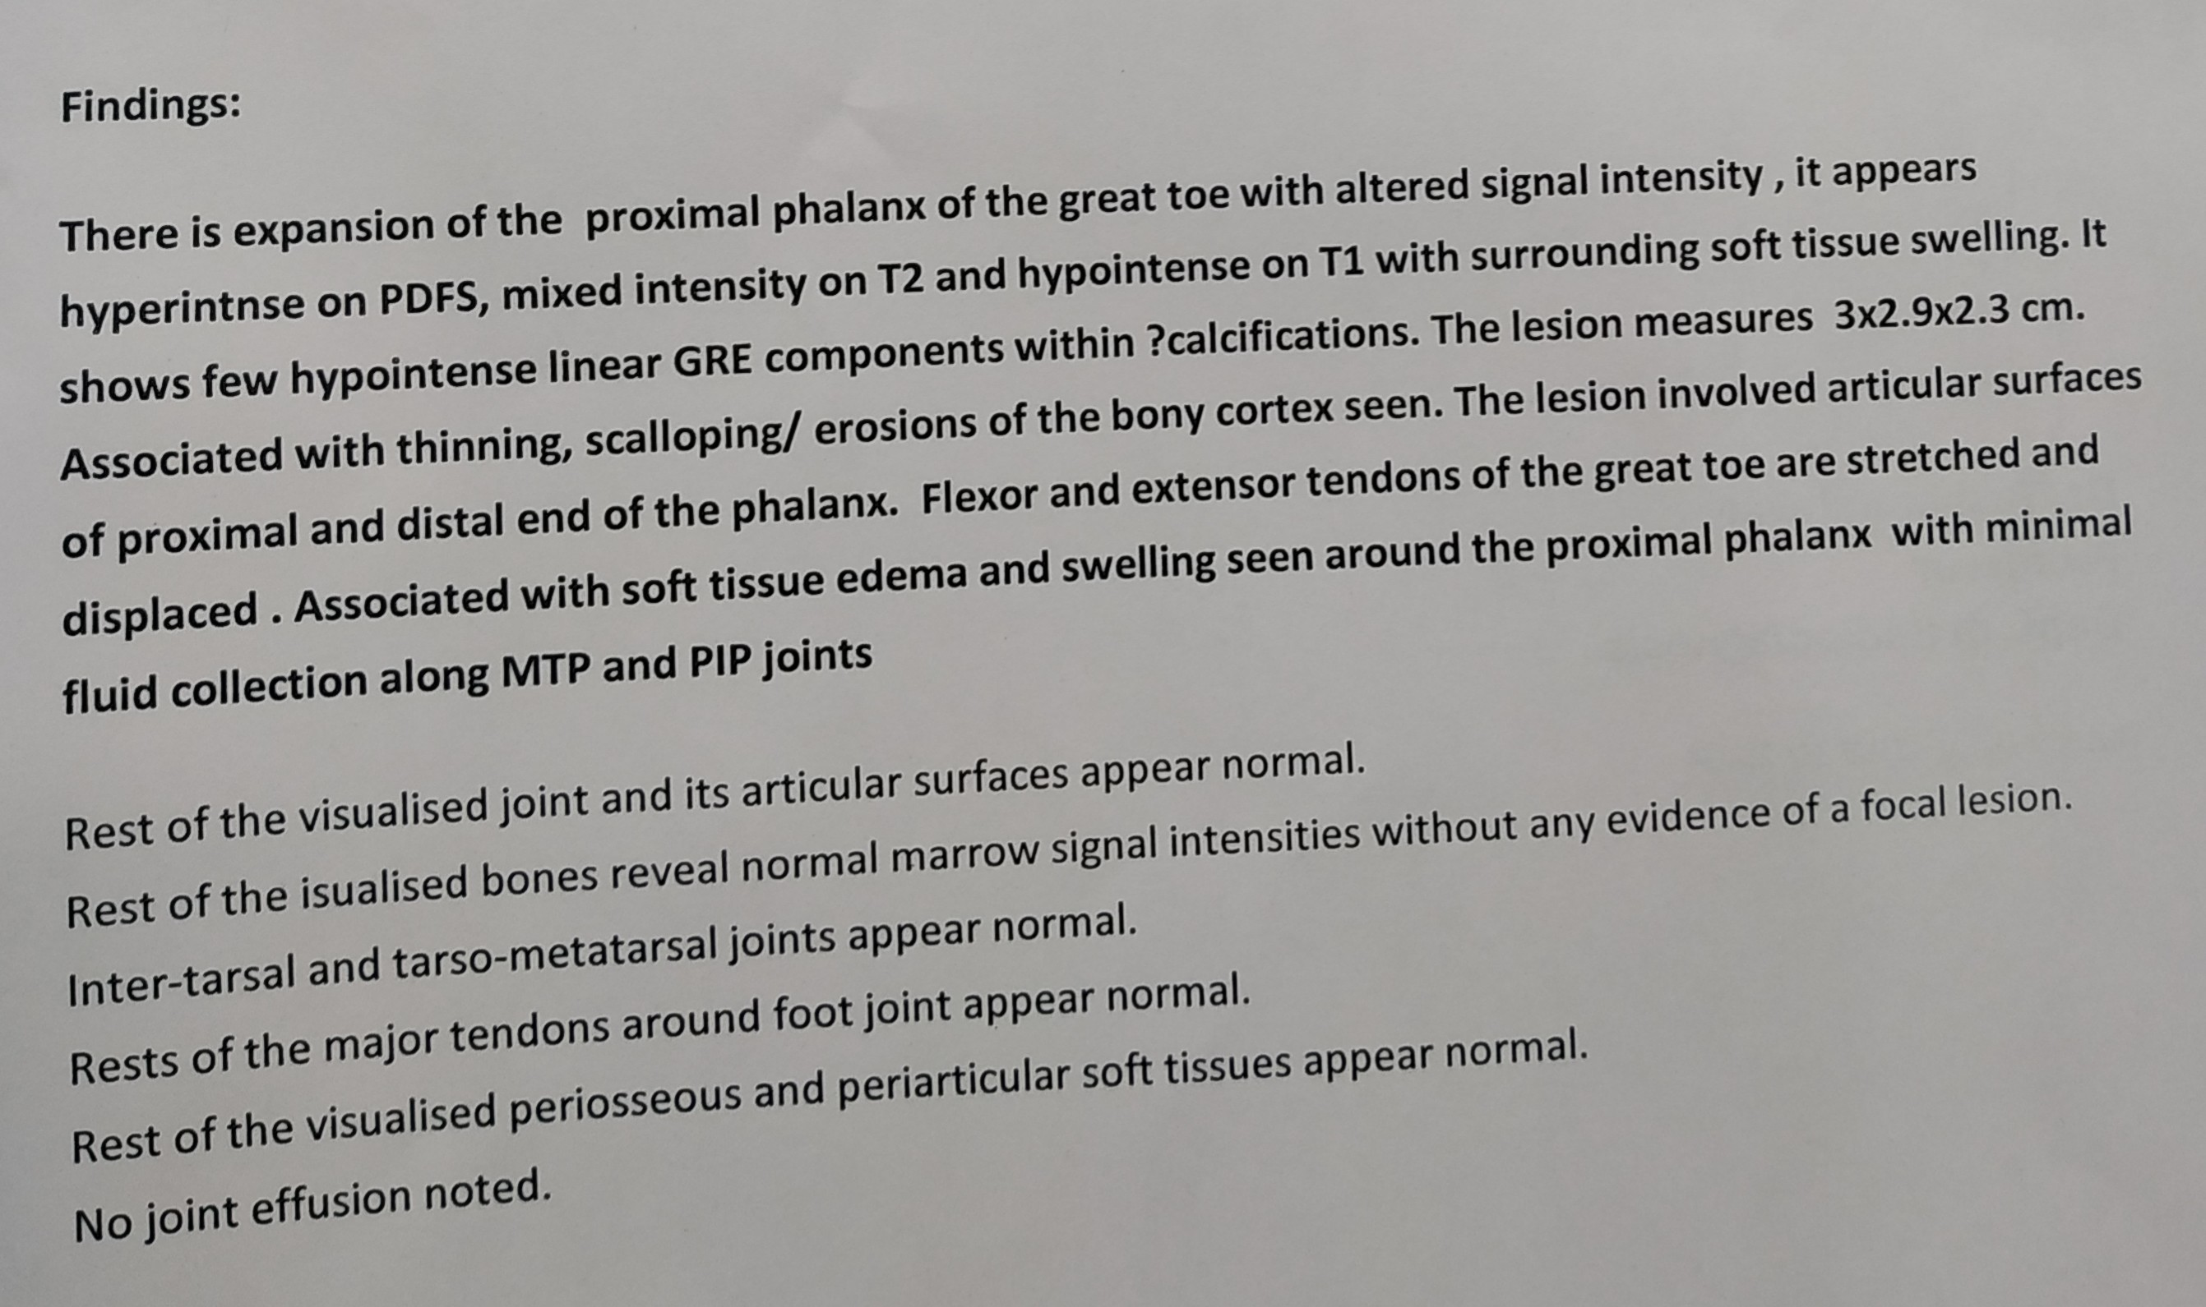

Slide 9
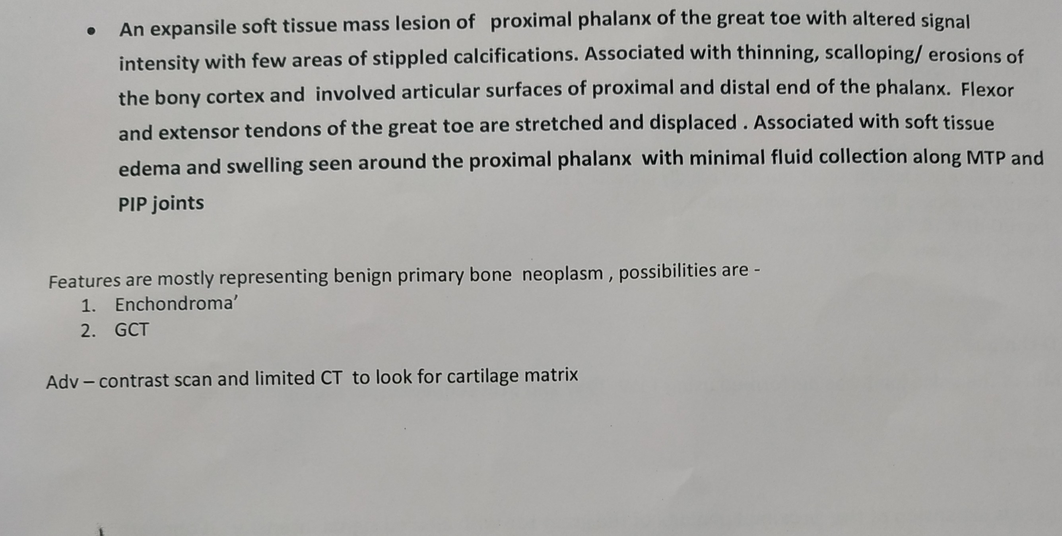

Slide 10
Core needle biopsy s/o benign chondroma

Slide 11
SURGICAL PROCEDURE
Dorsal incision was marked along the great toe along the tendon of extensor halluces longus, extending 2cm proximal to MTP joint and distally to base of nail bed
Complete exposure of the tumour was done and along with excision of proximal phalanx after incising the dorsal aspect of the joint capsule
Swelling was expansile and multiloculated involving whole of the proximal phalanx and inseperable from the skin at some areas.
Hence the decision was taken to remove whole of proximal phalanx along with tumour.Gap was filled up with fibular strut graft

Slide 12
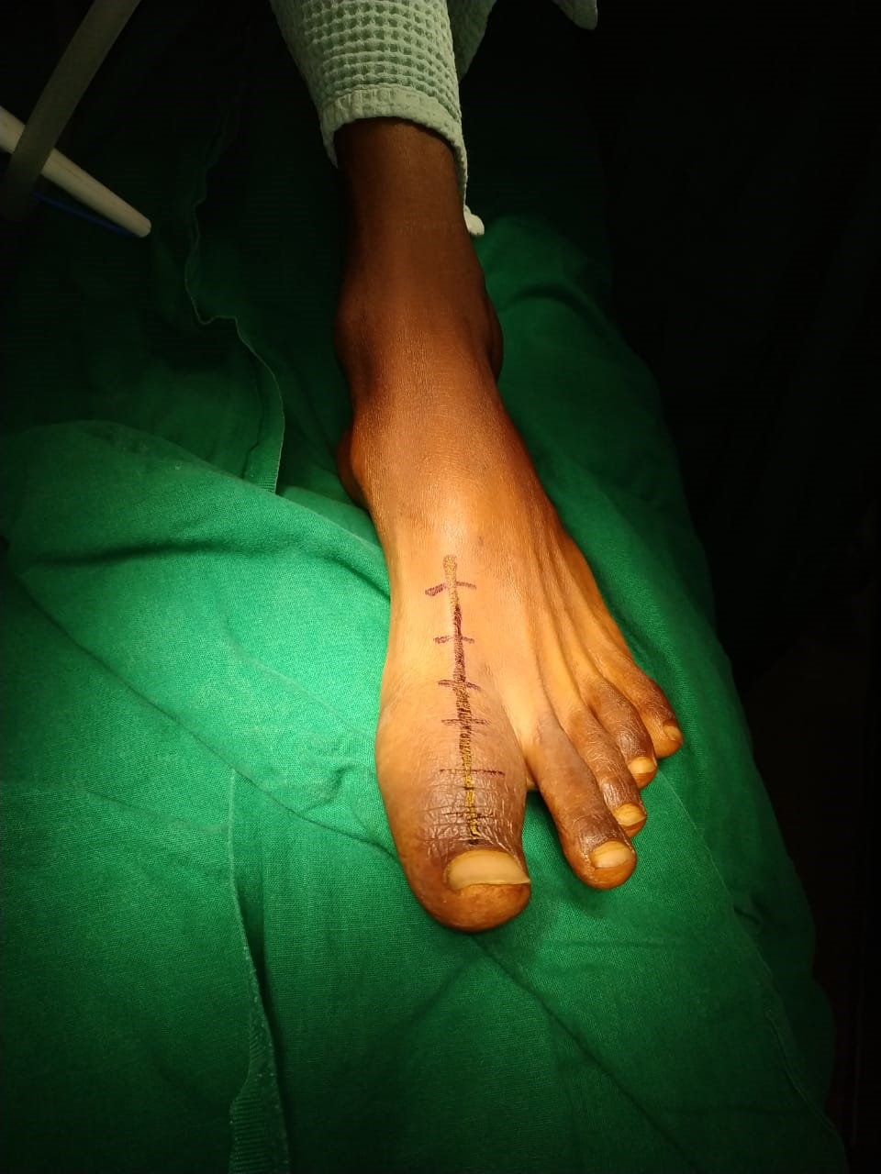

Slide 13
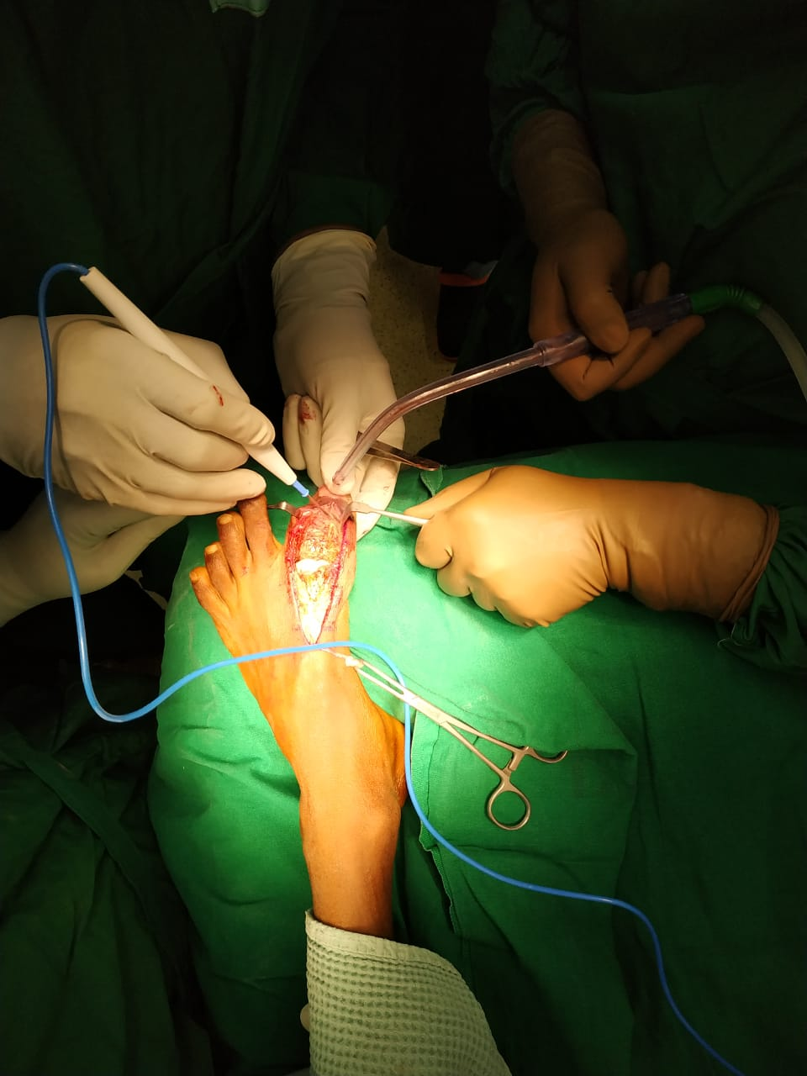

Slide 14
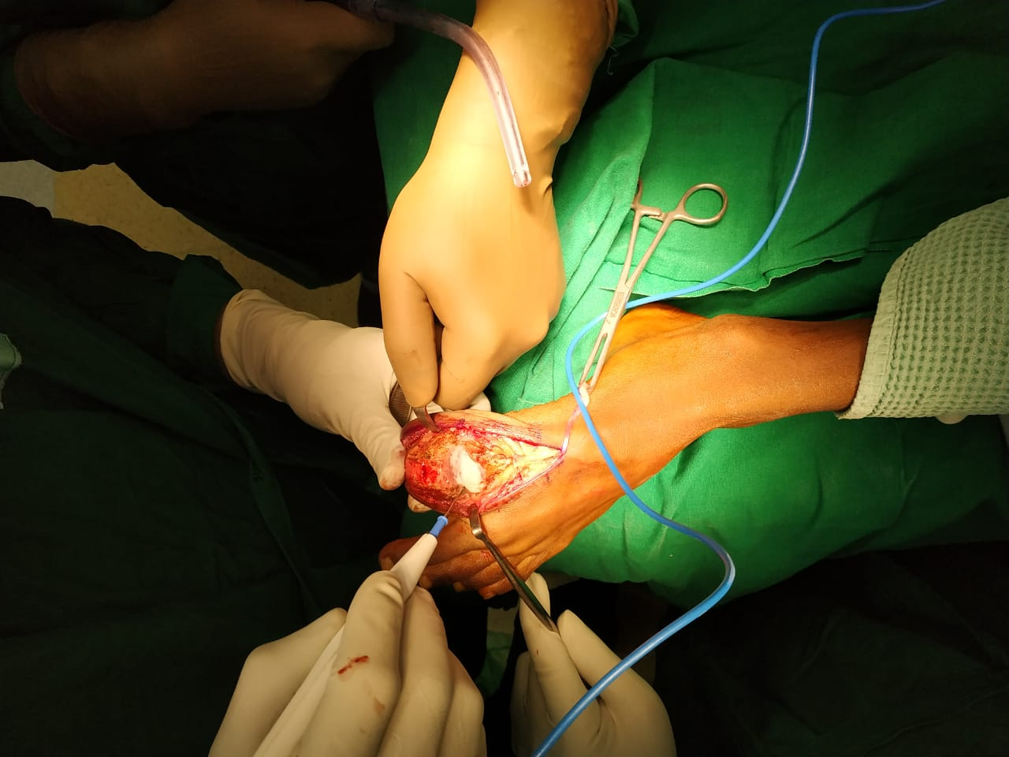

Slide 15
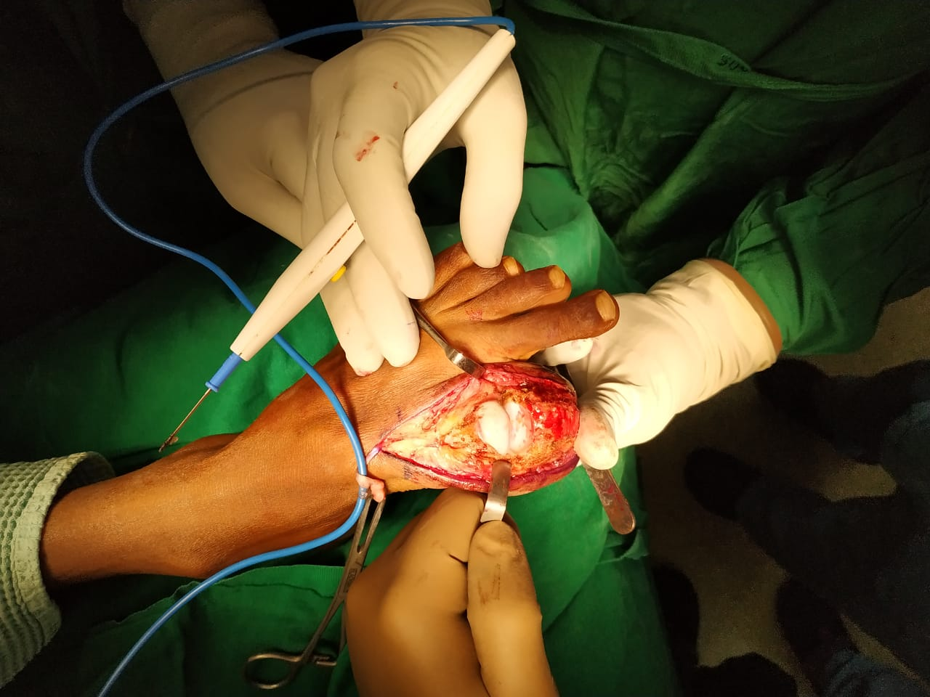

Slide 16
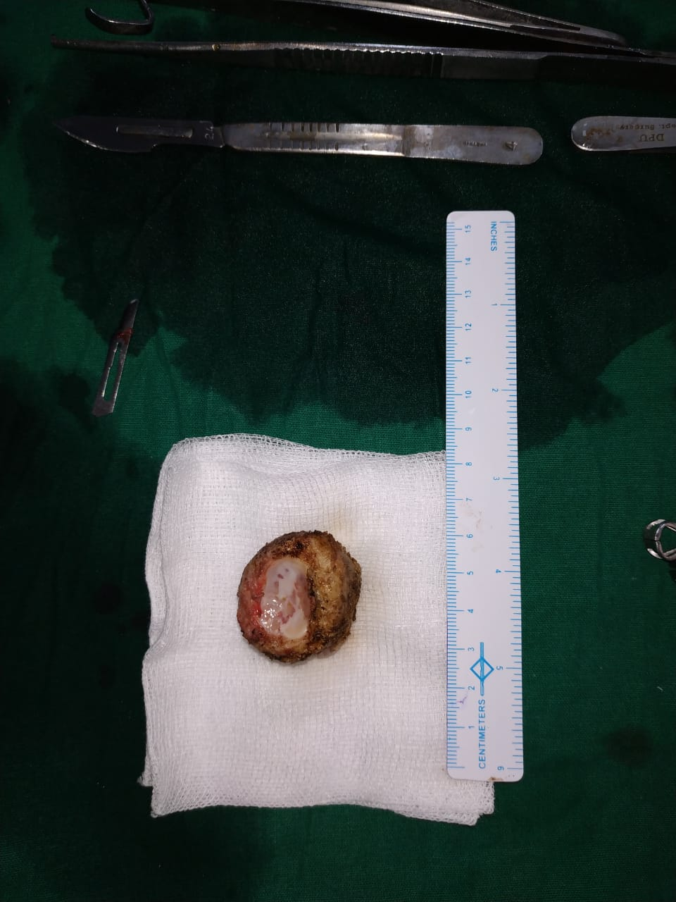
Tumor mass removed intra-operatively

Slide 17
HPE of Intra-op sample
s/o ENCHONDROMA
Tumor comprised of lobules of hyaline cartilage separated by bone marrow

Slide 18
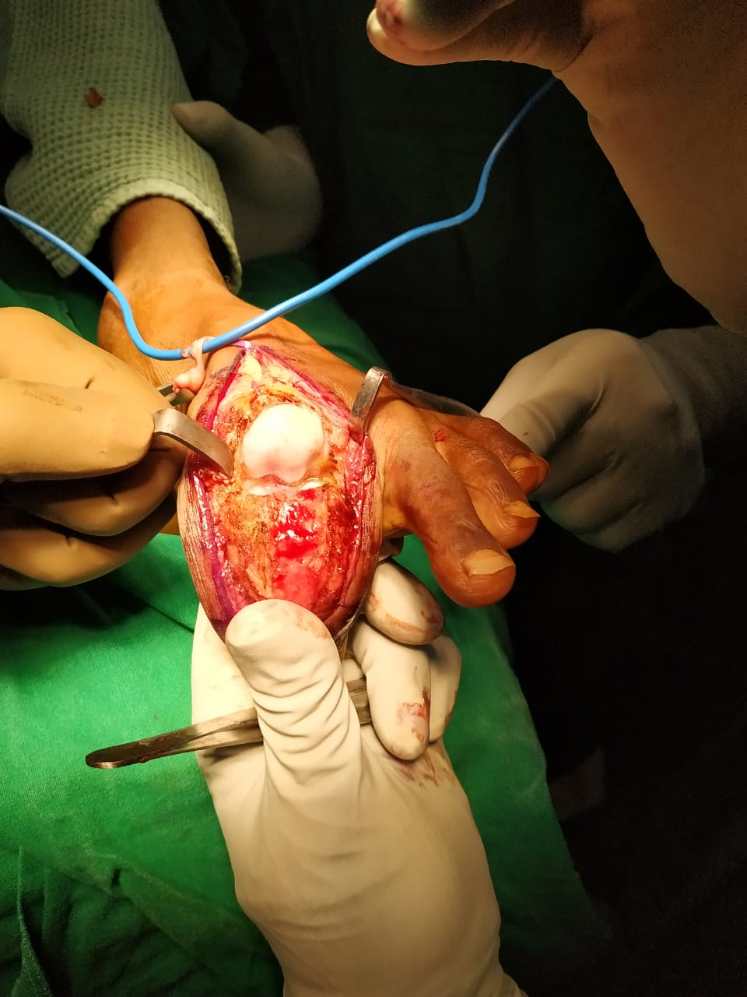

Slide 19
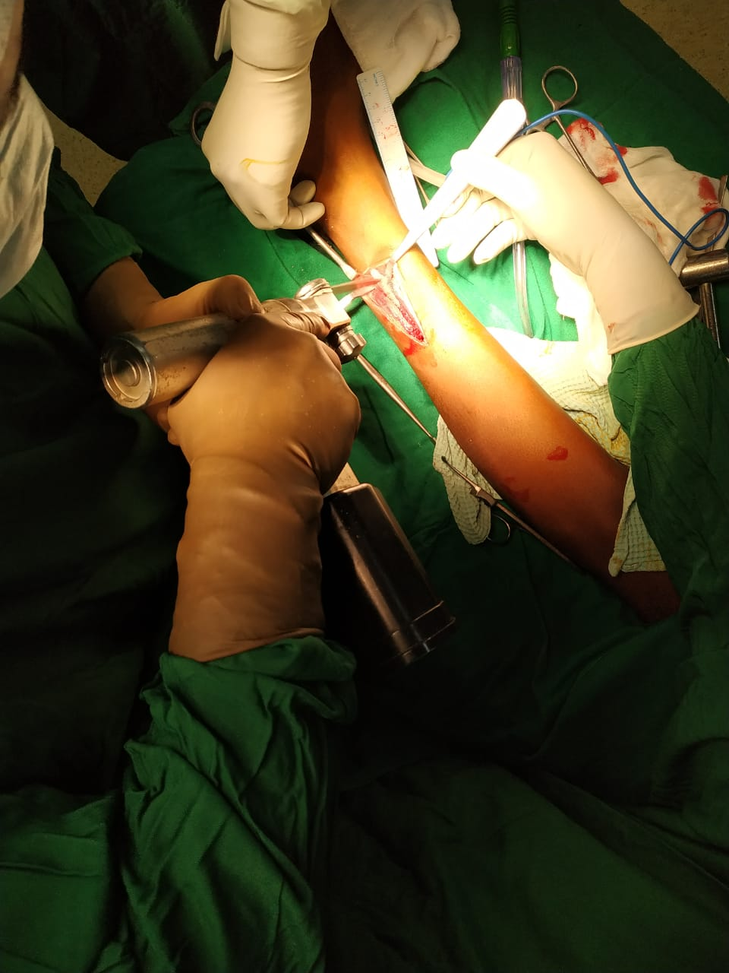

Slide 20
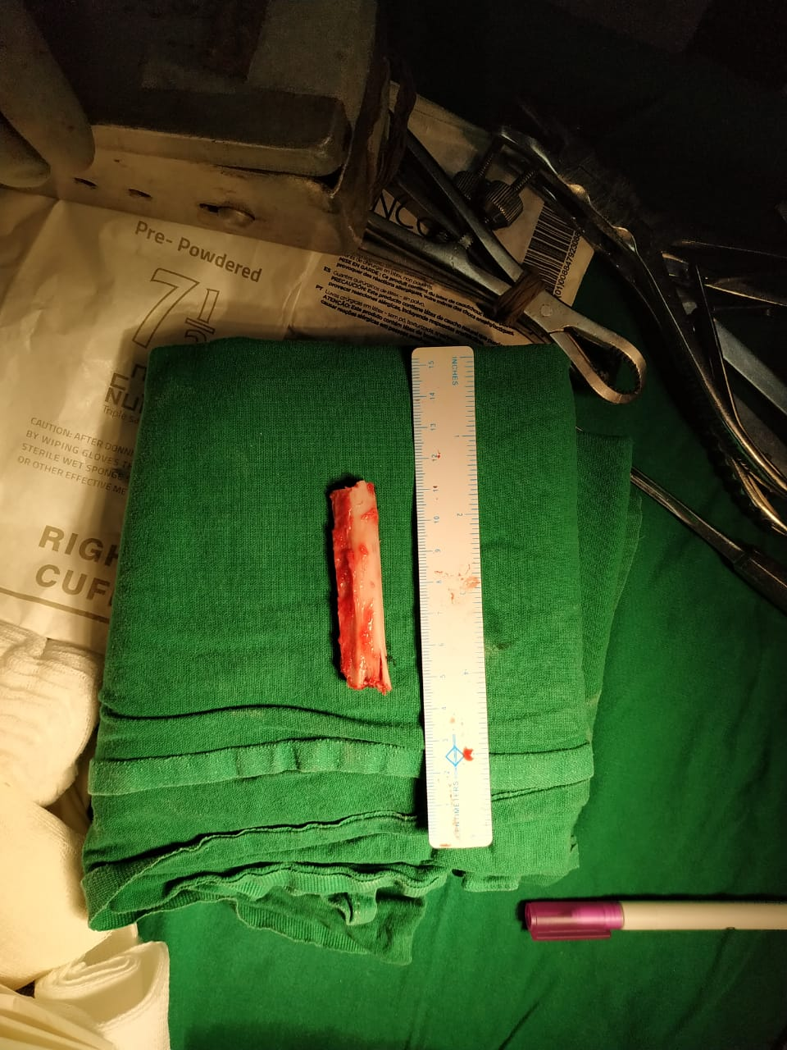
6cm FIBULAR STRUT graft was taken

Slide 21
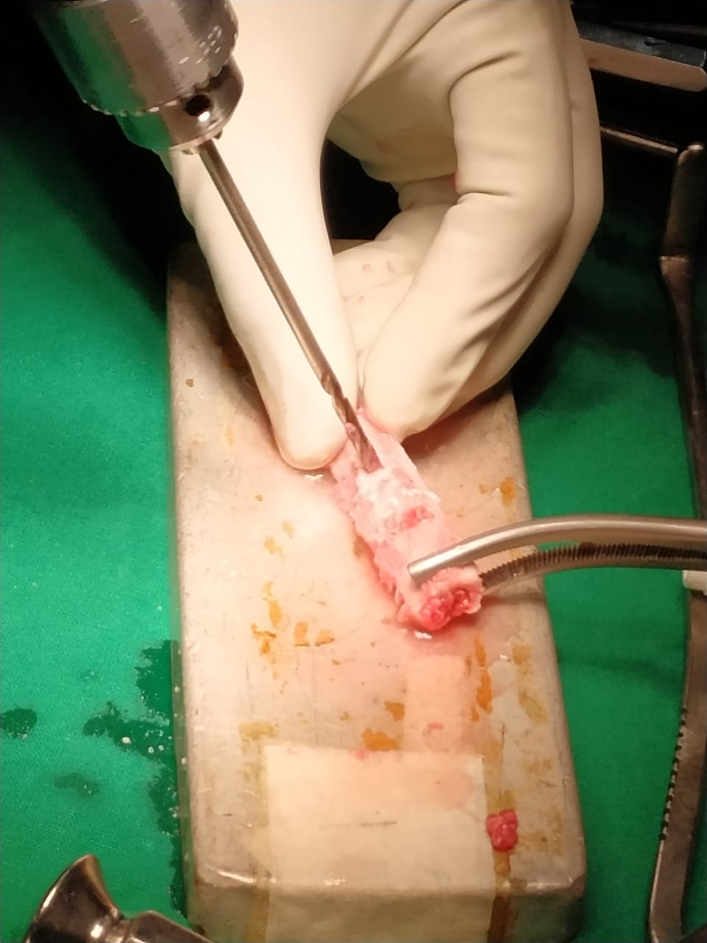

Slide 22
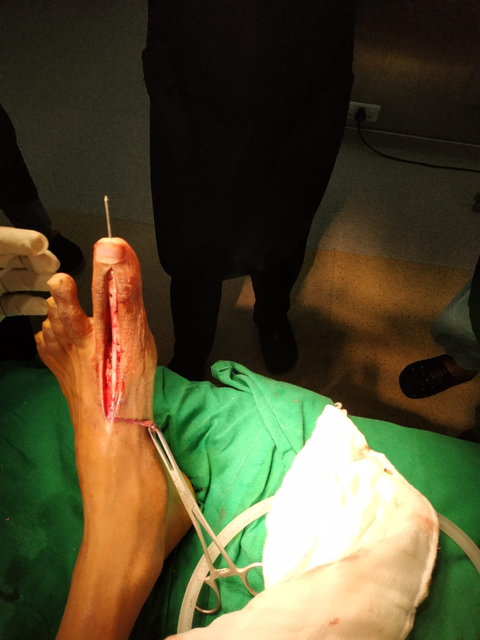
K wire fixation of the fibular strut graft to maintain the length and stability

Slide 23
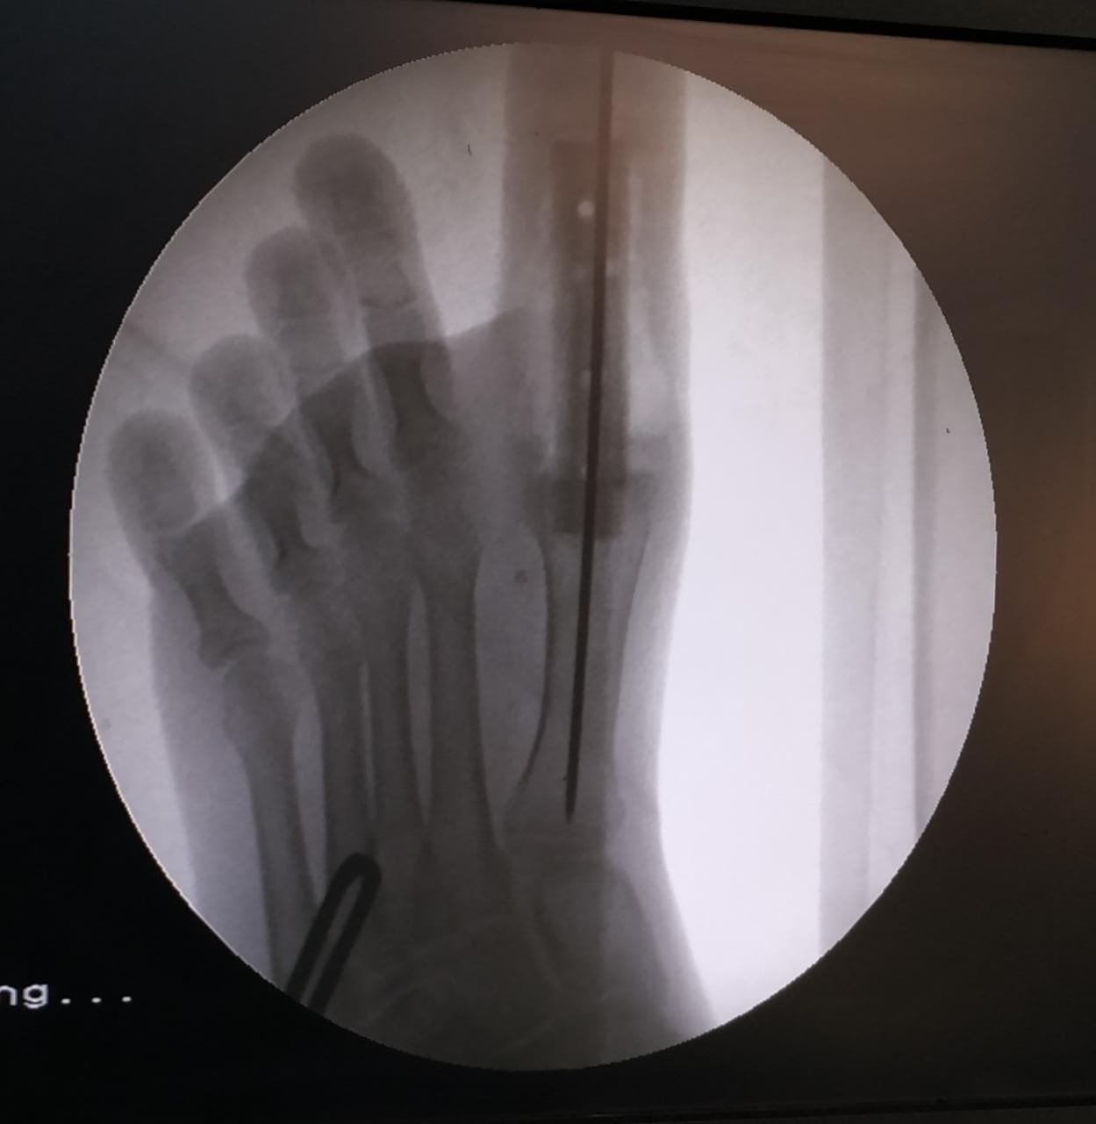
Intra op C-arm pictures

Slide 24
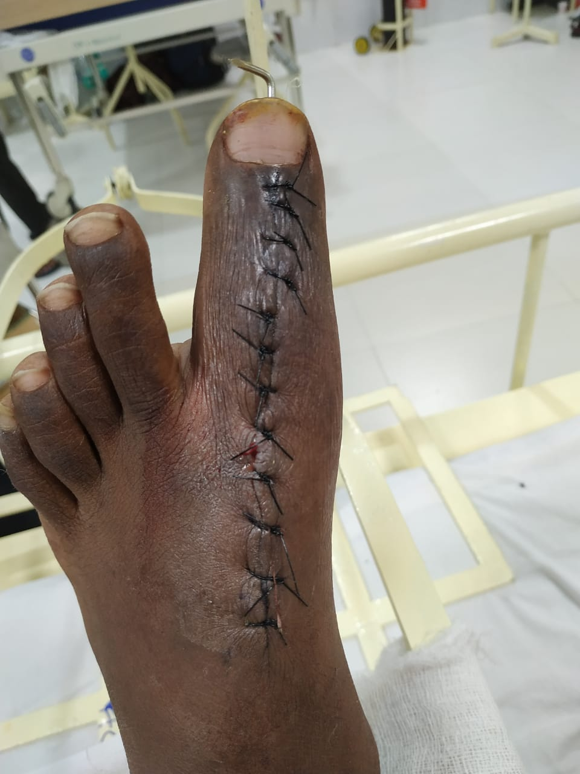

Slide 25
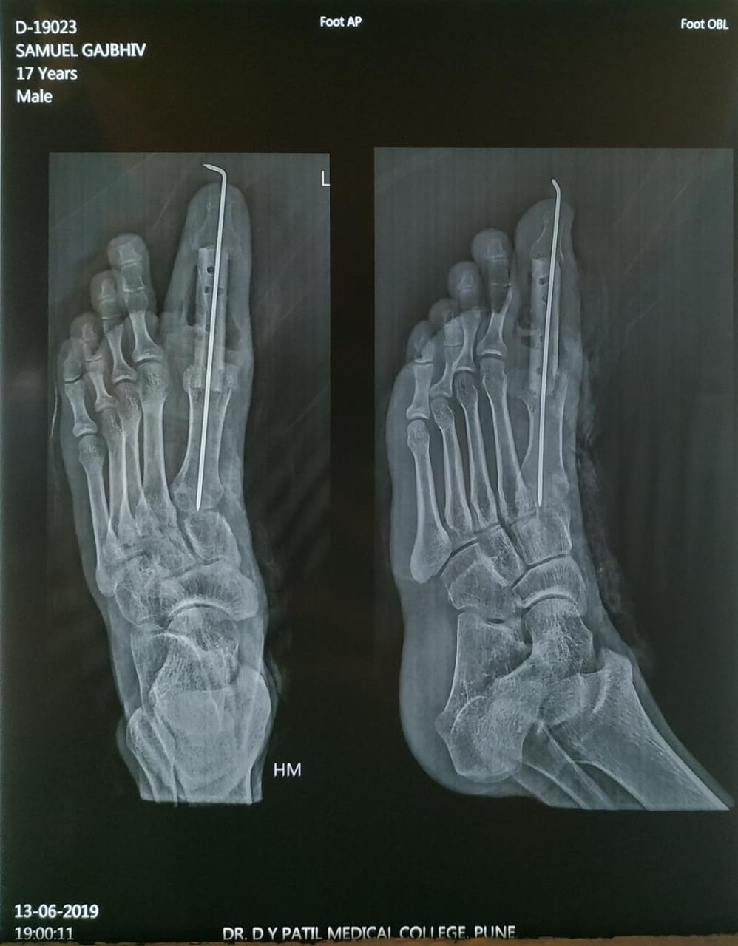
ImmediatePost OP Xray

Slide 26
After the surgery patient was put on a below knee slab non weight bearing for 12 weeks with a gradual transition to partial weight bearing

Slide 27
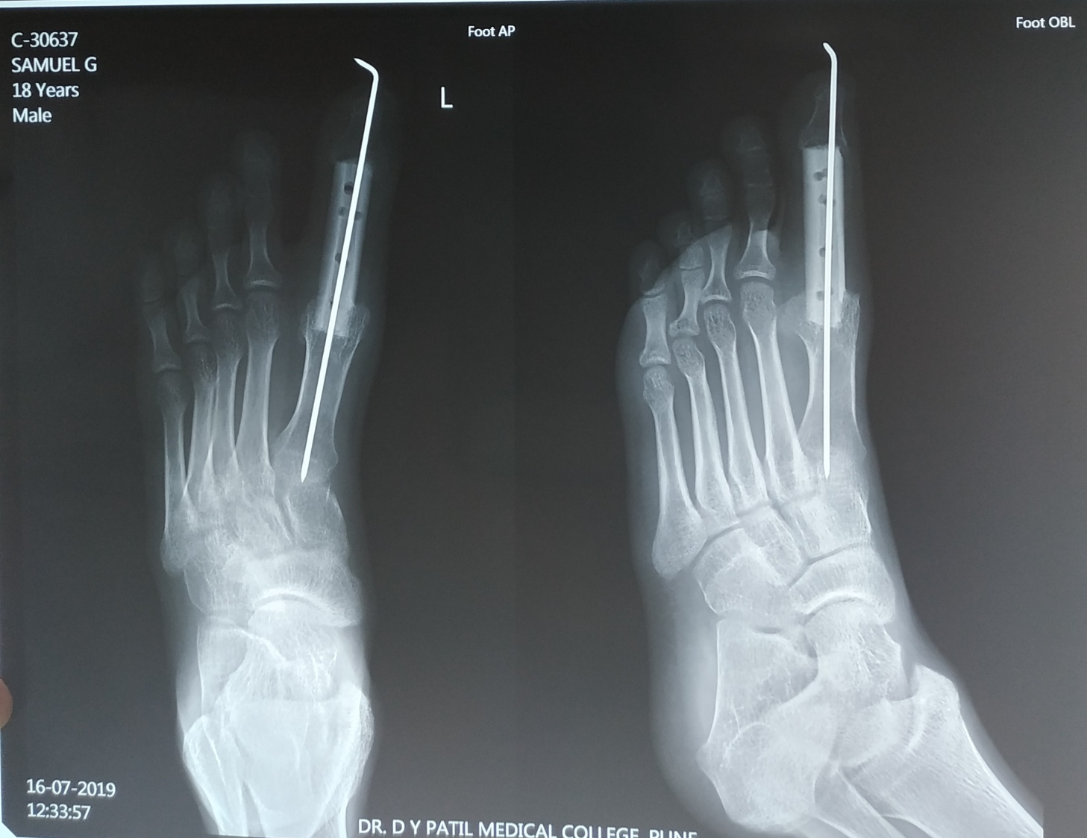
4 Weeks Post OP Xray

Slide 28
ENCHONDROMA
A benign chondrogenic tumor composed of hyaline cartilage
Located in the medullary cavity
Caused by an abnormality of chondroblast function in physis
EPIDEMIOLOGY
INCIDENCE: 2nd MC benign cartilage lesion(osteochondroma is MC)
Male:female ratio 1:1
MC in 20-50 yrs olds
Usually found in medullary cavity of diaphysis or metaphysis

Slide 29
The most common location hand (60%)>feet
MC bone tumor in hand is enchondroma.
Other locations include distal femur(20%)> proximal humerus(10%)
Rare in the pelvis,scapula, ribs
PATHOPHYSIOLOGY
Enchondromas represent incomplete enchondral ossification
Chondroblast and fragments of epiphyseal cartilage escape from the physis,displace into the metaphysis and proliferate there

Slide 30
ASSOCIATED CONDITIONS
OLLIER’S disease (multiple endochodromatosis)
Sporodic inheritence with no genetic predisposition.
Skeletal dysplasia with failure of normal enchondral ossifications.
Enchondromas throught the metaphysis and diaphyses of long bones
Involved bones are dysplastic,with shortening and bowing
Risk of malignant transformation <30%
Notes:
Harsh

Slide 31
MAFFUCCI syndrome
Sporodic inheritence with no genetic predisposition
Multiple enchondromas and soft tissue angiomas
Radiographically,enchondromas in Maffucci’s syndrome markedly expand the bone and angiomas are seen as small,round calcified phlebolith
Risk of malignant transformation up to 100%
Also has increased risk of visceral malignancies (astrocytoma,GI malignancy)

Slide 32
Presentation
SYMPTOMS
asymptomatic, discovered incidently on radiographs--Usually true for enchondromas in long bones and foot
Pathological fractures--Often seen with enchondromas in the hand
Pain is uncommon

Slide 33
Physical exam
Shortening and angular deformities
Enchondromas may disrupt the growth plate
Imaging
radiographs
skeletal surveys if polyostotic disease is suspected

Slide 34
FINDINGS
well defined lucent central medullary lesions that calcify over time
1 to 10 cm in size
metaphyseal location when they first appear
Appear more like diaphyseal as the long bones grows
Pop corn stippling, arcs whorls rings
Minimal endosteal erosion (<50% width of cortex)
Cortical expansion and thinning may be present in hands and feet

Slide 35
OLLIER’S DISEASE
Enchondromas markedly expand the bone
bones are dysplastic with shortening and bowing
MAFFUCCI’S SYNDROME
Enchondromas markedly expand the bone
Angiomas are visible as calcified pheleboliths

Slide 36
MRI
Indications
Identify size and intramedullary extent and soft tissue extension
Differentiate from chondrosarcoma
Findings
Lobular and bright in T2 weighted images
No bone marrow edema or perosteal reaction
May show steak of cartilage or “sled runner tracks”
Medullary fill >90% suggests chondrosarcoma instead

Slide 37
Core Needle Biopsy
from areas of bone scalloping or lysis
Prone to to sampling error due to sample heterogeniety
Chondrosarcomas may contain areas of benign hyaline cartilage
Often impossible to differentiate from low grade chondrosarcoma

Slide 38
Histology
Gross appearance
- blue grey lesions lobulated hyaline cartilage ,with scattered calcifications

Slide 39
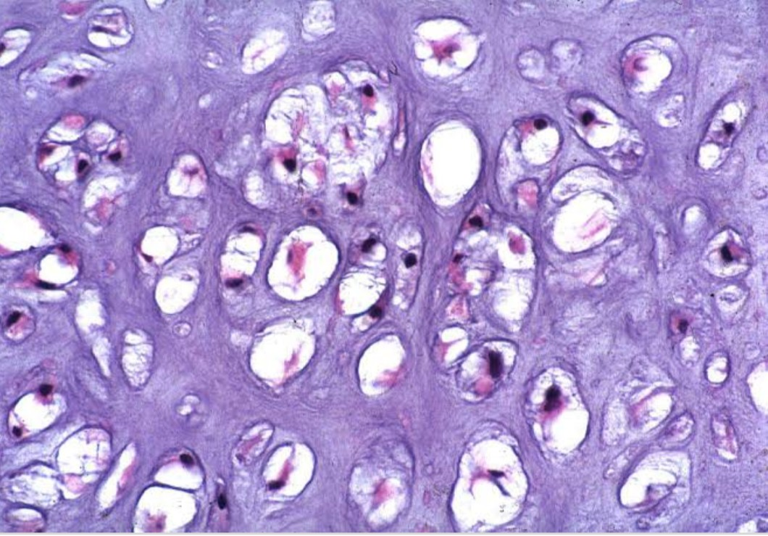
HISTOPATHOLOGY
Hypocellular with bland ,mature hyaline cartilage (blue balls of cartilage ) separated by normal marrow

Slide 40
TREATMENT
Non operative
treatment for vast majority of asymptomatic enchondromas
Serial radiographs at 6 months and 12 months to confirm radiographic stability
Operative
intra lesional curretage and bone grafting

Slide 41
THANK YOU

