Slide 1
JULY 2019 CPC
BY
DEPARTMENT OF PATHOLOGY
AND
DEPARTMENT OF ORTHOPAEDICS

Slide 2
Case 1 :
Presented by Dr BHAVANA VASU ( JR 2)
Department of pathology

Slide 3
45 year old female came with :
History : 1.Generalized weakness
2. History of weight gain 4 months
3. Palpitations, headache
and sweating
4. Past history – k/c/o HTN
- k/c/o DM since 5 months, on medication

Slide 4
Examination :
Pallor
Clubbing , icterus negative
Facial puffiness
Hirsutism present
Pulse -88 bpm
BP-140/90 mm of Hg
CVS: S1, S2 heard
RS: NAD
CNS : NAD
Per abdomen : NAD

Slide 5
Investigations :
CBC: Hb = 14.6 g/dl
TLC = 11,500/ cumm
DLC: N= 65%, L = 30, E= 2% , M= 3%
Platelets = 2. 3 lakhs / cumm
RFT: Blood Urea= 35 mg / dl ( 15-40 md/dl)
Serum creatinine =0.71mg/ dl ( 0.6 – 1.2 mg / dl )
Sodium = 141mmol/ L ( 135- 145 mmol/ L )
Potassium = 4.7mmol/dl (3.5 -5.0 mmol/dl )
LFT: Total bilirubin = 0.40 mg/dl ( 0- 1 mg /dl )
Direct bilirubin ( conjugated ) = 0.06 mg / dl ( 0- 0.35 mg / dl )

Slide 6
Investigations:
Blood sugar F= 200 mg / dl ( 70 – 110 mg / dl )
Hb A1c = 10 %
HIV = Non reactive
Urine routine/ microscopy = Pus cells : occasional
Epithelial cells : occasional

Slide 7
Investigations :
X – ray : NAD
USG: A well defined mass noted in retro peritoneum region .S/O adrenal neoplasm etiology likely adrenal adenoma / pheochromocytoma.
Renal Doppler study : Normal

Slide 8
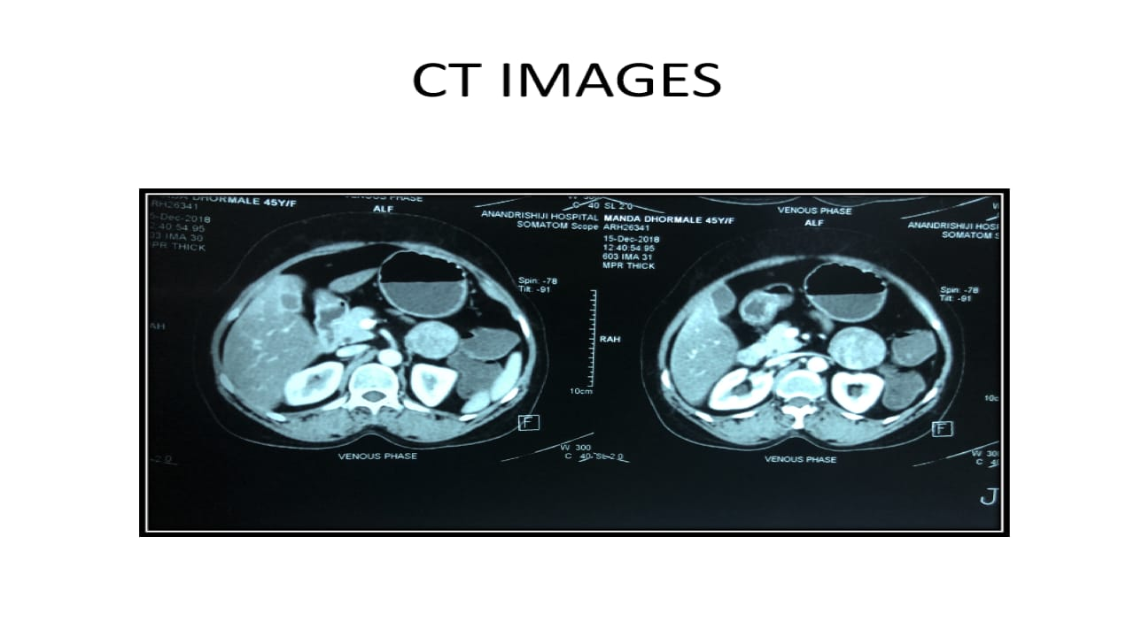
A well defined mass seen in retro peritoneum in the anterior pararenal space , 5.4x 4.6x4.2 cms likely adrenal mass.

Slide 9
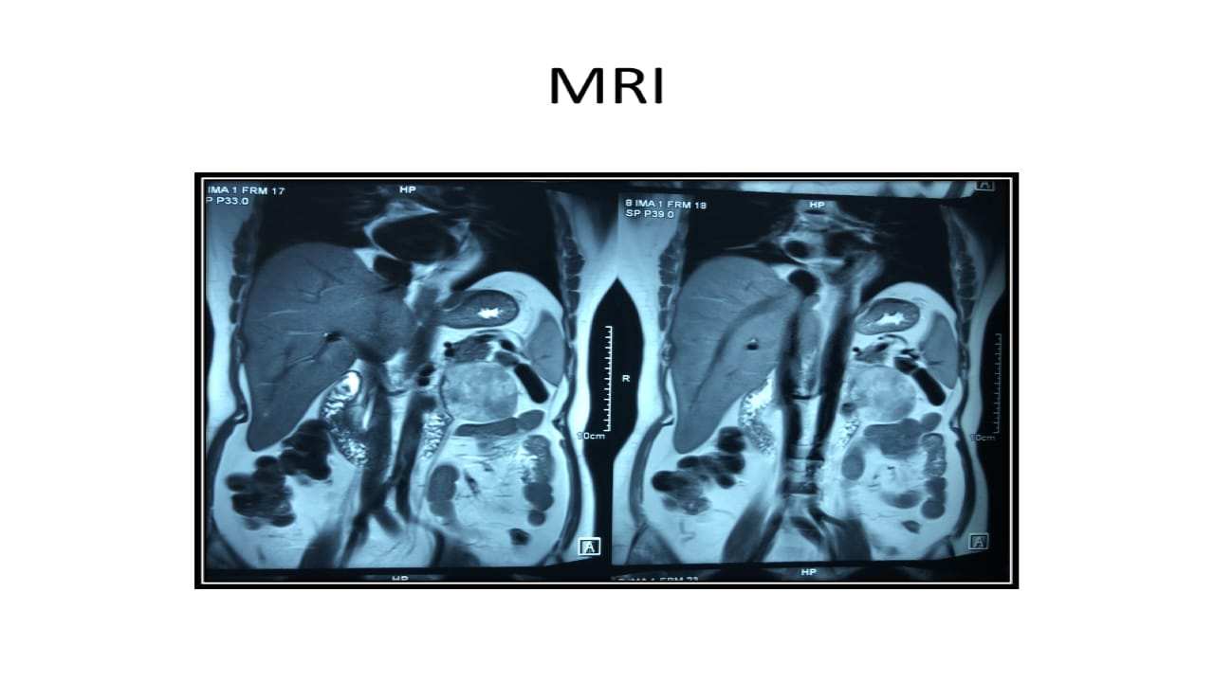
A well defined round mass 5.8 x 5.2x 4.8cm in retroperitoneum in anterior pararenal space, appears to be left adrenal mass.

Slide 10
Investigations :
Urinary metanephrine level : 67. 20 mcg/ 24 hrs ( < 350 mcg/ 24 hrs)
Urinary VMA : 4. 62 mg/ day ( 15 mg / day )
Aldosterone : 2.43 ng /dl ( 2.52- 39.2 ng /dl )
Plasma metanephrine free : 51 pg/dl ( 65pg/dl )
Serum K+ : 3.4
Cortisol : 23.92 mcg /dl ( 6.02 -18.4 mcg /dl )
Direct renin : 6.6 mciu/ml ( 4.4 – 46 mciu/ ml )

Slide 11
Gross :
External surface :
Cut surface :
Received specimen labelled as left adrenal mass measuring 6 cms in diameter, weighing 50 gms
External surface = Encapsulated. Greyish white in
colour with congested and dilated blood vessels .
Cut surface = yellow to tan colour , soft to firm in
consistency . No areas of necrosis

Slide 12
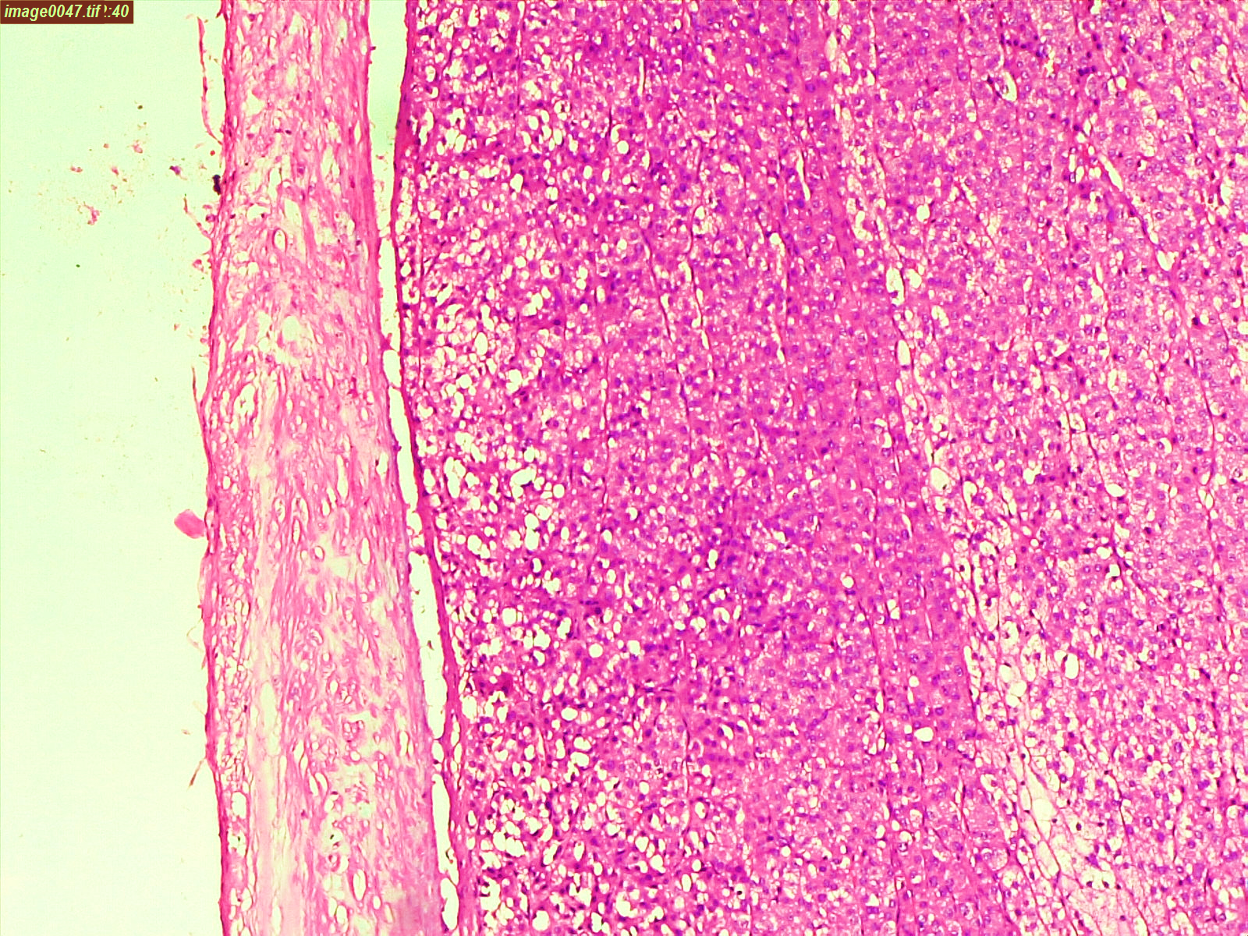
(H&E, 100 x)
Notes:
multiple sections shows capsule which was intact and tumour cells seen.

Slide 13
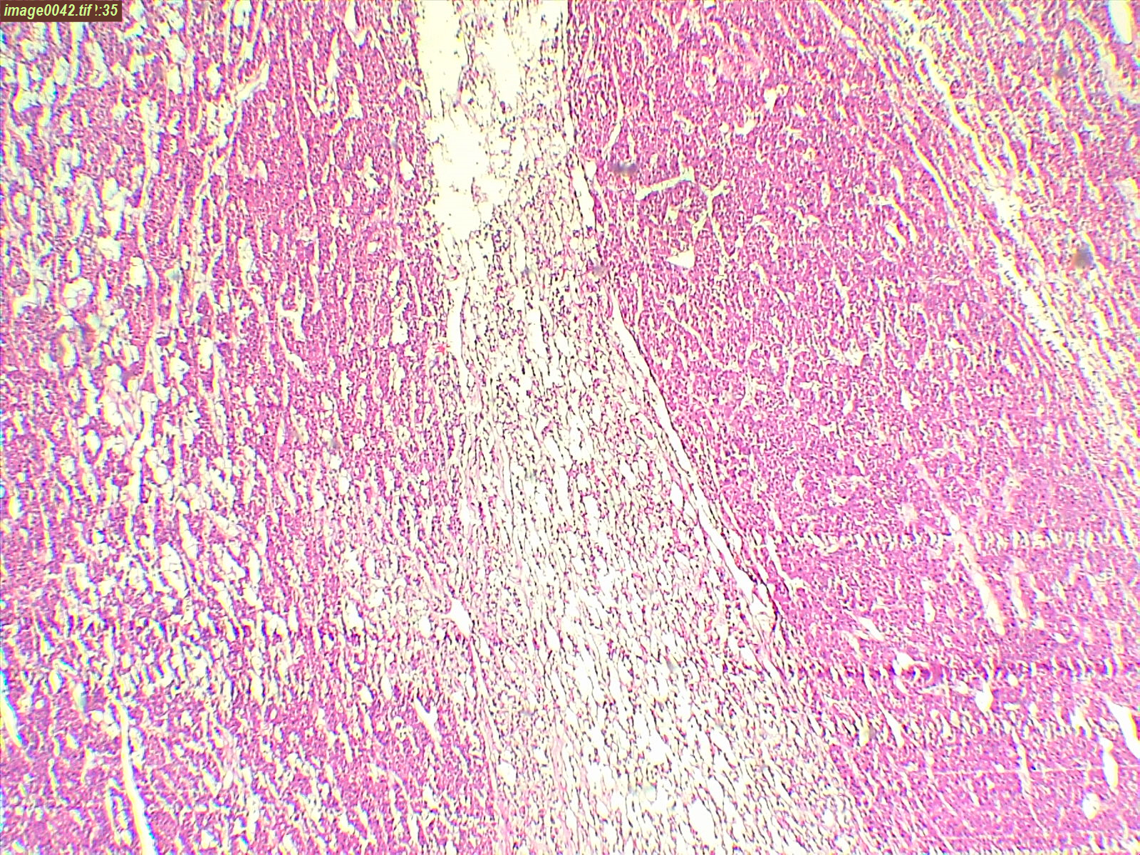
H & E ( 100 x)
Notes:
Variation in pattern seen . Cells with eosinophilic cytoplasm, clear cells and zallballen pattern are seen.

Slide 14
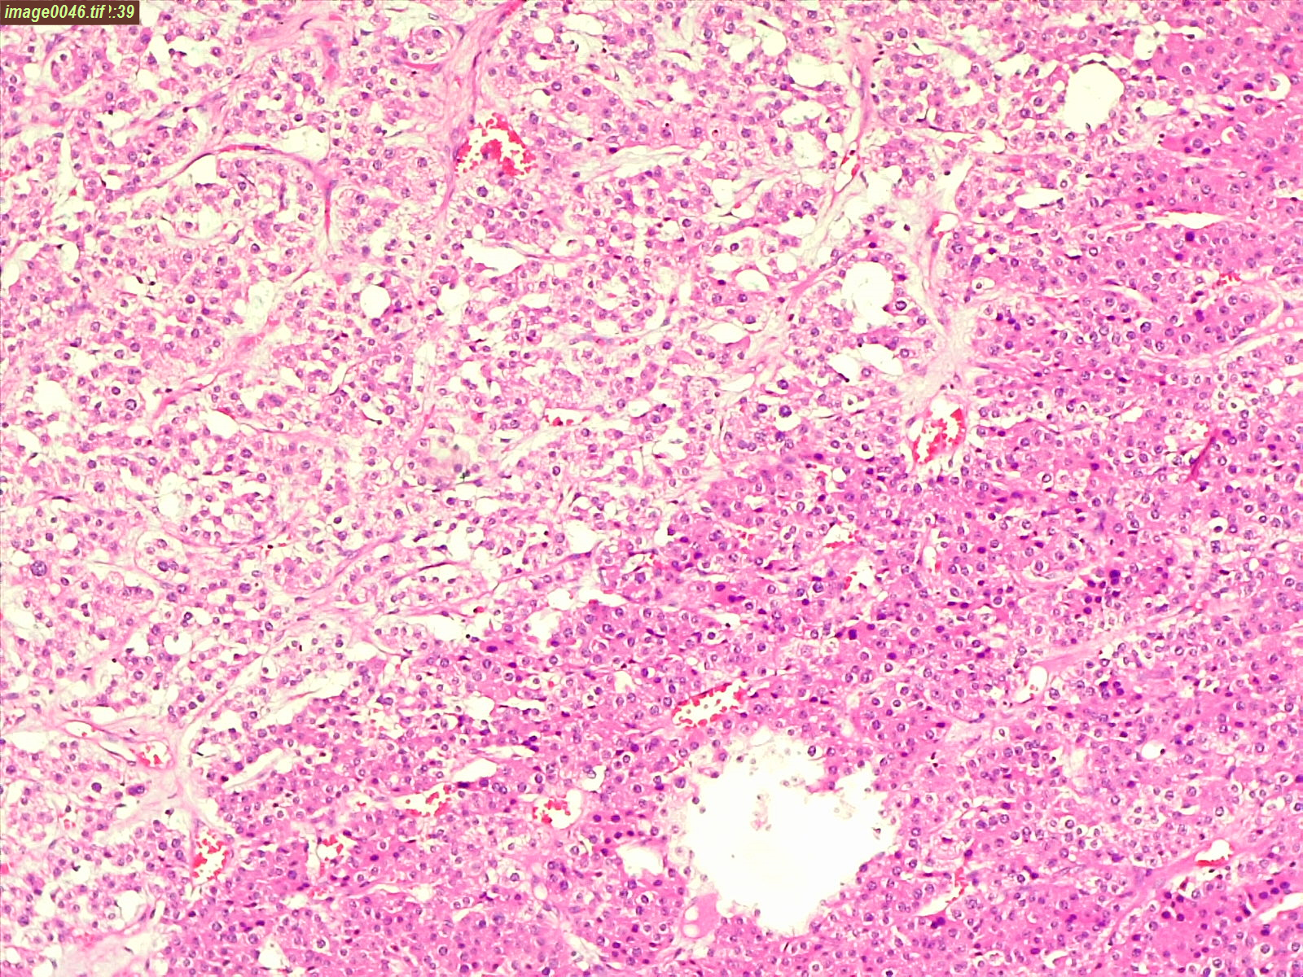
(H&E,100x)
Notes:
Two variations seen . Right side showing more eosinophilic cytoplasmic cells and left side showing normal cells .

Slide 15
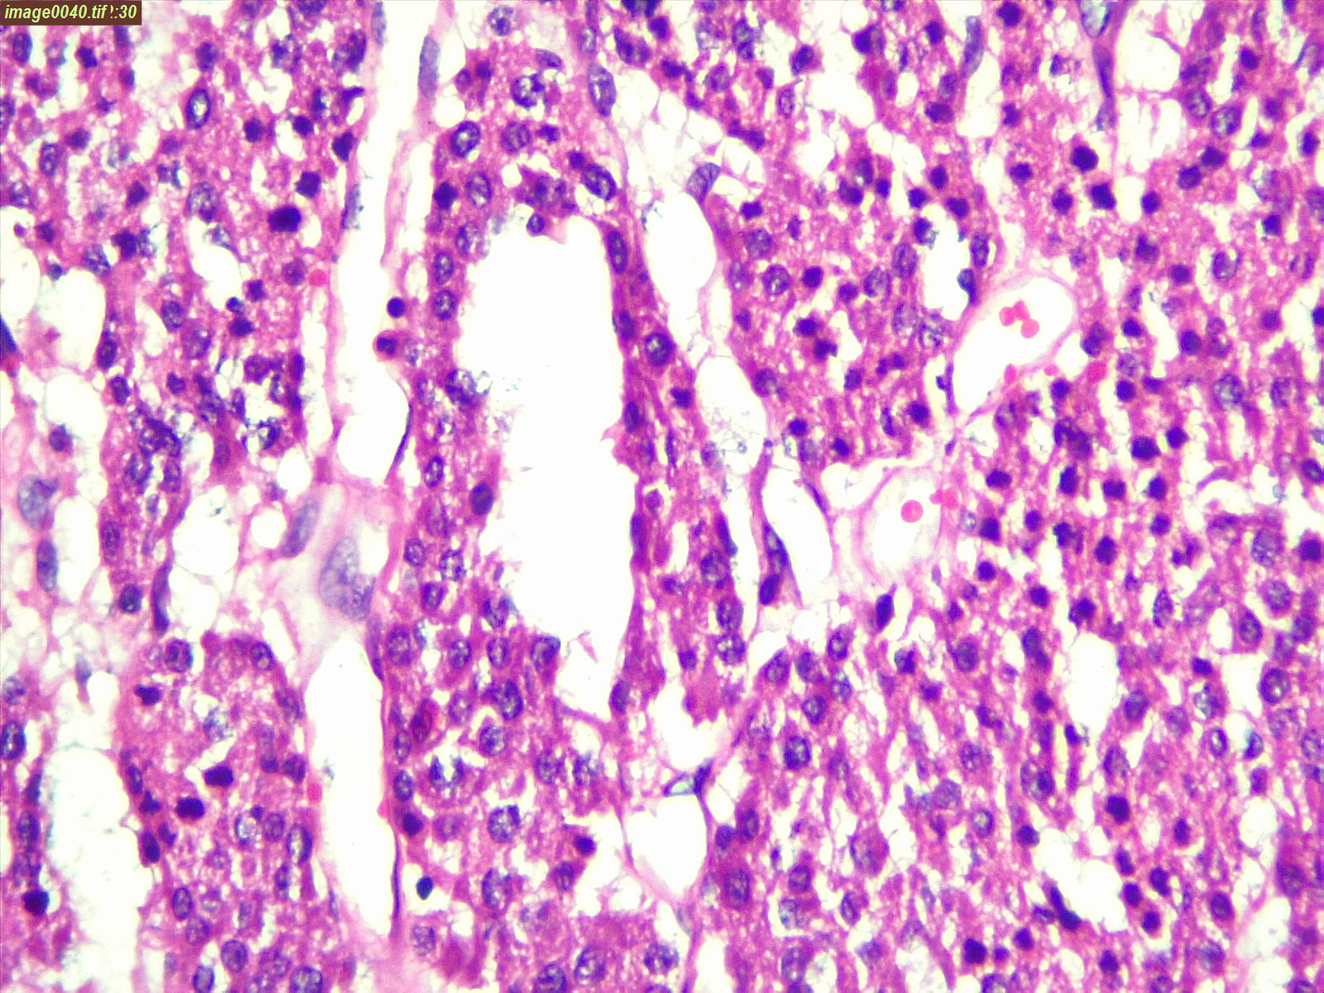
(H &E,400x)
Notes:
Cells are round to polygonal with eosinophilic to vacuolated cytoplasm . The nuclei are round to oval with mild pleomorphism . Mitotic activity is low

Slide 16
Based on the clinical features, radiological and biochemical investigations, gross and microscopy examination the following D/ D were considered D/D : 1. Adrenal corticoadenoma 2. Pheochromocytoma 3. Adrenal corticocarcinoma Further Immunohistochemistry was done for confirmation
Notes:
Microscopically it is very difficult to differentiate between adrenal cortico adenoma and pheochromocytoma due to variations in patterns.

Slide 17
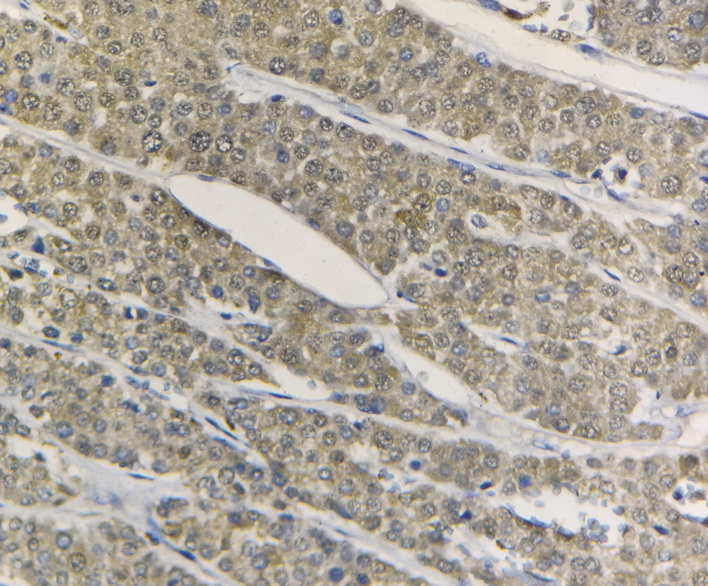
Synaptophysin : cytoplasmic positivity (IHC 400x)
Notes:
Synaptophysin is positive in adenoma , carcinoma and pheochromocytoma .

Slide 18
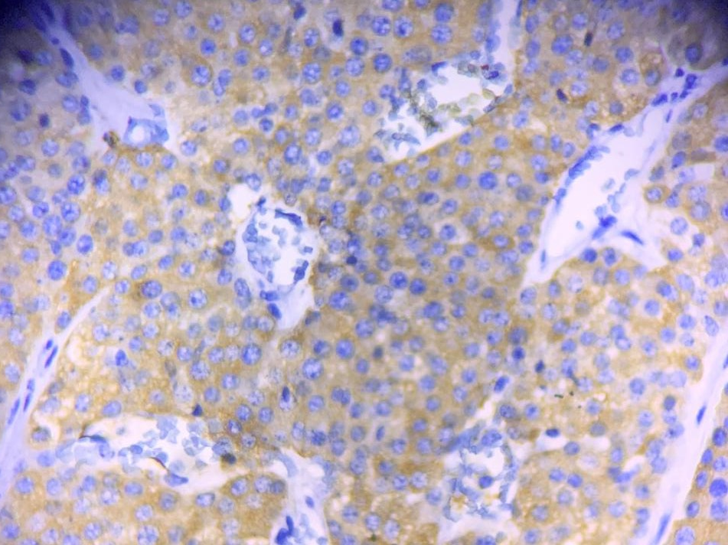
Calretinin : cytoplasmic positive (IHC, 400x)
Notes:
calretinin is positive in adenoma

Slide 19
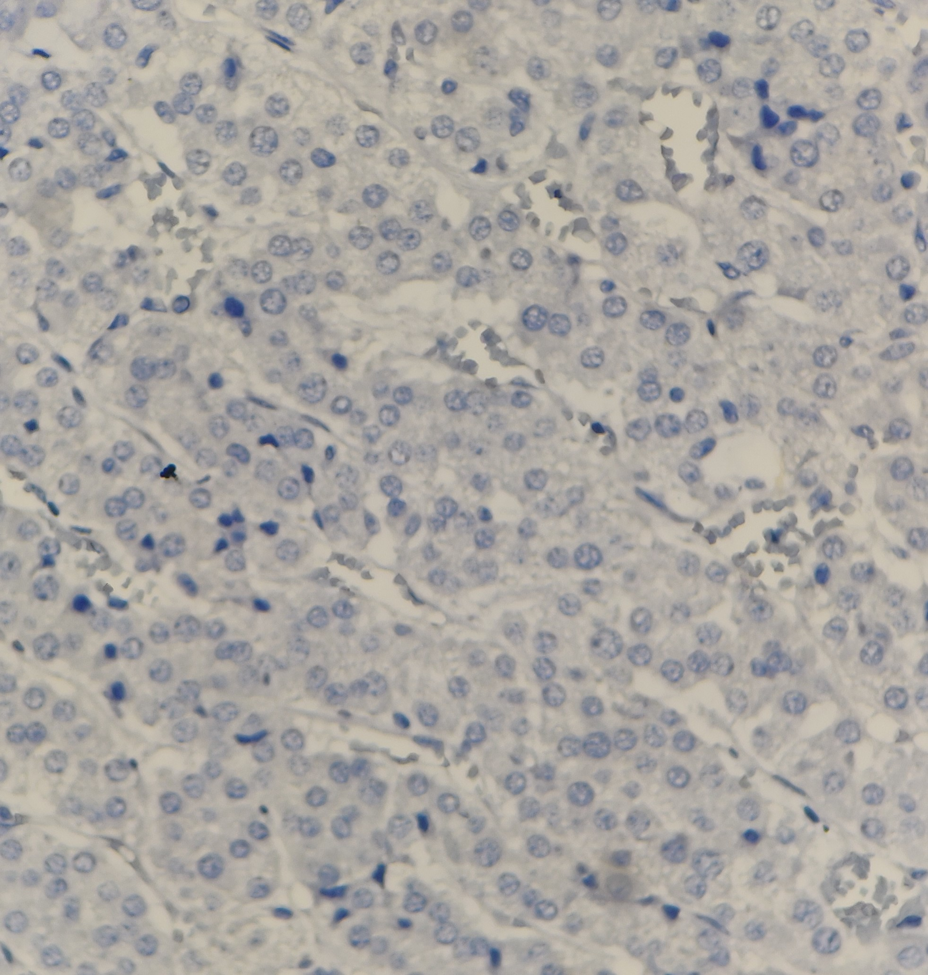
Chromogranin negativity (IHC,400x)
Notes:
Chromogranin is positive for pheochromocytoma

Slide 20
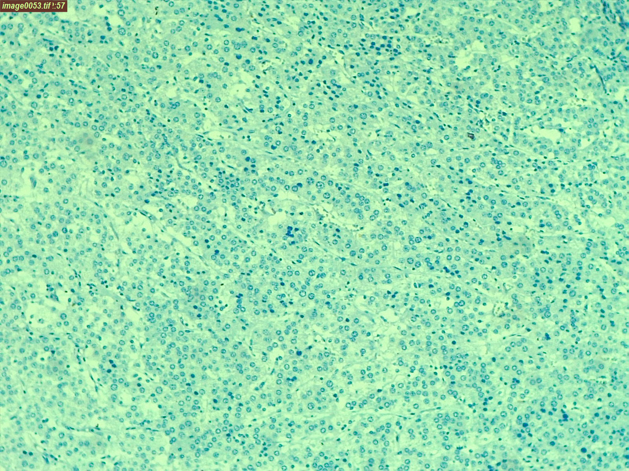
Ki 67 showing low proliferation rate (IHC,x400)
Notes:
Ki 67 shows high proliferation rate in carcinoma

Slide 21
Impression : Adrenocortico Adenoma

Slide 22
Discussion :
Adrenal cortical adenomas represent the most common primary adrenal lesion .
Incidence is 7 % with female predominance . Seen from 5th to 7th decade.
They may be functioning ( producing aldosterone , cortisol or sex hormones ) or non functioning .
Grossly , adenoma are usually solitary , characteristically small, rarely exceeding 5cms in greatest diameter or 50 gms in weight
Adenoma are well circumscribed and typically encapsulated.
Adenoma is immunoreactive for synaptophysin, calretinin, but negative for chromogranin

Slide 23
Discussion:
Adrenocortical adenoma
Adrenocortical carcinoma
Gross: solitary , weigh 50gms or less
Lack areas of necrosis, hemorrhage
Mitotic activity is < 5 per 50 per high power field.
No capsular invasion
No vascular invasion
Ki 67 proliferation rate is low.
Gross: solitary, weigh > 10gms reach upto 1000gms.
Areas of necrosis, haemorrhage
Mitotic activity is > 5 per 50 high power field.
Capsular invasion
Vascular invasion
Ki 67 proliferation is high .

Slide 24
Differentiating points for pheochromocytoma :
Primary neoplasms of adrenal chromaffin cells
Symptoms due to increased catecholamines : hypertensive episodes, Triad : 1.Sweating attacks,
2. Tachycardia
3.Headache
( but these symptoms are seen less than ¼ th of patients )
Confirmation is done by testing catecholamines levels by plasma free metanephrines or urinary fractioned metanephrines.
Gross :weighs from few grams to over 2000gms .

Slide 25
Differentiating points for pheochromocytoma
Often have areas of necrosis ,haemorrhage and cyst formation .
Microscopy : cells arranged in well defined nests ( ZELLBALLEN ) pattern separated by fibrovascular stroma .
Contains numerous dense core granules of neurosecrectory type .
Immunoreactive for chromogranin

Slide 26
THANK YOU !

