Slide 1
Comparision of Functional Outcome
of Various Modalities of Management of Distal Tibial Fractures

Slide 2
Introduction
Distal tibial fractures remain a challenge to orthopedic surgeons. They usually occur as a result of high energy trauma in young patients, but in the elderly they can result from a simple fall. In the elderly, the problem is compounded by poor bone-stock, their limited ability to partially weight bear in co-morbid conditions.

Slide 3
The main challenges
The compromised skin and soft tissue envelope as in open fractures lead to a high incidence of complications following open reduction and internal fixation.
In the mataphysis, fixation is less rigid and early loosening is a frequent as the cancellous is open and „celllike‟ and therefore ill equipped to support as screw thread.
Comminuted fracture patterns, which create difficulty in achieving rigid fixation since the purchase in trabecular bone is less than optimal to permit weight bearing or even start early joint mobilization.
These high energy fractures may be associated with extremely damaged soft tissue envelope, as well as comminuted metaphyseal region and articular surface making anatomical reduction difficult

Slide 4
Following are various classical and conventional methods available to address such injuries, but each has its own set of advantages and disadvantages
Non-operative management: Closed, simple fractures in patients those are having associated Co-morbid diseases rendering them unfit for anesthesia, leaving them to be managed conservatively.
Intramedullary nailing: Simple fractures, those without associated soft tissue envelope damage and less comminution, can be managed with intramedullary nailing.
External fixators: These fixations have been successful in reducing the fractures temporarily and attending the soft tissue injuries.
Plating devices: Fractures not associated with significant soft tissue damage can be treated with open reduction and plating. This may be done with conventional, bridge plating technique or locking plating.
Hybrid External fixation: In periarticular fractures wires are placed into the metaphyseal region and schanz pins into the diaphyseal region after reducing the fractures.

Slide 5
Clinical features
Pain, swelling over ankle region .
Physical examination should include the assessment of neurovascular status of the patient’s injured limb, since compartment syndrome may be apparent within few hours. It is extremely important to examine the skin thoroughly and any open wound should be assessed.

Slide 6
Radiological Assessment
Antero-posterior , lateral and mortise radiographs of the ankle Joint and
Antero- posterior & Lateral radiograph of leg including knee and ankle joints must be taken.
Computed tomography is useful in cases of fractures extending into the joint

Slide 7
Treatment principles
Even though the treatment of distal tibial fractures remains controversial, the following principles should be significantly adhered in order to achieve the goal of good functional out come.
Careful assessment and treatment of the entire patient and the injured limb leads in priority than the treatment of fracture alone. The Basic principles in the management are
1. Assurance of adequate blood flow
2. Provisional reduction of marked deformity or dislocation
3. Care of the open wound
4. Precise reduction of the skeletal deformity
5. Maintenance of reduction till the healing is complete
6. Rehabilitation

Slide 8
This study deals with the analysis of out come of various modalities of treatment of distal tibial fractures depending on the type of fracture, location of the fracture and the status of the soft tissue envelope.

Slide 9
Patients admitted with distal tibial fractures with or without intra articular extension and those having closed or open injuries were considered for this study
Age Group | Male | Female
16-30 | 2 | 1
31-40 | 3 | -
41-50 | 2 | -
51-60 | 2 | -
The total number of patients in this study is 10 with their ages ranging from 16-65 years with an average of 35 years.
There were 9 males and 1 female.

Slide 10
Mode of Injury:
RTA - 6
Fall - 3
Fall of Heavy Object - 1
Incidence of Open Injuries according to The Gustilo - Anderson System:
1. Grade I - 0
2. Grade II - 2
3. Grade III A - 1
B - 0
C - 0
Rest 7 patients were not having any open injury

Slide 11
All fractures were classified according to AO system
There were totally 8 patients in type A, 1 patients in type B and 1 patients in type C
43A – Extra articular
43B – Partial articular
43C – Intra Articular

Slide 12
In 3 patients with open injuries and severe comminution, external fixation was done, whereas, in another 4 patients with closed, simple fractures interlocking nailing was done.
3 Patients with closed injuries away from the tibial plafond were treated with plating technique.

Slide 13
Analysis Of Results
The outcome of treatment of distal tibial fractures, is most affected by the severity of injury, management of the fracture and occurrence of certain complications.
There are no uniformly accepted criteria for rating results.
A number of factors are important for assessing results of tibial shaft fractures.

Slide 14
Criteria which was proposed by JOHNER and WRUH (1983) has now become widely accepted.
This criterion considers
nonunion, osteitis, amputations,
neurovascular disturbances,
deformity – varus,valgus, rotation,
shortening
mobility of knee, ankle, subtalar joints,
pain
gait

Slide 15
Non union, Osteitis, Amputation: None patient in our study had non-union or amputation.
Neuro Vascular Disturbances: No patient had developed neurovascular complication in our study
Deformity:
5 Patients had varus / valgus deformity ranging 2-5 degree
3 Patients has varus / valgus deformity ranging 6-10 degree

Slide 16
Mobility :
Knee:
all patients had full range of movements.
Ankle:
8 patients had > 80% of normal movements
2 patients had < 50% of Ankle movement.
Subtalar Joint:
All patients has regained almost normal range of subtalar movement

Slide 17
Pain:
2 patients with interlocking nailing had anterior knee pain.
4 patients had occasional pain at the fracture site for 2 months.
4 patients had moderate amount of pain at the fracture site for 1 month.
2 patients had severe pain at the fracture site
Gait: Gait was near normal in almost all patients.

Slide 18
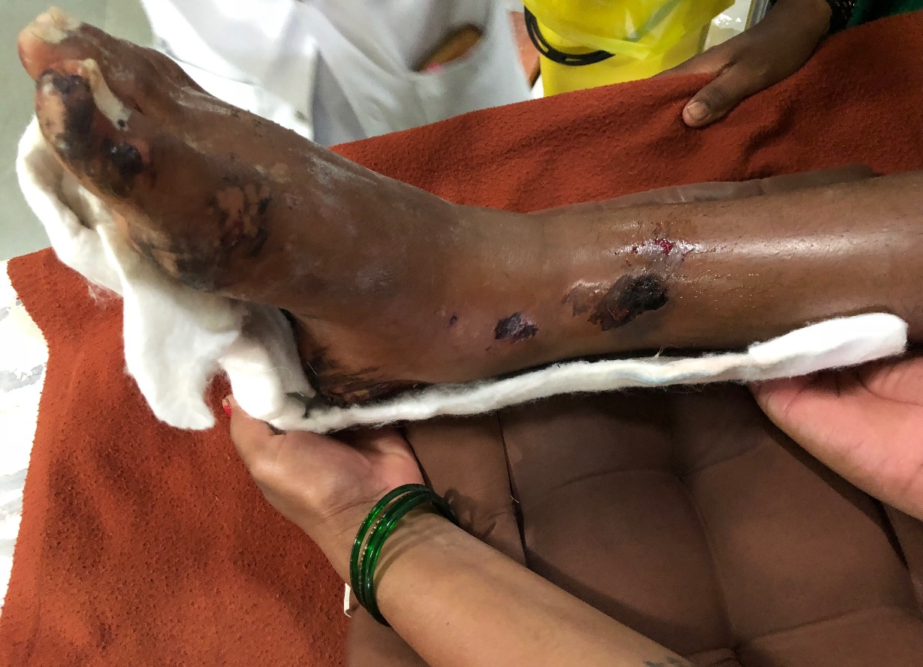
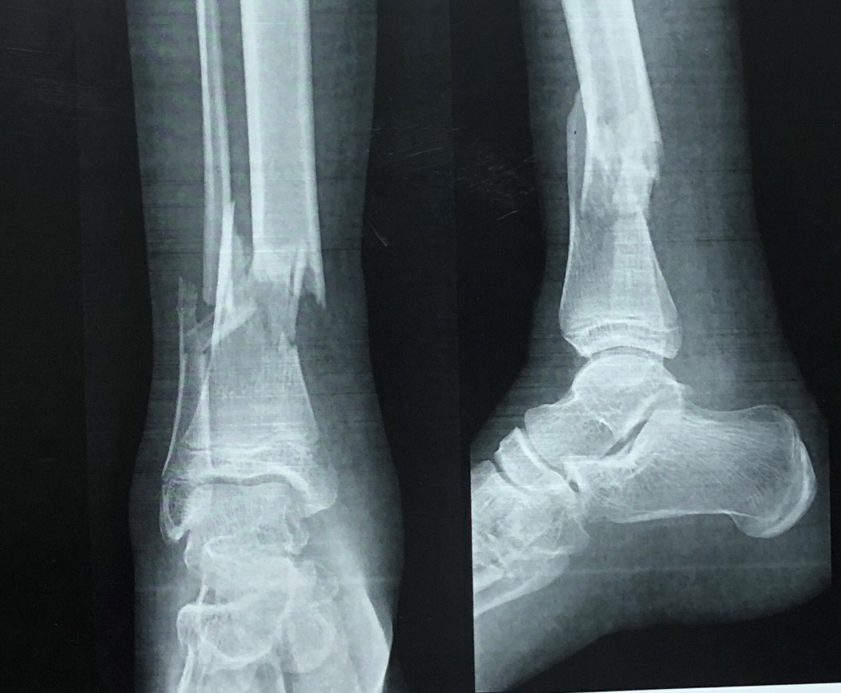

Case 1
Case 1
AP – Lateral RadIograph Of ankle Of 16 y/m showing comminuted distal tibia and fibula fracture

Slide 19
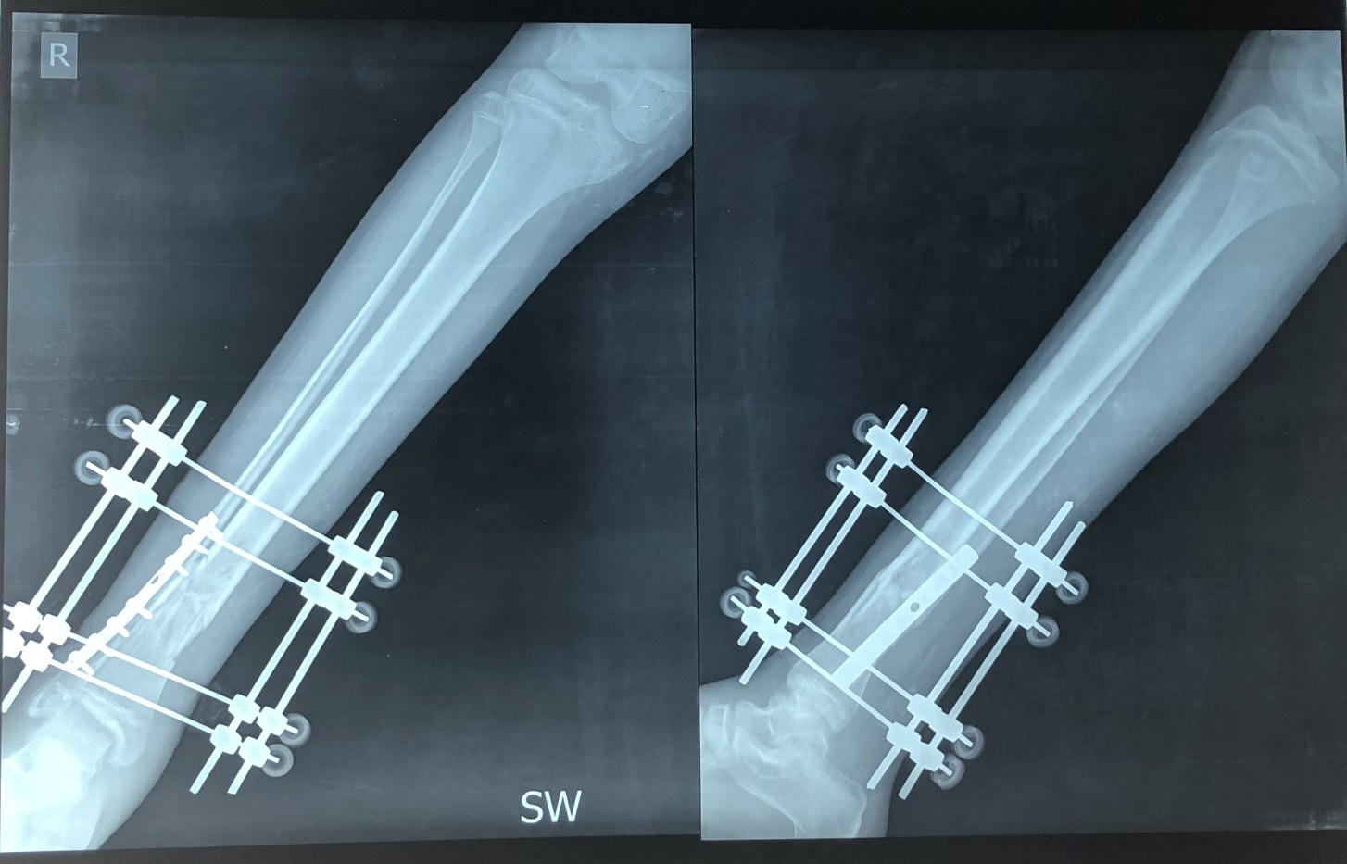
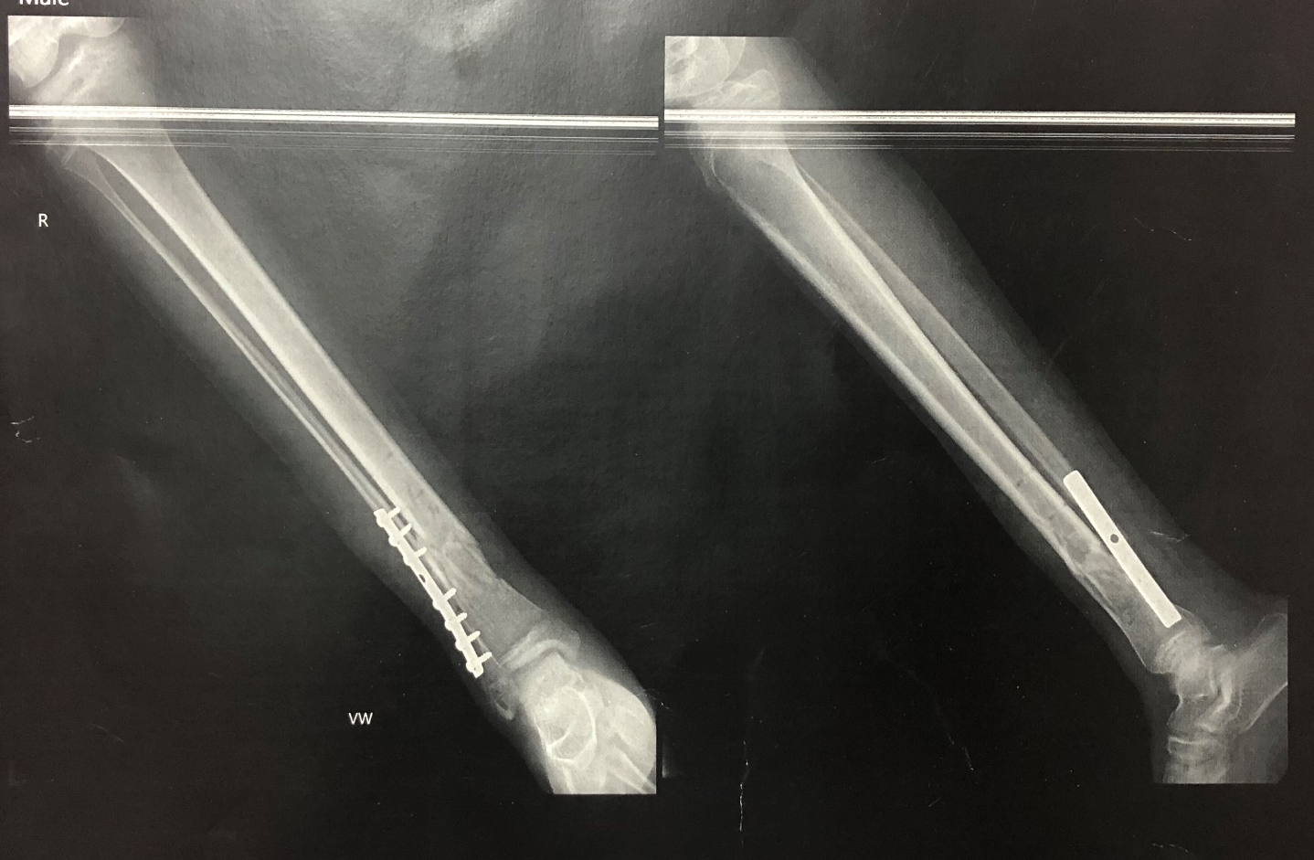
Immediate post of Xray showing good reduction and Xray at 6 weeks follow up showing union .

Slide 20
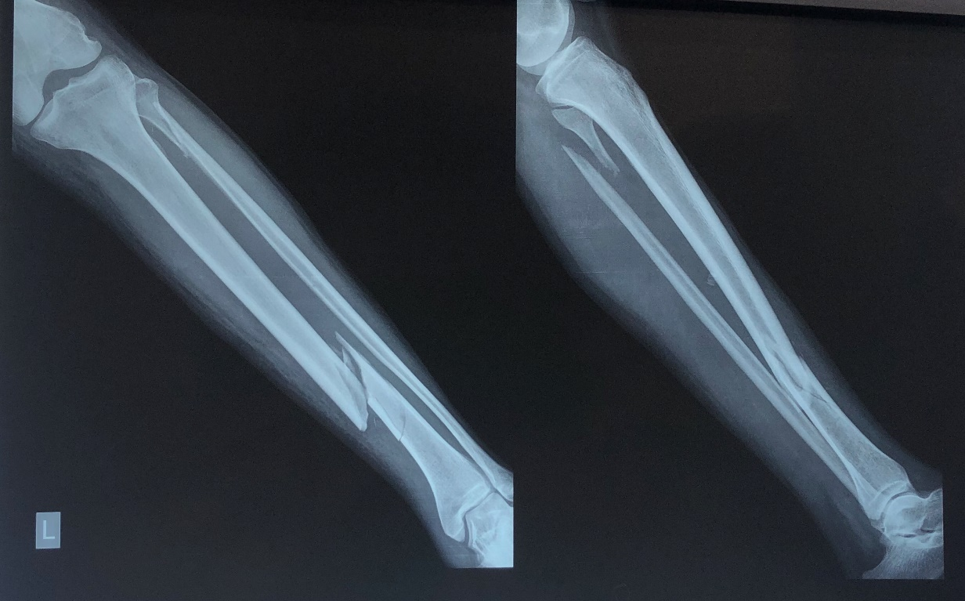
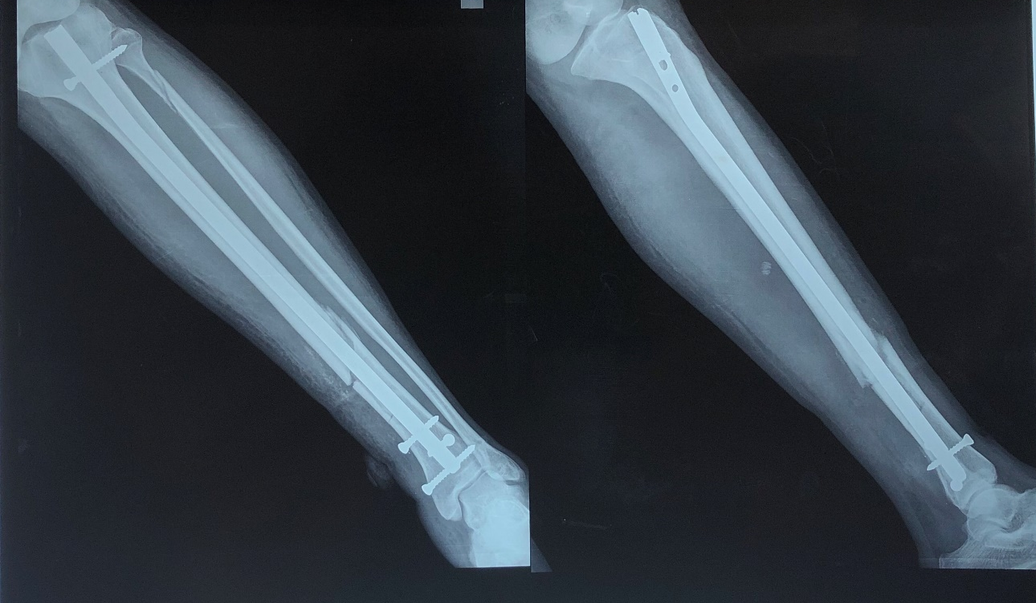
Case 2
AP AND LATERAL RADIOGRAPH OF LEG SHOWING DISTAL TIBIA FRACTURE
Post op Xray showing good reduction With intramedullary interlocking nail

Slide 21
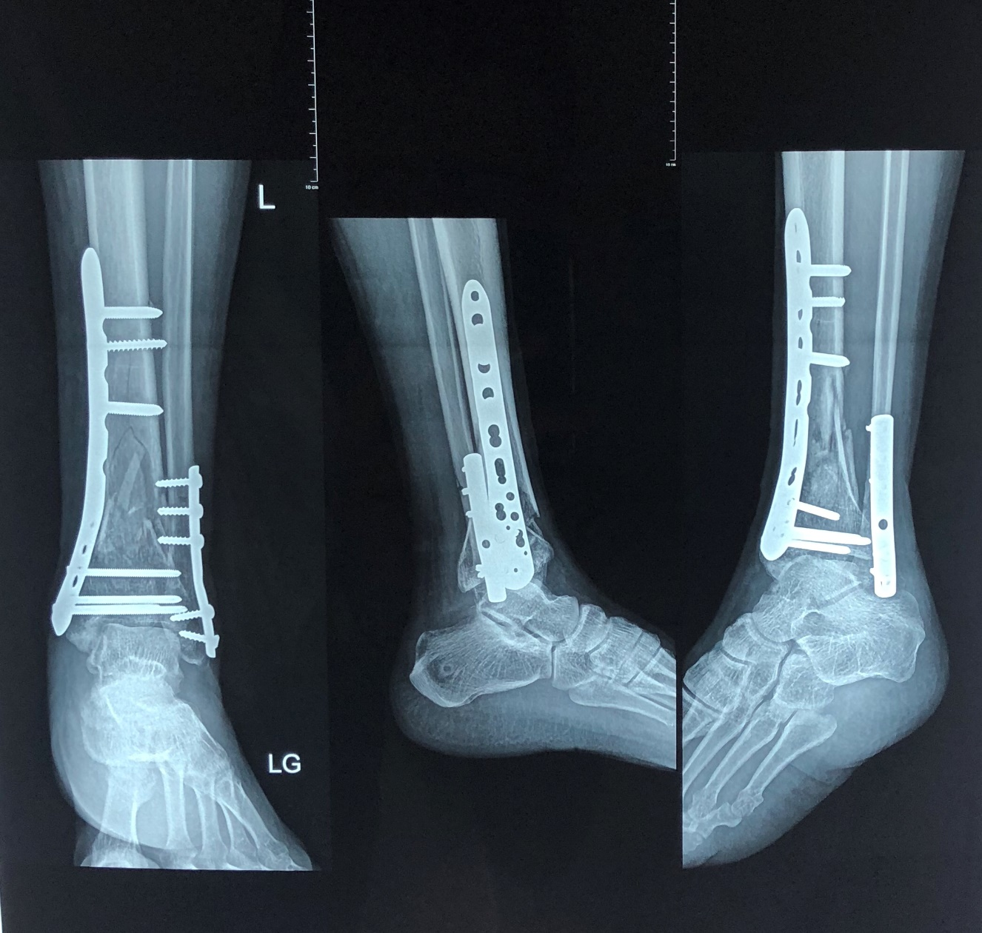
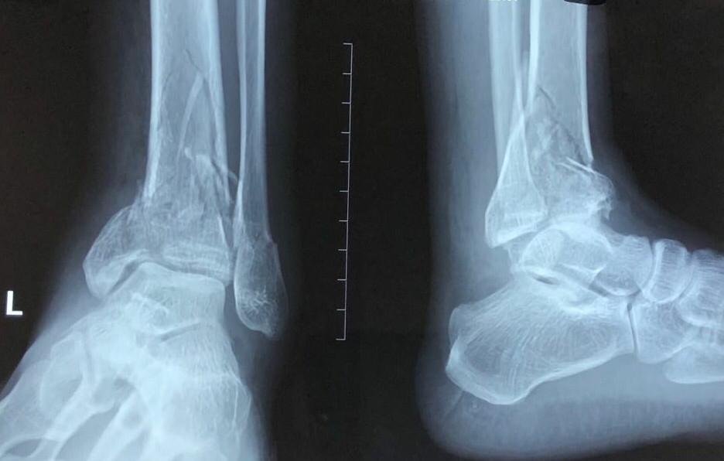
Case 3
AP & Lateral radiograph Of ankle showing comminuted distal tibia and fibula fracture
Post op Xray showing good reduction with Minimally invasive plating for distal tibia

Slide 22
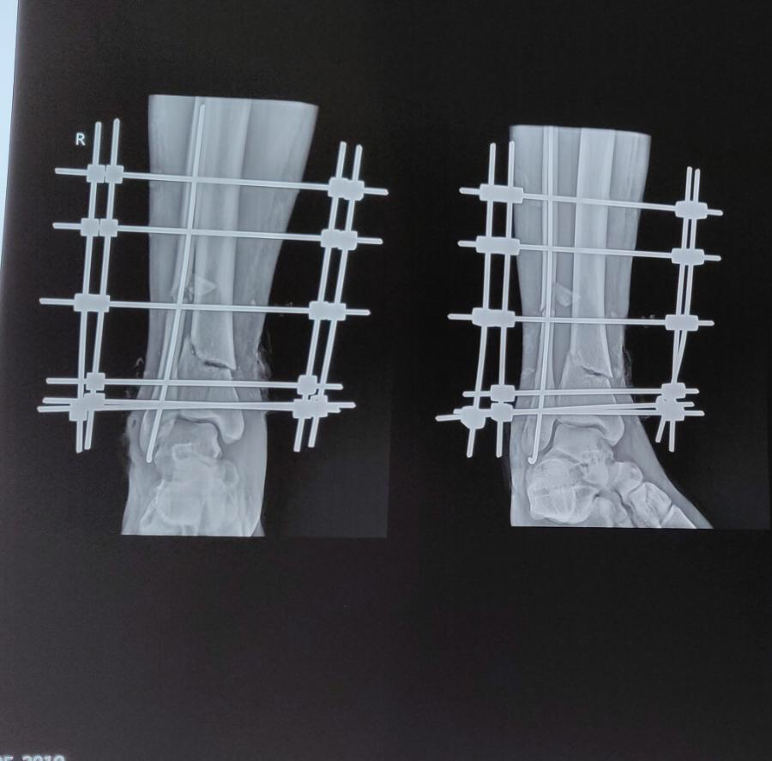
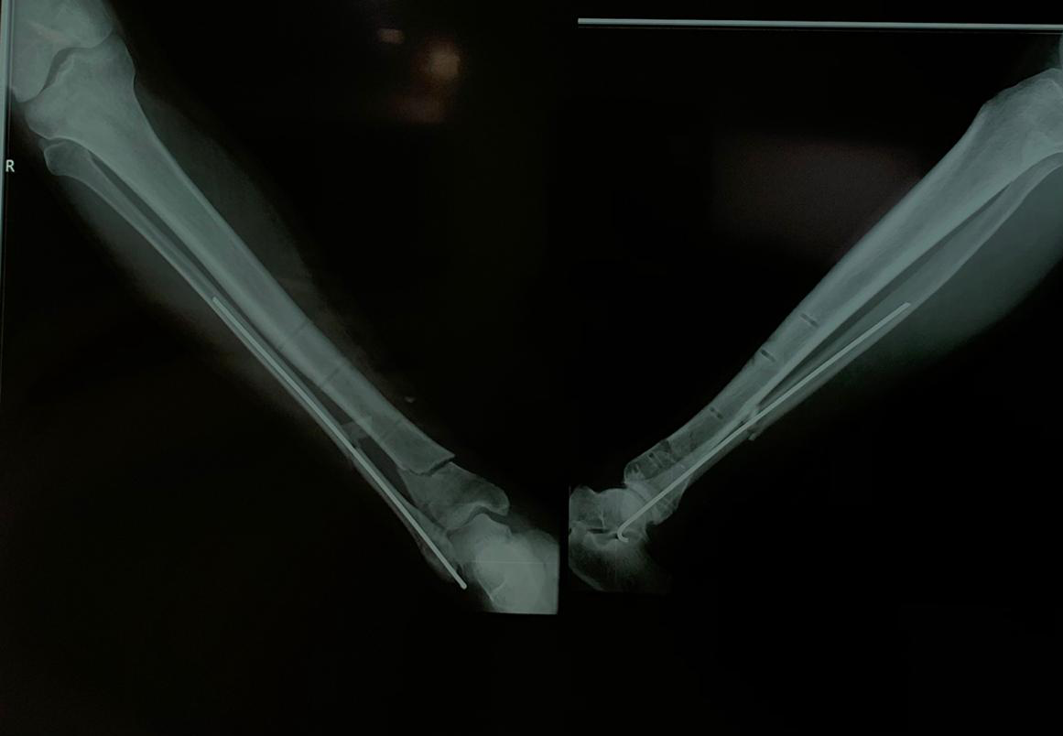
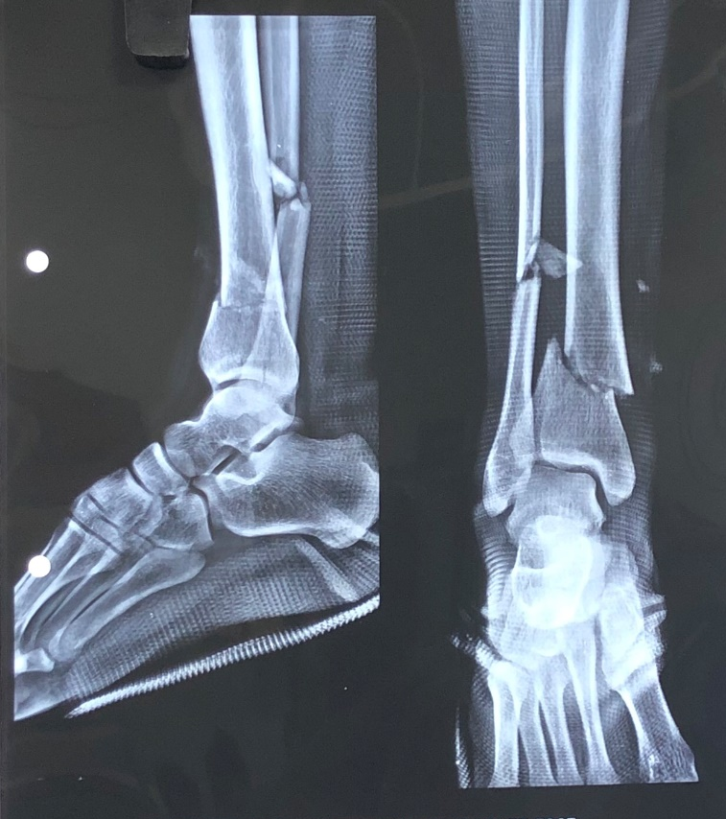
Case 4
AP & lateral radiograph Of 37 y/m showing distal tibia fibula fracture
Immediate post op Xray showing good reduction with external fixator for distal tibia
At 8 weeks follow up Xray showing union

