Slide 1
AN UNUSUAL CASE OF PLEURAL EFFUSION
DR.ANIKET BHIDE
DEPARTMENT OF PATHOLOGY- JRII

Slide 2
A 50 year old male patient, engineer by profession presented with complaints of-
Breathlessness- Since 20 days, was insidious, progressive, MMRC II, No history of wheeze/allergic trigger/orthopnea.
Dry Cough since 20 days
Nausea
Right Sided Chest Pain which increased in lying position
Notes:
MMRC- Modified Medical research council, it is a dyspnea scale.
All complaints were present since 20 days

Slide 3
Past History
Patient is a known case of Diabetes Mellitus type 2 since 10 years on insulin (actrapid) and also coronary artery disease since 7 years.
Personal History
No fever or reduced Appetite
Weight Loss since 20 days
Bowel Bladder Unaltered
No Addictions
No history of pulmonary TB in family

Slide 4
On Examination
The patient was conscious, cooperative and well oriented
No Pallor, Icterus, Clubbing Cyanosis, Lymphadenopathy, Edema
Patient was Afebrile
BP-120/80 mmhg
RR-18/min
Pulse- 82/min
SpO2 was normal, 95%

Slide 5
Systemic Examination
RS- Inspection- Right decreased chest movement
Palpation- TVF decreased on right 4th ICS and below
Percussion- Dull note present on right 4th ICS and below
Auscultation- Left; Normal vesicular breath sounds
Right; decreased breath sounds (Right Mammary, Right Inter-Scapular Area, Infra-scapular area, Infra-axillary area)
CVS- S1S2 heard. No murmur
CNS- Conscious and Well Oriented. NAD
P/A- Soft and non Tender. No Hepatosplenomegaly.

Slide 6
Investigations
CBC- Within normal limits
Serum Electrolytes- Within normal limits
Total Billirubin- 0.45mg/dl
Conjugated Billirubin- 0.16mg/dl
Unconjugated billirubin- 0.29mg/dl
SGOT-20 IU/L
SGPT- 21 IU/L
Alkaline Phosphatase- 43 IU/L
HBA1C- 11.20 %
Serum Uric Acid- 8 mg/dl
Serum Urea-18mg/dl
Serum Creatinine- 0.80 mg/dl

Slide 7
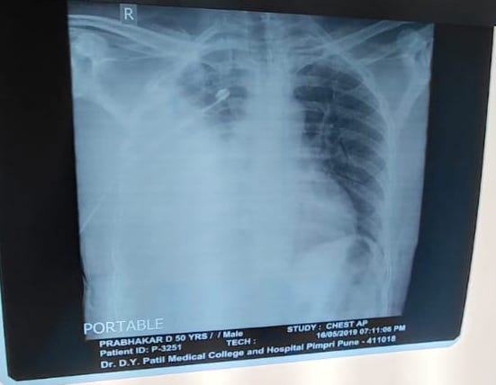
Chest X-ray was done which showed Right massive pleural effusion.

Slide 8
2D Echo was done which was suggestive of IHD with a ejection fraction of 45%
Grade I LVDD with mild Tricuspid regurgitation.
USG abdomen and pelvis was normal
USG thorax was suggestive of massive effusion with septations
PET CT scan was also done
The scan showed a right sided loculated pleural effusion with FDG avid pleural thickening, S/O of primary pleural malignancy as mesothelioma
Notes:
LVDD- Left Ventricualar Diastolic Dysfunction.

Slide 9
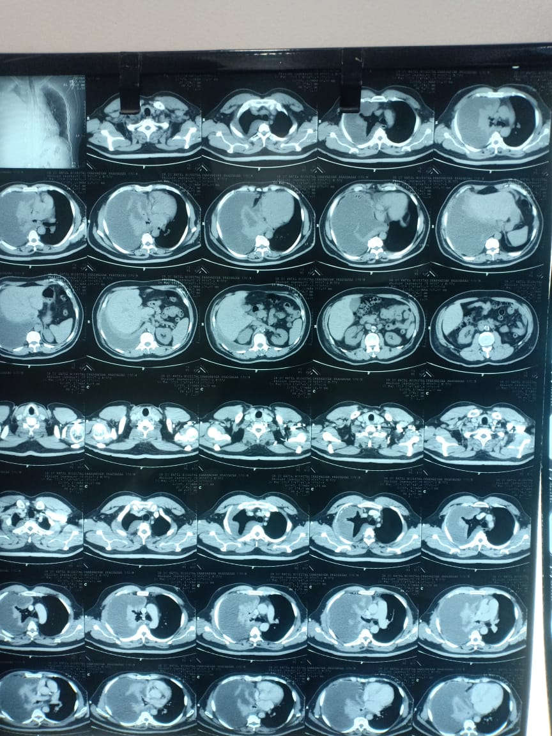
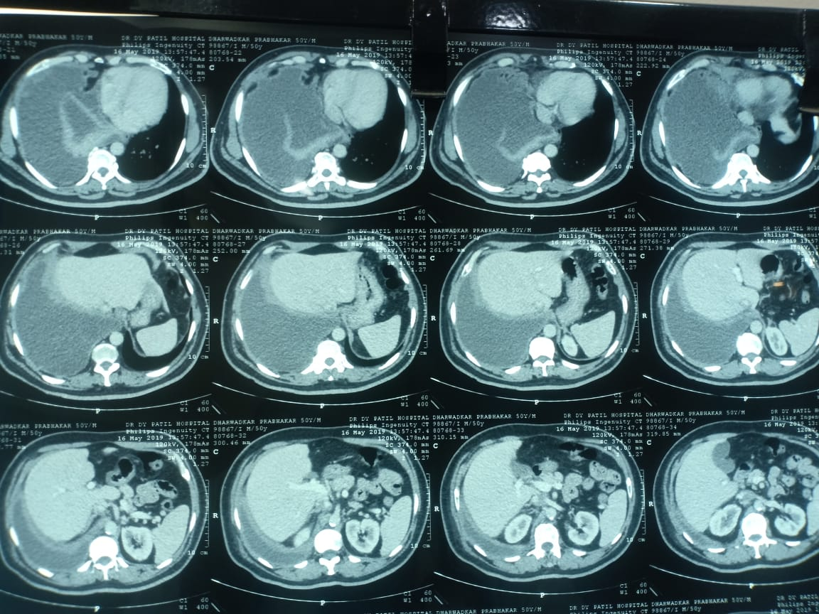
CT scan of the thorax was done by obtaining thin sections from lung apices to the domes of the diaphragm.
Gross pleural effusion was seen with surrounding thick, enhancing pleura and compression atelecstasis of right lung.
Above finding possibly due to empyema
Left lung parenchyma, trachea, heart and mediastinal lymph node all appear to be normal.

Slide 10
Diagnostic and Therapeutic Pleural fluid Aspiration was done
Approximately 800ml of fluid was aspirated, which was straw coloured
The fluid was then sent to the Central Clinical Laboratory(CCL) for Routine Microscopy, proteins and glucose and to the pathology department for examination for malignant cytology.

Slide 11
3ml of fluid was received in the CCL, straw coloured in appearance
No clot,coagulum or deposits seen
Microscopy revealed
Total leucocyte count of 3000 cells (N-40%; L-20%, Mesothelial cells-40%)
RBC count- 20-22 cells

Slide 12
Furthermore the fluid was then sent for Biochemical Examination which showed
Proteins- 6 gm%
LDH- 2440 IU/L
Glucose- 6mg/dl
ADA-47 IU/L

Slide 13
The Pleural fluid was stained with leishman’s stain and examined under the microscope.
Microscopy showed a markedly cellular smear predominantly consisting of polymorphs and macrophages.
Pleural fluid sent for malignant cytology to the department of pathology was reported as smears showing benign clusters of reactive mesothelial cells with collection of chronic inflammatory cells along with histiocytes
Background was proteinacious
No Malignant cells/granuloma seen

Slide 14
Thoracoscopy was done and the biopsy obtained was then sent for histopathological examination.
The specimen was received for histo-pathological examination in 3 separate bottles.
Notes:
It in 3 tissue bits each measuring 0.1

Slide 15
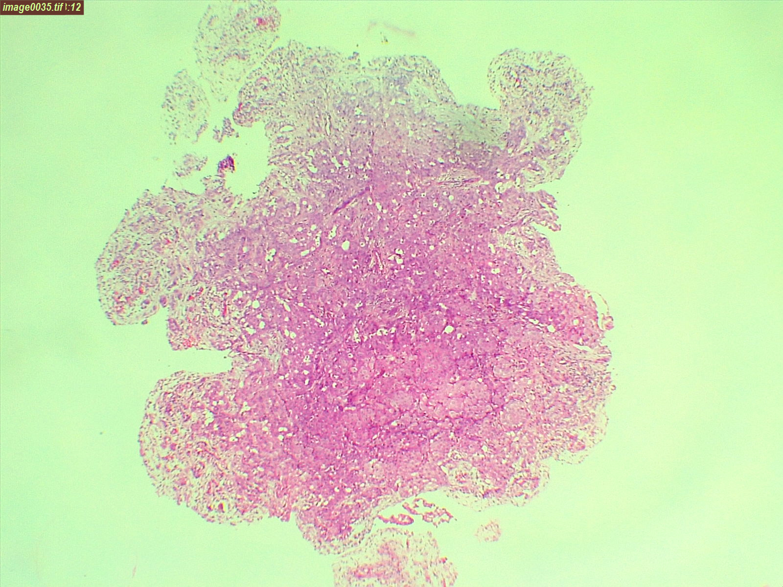
Notes:
Histopathological examination showed round to polygonal cells with moderate pleomorphic nuclei showing nucleoli. Cytoplasm is pale eosinophilic. There were even oval to spindle shaped cells infiltrating in small nest in a background of desmoplastic stroma. These cells showed pleomorphism and hyperchromasia.

Slide 17
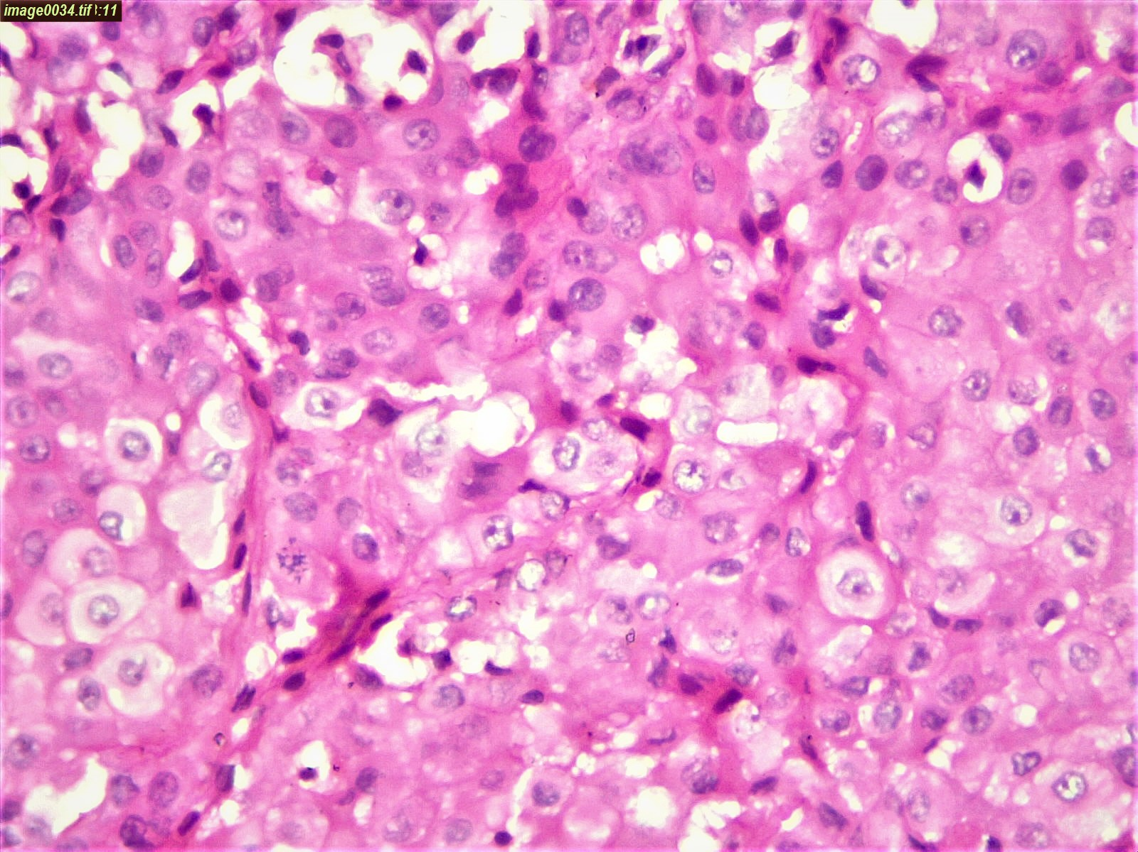

Slide 21
The sampled tissue was Positive for Malignancy
Based on the ivestigations done the differentials are-
A)Malignant mesothelioma
B)Adenocarcinoma

Slide 22
For confirmation IHC was done.

Slide 23
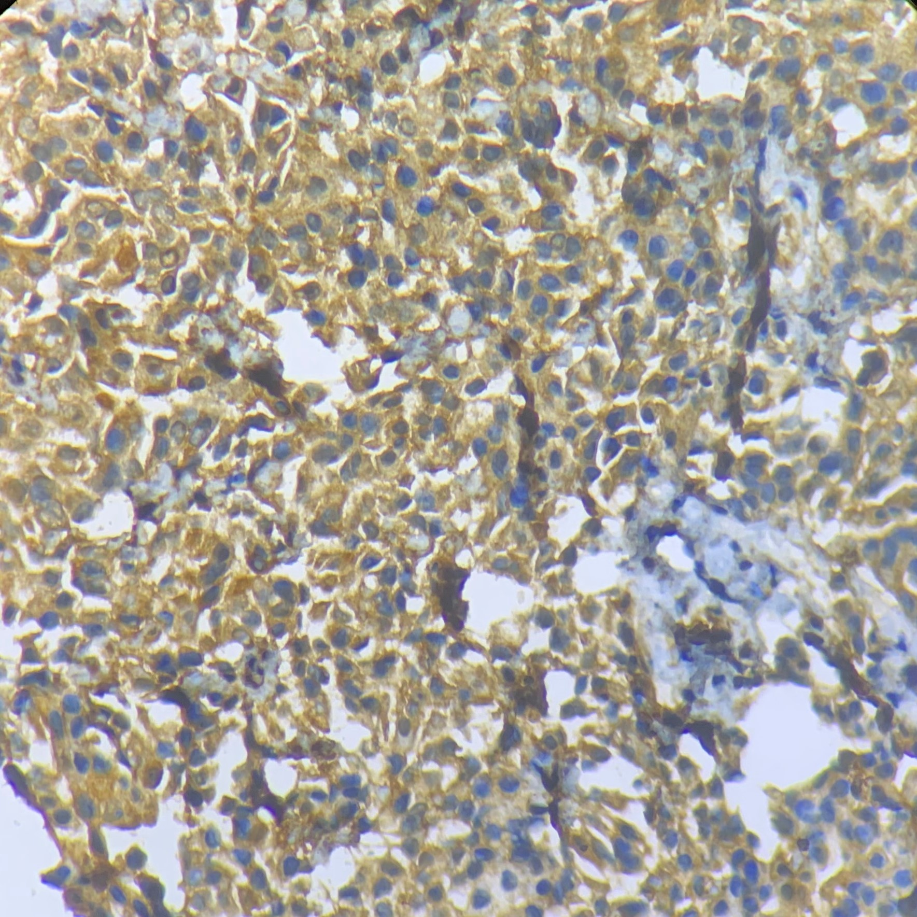
IHC Marker Calretinin (400x)
Notes:
It was Strongly positive for calretinin, positive for EMA, and negative for TTF-1 which rules out adenocarcinoma.
Other markers done were EMA, VIMENTIN, CK-PAN, WT-1, CD15, CEA

Slide 24
IHC Marker EMA (400x)

Slide 25
Discussion
Malignant mesothelioma arises from mesothelial lining of pleura, peritoneum, pericardium and tunica vaginalis.
Malignant pleural mesothelioma is the most common of these.
Approximately 80% to 90% of individuals with this cancer have a history of exposure to asbestos.
Those who work directly with asbestos (shipyard workers, miners, insulators) are at greatest risk,
The latent period after the initial exposure is long, often 25 to 40 years, suggesting that causative driver mutations are acquired slowly, over a long period of time.

Slide 26
It has been hypothesized that asbestos fibers preferentially gather near the mesothelial cell layer, where they generate reactive oxygen species that cause DNA damage and mutations.
Malignant mesotheliomas are often preceded by extensive pleural fibrosis and plaque formation, readily seen on computed tomography scans. These tumors begin in a localized area and over time spread widely, either by contiguous growth or by diffuse seeding of pleural surfaces.
The neoplasm may directly invade the thoracic wall or the subpleural lung tissue, but distant metastases are uncommon.

Slide 27
Treatment
Treatment modalities for mesothelioma include surgery, chemotherapy and radiotherapy and recent studies have shown emergence of immunotherapy as well.
Surgery is usually indicated for patients that are diagnosed in the early stages. The median overall survival for these patients after treatment is 22.5 months.
Patients who are diagnosed late generally undergo chemotherapy as the preferred choice of treatment as surgery is not advisable.
The overall survival for patient in stage 3 is 17.9 months and in stage 4 is 14.9 months
Radiotherapy is not a frequently used modality, whereas Immunotherapy is a emerging mode of treatment under trial.

Slide 28
The Patient was then referred to an oncology center for further management as suggested.

Slide 29
THANK YOU

