Slide 1
A CASE OF FAILED HEMIARTHROPLASTY OF HIP

Slide 2
HISTORY
58/M, complaints of pain in the left hip region since 3 years, aggravated over the past 2-3 months
No history of trauma or fall.
History of joint replacement done 10 years ago
No co morbidities reported

Slide 3
on examination
14-15 cms old healed scar seen along the
postero-lateral portion of the left hip joint.
No scar dehiscence or tenderness present
No sinus/ discharge/ induration present
The patient had painful limp on attempting to walk
Range of motion-
MOVEMENT | LEFT | RIGHT (NORMAL)
FLEXION | 90 | 120
EXTENSION | 5 | 20
ABDUCTION | 15 | 40
ADDUCTION | 20 | 25
INT.ROTATION AT 90 FLEXION | 30 | 45
EXT.ROTATION AT 90 FLEXION | 30 | 45

Slide 4
PRE-OPERATIVE X-RAY
THIN RIM OF ACETABULUM
BROKEN IMPLANT

Slide 5
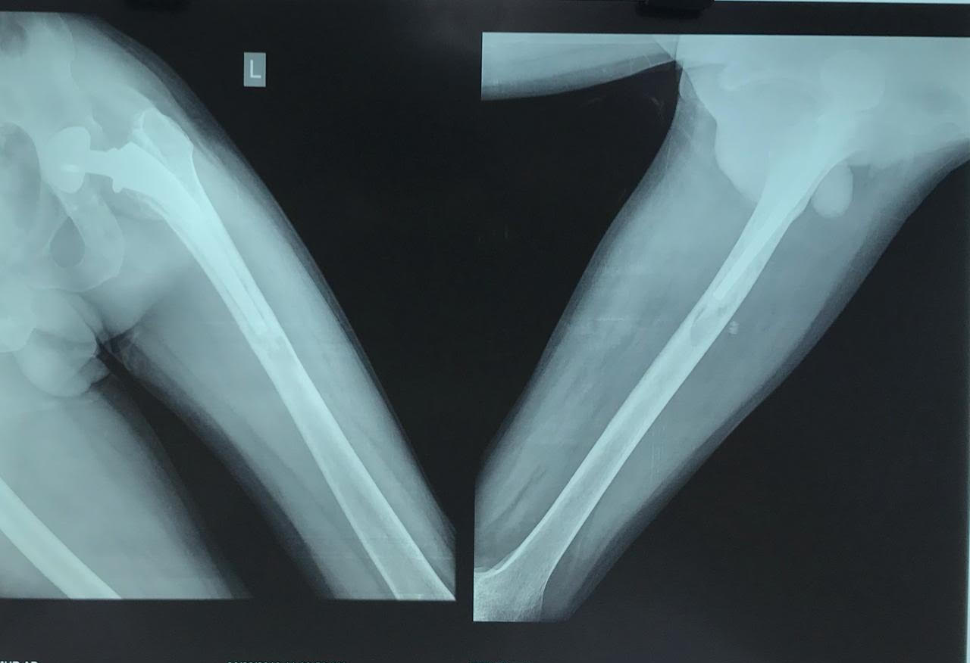
BROKEN IMPLANT
OSTEOLYSIS
THICK CEMENT MANTLE

Slide 6
BROKEN IMPLANT

Slide 7
PRE-OP PREPARATIONS
Routine lab investigations- to rule out infection
HB-13.8GM%
TLC- 7400/cu.mm
CRP (Q)- 5.6 mg/L.
ESR-12mm
Templating was done
Hip aspiration was done and sent for culture which showed no growth of any organism.
Bone cement was kept ready
Bone Grafting consent was taken and kept ready if the need arises

Slide 8
INTRA-OP
INFECTION WAS RULED OUT CLINICALLY USING INTRA-OP FINDINGS
Soft tissue was healthy.
Bone was undamaged and healthy
There was no presence of any sinus, discharge or any collection
Histopathology and culture/sensitivity samples of the tissue were sent.
Other methods to rule out infection using kits (like leucocyte esterase test, alpha defensin test) can also be used.

Slide 9
CHALLENGES MET INTRA-OP
Ruling Out Of Infection
Planning Of Osteotomy
Removing The Cement Mantle
Removing The Stem
Stable Fixation Of Osteotomy
Haemorrhage
Ensuring Minimal Bone Loss
Big Inventory Of The Instruments And Implants

Slide 10
DURING THE SURGERY

Slide 11
EXTENDED TROCHANTERIC OSTEOTOMY WAS DONE
TO REMOVE THE CEMENT

Slide 13
FEMORAL CANAL CLEARED OF ALL CEMENT DEBRIS

Slide 14
REMOVING THE METALLOSIS

Slide 15
INTRA-OPERATIVE FINDINGS
METALLOSIS OF THE SOFT TISSUE

Slide 16
HISTOPATHOLOGY REPORT

Slide 17
THE ORIGINAL IMPLANT

Slide 18
THE NEW IMPLANT
GEN-X LONG STEM
STAINLESS STEEL
(H.A. COATED)

Slide 19
POST-OPERATIVE X-RAY

Slide 20
ANATOMICAL REDUCTION OBTAINED
THE OSTETOMIZED FLAP FIXED IN PLACE USING
DEPUY SYNTHASE CABLES

Slide 21
Post-op rehabilitation
Bed side sitting and quadriceps and knee range of motion exercises were started from the third day.
Patient was kept Non weight bearing and ambulation with walker for three weeks.
He was strictly advised to avoid sitting cross-legged, squatting and strictly walk on flat surfaces and planes for atleast 3-4 weeks of the post operative period.
Patient was started with full weight bearing after 6 weeks.

Slide 23
THANK YOU…

