Slide 1
Dr. Amol Patil
A CASE OF NEGLECTED PELVIS FRACTURE

Slide 2
HISTORY
A 30 yr Male brought to EM on Stretcher.
C/O pain in pubic region.
H/o MVA.
Previous conservative treatment taken.
Unable to sit.

Slide 3
ON EXAMINATION
G/E- WNL.
ON Ex- Tenderness over pubic and low back region.
Pelvic Distraction/compression tests +
Pelvic symphysis gap of 3 finger breadth present.
No DNVC.
Rt lower limb shortening of 2cm.

Slide 4
RADIOLOGICAL EVALUATION

Slide 5
PELVIS WITH BOTH HIP AP VIEW

Slide 6
X RAY S/O
Unstable Pelvic Ring Diastasis
USG- Abdo-pelvis (WNL)
CT Scan .

Slide 7
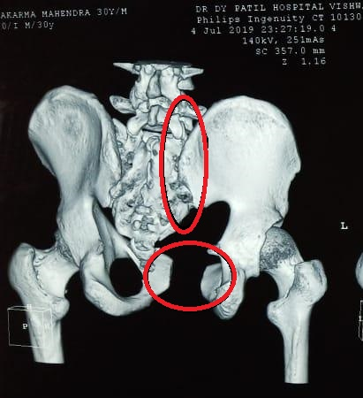
C T SCAN

Slide 8
CT Scan Axial cut

Slide 9
32 mm

Slide 10
DIAGNOSIS
Pelvis symphyseal diastasis – (APC) Antero-posterior compression type II Unstable fracture according to YOUNG AND BURGESS classification.

Slide 11
CHALLENGES DECIDING THE MANAGEMENT
Pre Operatively
Bed Ridden patient.
Anatomical variation.

Slide 12
COPYRIGHTS @ GRAYS ANATOMY

Slide 13
COPYRIGHT @ROCKWWOD & GREENS FRACTURES IN ADULTS VOLUME 2

Slide 14
TREATMENT
Pubic Diastasis – ORIF with plating.
SI joint – CRIF with CC screw Fixation.
Intra op
-Reduction and deformity correction.
-Neuro vascular damage.

Slide 15
INTRA OP IMAGES

Slide 21
POST OPX RAY – PELVIS

Slide 23
POST OP MANAGEMENT
Prpoed up position till 45 degree for 2 weeks.
Weight bearing walking after 4 weeks.
Check x ray after 4 weeks.
Notes:
ABSOLUTE INDICATIONS - 1. OPEN PELVIC FRACTURES OR THOSE IN WHICH THERE IS ASSOCIATED VISCERAL PERFORATION REQUIRING OPERATIVE INTERVENTIONS.
2. OPEN BOOK FRACTURES OR VERTICALLY UNSTABLE FRACTURES WITH ASSOCIATED PATIENT HEAMODYNAMIC INSTABILITY.
RELATIVE INDICATION- 1. SYMPHYSEAL DIASTASIS > 2.5 CM (LOSS OF MECHANICAL INSTABILITY)
2. LEG LENTH DISCREPANCY >1.5 CM.
3. ROTATIONAL DEFORMITY
4. SACRAL DISPLACEMENT
5. INTRACTABLE PAIN.

Slide 24
Take Home Message
If managed properly, Pelvic injuries can be treated without extensive approaches.

