Slide 1
Multi-parametric MRI Breast: A problem solving method
Dr. Pooja Karanjule (Jr III)
Dr. Pratiksha Yadav (Professor)
Radio-diagnosis Department.

Slide 2
MULTIPARAMETERS OF MRI
1. Basic sequences of MRI Breast :T1WI, T2WI and STIR images gives morphology of the lesion.
2. Dynamic contrast enhanced MRI
Dynamic CEMR(contrast enhanced MRI) imaging along with associated kinetic curves, helps to characterize breast lesions and/or provide a clue to differential diagnosis.
3. Diffusion weighted images(DWI)
DWI help to further characterize breast lesions and add to the diagnostic confidence of the radiologist.
4. MR Spectroscopy
The main advantage of MR Spectroscopy is the detection of metabolite concentrations directly in patients without any sample extraction or sample preparation, suggesting MRS’s superiority in medical application.

Slide 3
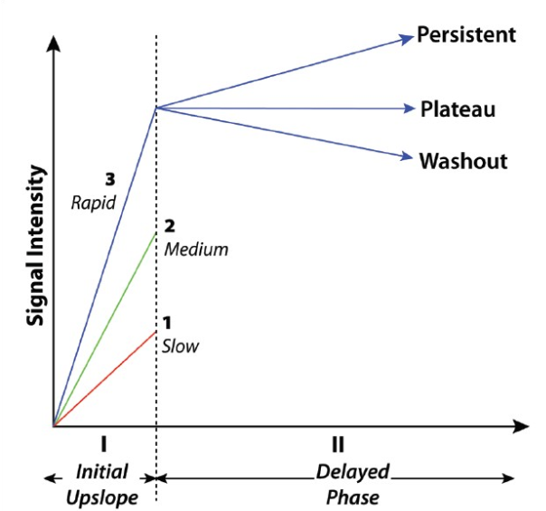
KINETIC CURVE
Type I
Type II
TYPE III
Notes:
The kinetics showing rapid initial enhancement after washout or plateau is suspicious of malignancy;
the kinetics showing persistent enhancement is more likely benign.

Slide 4
CASE 1
65 year old female
C/o pain in bilateral breast since 10-15days.
No H/O trauma, nipple discharge, fever.
No family history.
Notes:
CHANDRABHAGA OZAR
65Y/F

Slide 5
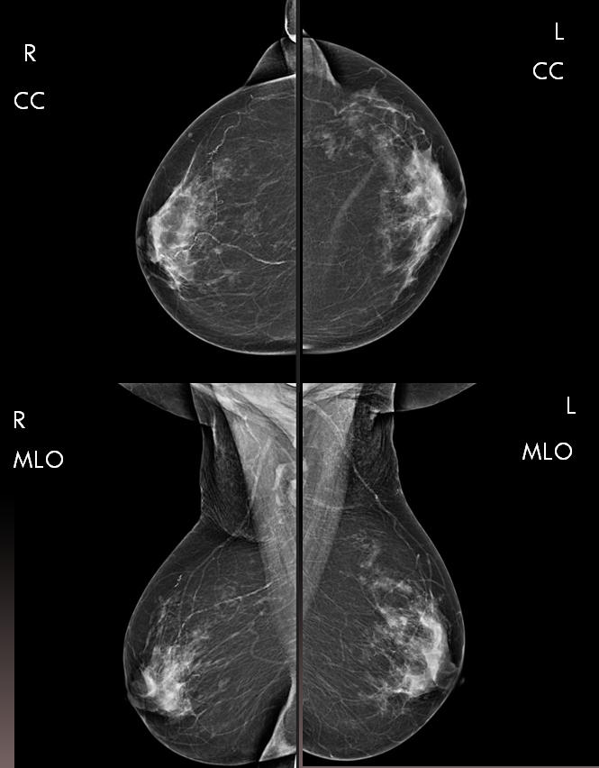
B
A
Notes:
A and B area right and left cranio-caudal( CC)
C and D are right and left medio-lateral oblique ( MLO ) views
Type C breast ( This may obscure small lesions ) :Mixed fibroglandular parenchyma with heterogeneous density.
IMPRESSION : – Ill-defined Heterogeneous density seen in the mammary region of the bilateral breast in n 2-D mammogram .
Focal asymmetry seen in the upper outer quadrant of the left breast which was suspicious of malignancy.

Slide 6
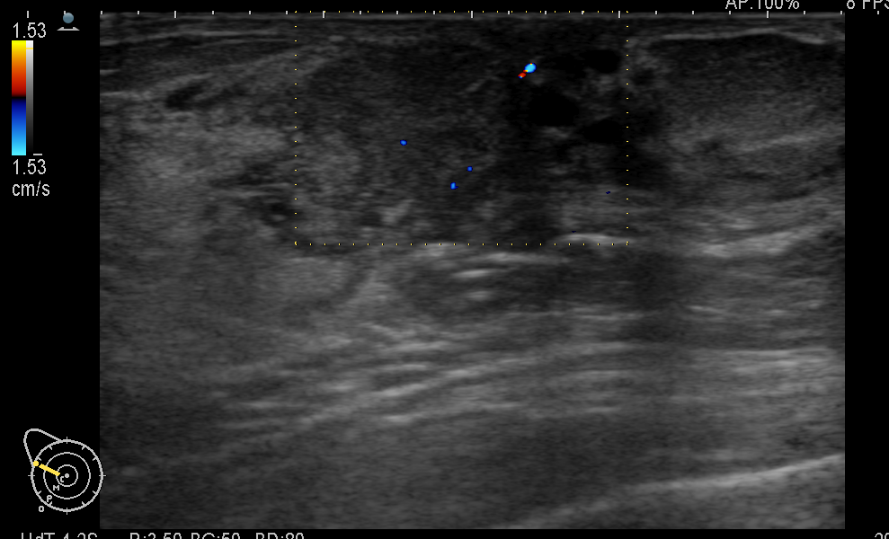
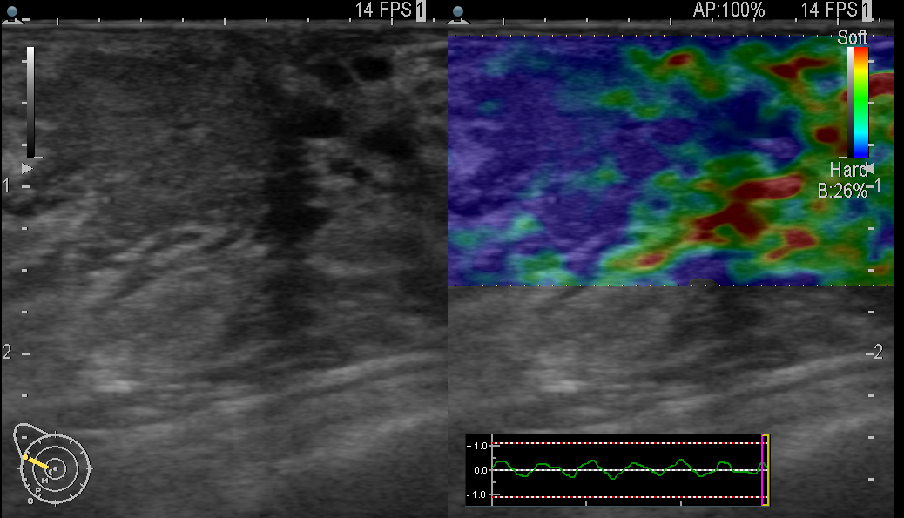
USG : Color Doppler
USG ELASTOGRAPHY
However on USG the lesion in right breast was suspicious for malignancy and was given BIRADS 4.
So MRI was advised to for further evaluation as there was suspicious lesion for malignancy on left side on mammography and on ultrasound the right breast showed suspicious lesion.
Notes:
USG : there was lesion on both side bt The lesion on right side showed mild internal vascularity and appeared hard on elastography.

Slide 7
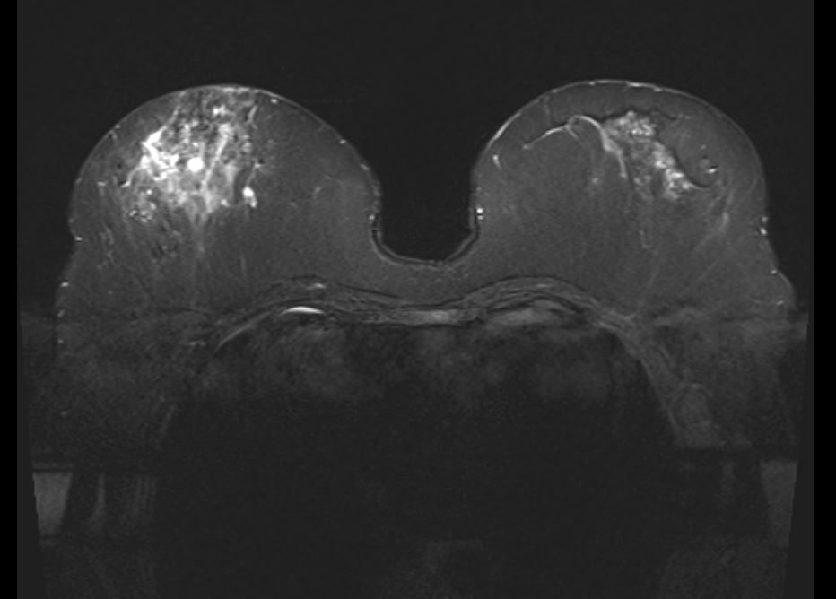
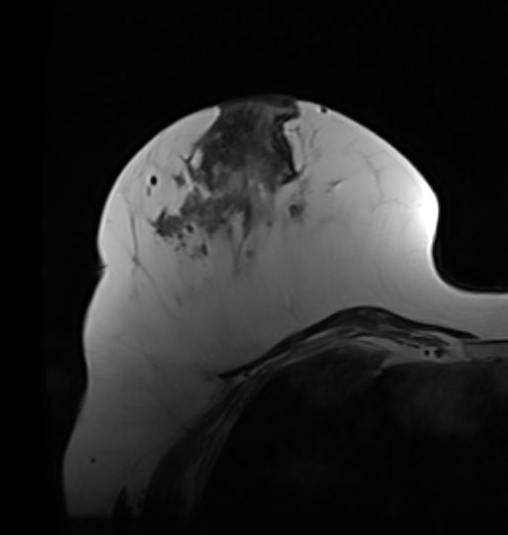
STIR
Right Breast
T2WI
Notes:
A : STIR and B: Right breast T2WI
There is diffuse altered signal intensity seen in the mammary region of the breast appearing hyperintense on STIR and Hypointense on T2WI.

Slide 8
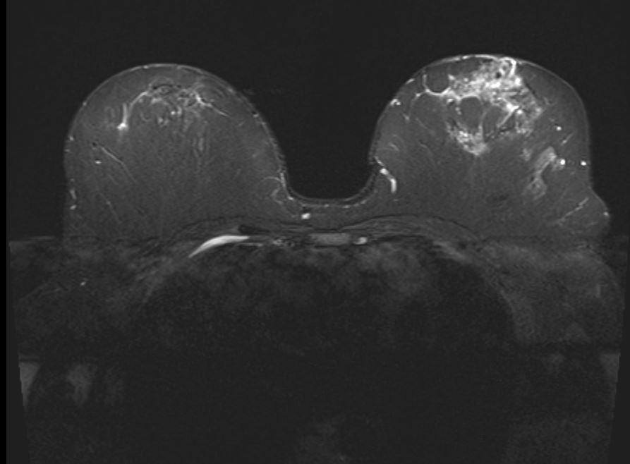
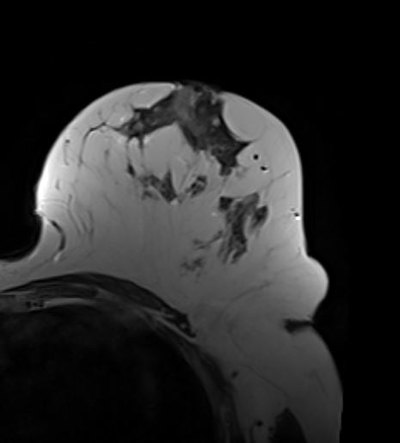
STIR
Left breast
T2WI
Notes:
A : STIR and B: Left breast T2WI
There is altered signal intensities noted in Left breast appearing hyperintense on STIR and Hypointense on T2WI.

Slide 9
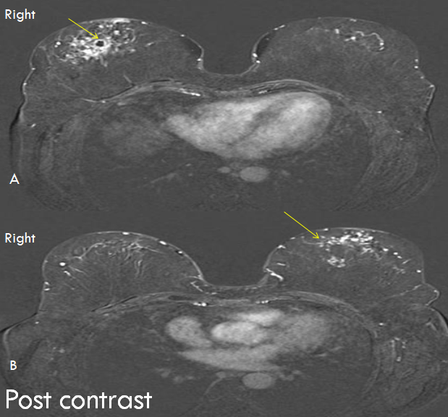
Notes:
B: Dynamic Post contrast subtracted image shows :
A well defined cystic lesion seen at 9’ o clock position of right breast. It showed peripheral post contrast enhancement
There are diffuse nodular enhancement seen in the breast parenchyma with type I kinetic curve.
Which was also Benign after on histopathology.

Slide 10
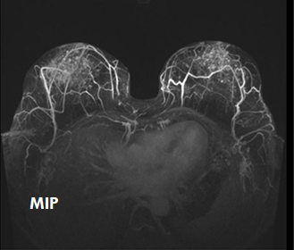
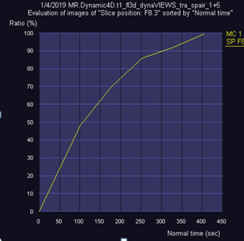
On MRI : infective etiology with bilateral
Diffuse granulomatous mastitis
BIRADS –ACR 3 (probably benign pathology)
Type I kinetic curve
Notes:
A : MIP image

Slide 11
CASE 2
45 years old female
C/o painless lump in breast since 1year.
No h/o nipple discharge .
No family history.
Notes:
SHOBHA KAMBLE
IMPRESSION : An ill defined mass lesion seen in the left breast diffusely involving the upper outer quadrant and extending in to the lower outer quadrant too. . Multiple small irregular masses seen adjacent to this large mass. Architectural distortion seen. There is skin thickening and nipple retraction seen.These findings are highly suggestive for malignancy.

Slide 12
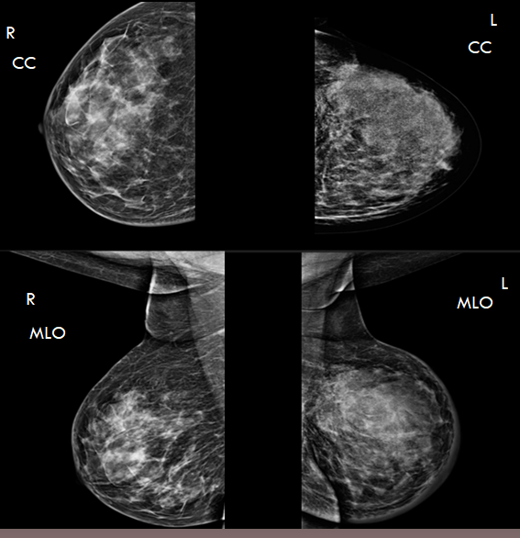
Notes:
A and B area right and left cranio-caudal( CC)
C and D are right and left medio-lateral oblique ( MLO ) views
IMPRESSION :
LEFT BREAST :
Left breast showed heterogenously dense type c parenchyma.
An ill defined mass lesion seen in the left breast diffusely involving the upper outer quadrant and extending in to the lower outer quadrant too and the margins are obscured.
Multiple small irregular masses seen adjacent to this large mass. Architectural distortion seen. There is skin thickening and nipple retraction seen.
Category 4C: High suspicion for malignancy
Right breast showed heterogenously dense type c parenchyma. So for the pre-op assessment mri was advised.

Slide 13
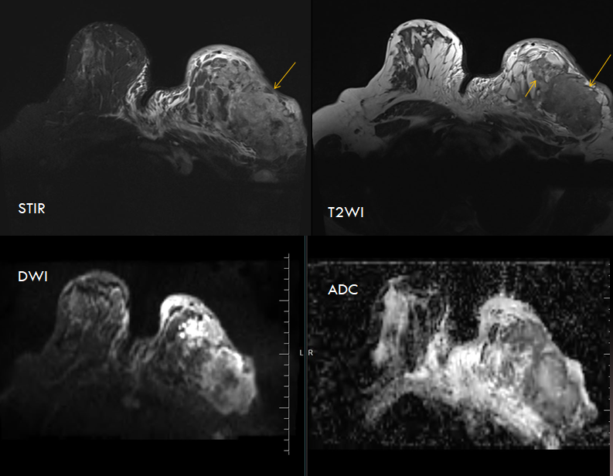
Notes:
There is an ill defined ,large heterogeneous mass seen predominantly occupying the upper outer quadrant 7.97cm ( CC) x 7.6 cm ( AP) x 6cm ( Trans) of the left breast . Multiple small heterogeneous lesions seen in the adjacent region .It showed heterogeneous signal intensity on STIR and T2WI and showed diffusion restriction with corresponding low values.

Slide 14
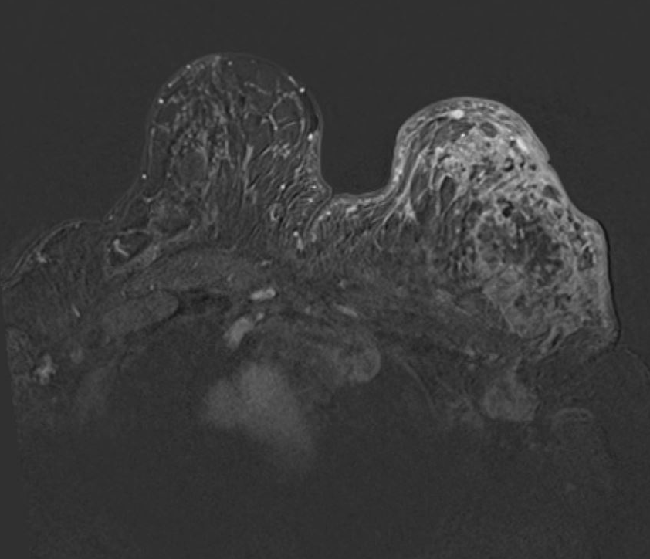
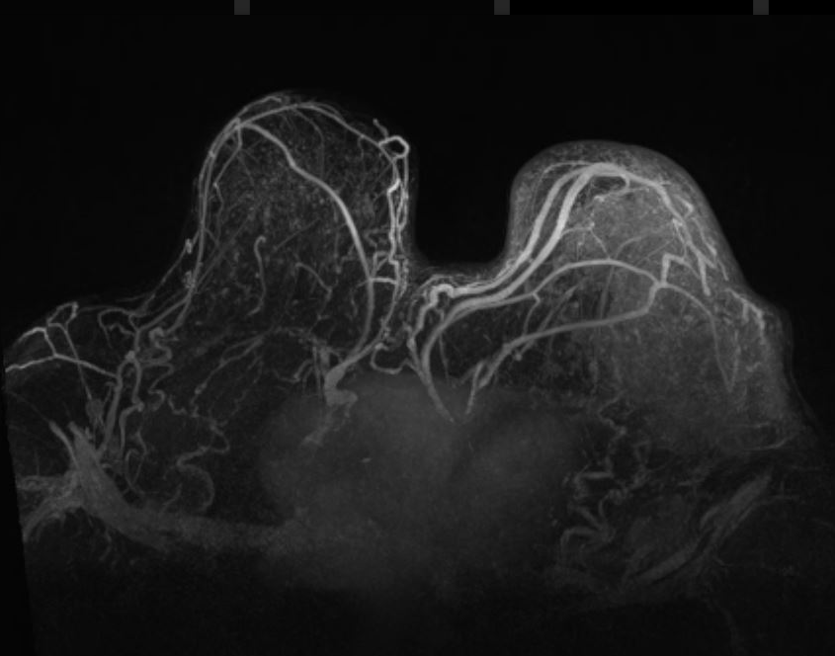
Post-contrast
MIP image
Notes:
On post contrast study,it showed multiple heterogenously enhancing lesions
MIP Images shows the increased vascularity to the mass lesion.

Slide 15
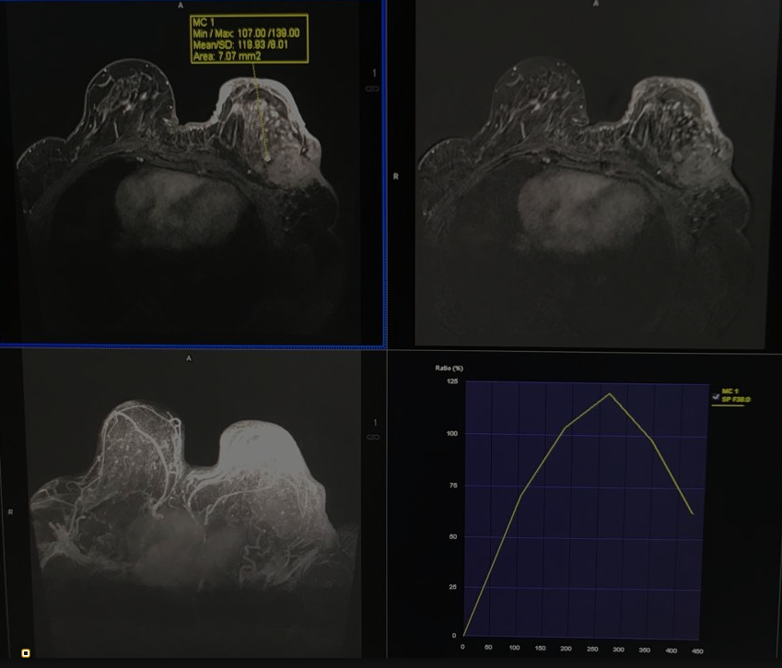
TYPE III Kinetic curve

Slide 16
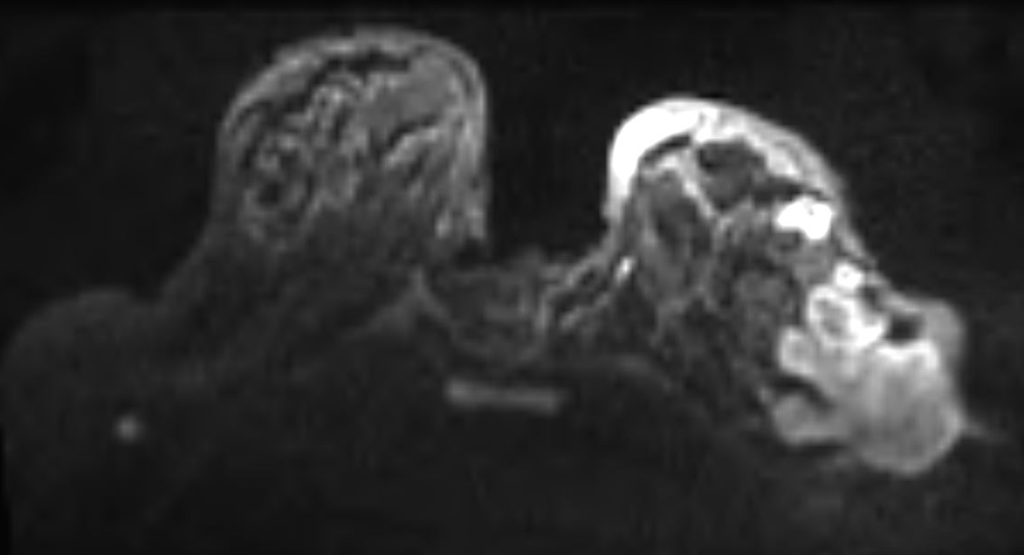
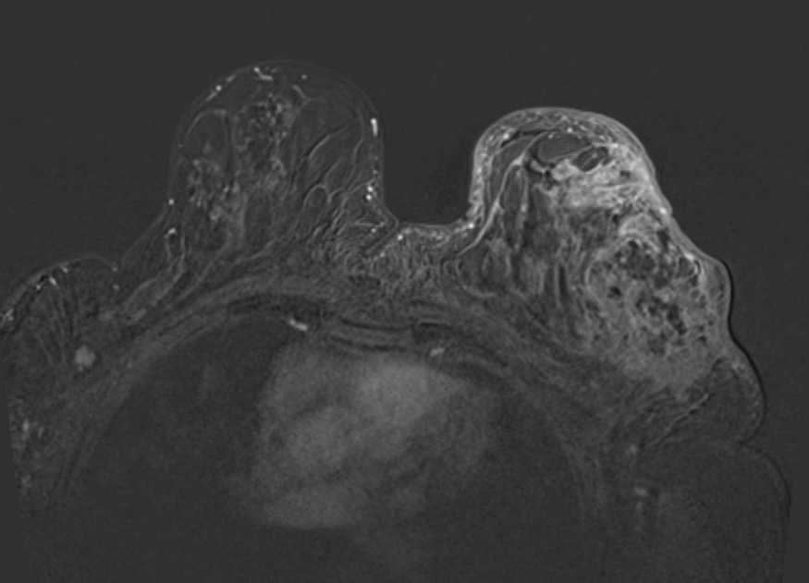
DWI
POST-CONTRAST
Notes:
A well defined small lesion was seen in right axilla on MRI showing diffusion restriction and post-contrast enhancement on post contrast study.

Slide 17
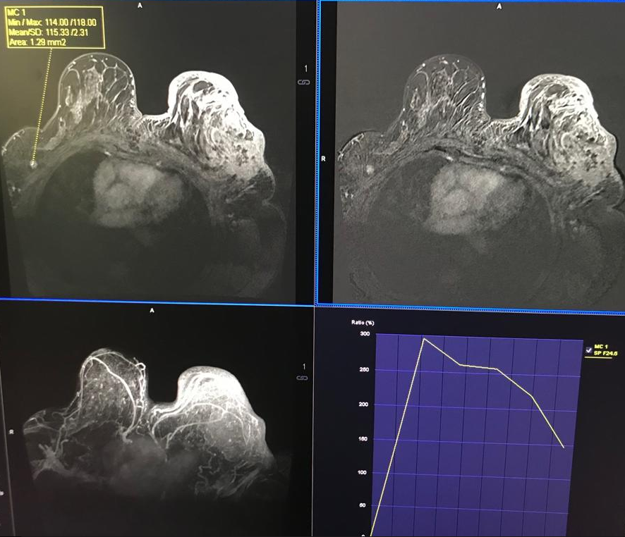
MIP
Type III kinetic curve
These findings are s/o multicentric malignancy ,locally advanced carcinoma in left breast with metastasis in contralateral breast.
BIRADS – V (Highly s/o malignancy)
Notes:
Contralateral axillary spread of breast cancer carries a poor prognosis but may have different prognostic implications than metastatic disease. Contralateral axillary metastatic disease may occur through dermal lymphatic spread .
So it is always advisable to do breast MRI as pre-operative assessment to evaluate the contralateral breast and also in aggressive diffuse malignancy underlying pectoralis muscle and chest involvement can be accurately obtained by MRI.

Slide 18
CASE 3
41 year old female came with complain of painless lump in right breast since 6 years. It was gradually progressive in nature.
No H/O trauma, nipple discharge, breathlessness.
No family history
Notes:
SUNITA TAMBE
41Y/F

Slide 19
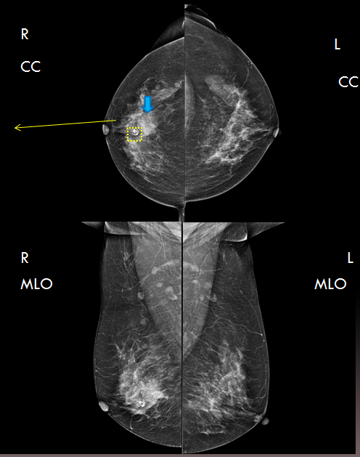

Notes:
These are right and left breast cranio-caudal( CC) medio-lateral oblique ( MLO ) views
Breast parenchymal density –Mixed fibroglandular parenchyma .
Type C
There is a mass seen in the central mammary region at 12’ o clock position which measured approx. 2.8x2.9cm with obscured margins .
Involving middle 1/3rd nipple .
BIRADS 4 : Category 4C: High suspicion for malignancy
Another small well defined mass with calcification seen anterior to the above mass is suggestive of calcified fibroadenoma.

Slide 20
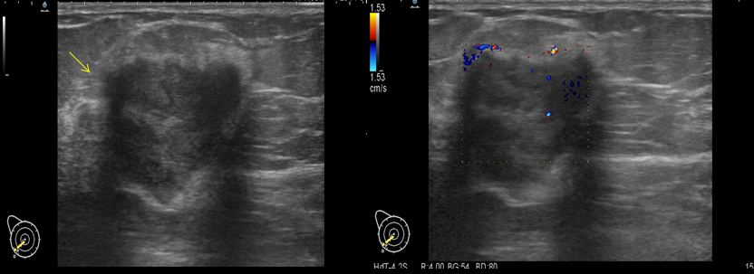
USG WITH COLOR DOPPLER
USG Right breast : showed heterogeneously hypoechoic mass with irregular margins showing internal vascularity.
Notes:
USG Right breast : showed heterogenously hypoechoic mass with irregular mass showing internal vascularity.

Slide 21
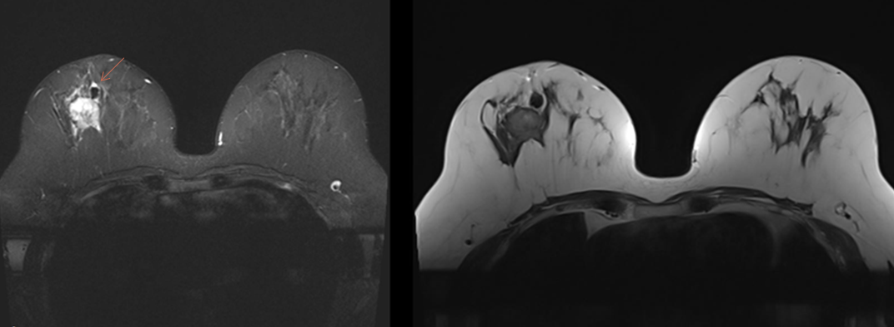
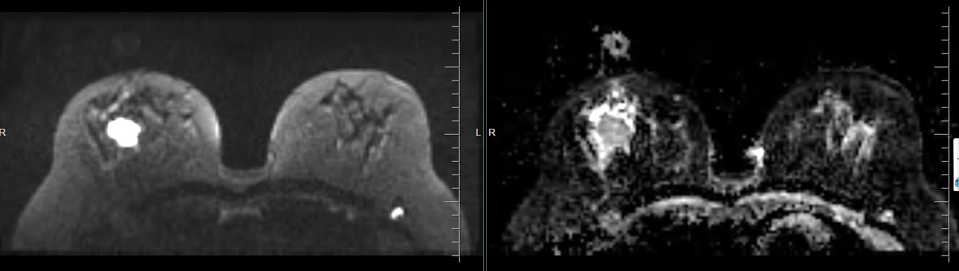
STIR
T2WI
DWI
ADC
Notes:
A large ill defined mass lesion with irregular margins showing altered signal intensity noted in right breast appearing hyperintense on STIR images and hypointense on T2WI
Another well defined lesion seen just superior to the mass lesion which appears hypointense on STIR and T2WI – likely suggestive of benign lesion ( calcification).
The lesion showed Diffusion restriction on DWI with corresponding low values on ADC.

Slide 22
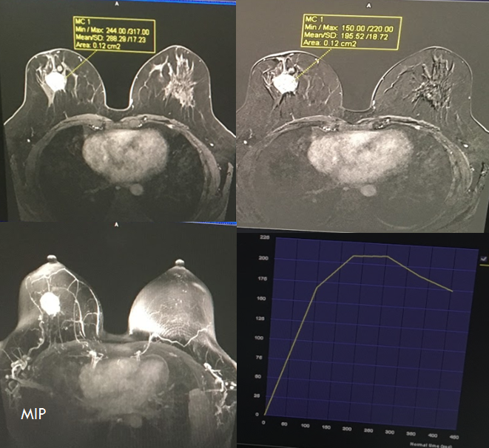
TYPE III kinetic curve

Slide 23
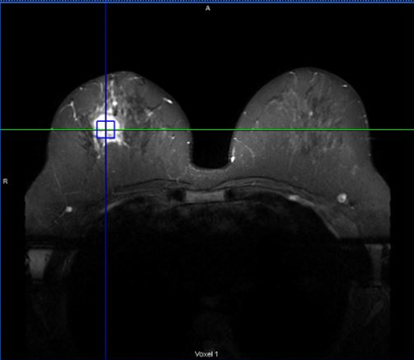
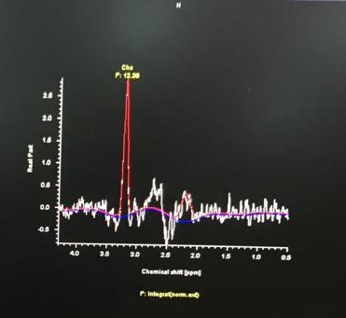
MR spectroscopy showed elevated choline peak – suggested malignancy which correlated with HPE findings.

Slide 24
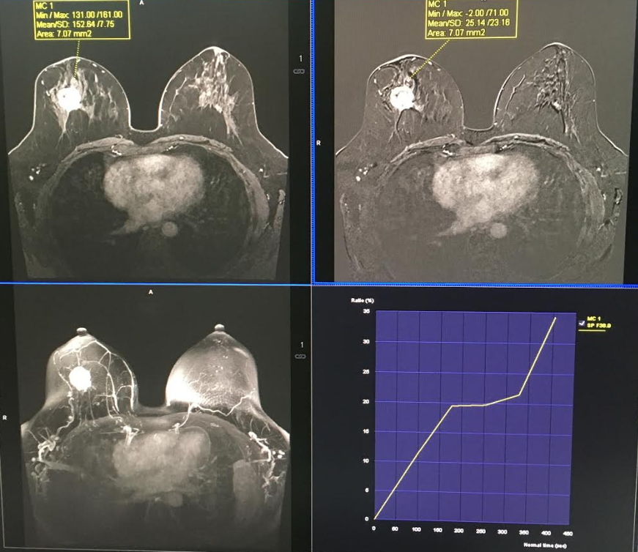
TYPE I kinetic curve

Slide 25
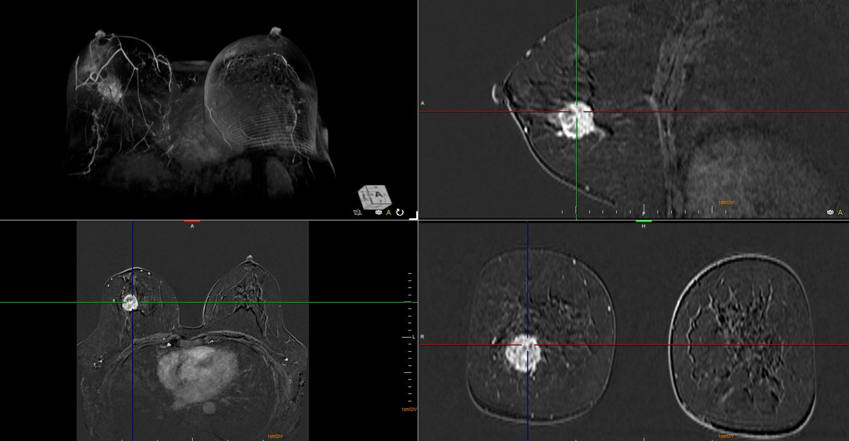
Notes:
This 3D MRI which helps us to exactly locate the lesion and evaluate its extent.

Slide 26
TAKE HOME MESSAGE
So to conclude multipara-metric MRI is excellent and non invasive method for differentiation of benign and malignant breast lesion

Slide 27
THANK YOU

Slide 28
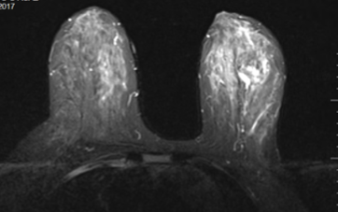
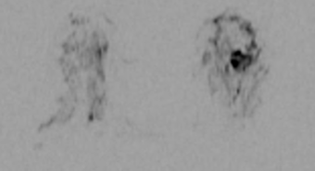
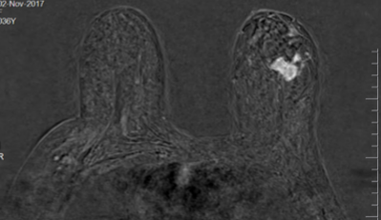
DWI Imaging with Background Suppression
STIR
DWI with background suppression
CEMR

Slide 29
DWI with background suppression

Slide 30
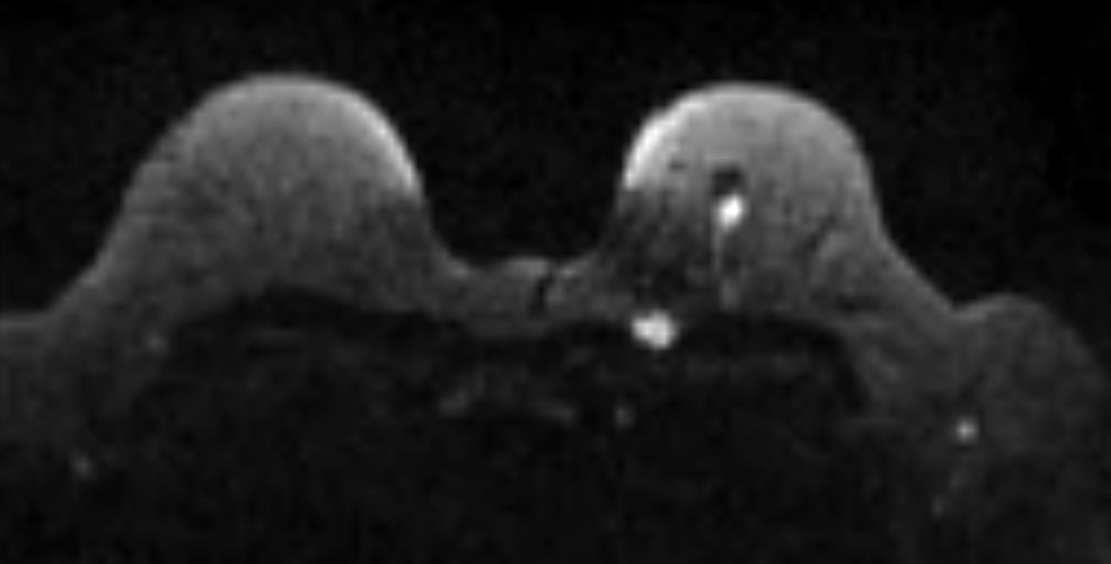
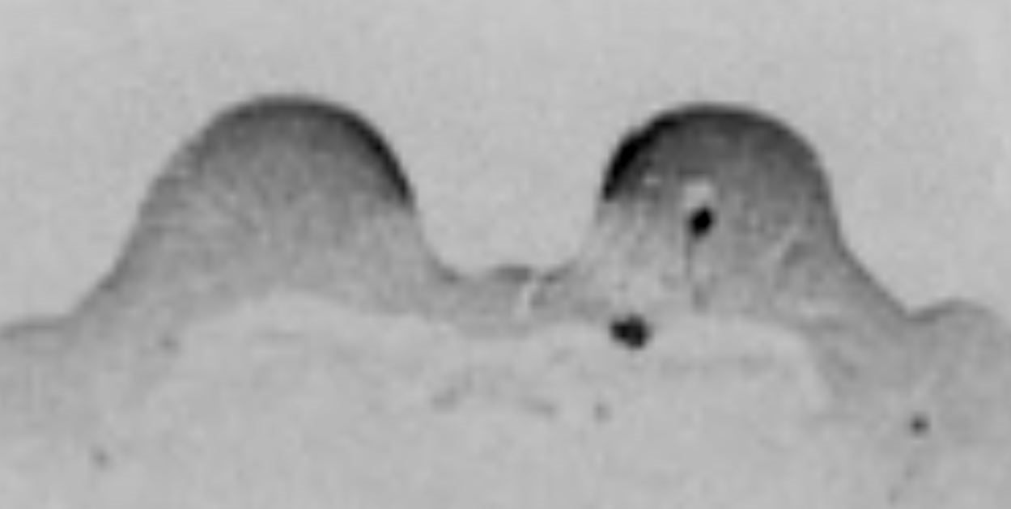
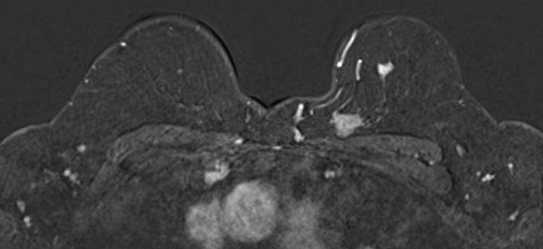
DWI with background suppression

