Slide 1
CARDIAC MRI
DR. RISHIKA GUPTA (JR III)
Department of Radio diagnosis

Slide 2
CASE

Slide 3
HISTORY
40 year old female patient (1/12/18)
C/O Chest pain since 1 month.
A/W dyspnoea on excretion and bluish discolouration of body.
H/O similar episode 1 year back which subsided on medication.
No H/O DM, TB, HTN, Past surgery

Slide 4
INVESTIGATIONS
Hb – 13gm%
TLC – 12,200/cumm
Platelet count -5 lacs/cumm
S. Sodium – 132 mEq/L
S. Potassium- 3.7 mEq/L
S. urea- 29mg/dl
S. creatinine- 0.64mg/dl
INR- 1.1
aPTT- 22.7

Slide 5
ECG- showed sinus tachycardia with left bundle branch block and few ventricular premature beats.
2D ECHO (22/11/18)- LV mass- 41 x 31 mm in apical septal area. RV mass- 16 x 24mm in apical area. Hypokinetic left ventricle .
Notes:
Ecg- lbbb- blurring of qrs complex in V6
VPC- aVL,Avf,I,III

Slide 6
TECHNIQUE
Plain multiplanar cardiac MR was performed.
Acquisition was performed in :
Four-chamber - T2 HASTE, TRUFI, Cine, perfusion
Short axis - Cine, perfusion
Two- chamber views - Cine.
LVOT; RVOT
Delayed post contrast viability imaging was also performed with IR sequences(phase sensitive and magnitude).

Slide 7
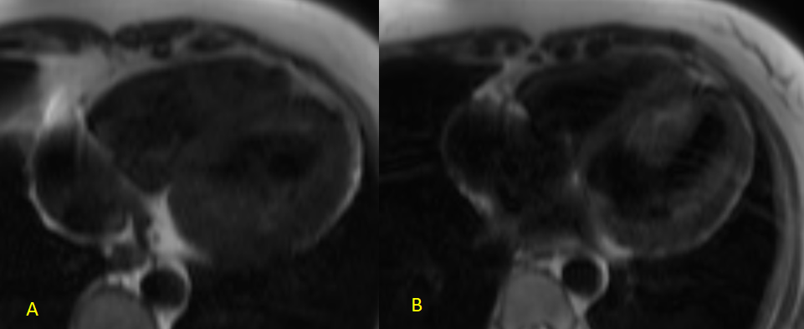
T2 HASTE 4 CHAMBER VIEW
Notes:
T2 HASTE 4 CHAMBER VIEW - black blood sequence shows mass that is isointense to the muscle in the left ventricle , that is focally adherent to the interventricular septum and also in the right ventricle in the apical region

Slide 8
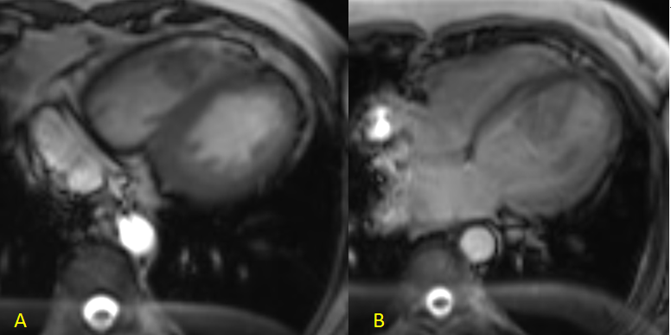
TRUFI 4 Chamber view
Notes:
TRUFI 4 Chamber view, bright blood sequence shows similar findings

Slide 9
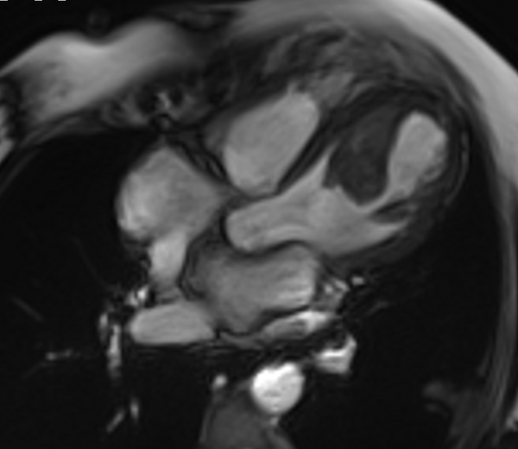
Cine 4 chamber view
Notes:
Dilated left ventricle (5.7 cm) with isointense lesion in the left ventricle that is adherent to the interventricular septum,
Also there is hypokinesia of the anteroseptal, apical and inferolateral wall

Slide 10
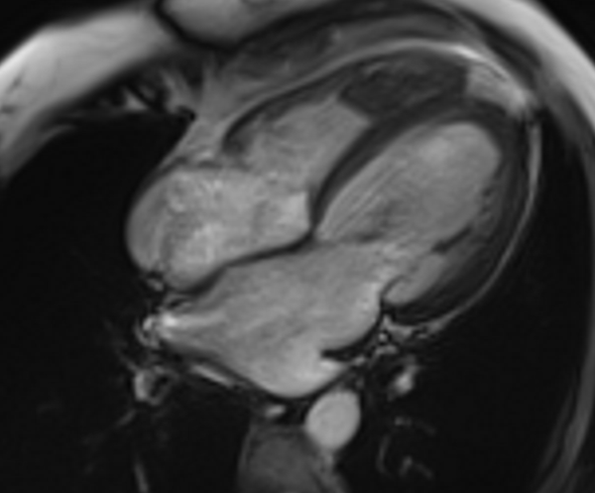
Cine 4 chamber view

Slide 11
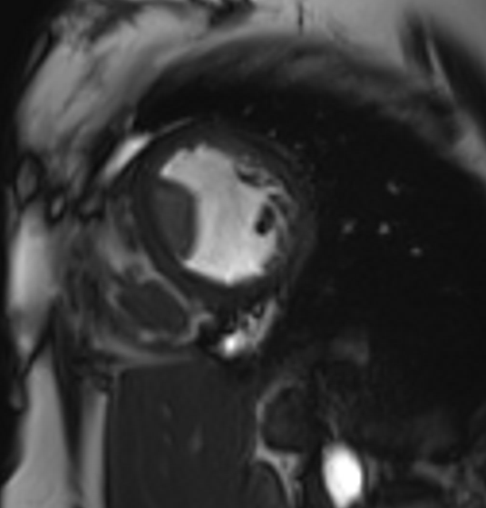
Cine short axis view
Notes:
Global hypokinesia In the septum , anterior wall , inferior wall and lateral wall.

Slide 12
Perfusion- short axis

Slide 13
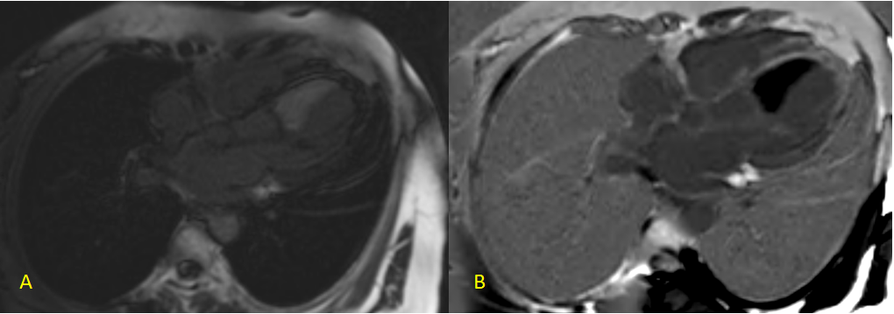
MAG & PSIR- 4 chamber view
Notes:
10 min delayed images MAG magnitude phase for better characterization of enhancement and PSIR
Delayed enhancement is seen in the anteroseptal and inferolateral wall of the left myocardium.

Slide 14
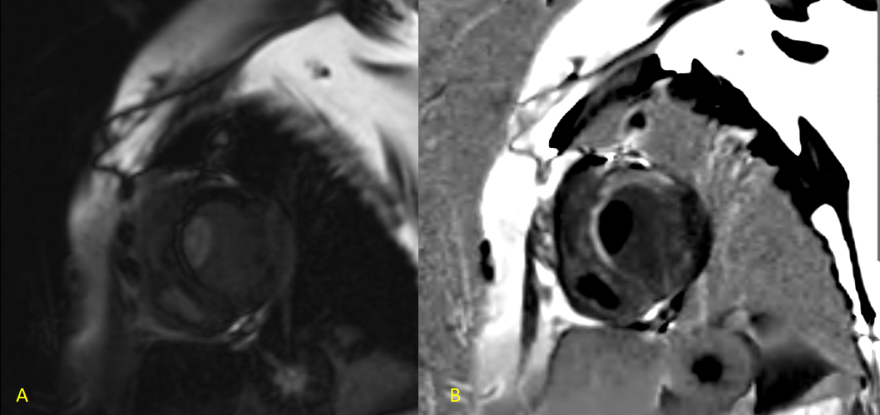
MAG & PSIR – short axis view
Notes:
MAG and PSIR
Delayed enhancement is seen in the anteroseptal and inferolateral wall of the left myocardium, where it is showing >50% subendocardial and transmural involvement suggesting that functional recovery cannot be done
However, there is subendocardial involvement only in the inferolateral wall , suggesting good prognosis and possible recovery

Slide 15
Notes:
Intraventricular thrombus in right and left ventricle
Dilated left ventricle
Global hypokinesia of left ventricle.
Transmural and subenocardial scar (LAD and RCA territory) with poor likelihood of functional recovery in the anteroseptal segments.
Subenocardial infarct involving inferolateral segment of LCx territory (<50% involvement of myocardium) with likelihood of functional recovery.
LVEF 20.6 %

Slide 16
THANK YOU!

