Slide 1
ADVANCES IN SPINE IMAGING ON MRI

Slide 2
A noninvasive procedure to evaluate different types of tissue, including
the spinal cord
intervertebral disks
spaces between the vertebrae through which the nerves travel
distinguish healthy tissue from diseased tissue.

Slide 3
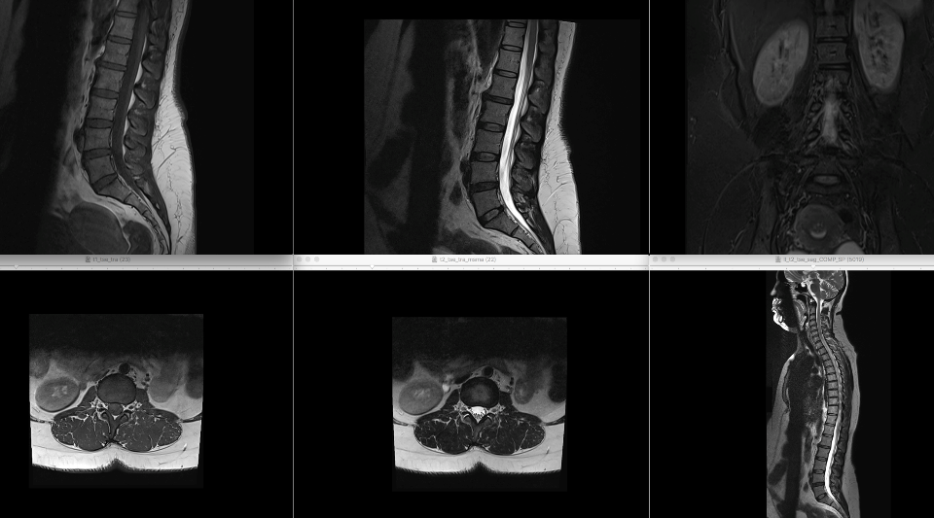
Screen Shot 2019-02-11 at 12.44.17 PM
Notes:
ADC
DIFFUSION

Slide 4
DIFFUSION ADC

Slide 5
To depict cellularity
Malignant infiltration → dense compact tumor infiltration → inhibits free movement of water molecules, causing diffusion restriction
The areas of restricted diffusion appear bright on DW-MRI and dark on ADC mapping

Slide 7
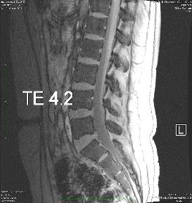
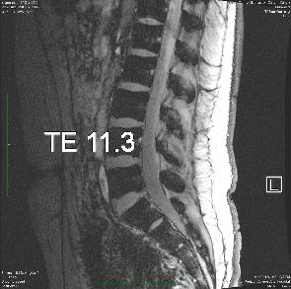
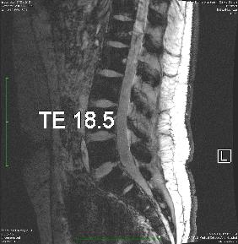
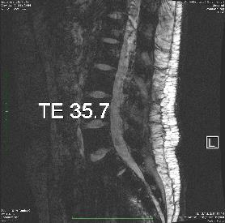
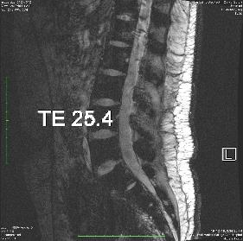
T2* Imaging

Slide 8
T2* Imaging

Slide 9
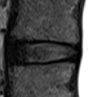
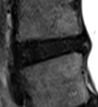
utilize the physics of water molecule relaxation within a magnetic field to produce images → highlights the presence of proteoglycans, hydration level
Conventional T2 weighted sagittal MRI sequences are used to create a subjective grading scale for disc health based on morphological features → lack specificity
Quantitative T2* mapping may offer promise in more accurately determining the health of disc

Slide 10
Post Processed

Slide 11
Lumbar Plexus Imaging
3D VIBE
DESS
STIR 3D SPACE
- T1-weighted images with high contrast and spatial resolution
- relatively short acquisition time
enables acquisition of high resolution 3D datasets
can obtain heavily T2W images as well as T1W or FLAIR images
Double Echo Steady State
High SNR

Slide 12
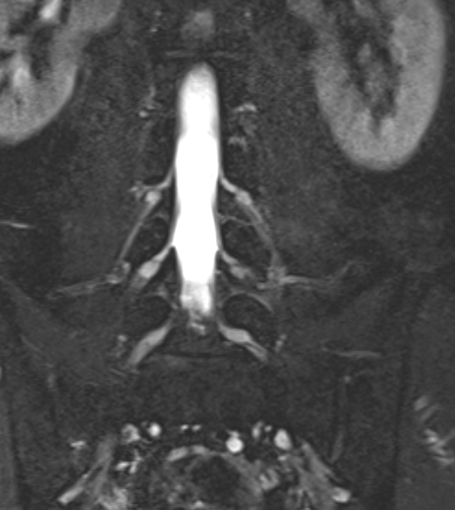
Ganglions of lumbar plexus

Slide 13
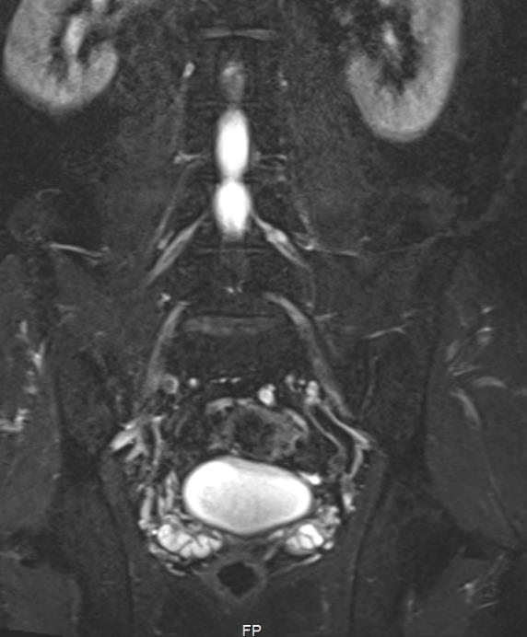
Lateral femoral cutaneous nerve
Obturator nerve

Slide 14
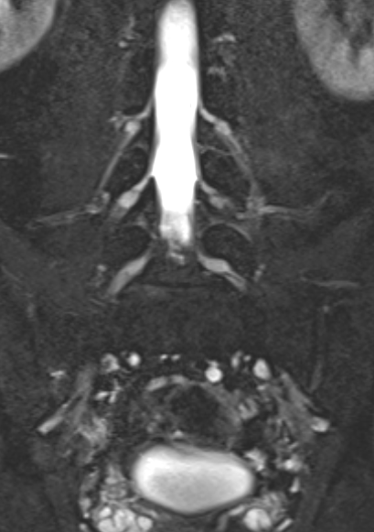
Ilioinguinal nerve

Slide 15
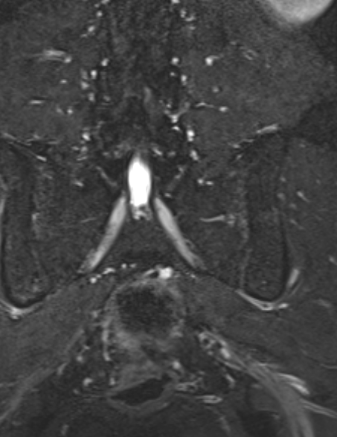
Femoral nerve

Slide 16
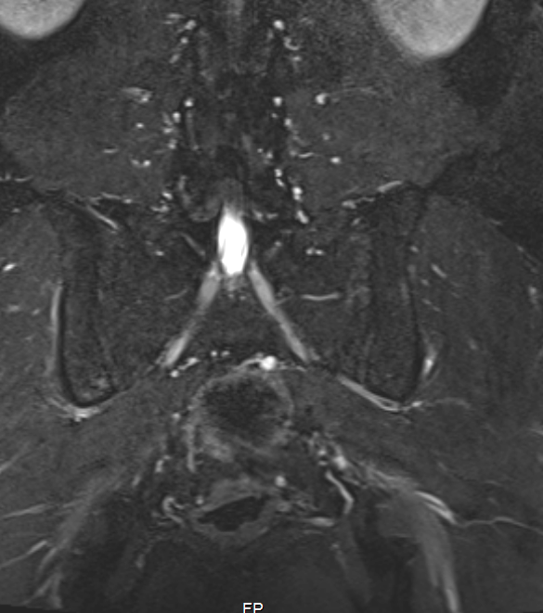
Sciatic nerve
Notes:
The sciatic plexus is formed by the ventral rami of the L4–S3 nerve roots, which join to form the tibial, common peroneal, and posterior femoral cutaneous nerves. After the sciatic plexus exits the pelvis through the greater sciatic foramen (which descends anterior, above, or through the piriformis muscle), the tibial and common peroneal components become enclosed in a common nerve sheath, forming the sciatic nerve. The sciatic nerve then enters the gluteal region and courses inferiorly between the adductor magnus and gluteus maximus muscles to the distal one-third of the thigh, where it divides into the tibial and common peroneal trunks. The posterior femoral cutaneous nerve is a sensory branch of the sacral plexus that arises from the posterior divisions of the S1 and S2 roots and the anterior divisions of the S2 and S3 roots and travels immediately posterolateral to the sciatic nerve. It courses under the gluteus maximus, branches into the perineal and inferior cluneal nerves, and descends in the posterior thigh over the long head of the biceps femoris to the back of the knee, where it pierces the deep fascia and accompanies the small saphenous vein to the middle back of the leg. The terminal segments of the posterior femoral cutaneous nerve communicate with the sural nerve (9,12,21). The sciatic plexus and sciatic nerves are consistently seen at MR neurography, normally with symmetric morphologic characteristics and signal intensity, given the limitations of inconsistent fat suppression (Fig 8).

Slide 17
Diffusion Tensor Imaging(DTI)
DTI is an advanced non-invasive technique of MR which enables visualization as well as qualitative and quantitative assessment of the integrity of the white matter tracts.
DTI is used primarily for assessing white matter of the brain and spinal cord, because movement of the water particles in these structures is limited in directions perpendicular to the white matter fibres called anisotropic diffusion.

Slide 18
DTI

Slide 20
Clinical applications of DTI in spinal cord
TRAUMA

Slide 21
TUMOR

Slide 22
Degenerative myelopathy
Demyelinating
Infectious diseases

Slide 23
UTILITY
Increases diagnostic confidence
Additional raw data
Ultra structural detailing

Slide 24
THANK YOU

