Slide 1
A CASE OF NON ARTERITIC ISCHEMIC OPTIC NEUROPATHY in a young male
Dr. Divya Motwani

Slide 2
48 years man
worker at a construction site (operates with grinding machines)
residing in Pune
Chief Complaints - (RE) sudden, painless diminution of vision since morning

Slide 3
History Of Present Illness:
Patient was apparently alright until he woke up in the morning and developed sudden, painless diminution of vision in the right eye since morning.
Same sided headache since 2 days which was throbbing and continuous in nature.
No history of flashes or floaters.
No history of lifting any heavy weights.
No history of spectacle use.

Slide 4
Past History :
History of trauma to the right eye 15 years back with grinding particle while working after which the patient had mild watering and redness. No treatment was taken.
No history of DM, HTN, IHD or any systemic illness.
No history of any similar complaints in the past.
Family History : not significant
Personal History :
Sleep , appetite , bowel , bladder was normal

Slide 5
General Examination:
The patient was conscious , stable, well oriented to time place and person
Systemic examination :
WNL

Slide 6
Ocular Examination
OCCULAR EXAMINATION | RIGHT EYE | LEFT EYE
VISION | FC AT 2 FT , PL PRESENT, PR ACCURATE | 6/12P
PIN HOLE | NOT IMPROVING | 6/6P
BCVA | NOT IMPROVING | 6/6P (+0.75DS)
EXTRA OCULAR MOVEMENTS | FULL, FREE AND PAINLESS IN ALL GAZES | FULL, FREE AND PAINLESS IN ALL GAZES
HEAD POSTURE | CENTRAL
LID AND ADNEXA | WNL | WNL

Slide 7
ANTERIOR SEGMENT EXAMINATION
EXAMINATION | RIGHT EYE | LEFT EYE
CONJUCTIVA | NORMAL | NORMAL
CORNEA | CLEAR | CLEAR
ANTERIOR CHAMBER | NORMAL DEPTH | NORMAL DEPTH
IRIS | NORMAL PATTERN | NORMAL PATTERN
PUPIL | C/C/RTL NO RAPD | C/C/RTL
LENS | CLEAR | CLEAR
IOP WITH APPLANATION TONOMETER | 18MMHG | 20MMHG

Slide 8
FUNDUS EXAMINATION
FUNDUS EXAMINATION | RIGHT EYE | LEFT EYE
MEDIA | CLEAR | CLEAR
OPTIC DISC | DISC MARGINS BLURRED | WNL
CUP DISC RATIO | NOT APPRECIATED | 0.2
NEURO RETINAL RIM | NOT APPRECIATED | HEALTHY
MACULA | NORMAL | NORMAL
FOVEAL REFLEX | PRESENT | PRESENT
GENERAL FUNDUS | TORTUOUS VESSELS | WNL

Slide 9
RIGHT EYE

Slide 10
LEFT EYE

Slide 11
Differential Diagnosis
Optic neuritis
NAION
AAION
Impending CRVO

Slide 12
INVESTIGATIONs
Routine blood reports – wnl (CBC, ESR, CRP)
Patient was found to have raised homocystine levels – 39mcmol/l (normal levels 4 – 15 mcmol/l)
Colour vision test could not be performed due to poor vision.
Perimetery could not be performed due to poor vision.
OCT s/o mild edema of the optic disc in the right eye .
Left eye optic disc –wnl

Slide 13
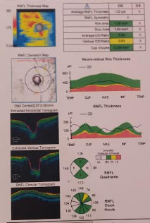
RIGHT EYE
LEFT EYE

Slide 14
CT scan of brain and orbit
S/o –a well defined metallic density,10x4 mm along the lateral aspect of right eyeball/ deep to lateral rectus muscle within the right orbit s/o a foreign body.

Slide 15
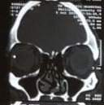

Slide 17
YOUNG PATIENT
NO SYSTEMIC ILLNESS
SUDDEN DOV AFTER WAKING UP IN THE MORNING
HYPERMETROPIC DISC IN THE OTHER EYE
RE DISC WITH BLURRED MARIGINS

Slide 18
PROVISIONAL DIAGNOSIS
RIGHT EYE NON–ARTERITIC ISCHEMIC OPTIC NEUROPATHY WITH INCIDENTAL INTRA OCULAR FORIGEN BODY.

Slide 19
PLAN OF MANAGEMENT
INJECTION IV METHYL PREDNISOLONE 1GM/ DAY FOR 3 DAYS
Followed by oral prednisolone 50mg tapered every 3 days
(RE) E/D PREDISOLONE ACETATE 1% QID FOR 2 WEEKS
(RE) E/D NEPAFENAC 0.1% TDS FOR 2 WEEKS
Folic acid supplements 5mg for 1 month.

Slide 20
Takayama K, Kaneko H, Kachi S, Ra E, Ito Y, Terasaki H. High-dose intravenous pulse steroid therapy for optic disc swelling and subretinal fluid in non-arteritic anterior ischemic optic neuropathy. Nagoya J Med Sci. 2017;79(1):103–108. doi:10.18999/nagjms.79.1.103
Hayreh, Sohan Singh, and M. Bridget Zimmerman. “Non-Arteritic Anterior Ischemic Optic Neuropathy: Role of Systemic Corticosteroid Therapy.” Graefe's Archive for Clinical and Experimental Ophthalmology, vol. 246, no. 7, 2008, pp. 1029–1046., doi:10.1007/s00417-008-0805-8.

Slide 21
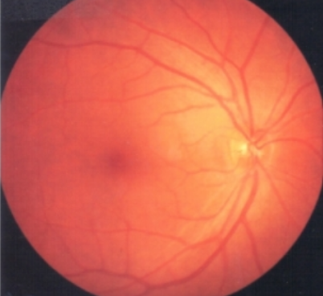
ON FOLLOW UP
The patient was symptomatically better after 1 week of treatment.
The vision in the right improved to 2/60 NI on pinhole after 1 week.
The disc edema reduced.

Slide 22
DISCUSSION
Ischemic Optic Neuropathy is an acute, painless optic neuropathy occurring predominantly in patients over 50 years of age.
AION is categorized as either arteritic or nonarteritic.

Slide 23
Pathophysiology
NAION
Insufficiency of optic disc circulation
d/t structural crowding of nerve fiber
Inadequate oxygenation
Ischemia and
swelling of disc

Slide 24
Take home message
NAION IS ALSO AN IMPORTANT CAUSE OF SUDDEN LOSS OF VISION EVEN IN YOUNG PATIENT.
A HYPERMETROPIC DISC IS AT RISK.
HOMOCYSTINE LEVELS SHOULD ALSO BE EVALUATED IN SUCH INDIVIDUALS.

Slide 25
THANK YOU

