Slide 1
AN UNUSUAL CASE OF ORBITAL CYSTICERCOSIS Dr. Chaitali Desai Dr DY Patil Medical College,Pune

Slide 2
A 25 year old housewife presented with LE Drooping of upper eyelid (Unilateral ptosis) 1month Pain Redness

Slide 3
No H/O diminution of vision No H/O ocular trauma or foreign body. No H/O insect bite No H/O similar swelling around eye or on face No H/O heat or cold intolerance, weight gain or loss,swelling in the neck or palpitations. No H/O diurnal variations No H/O any aggravating or relieving factors

Slide 4
Past History: No H/O of spectacle use or any ocular procedure Medical History :- No H/O HTN/ DM/ Thyroid disorders/ stroke /generalised weakness/ difficulty in movements or swallowing No H/O any known allergies or exposure to possible allergen. No H/O swelling anywhere else in the body. Family History :- No such similar complaints Personal History :- Sleep, bowel, bladder habits– WNL Non-vegetarian No addictions

Slide 5
General examination: Pt is conscious, co-operative and well oriented to time, place and person. P-88/min BP- 110/70 mm of Hg Systemic examination: CVS,RS – NAD P/A – No Organomegaly CNS – No neurosensory deficit, Cranial nerve exam - WNL

Slide 6
OCULAR EXAMINATION:
 | RE | LE
Vn | 6/6, N6 | 6/6, N6
Ph | - | -
BCVA | - | -
Extraocular Movements | Free, full and painless | Restricted in upgaze
Head Posture | CENTRAL
Ocular Symmetry | Orthophoric | Orthophoric
Eyelids | Normal (Palpebral fissure height- 9mm) | Ptosis (Palpebral fissure height 6mm) Moderate Diffuse upper eyelid edema . tenderness, local rise of temp, redness + , skin was tense.
Eye brows | Raised | N
Orbit | N 17mm | N 19mm

Slide 7
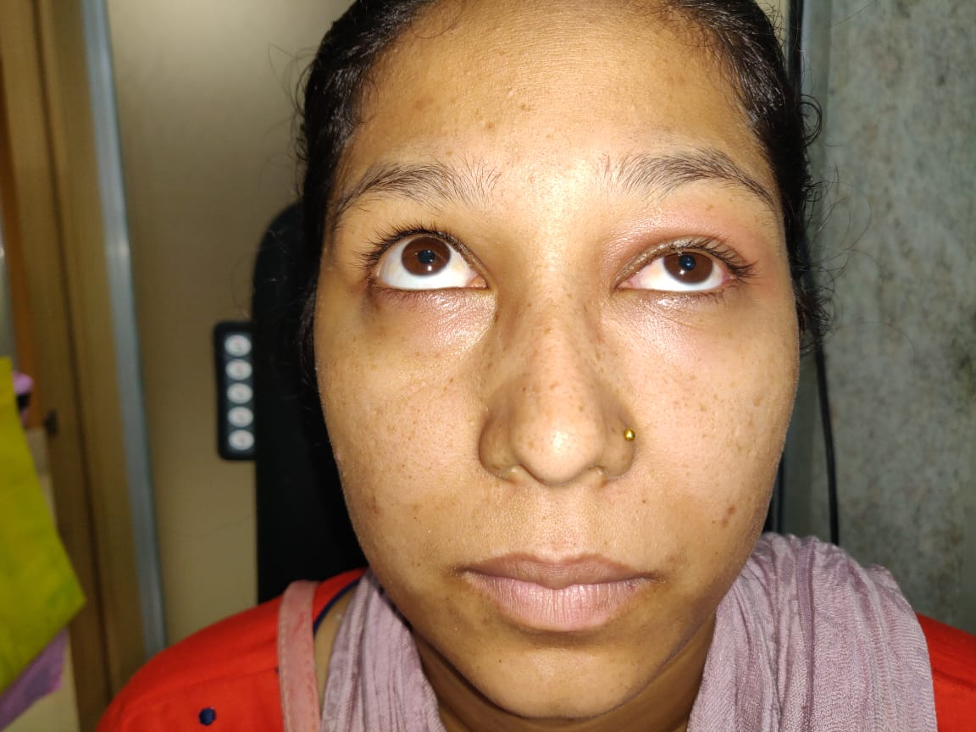
LE Restricted eye movements in upgaze with diplopia

Slide 8
ANTERIOR SEGMENT EXAMINATION Fundus- BE WNL
 | RE | LE
Conjunctiva | N | Mild congestion
Cornea | Clear | Clear
Anterior Chamber | N Depth | N Depth
Iris | N Pattern | N Pattern
Pupil | C/C/ RTL | C/C/RTL
Lens | Clear | Clear
 | RE | LE
IOP | 14 mm of Hg | 14 mm of Hg
SAC | Patent | Patent

Slide 9
DIFFERENTIAL DIAGNOSIS: -Parasitic Infection of the Orbit -Orbital pseudotumour -Thyroid related orbitopathy

Slide 10
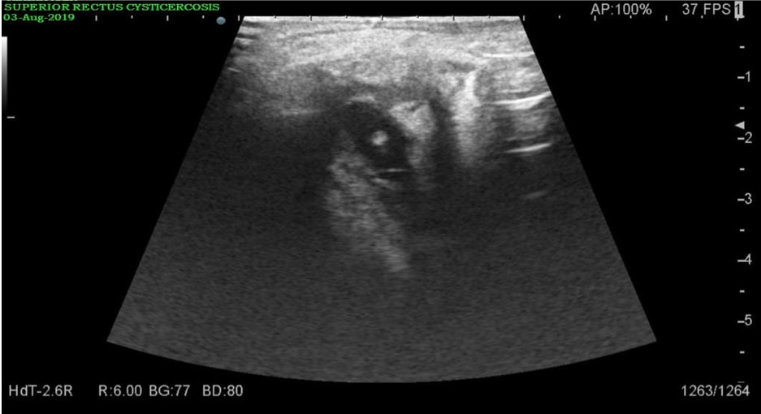
B-SCAN (LE) Well defined anechoic lesion 11x8mm noted in the Superior Rectus Muscle with an echogenic focus within most likely scolex

Slide 11
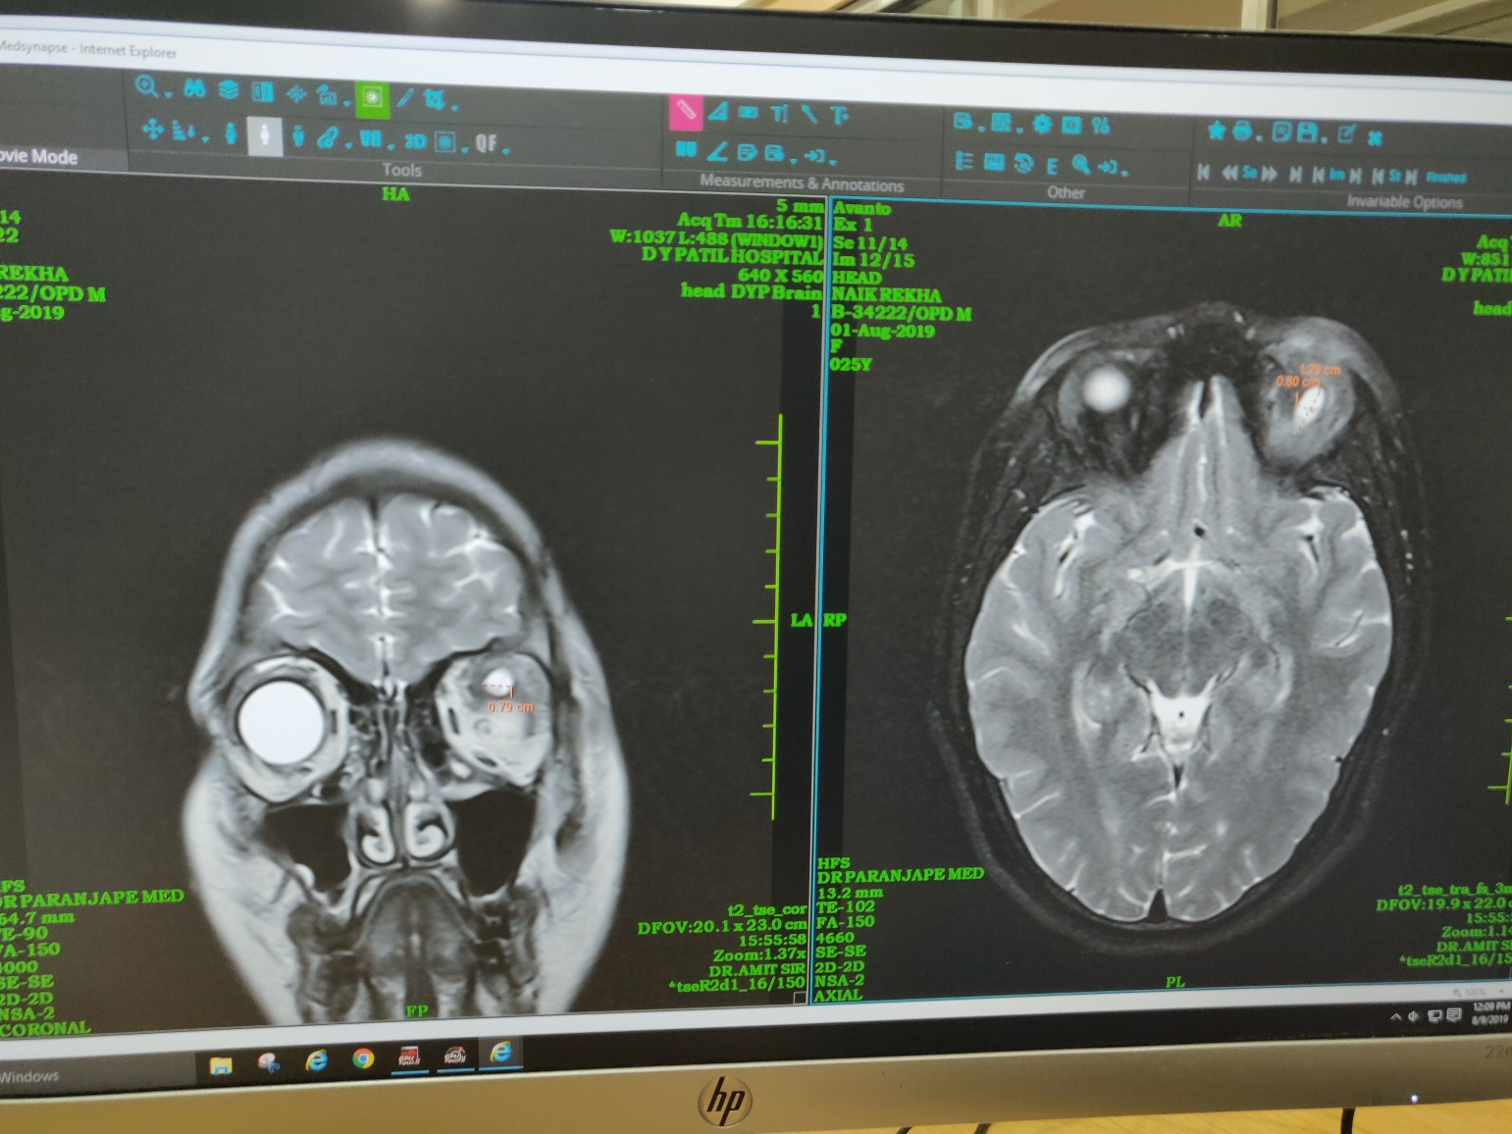
MRI Brain+Orbit Well defined cystic lesion in the Superior Rectus-LPS Muscle Complex appearing hypointense on T1WI, hyperintense on T2WI measuring 8.5x8x12mm. The cystic lesion shows an eccentric nodule likely scolex. Entire Superior Rectus along with LPS appears thickened

Slide 12
INVESTIGATIONS
Complete Blood Count- WNL
Blood Biochemistry – WNL
Absolute eosinophilic count – 340cells/mcL(30-350cells/mcL)
Thyroid Function Test - WNL
Stool examination WNL
USG Abdo & Pelvis- WNL
ELISA for Anticysticercal Antibodies- Not done (Patient not willing)

Slide 13
DIAGNOSIS : Cysticercosis of LE Superior Rectus + LPS Muscle Complex.

Slide 14
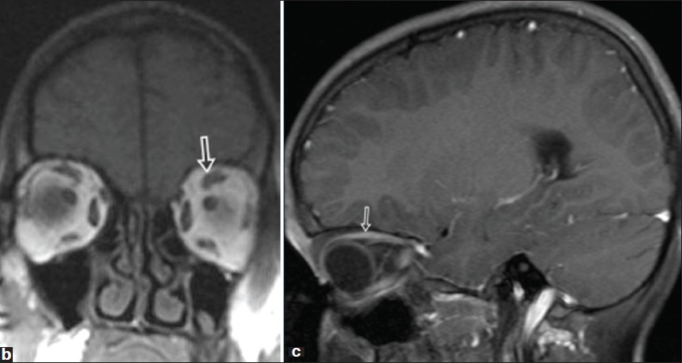
TREATMENT -Tab Albendazole 15mg/kg (in divided dose) BD for 1 month -Tab Prednisolone 1mg/kg OD tapered over 4 weeks. a)Post treatment clinical photograph showing resolution of LE ptosis and compensatory lid retraction in the RE b)$ c) MRI after treatment shows complete resolution of lesion in left superior rectus and LPS complex

Slide 15
At Presentation At 1 month of follow up

Slide 16
Discussion Ocular cysticercosis is caused by Cysticercus cellulosae, which is a larval form of the pork tapeworm Taenia solium. Cysticercosis is endemic in Asia, Africa, South and Central America, Eastern Europe, Mexico and Russia. Consumption of undercooked pork and use of contaminated vegetables or water can cause this infection.

Slide 17
Cysticercosis primarily affects the central nervous system(CNS), subcutaneous tissue, external eye structures, muscles, and intraocular structures like vitreous and retina. Ophthalmic cysticercosis can cause loss of vision, periorbital pain, scotoma and photopsia

Slide 18
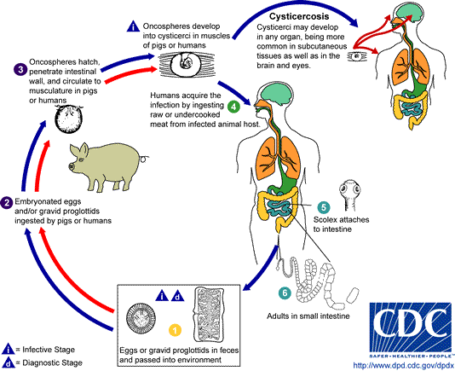
Life Cycle
DEFINITIVE HOST –
Man
INTERMEDIATE HOST –
Pig

Slide 19
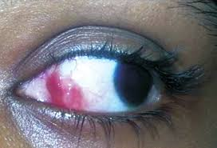
Different ocular forms
Eyelid cyst
Subconjunctival Cyst
Cyst in Anterior Chamber
Dhiman R, Devi S, Duraipandi K, Chandra P, Vanathi M, Tandon R, Sen S. Cysticercosis of the eye. Int J Ophthalmol 2017;10(8):1319-1324

Slide 20
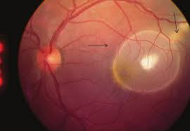
Intravitreal Cyst
Submacular cyst

Slide 21
Ocular cysticercosis can have varied clinical presentation which is non-specific and better diagnosed with thorough imaging Judicious use of oral steroids and anti-parasitic agents help in remission of cyst and is the mainstay of treatment. Therefore it is important to be aware of the clinical presentation of ophthalmic parasites for proper diagnosis and management, to prevent sight threatening and life threatening complications

Slide 22
REFERENCES
1. Rath S, Honavar SG, Naik M, Anand R, Agarwal B, Krishnaiah S, Sekhar GC. Orbital cysticercosis: clinical manifestations, diagnosis, management, and outcome. Ophthalmology. 2010;117(3):600–605.
2 . Kamali NI, Huda MF, Srivastava VK. Ocular cysticercosis causing isolated ptosis: A rare presentation. Ann Trop Med Public Health 2013;6:303-5
3 . Basu, Sriparna & Muthusami, Sunil & Kumar, Ashok. (2009). Ocular cysticercosis: An unusual cause of ptosis. Singapore medical journal. 50. e309-11.
4. Dhiman R, Devi S, Duraipandi K, Chandra P, Vanathi M, Tandon R, Sen S. Cysticercosis of the eye. Int J Ophthalmol 2017;10(8):1319-1324
5. Sihota R, Honavar SG. Oral albendazole in the management of extraocular cysticercosis. Br J Ophthalmol. 1994;78(8):621–623.

Slide 23
THANK YOU

