Slide 1
Our experience with rituximab in pemphigus
Dr. Saijal Gupta

Slide 2
Pemphigus treatment: Through the ages
Steroids
Notes:
emphigus vulgaris (PV) is a potentially fatal autoimmune, intraepithelial disease characterized by flaccid blisters and erosions of the skin and mucous membranes and histologically by acantholysis.
he primary objective of the therapeutic management of PV is initially to control the disease, heal the bullous skin and mucous lesions, and minimize the associated functional impairment. Subsequently, the real challenge is to prevent relapses in the long run and avoid adverse events associated with the prolonged use of steroids and immunosuppressive agent

Slide 3
Pemphigus treatment: Through the ages
1983
Steroids DCP
Notes:
emphigus vulgaris (PV) is a potentially fatal autoimmune, intraepithelial disease characterized by flaccid blisters and erosions of the skin and mucous membranes and histologically by acantholysis.
he primary objective of the therapeutic management of PV is initially to control the disease, heal the bullous skin and mucous lesions, and minimize the associated functional impairment. Subsequently, the real challenge is to prevent relapses in the long run and avoid adverse events associated with the prolonged use of steroids and immunosuppressive agent

Slide 4
Pemphigus treatment: Through the ages
Steroids DCP Steroid sparing agents
Notes:
emphigus vulgaris (PV) is a potentially fatal autoimmune, intraepithelial disease characterized by flaccid blisters and erosions of the skin and mucous membranes and histologically by acantholysis.
he primary objective of the therapeutic management of PV is initially to control the disease, heal the bullous skin and mucous lesions, and minimize the associated functional impairment. Subsequently, the real challenge is to prevent relapses in the long run and avoid adverse events associated with the prolonged use of steroids and immunosuppressive agent

Slide 5
Pemphigus treatment: Through the ages
1999
Steroids DCP Steroid sparing agents Rituximab
Notes:
emphigus vulgaris (PV) is a potentially fatal autoimmune, intraepithelial disease characterized by flaccid blisters and erosions of the skin and mucous membranes and histologically by acantholysis.
he primary objective of the therapeutic management of PV is initially to control the disease, heal the bullous skin and mucous lesions, and minimize the associated functional impairment. Subsequently, the real challenge is to prevent relapses in the long run and avoid adverse events associated with the prolonged use of steroids and immunosuppressive agent

Slide 6
Rituximab: The journey
Notes:
In 1997, Fda approved for nhl.
Since 1999. used for paraneoplastic pemphigus in nhl and cll
In 2018,it is the first biologic therapy approved by the FDA for PV and the first major advancement in the treatment of the disease in more than 60 years. The FDA previously granted Priority Review, Breakthrough Therapy Designation and Orphan Drug Designation to Rituxan for the treatment of PV. With today’s FDA decision, Rituxan is now approved to treat four autoimmune diseases- nhl, cll, ar. Granulomatosis with Polyangiitis (GPA) (Wegener’s Granulomatosis) and
Microscopic Polyangiitis (MPA) in adult patients in combination with glucocorticoids
The United States FDA approved rituximab for the treatment of adults with moderate-to-severe pemphigus vulgaris in June 2018
The first ever drugapproved for the treatment of pemphigus vulgaris

Slide 7
Rituximab: The journey
Notes:
In 1997, Fda approved for nhl.
Since 1999. used for paraneoplastic pemphigus in nhl and cll
In 2018,it is the first biologic therapy approved by the FDA for PV and the first major advancement in the treatment of the disease in more than 60 years. The FDA previously granted Priority Review, Breakthrough Therapy Designation and Orphan Drug Designation to Rituxan for the treatment of PV. With today’s FDA decision, Rituxan is now approved to treat four autoimmune diseases- nhl, cll, ar. Granulomatosis with Polyangiitis (GPA) (Wegener’s Granulomatosis) and
Microscopic Polyangiitis (MPA) in adult patients in combination with glucocorticoids
The United States FDA approved rituximab for the treatment of adults with moderate-to-severe pemphigus vulgaris in June 2018
The first ever drugapproved for the treatment of pemphigus vulgaris

Slide 8
Rituximab: The journey
Notes:
In 1997, Fda approved for nhl.
Since 1999. used for paraneoplastic pemphigus in nhl and cll
In 2018,it is the first biologic therapy approved by the FDA for PV and the first major advancement in the treatment of the disease in more than 60 years. The FDA previously granted Priority Review, Breakthrough Therapy Designation and Orphan Drug Designation to Rituxan for the treatment of PV. With today’s FDA decision, Rituxan is now approved to treat four autoimmune diseases- nhl, cll, ar. Granulomatosis with Polyangiitis (GPA) (Wegener’s Granulomatosis) and
Microscopic Polyangiitis (MPA) in adult patients in combination with glucocorticoids
The United States FDA approved rituximab for the treatment of adults with moderate-to-severe pemphigus vulgaris in June 2018
The first ever drugapproved for the treatment of pemphigus vulgaris

Slide 9
Rituximab: The journey
Notes:
In 1997, Fda approved for nhl.
Since 1999. used for paraneoplastic pemphigus in nhl and cll
In 2018,it is the first biologic therapy approved by the FDA for PV and the first major advancement in the treatment of the disease in more than 60 years. The FDA previously granted Priority Review, Breakthrough Therapy Designation and Orphan Drug Designation to Rituxan for the treatment of PV. With today’s FDA decision, Rituxan is now approved to treat four autoimmune diseases- nhl, cll, ar. Granulomatosis with Polyangiitis (GPA) (Wegener’s Granulomatosis) and
Microscopic Polyangiitis (MPA) in adult patients in combination with glucocorticoids
The United States FDA approved rituximab for the treatment of adults with moderate-to-severe pemphigus vulgaris in June 2018
The first ever drugapproved for the treatment of pemphigus vulgaris

Slide 10
Rituximab: The journey
Notes:
In 1997, Fda approved for nhl.
Since 1999. used for paraneoplastic pemphigus in nhl and cll
In 2018,it is the first biologic therapy approved by the FDA for PV and the first major advancement in the treatment of the disease in more than 60 years. The FDA previously granted Priority Review, Breakthrough Therapy Designation and Orphan Drug Designation to Rituxan for the treatment of PV. With today’s FDA decision, Rituxan is now approved to treat four autoimmune diseases- nhl, cll, ar. Granulomatosis with Polyangiitis (GPA) (Wegener’s Granulomatosis) and
Microscopic Polyangiitis (MPA) in adult patients in combination with glucocorticoids
The United States FDA approved rituximab for the treatment of adults with moderate-to-severe pemphigus vulgaris in June 2018
The first ever drugapproved for the treatment of pemphigus vulgaris

Slide 11
Rituximab: The journey
Notes:
In 1997, Fda approved for nhl.
Since 1999. used for paraneoplastic pemphigus in nhl and cll
In 2018,it is the first biologic therapy approved by the FDA for PV and the first major advancement in the treatment of the disease in more than 60 years. The FDA previously granted Priority Review, Breakthrough Therapy Designation and Orphan Drug Designation to Rituxan for the treatment of PV. With today’s FDA decision, Rituxan is now approved to treat four autoimmune diseases- nhl, cll, ar. Granulomatosis with Polyangiitis (GPA) (Wegener’s Granulomatosis) and
Microscopic Polyangiitis (MPA) in adult patients in combination with glucocorticoids
The United States FDA approved rituximab for the treatment of adults with moderate-to-severe pemphigus vulgaris in June 2018
The first ever drugapproved for the treatment of pemphigus vulgaris

Slide 12
Rituximab: The journey
Notes:
In 1997, Fda approved for nhl.
Since 1999. used for paraneoplastic pemphigus in nhl and cll
In 2018,it is the first biologic therapy approved by the FDA for PV and the first major advancement in the treatment of the disease in more than 60 years. The FDA previously granted Priority Review, Breakthrough Therapy Designation and Orphan Drug Designation to Rituxan for the treatment of PV. With today’s FDA decision, Rituxan is now approved to treat four autoimmune diseases- nhl, cll, ar. Granulomatosis with Polyangiitis (GPA) (Wegener’s Granulomatosis) and
Microscopic Polyangiitis (MPA) in adult patients in combination with glucocorticoids
The United States FDA approved rituximab for the treatment of adults with moderate-to-severe pemphigus vulgaris in June 2018
The first ever drugapproved for the treatment of pemphigus vulgaris

Slide 13
Pemphigus vulgaris (13)
Pemphigus vegetans (2)
Pemphigus foliaceous(2)
Notes:
IL: 0.25 mg/cm2

Slide 14
Rituximab administration
Low RA : 2 fortnightly doses of 500 mg
Lymphoma : 4 weekly doses of 375 mg/m² of BSA
Intralesional: 2 fortnightly doses of 0.25 mg/cm²
Protocol | P. vulgaris | P. vegetans | P. foliaceous
Low RA | 6 | 1 | -
Lymphoma | 6 | 1 | 2
Intralesional | 1 | - | -
Notes:
Both the cases of foliaceous were given lym. Half cases pf vullgaris and vegatns were treated

Slide 15
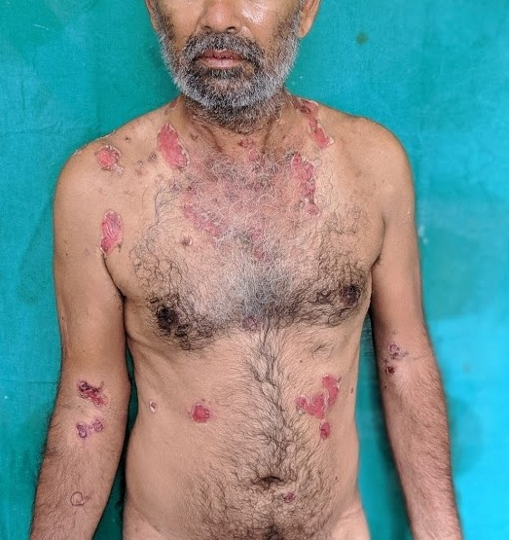
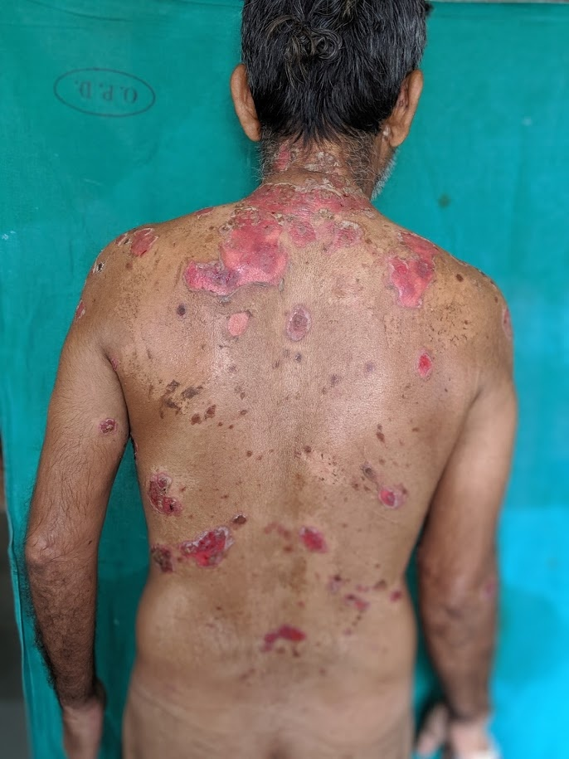
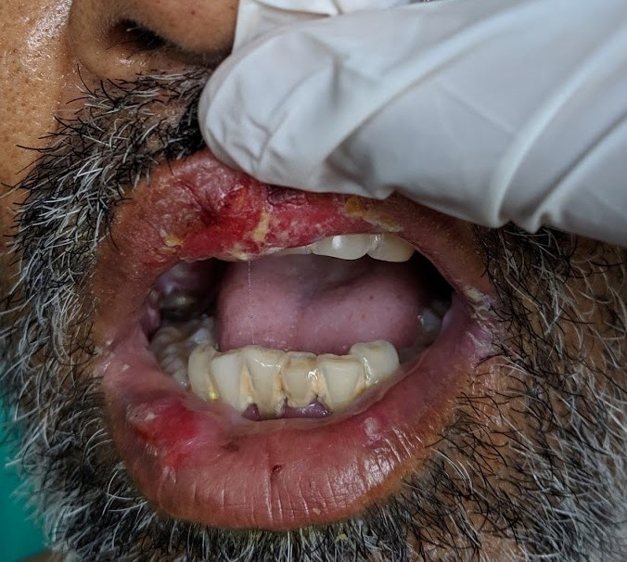
Pemphigus vulgaris
Notes:
Potentially fatal immunobullous dermatosis characterized
Clinically :flaccid vesicles and painful erosions

Slide 16
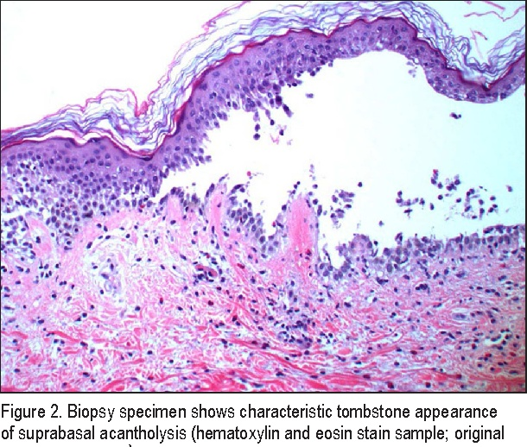
HPE of pemphigus vulgaris
: suprabasal cleft with acantholysis
(H&E ;10x)
Notes:
Suprabasal blister with acantholysis“row of tombstones” appearance, acantholytic cells- large round keratinocyte with hypertrophic nucleus
IgG bound to surface
of keratinocytes
(intercellular pattern

Slide 17
“Row of tombstones” appearance
(H&E; 40x)

Slide 18
DIF: fishnet pattern
ELISA : Demoglein 1,3- mucocutaneous
Desmoglein 3 - mucosal dominant

Slide 19
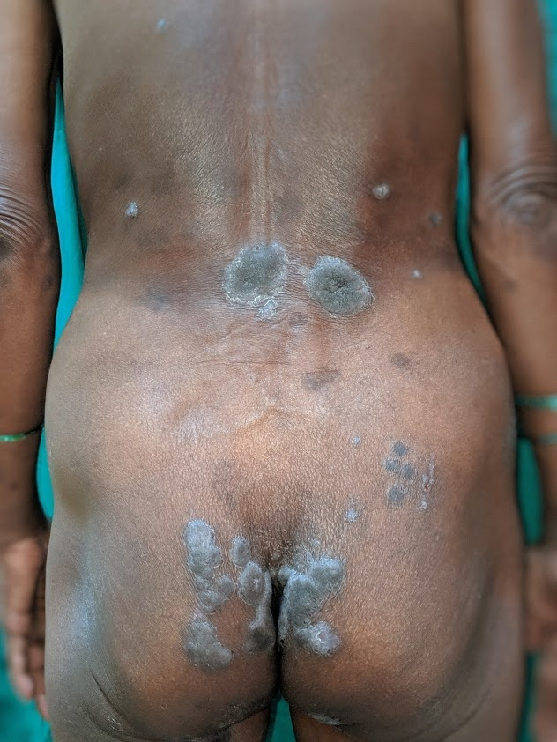
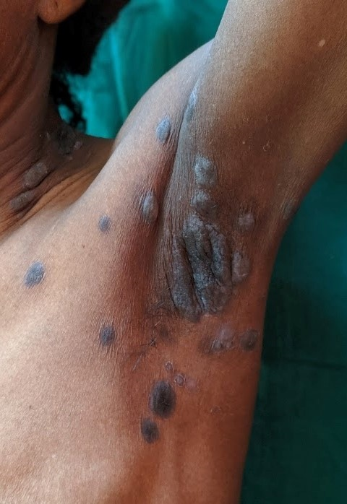
Pemphigus vegetans
Notes:
rare variant of pemphigus vulgaris, first described in 1876
presents as heaped up vegetating and verrucous plaques mainly in the flexures.

Slide 20
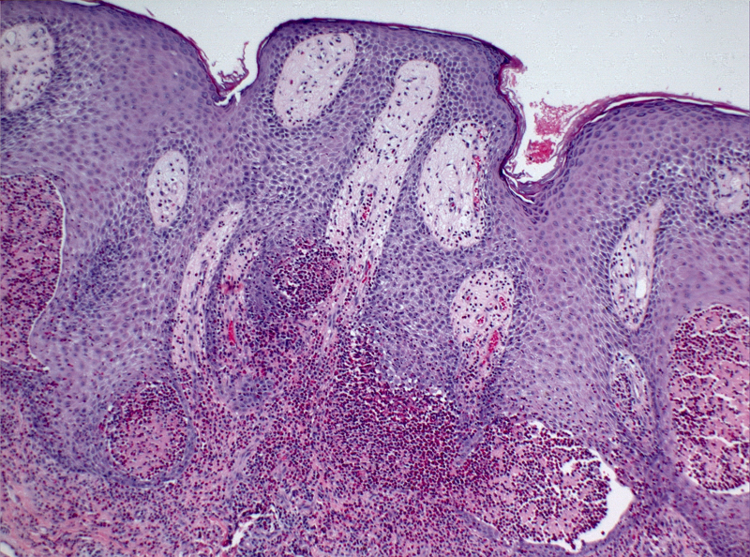
HPE of pemphigus vegetans: Suprabasal acantholysis, dermal papillomatosis and intraepidermal neutrophilic abscesses
(H&E; 10x)
Notes:
Suprabasal acantholysis, with papillomatosis of the dermal papillae and downward growth of epidermal
strands into the dermis; presence of hyperkeratosis and scale-crust; eosinophilic or neutrophilic intraepidermal abscesses
ELISA-Desmoglein 3,sometimes desmoglein 1

Slide 21
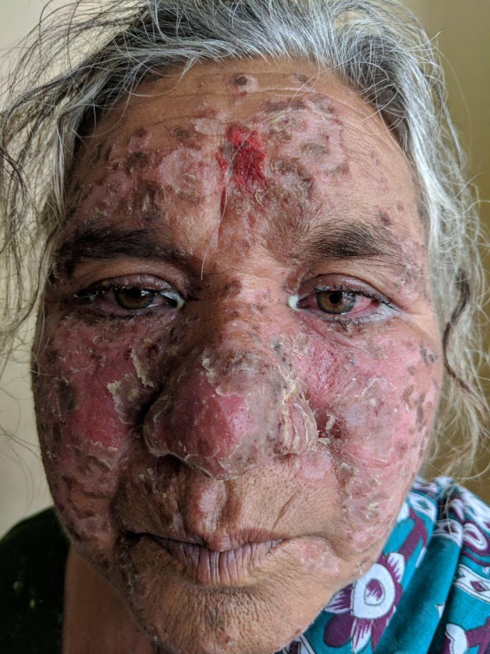
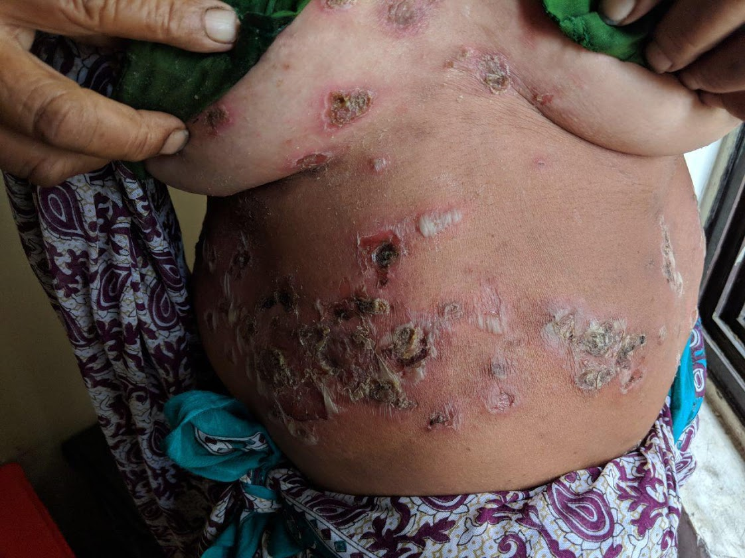
Pemphigus foliaceous
Notes:
superficial variant of P. vulagris characterized by
Clinically: Fragile, superficial bullae on skin that rupture easily to yield erosions

Slide 23
HPE of pemphigus foliaceous: Acantholysis in granular layer with subcorneal pustule
(H&E; 10x)
Notes:
Acantholysis and cleavage is much higher

Slide 24
Work plan
Admission
Clinical work up, biopsy, dsg 1/3
Pre-infusion investigations
Premedication
Rituximab infusion

Slide 25
Pre-infusion investigations
CBC
Urine analysis
RFT, LFT, serum electrolytes, blood glucose
HIV, HBsAg, anti-HCV Ab
CXR- PA
ECG and/or 2 D ECHO
Notes:
All patients were admitted, history was taken, and biopsy done to confirm the diagnosis.
Only 3 were affording for DSG levels
1-P. foliaceous- Dsg 1 +
2- P. vulgaris- Dsg 1 and 3 +

Slide 26
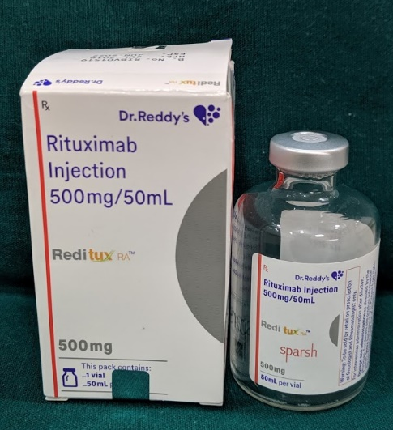
Premedication
IV: Hydrocortisone (100 mg) & pheniramine maleate (45.5 mg)
PO: Paracetamol (1g)
30 min
Rituximab infusion
500mg/50 ml in 300 ml of NS @
8 dpm x 30 min →16 dpm x 30 min→24 dpm x 30 min→32 dpm
over 5–6 hours with half hourly TPR/BP
Notes:
500 mg per 50 ml

Slide 27
 | A/S | Diagnosis | Areas | Duration | Indication for Rituximab | Protocol | Adverse effects | Follow up
1. | 40y/M | P. vulgaris | Oral cavity, face, trunk, UL, LL | 12 m | Recalcitrant | Low RA | Infusion reaction | 1 y
2. | 33y/M | P. vulgaris | Oral cavity, trunk | 5 m | Willing | Low RA | - | 8 m
3. | 35y/M | P. vulgaris | Oral cavity, trunk | 10 m | Recalcitrant | Low RA | - | 6 m
4. | 31y/F | P. vulgaris | Oral cavity, trunk, UL, LL | 14 m | Recalcitrant | Low RA | - | 8 m
5. | 33y/F | P. vulgaris | Oral cavity, trunk | 6 m | Willing | Low RA | Infusion reaction | 10 d
6. | 61y/F | P. vulgaris | Scalp, face, trunk | 6 m | Relapse | Low RA | - | 2 m
7. | 32y/F | P. vulgaris | Oral cavity, face, trunk | 5 y | Recalcitrant | Low RA | - | 3 m
8. | 41y/M | P. vulgaris | Oral cavity, trunk | 3 m | Willing | Ly | - | 8 m
9. | 62y/F | P. vulgaris | Oral cavity, trunk | 10 y | Steroid C/I | Ly | - | 4 y
10. | 41y/F | P. vulgaris | Oral cavity | 5 y | Steroid induced S/E | Ly | - | 4 y
11. | 59y/M | P. vulgaris | Trunk, LL | 5 y | Steroid C/I | Ly | - | 4 y
12 | 19y/F | P. vulgaris | Oral cavity, face, trunk | 2 m | Steroid induced S/E | Incomplete Ly | - | 4 y
13. | 22y/M | P. Vulgaris | Scalp | 13 m | Recalcitrant | IL | - | 1 y
14. | 35y/F | P. Vegetans | Oral cavity, trunk, LL | 10 m | Steroid C/I | Low RA | Infusion reaction, acneform eruptions | 3 m
15. | 31y/F | P. Vegetans | Oral cavity, scalp | 6 m | Steroid induced S/E | Ly | Episcleritis | 5 m
16. | 68y/M | P. foliaceous | Trunk, UL, LL | 2m | Willing | Ly | - | 8 m
17. | 65y/M | P. foliaceous | Face, UL, LL, Trunk | 12 m | Recalcitrant | Ly | - | 2 m

Slide 28
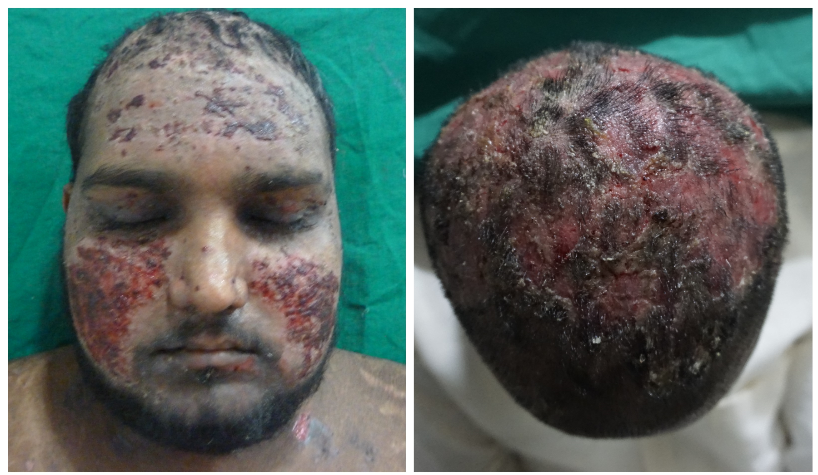
22y / M
Notes:
A 22-year-old male presented to us in March 2016 with
recurrent painful intraoral ulcers, flaccid blisters/erosions on upper trunk/upper limbs and extensive encrusted erosions over scalp (Figure1a, b) since 6 month
Clinical suspicion of PV was confirmed histopathologically and by direct immunofluorescence

Slide 29
After rituximab infusion
Notes:
low financial status lesser doses at longer intervals (500mg fortnightly ×4) vis-à-vis its classical protocols-- in rheumatoid arthritis/lymphoma
Whereas the patient’s mucosal and truncal lesions cleared within a few weeks of rituximab infusion, the ones on the scalp persisted for 7-8 months despite additional immunosuppressive strate
Following the report from PGI chandigarh of il rituximab in intraoral lesion of pv we were motivated to try the same modality in cutaneous for the first time ever

Slide 30
Intralesional rituximab on scalp
Given in outpatient setting
0.25 mg/cm² x 400 cm² = 100 mg dose
2 doses fortnightly
without premedication
Improvement started within 2w and
resolved after the 2nd dose
Notes:
lesser doses at longer intervals 500mg fortnightly ×4 the ones on the scalp persisted for 7-8 months we administered

Slide 31
After intralesional rituximab
This first time report hereto of IL rituximab in cutaneous lesions
---under publication process in IJDVL
Notes:
after a washout period of three months, we administered intralesional rituximab in an outpatient setting (0.25 mg/cm2; area of scalp lesions, 400cm2; 100mg dose; fortnightly×2) without premedication. Follow up on days 15, 30 and thereafter, monthly revealed remission at 16 weeks and a satisfied patient without disease recurrence/serious adverse drug reactions at 6 months

Slide 32
Demographic data Sex Age
Mean age= 41 years

Slide 33
Age of onset
In this case series,
2/3rd had disease onset before 40 y
Notes:
The age of onset in 2/3rd was much earlier than the western population. In fact one patient developed at 18 y. similar earlier age on onset has also been reported in a study from PGI chandigarh.

Slide 34
Duration of disease
Notes:
5 patients were suffering from the disease for a period 6m to 1 y while 4 each had it t for a period 0f 1-5 and > 5 y. Luckily 4 patients came to us in were suffering 6m only and most of them were affording , while in one steroid were C/I.

Slide 35
Indications for rituximab

Slide 36
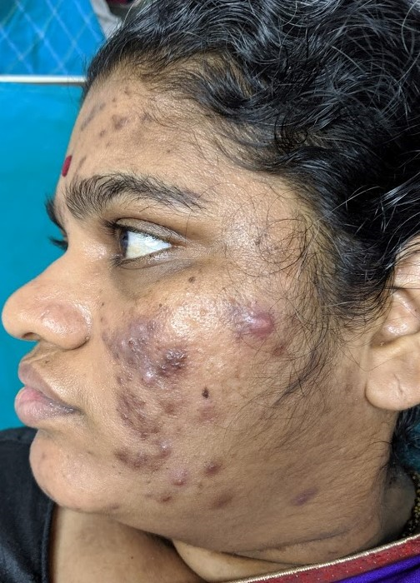
Adverse effects
Infusion reaction – 3 (17.6%)
Infection-1 (5.8%)
Episcleritis
HSV
Candidiasis
Acneform eruptions- 1 (5.8%)
Notes:
All adr after 1st dose At the beginning: slight burning sensation resolved spontaneously
During: at 24 dpm- ANAPHYLAXIS - infusion stopped, hydrocort and avil iv given, restarted at 8 dpm 2 h later
After:2 h after infusion- resolved spontaneousy

Slide 37
Follow up- Remission
6 m- 1 y (5)
< 6m (6)
1 y – 4 y (2)
> 4 y (4)
Recalcitrant scalp lesion: 1 → IL
Relapse: 1 after 16m of Ly → Low RA
Notes:
15 of our patients patients have been enjoying drug free remission for a follow up period
Of the remaining 2, the il ritu has already been discussed
Only 1 case had relapse 16 m after infusion as per Ly protocol. She was retreated with Low RA protocol and remain symptom free since 2m.

Slide 38
Discussion

Slide 39
Mechanism of action
Anti CD 20 MAb
Complement-dependent cytolysis
ADCC
Apoptosis
Depletion of mature B lymphocytes
sparing stem cells and pro B cells
Notes:
CD 20 is expressed on the surface of B cells from pre-B-cell through memory B-cell stages but neither on stem cells and pro B cells nor on plasma cells
as they don’t express CD20

Slide 40
Adverse effects
Common
Infusion reaction- 10%
Infections- 5%
Urticaria- 3 %
Rare
Tumor lysis syndrome
Cytopenias
Antibodies to the drug
CVS complications
Notes:
reactivation of HSV, oral candidiasis
sinus tachycardia, dysrhythmia and myocardial ischemia in patients with preexisting conduction abnormality or heart failure

Slide 41
Future trends
Rituximab for maintenance therapy
Many recent studies have reported low or no relapse rate with maintenance rituximab infusions
Ultra low-dose rituximab
Two doses of 100 mg every 3 months could deplete the B cell population for 6 months
Notes:
Rituximab acts by depletion of CD20 expressing circulating B cells, but has no action on CD20 negative early pre B cells and terminally differentiated plasma cells.[15] The B cell burden in autoimmune blistering diseases is much lower than in lymphoproliferative diseases. Recent studies have found 97% of circulating B cell depletion with rituximab dose as less as 1 mg/m2 (contrasting to 375 mg/m2 in lymphoma)
Desmoglein indices, CD19 and CD14 cell counts can be used to predicts relapse
100 mg rituximab may be sufficient to induce depletion of B cells for 3 months

Slide 42
Newer generation anti-CD20 Mab
Type I (ofatumumab, veltuzumab, and ocrelizumab) –
Cluster CD20 to enhance the recruitment and activation of complement for a potent CDC response
Type II (tositumomab or obinutuzumab)-
Exhibit stronger homotypic adhesion and induction of direct cell death but with a minimal CDC response.
Notes:
CDC complement dependent cytoxicity

Slide 43
Thank you!

