Slide 1
Pyoderma gangrenosum -Dr Dipti Mathias

Slide 2
Pramod/24 Y/M/Unmarried
Pustules over the right cheek
Notes:
24 y/o Pramod reported to our OPD .. with history of a single pustule over the right cheek 1 week ago ..the pustule gradually increased in size over the next few days , and over the span of a week he developed multiple such similar pustules , one of which developed into a nodule

Slide 3
Notes:
As the patient is a k/c/o nodulocystic acne intralesional steroid was administered into the nodule,following which he went home.Pramod returned to us a week later with history that the lesion did subside initially , but was followed 4/5 days later by a sudden severely painful inflammatory swelling over the right cheek , pain was of throbbing type & there was associated fever with chills and rigors.

Slide 4
Erythematous
Indurated plaque
Pustules
Erosions
Crusting
Violaceous border
Notes:
Examination revealed an erythematous indurated plaque over the right cheek about 6x6cm in size with overlying discharging pustules ,erosions, blackish crusting and violaceous border. Background of acne scarring present. Hair Nails Mucosa was normal.

Slide 5
Necrolytic cutaneous ulcer with violaceous undermined edges
Notes:
However over the next 3/4 days the lesion progressed to form a large necrolytic cutaneous ulcer with violaceous undermined edges. Despite being treated initially as cellulitis with intravenous ,

Slide 6
Inj.Monocef 1gm IV 12 hourly
Inj.Metrogyl 500mg IV 12 hourly
Inj.Linezolid 600mg IV 12 hourly
Inj.Piperacillin tazobactam 4.5g IV 8 hourly
Sofratulle dressing with soframycin twice daily
Notes:
.....the lesion did not show any sign of improvement......

Slide 7
General examination
Conscious, cooperative, well oriented
Patient was febrile-102.2 F
P-100bpm
R/BP- Normal
No pallor, icterus, cyanosis, clubbing, lymphadenopathy
Systemic examination- NAD
Notes:
On GPE the patient was febrile , tachycardic
Others parameters being normal

Slide 8
Investigations
Hb-7.9
TLC-20,000
P-80% L-10% E-02% M-08%
Platelet count- 3.20 L/cumm
CRP +
LFT/RFT-N
Blood sugar-N
S.Electrolytes-N
USG Abdo/Pelvis-WNL
Pus C/S-no growth
Notes:
Routine haematological examination revealed anaemia and leukocytosis
With polymorphonuclear leukocytes of 80 %
And a positive C reactive protein
Repeated Pus cultures showed no growth

Slide 9
Provisional diagnosis
Pyoderma gangrenosum
Probable differentials
Cellulitis
Ecthyma gangrenosum
Necrotising insect bite
Notes:
With this history our provisional diagnosis was of PG ; the differentials of cellulitis and EG having been already excluded by lack of response to antibacterials
The brown recluse spider not being found in our part of the world excluded NIB rxn

Slide 10
A 4 mm punch biopsy was sent for HPE
Meanwhile i/v/o strong clinical suspicion of PG
→Inj. dexamethasone 4mg IV 12 hourly x 5 days →Tab. wysolone 40mg x 2 weeks
→Tab. sulphasalazine 500 mg BD
Notes:
The patient was administered Dexamethasone 4mg intravenously at 12 hourly intervals for 5 days following which he was started on 40milligrams of per oral Wysolone OD and Sulphasalazine 500mg twice daily. (for the next 2 weeks.. Tablet Wysolone was subsequently tapered)

Slide 11
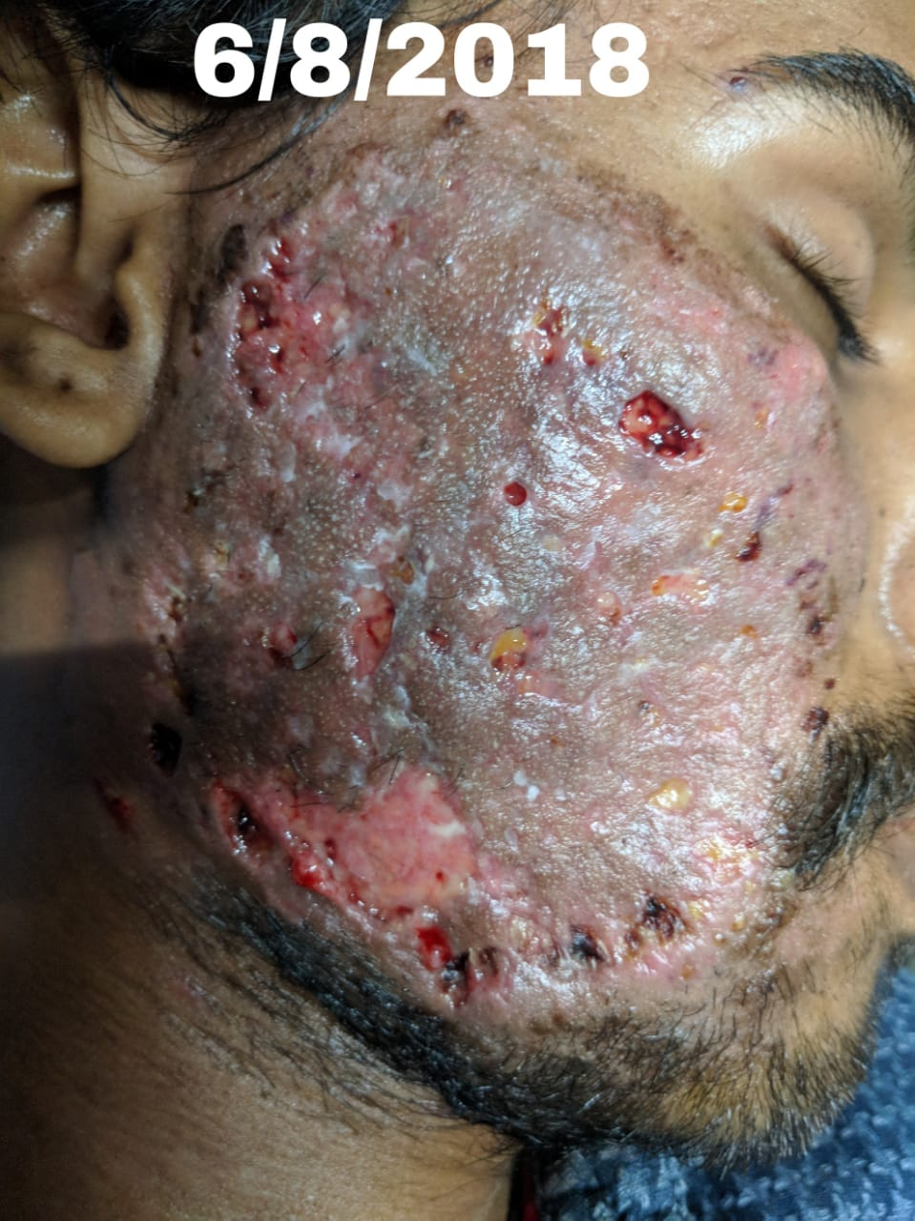
Notes:
Injectable Dexamethasone was started on the 2nd of August, and the patient showed dramatic improvement (as seen) in the appearance of the lesion within 3 days of starting Injectable CS

Slide 12
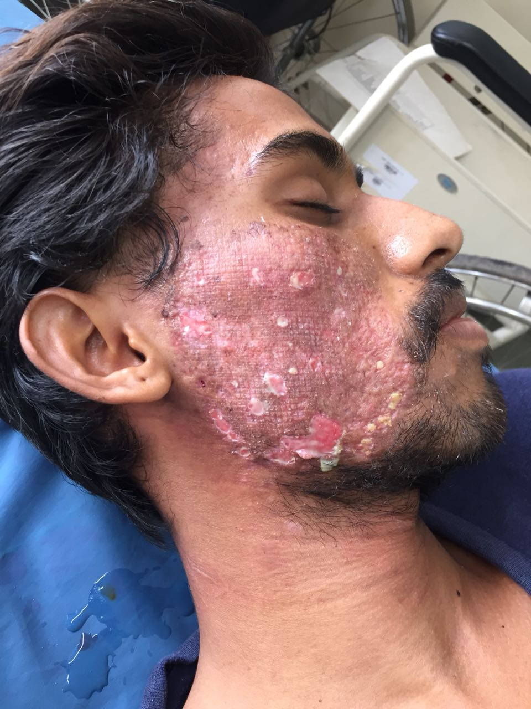
Notes:
These images depict further response to treatment in a timeframe of 1 week after the initiation of corticosteroid therapy

Slide 13
HPE
(H&E; 10x)
Epidermis – ulcerated; extravasation of RBC’s
and areas of thrombosis
Notes:
On HPE the epidermis shows ulceration with extravasation of RBS’s and areas of thrombosis

Slide 14
(H&E;40x)
Polymorphonuclear cell infiltrate in the superficial dermis
Notes:
In the higher magnification pmn cell infiltrate is seen in the sup dermis

Slide 15
Diagnosis
Pyoderma gangrenosum
Notes:
HPE thus corroborated our clinical impression of PG and the patient is being currently followed up and remains asymptomatic

Slide 16
Discussion

Slide 17
Pyoderma gangrenosum is a rare non‐infectious neutrophilic dermatosis
Incidence:0.63/100,000 person-years;increasing with age
Classical->Ulcerative type
Small, tender, red-blue papules , plaques, pustules that rapidly evolve into painful ulcers with characteristic violaceous undermined edges
Granulation tissue, necrosis or purulent exudate at the ulcer base
Healing with atrophic cribriform scarring
Fever, malaise,myalgia,arthralgia
Notes:
With an incidence of less than 1/100,000 person years ...... More commonly seen in middle aged females
The classical ulcerative variant usually presents over the lower limbs as ..... May affect genitals, mucosae
The ulcer base shows.. Associated systemic features of ...........may be present

Slide 18
Atypical→ parastomal
pustular
bullous
atypical
granulomatous superficial
Notes:
other atypical variants such as parastomal (following GI surgeries) ....... Are also described
Some of which have important associated morbidities ..

Slide 19
Associations
Pustular form | IBD 20-30%
Bullous form | Haematological and visceral malignancies 5% Monoclonal gammopathies 5%
 | Rheumatoid & seronegative arthritis 10%
 | Thyroid disease, spondylitis, osteoarthritis, psoriatic arthritis, chronic active hepatitis, hepatitis C viral infection, primary biliary cirrhosis,SLE, complement deficiency, hypogammaglobulinaemia, hyperimmunoglobulin E syndrome, AIDS, sarcoidosis, Takayasu arteritis, HS , acne conglobata , COPD
Notes:
is associated with .., of cases

Slide 20
Major criteria
Rapid progression of a painful necrolytic ulcer, irregular;violaceous undermined border
Minor criteria (any two)
(i)H/s/o pathergy
(ii)Cribriform scarring
(iii)Systemic diseases known to be associated with PG
(iv)Sterile dermal neutrophilia, +/- mixed inflammatory infiltrate
(v)Rapid response to systemic corticosteroids
Notes:
PG is a (diagnosis of exclusion) of relevant differentials and Dx entails the presence of major criteria and any two minor criteria
Pathergy is exaggerated response to minor skin trauma
& can be clinically elicited by making multiple pricks in the skin of the forearm using a sterile needle , positive pathergy is indicated by a papule/pustule or ulceration at the site of the needle prick
Our patient satisfied the major criteria and all minor criteria except for associated systemic diseases

Slide 21
Pathogenesis
Neutrophil trafficking and activation being central
Predisposition to an inflammatory cascade of events
Innate immunity
Autoinflammatory pathways
Cytokines →IL‐1β,TNF‐α, IL-8, IL-23, MMP 9
Notes:
.......is central to the pathogenesis of this prototypic neutrophilic dermatosis
There is also a predisposition to a cascade of inflammatory events, including activation of innate immunity, autoinflammatory pathways, cytokines including interleukin (IL)‐1β, tumour necrosis factor (TNF)‐α, IL-8, IL-23, MMP 9 and chemokines

Slide 22
Predisposing factors
Pathergy
Smoking
Appendicectomy
E.coli
PAPA Sx→ PSTPIP1/CD2BP1 gene
Notes:
In addition to the major PDF of pathergy, other PDF are , Genetic factors include those a/w PAPA syndrome which consists of .. pyogenic arthritis PG and acne
the gene is (proline serine threonine phosphatase) interacting protein 1
CD 2 binding protein 1

Slide 23
Disease course and prognosis: months to years
Recurrence:16-61%
Mortality of 16% over 8 years
Notes:
The disease lasts for m→y
A proportion of cases recur and has a mortality of 16%

Slide 24
Atypical features in our case
Female | Male
Older | Young
Lower extremities | Face
50% systemic associations | No systemic associations
Notes:
TABLE OF WHY MY CASE IS ATYPICAL
PG is commonly seen in middle aged females usually over the lower limbs and a/w systemic manifestations in more than half cases , our patient is a young adult male with ulcer over the face and no known systemic manifestations

Slide 25
Treatment options
Prednisolone 0.5-1mg/kg/day
Cyclosporine 5mg/kg
Pulsed prednisolone 1g/day x 5 days
Biologicals:Infliximab, Adalimumab,Etanercept,Anakinra,IVIG
Skin graft,granulocyte apheresis,topical sodium cromoglycate,topical nicotine,hyperbaric oxygen
Notes:
Combined prednisolone and cyclosporine
TNF inhibitors and other biologicals have also been tried as has been certain other alternatives

Slide 26
Case 2-following lower segment caesarean section
Notes:
2nd case under treatment following LSCS

Slide 27
Notes:
Currently a case is being managed along with our Obstetric colleagues of a 28 y/o primi who developed PG following the pathergy of lower segment CS ; there is h/o pathergy following IM injection over the buttock. Repeated pus cultures showed no growth and she did not respond to antibiotic therapy .She is now on the road to recovery and is receiving p/o wysolone 40mg OD, dapsone 100mg HS and alternate day collagen dressing

