Slide 1
Brooke-Spiegler syndrome
Dr. Aishwarya Raheja

Slide 2
Mahesh Gode 24Y/M/Unmarried
Multiple skin colored papules over face -8 years

Slide 3
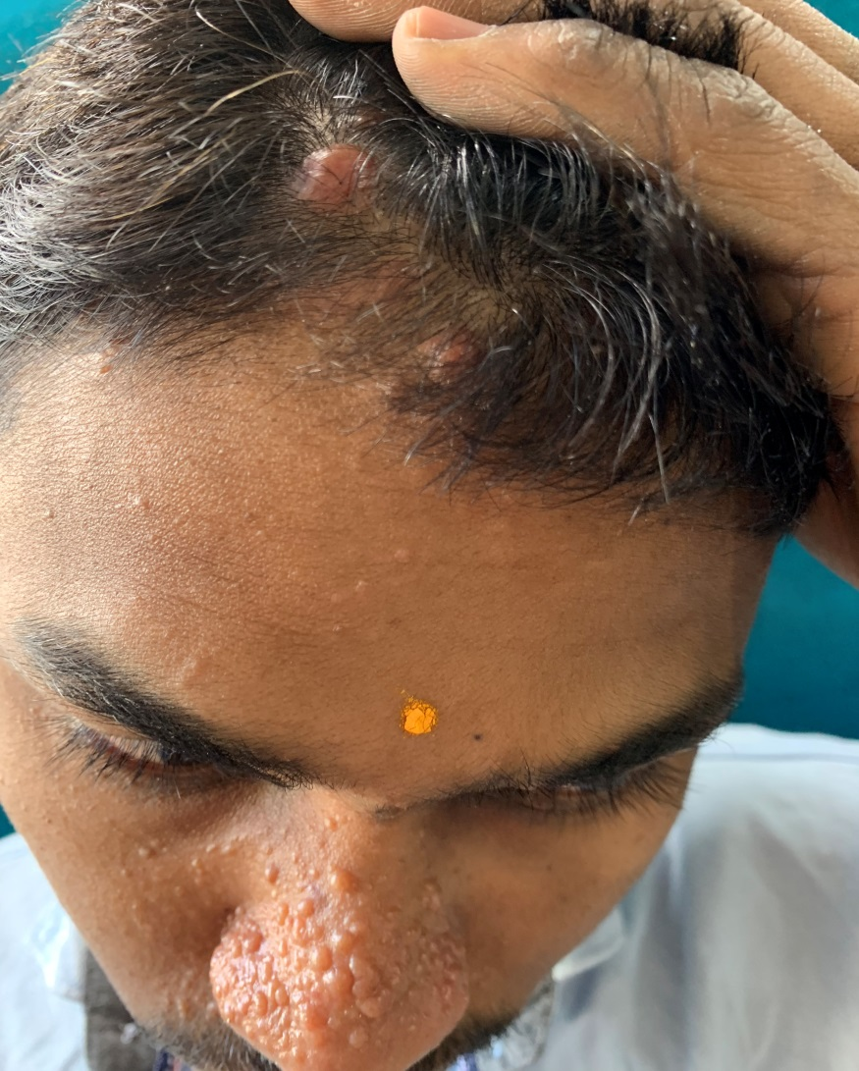
Two reddish nodules over scalp -2 years
Increasing in size and number- 2 months
Notes:
However there ws an increase…………………… of nodules over scalp since 2m which made his mother bring him to our opd

Slide 4
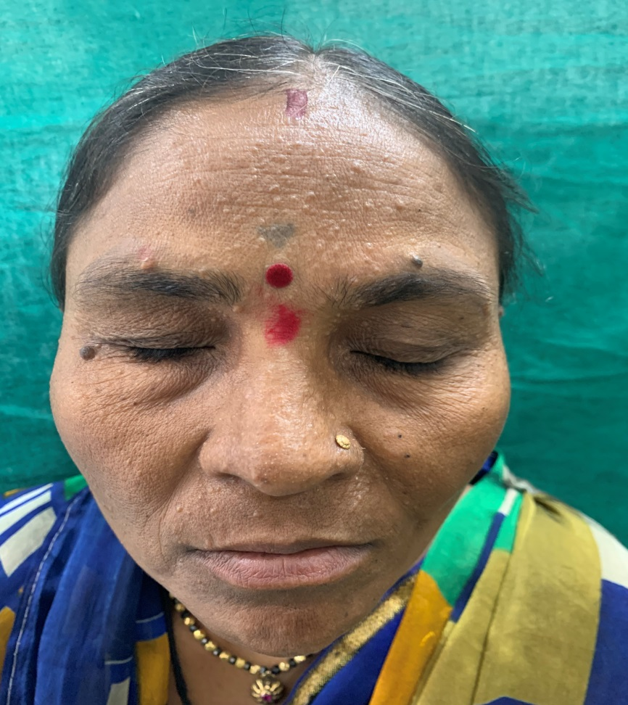
History of similar lesions in the mother- 15 years
None of other family members – similar lesions
Notes:
she too was noticed to have similar lesions on t area of her face which on interrogation she said was present since 15 years.

Slide 5
Examination
General examination- NAD
Systemic examination- NAD

Slide 6
Round skin-colored, 2-8 mm , smooth pearly-appearing non-tender papules over mid face, particularly nose and nasolabial folds
Notes:
Dermatological examn

Slide 7
Two larger (1-3cm) well defined reddish, dome-shaped, indurated, non-tender papulo-nodules

Slide 8
D/D → Hamartomas
Face
Trichoepithelioma
Syringoma
Adenoma sebaceum
Scalp
Cylindroma
Dermatofibroma
Spiradenoma
Follicular infundibular tumor
Trichoepithelioma
Notes:
On the basis of clinical presentation, various hamartomas were kept as it’s differential diagnosis

Slide 9
HPE - scalp lesion
(H&E;10x)
Islands of basaloid cells in a jig-saw puzzle pattern, with surrounding hyalinized material.
Notes:
As it’s mandatory for diagnosis of hamortomas, 1 biopsy each from scalp and nose was sent for histopath exam
In the deep dermis and subcutaneous planes,

Slide 10
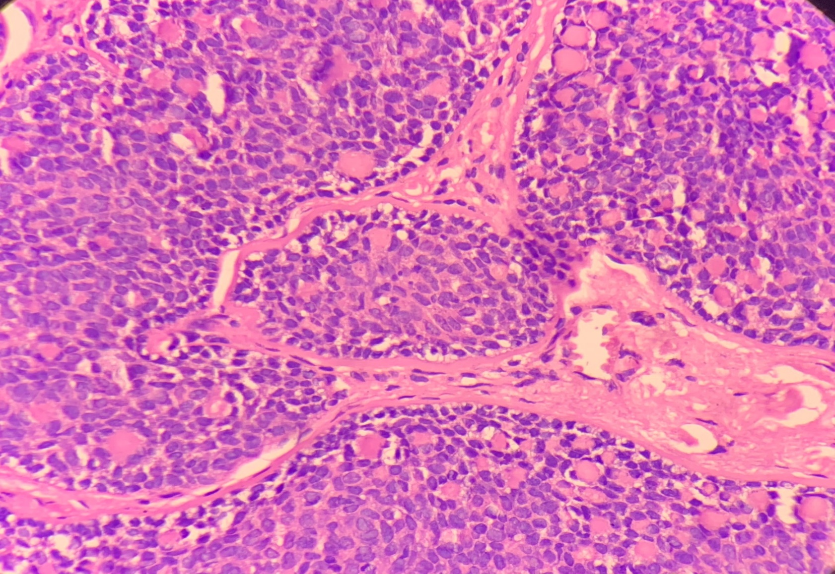
(H&E;40x)
Periphery→ small & basophilic
Centre→ larger and pale stained

Slide 11
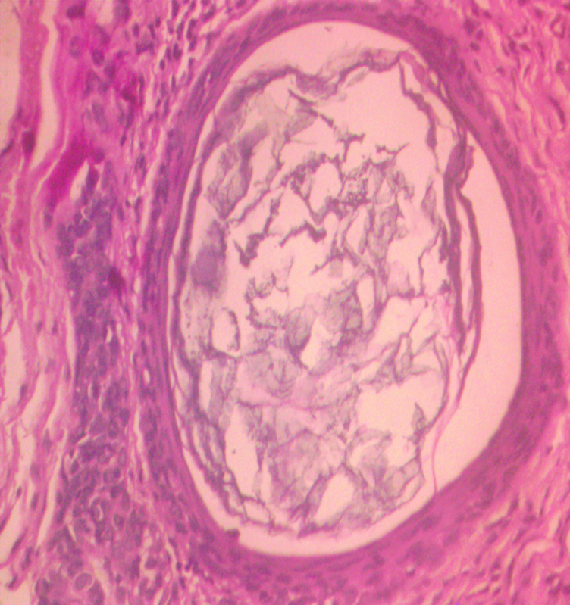
HPE- face lesion
Horn cyst
(H&E;10x)
Basaloid cells collections with immature follicular papillae and horn cysts were seen, surrounding fibrous stroma.
Notes:
Hpe of face lesion showed characteristic horn cysts in basaloid cell collections. The surrounding stroma was fibrous

Slide 12
(H&E;40x)
Notes:
In this high power, surrounding fibrous stroma can be better appreciated

Slide 13
Diagnosis
Scalp lesion
Cylindroma
Face lesion
Trichoepithelioma

Slide 14
Treatment
Cylindroma over the scalp was excised.

Slide 15
CO2 laser treatment of trichoepitheliomas

Slide 16
Discussion

Slide 17
This hamartomatous syndrome involves concurrent presence of adnexal tumors ,in particular trichoepithelioma, cylindroma & occasionally spiradenoma, all originating from germ cell of hair follicle
Autosomal dominant mode of inheritance
The mutated gene CYLD1 on 16q12-q13
Penetration - 60-100%

Slide 18
Mechanism of tumorigenesis
CYLD gene
encodes a deubiquinating enzyme
negative regulator of NFKẞ (adnexal proliferation)
Mutated CYLD gene
Tumorigenesis
Notes:
Nfkb- adnexal proliferation inducer
Mutated gene leads to upregulation of adnexal proliferation

Slide 19
Cylindroma
Apocrine and eccrine sweat gland differentiation.
May be solitary(most common) or multiple and usually occur in adults and increase in size throughout life.
Erythematous/skin colored → scalp, head and neck or trunk.
Some are painful.
Notes:
Mc on scalp- turban tumor

Slide 20
Histopathology
Circumscribed, nonencapsulated dermal nodules composed of islands and cords of basaloid cells with “jigsaw-puzzle-” like architecture
Surrounded by a thick, hyalinized, PAS-positive basement membrane.

Slide 21
Trichoepithelioma
Hamartomas with follicular differentiation
Solitary or multiple
Multiple, usually familial appearing centrofacially as firm, elevated, flesh coloured nodules usually less than 2 cm in diameter.

Slide 22
Histopathology
Symmetric lesion containing basaloid cells collections with immature follicular papillae and horn cysts,
The surrounding stroma containing these structures is typically fibrotic

Slide 23
Spiradenoma
Eccrine sweat gland differentiation
Relatively uncommon
Rarely familial
Usually solitary, painful firm rounded bluish dermal nodule 3–50 mm dia over front of the trunk and proximal limbs
Rare sites - vulva, breast and external ear

Slide 24
Histopathology
The tumour is lobular, with larger paler cells- around lumina; smaller darker cells form the periphery
Small tubular structures or cystic spaces and large dilated vascular channels present
Degenerative changes seen in old tumours

Slide 25
Treatment options
Excision
Dermabrasion
Electrodessication
Cryotherapy
Argon and Co2 lasers
Notes:
Various ablative options available include

Slide 26
------------890

