Slide 1
AN INTERESTING CASE OF CARDIAC MRI
By Dr. Neeraj Patil (Junior Resident)
Under the guidance of
Dr. Tushar Kalekar Dr. V M Kulkarni

Slide 2
65 year/male
C/o chest pain, dyspnea and generalized edema.
No h/o DM, TB, HTN, blood transfusion and past surgery.
Blood profile: Normal.
Chest x ray: Cardiomegaly and bilateral pleural effusion.
ECG/Echocardiography : Low voltage complex / Features of restrictive pattern

Slide 3
Multiplanar cardiac MRI done on 3 Tesla with dynamic contrast.
Acquisition performed in :
Black blood and white blood localizer chamber
Two chamber vertical long axis.
Four chamber : Horizontal long axis
Two chamber short axis
True four chamber
Two chamber and four chamber views : Cine
LVOT, RVOT
STIR
Delayed post contrast viability images with IR sequences ( Phase sensitive IR)

Slide 4
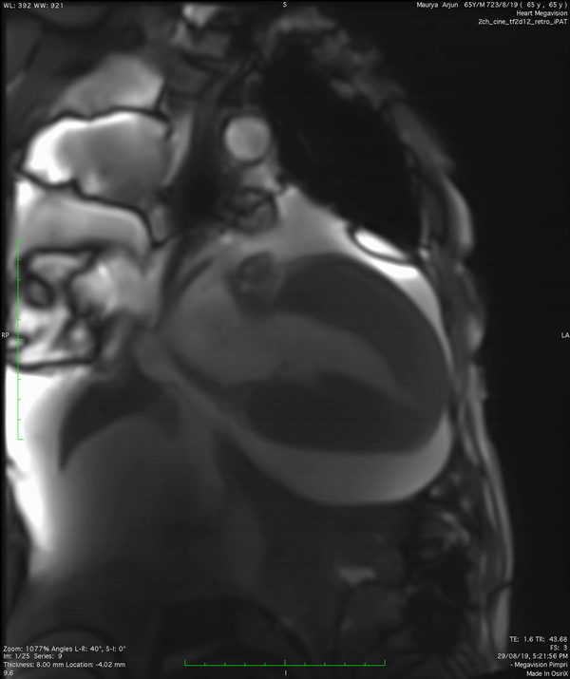
VERTICAL LONG AXIS 2 CHAMBER VIEW
Pleural effusion
Left ventricular hypertrophy
Lung collapse
Pericardial effusion
Notes:
Vertical long axis 2 chamber view , shows left ventricular hypertrophy, gross pericardial effusion, pleural effusion with collapse and mild global hypokinesia

Slide 5
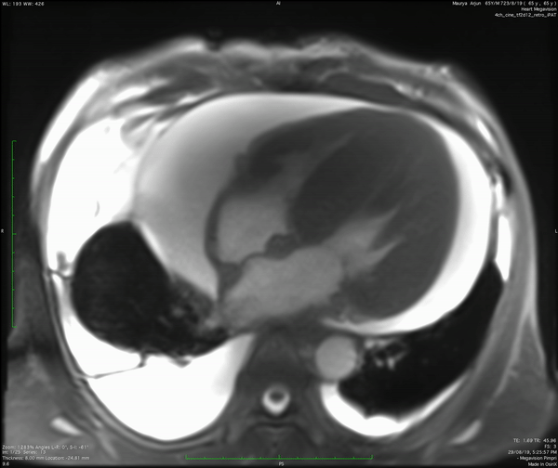
4 CHAMBER HORIXONTAL AXIS VIEW
Right ventricular hypertrophy
Interventricular septal hypertrophy
Left ventricular hypertrophy
Pericardial effusion
Notes:
4 chamber horizontal axis view
Normal anatomical position, moderate cardiomegaly seen with asymmetric gross left ventricular hypertrophy
Gross thickening of the myocardium seen with septum measures 30mm, left ventricle 31mm and right ventricular thickness 16mm
Gross pericardial effusion seen
Moderate right side and mild left side pleural effusion

Slide 6
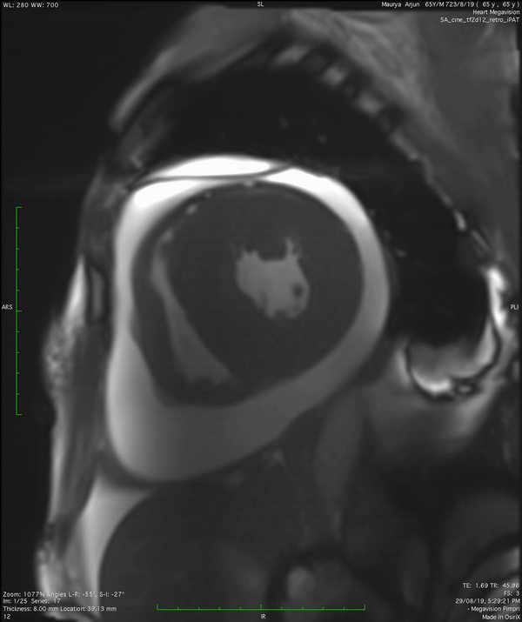
SHORT AXIS HORIZONTAL 2 CHAMBER VIEW
31 mm
Left ventricular hypertrophy
Right ventricular hypertrophy
16 mm
Notes:
Short axis horizontal 2chamber view
Gross asymmetric circumferential left ventricle hypertrophy, mild right ventricular hypertrophy and mild global hypokinesia

Slide 7
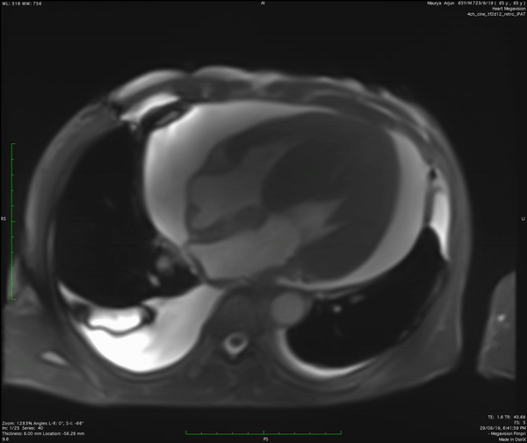
TRUE 4 CHAMBER VIEW
Mild global hypokinesia
TR
MR
Notes:
True 4 chamber
Right and left ventricle wall motion analysis shows mild global hypokinesia.
Mild regurgitaion of tr and mr
There is obliteration of basal cavity , mid cavity and apical cavity seen during systole due to myocardial hypertrophy.

Slide 8
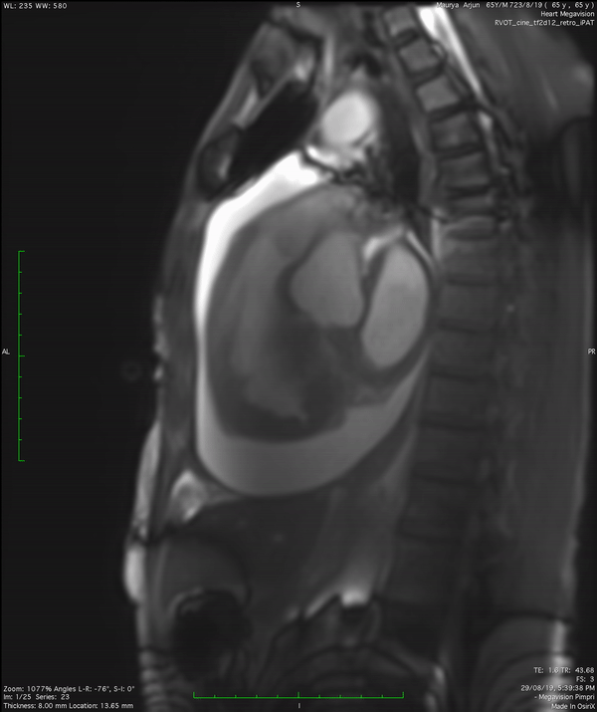
RVOT
Pulmonary artery
31 mm
Left atrial dilatation
Right ventricular hypertrophy
Notes:
rvot
Pericardial effusion , Mild hypertrophy of the right ventricle, pulmonary artery dilated 31mm in caliber

Slide 9
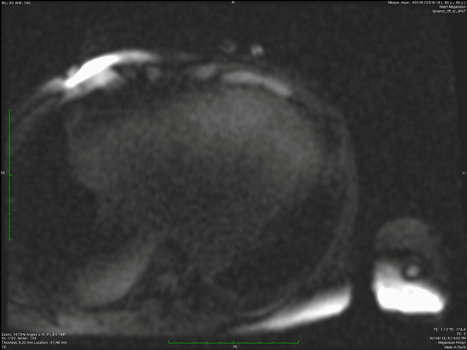
1st PASS DYNAMIC CONTRAST
No filling defect within cardiac chambers
Notes:
4 chamber 1st pass dynamic contrast sequence shows no filling defect within cardiac chambers

Slide 10
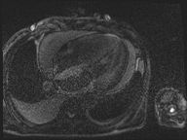
STIR sequence
Subendocardial edema
Edema
Notes:
STIR
Subendocardial edema

Slide 11
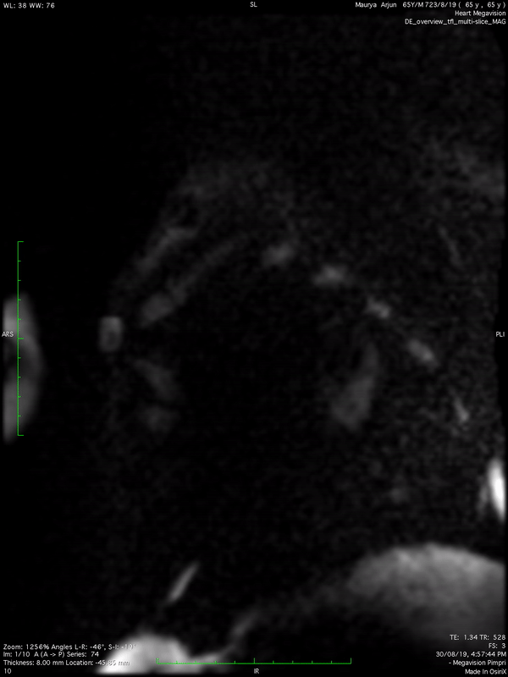
CONTRAST LOCALISER PSIR SEQUENCE
Nulling of myocardial signals
Notes:
Contrast localiser PSIR seq
Specific
Nulling of myocardial signals

Slide 12
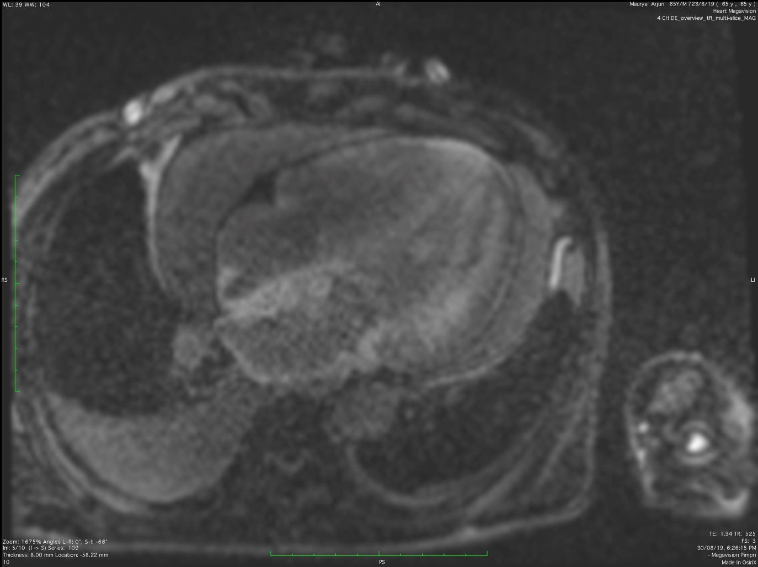
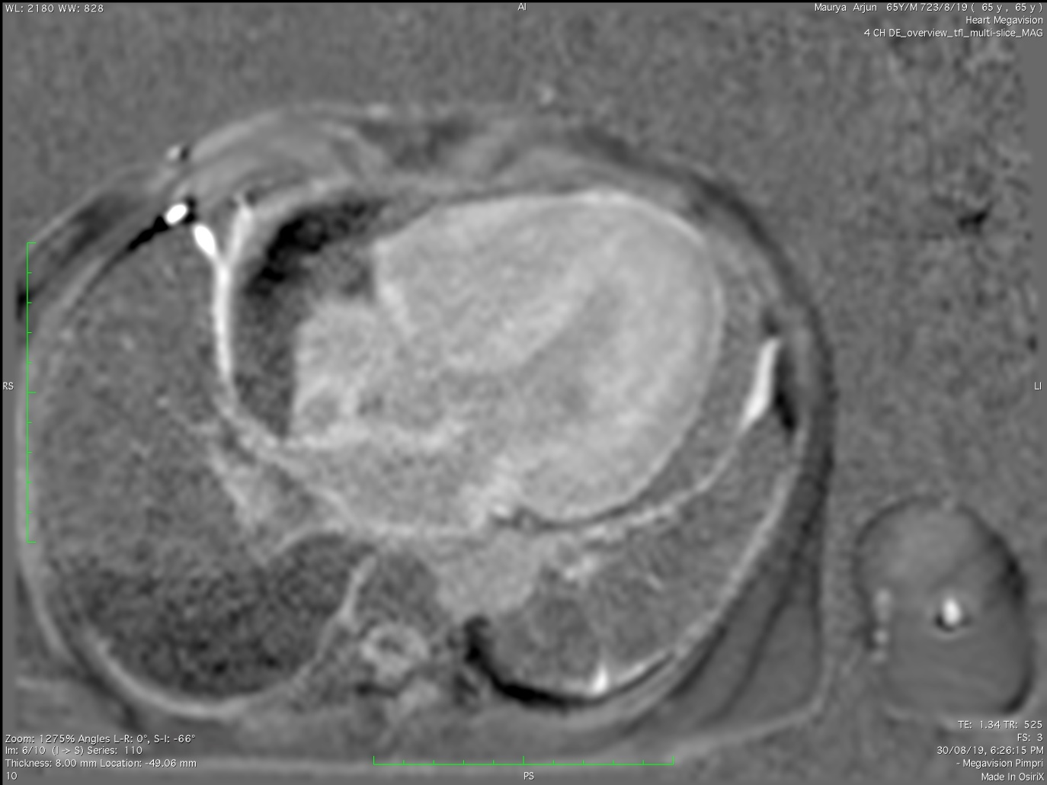
PHASE SEQUENCE
MAG SEQUENCE
Arrows represent - abnormal diffuse subendocardial as well as mid myocardium delayed gadolinium enhancement seen in all the chambers.
Notes:
Delayed imaging – enhancement analysis : on the right side MAG sequence, Left side Phase sequence IR there is an abnormal diffuse subendocardial as well as mid myocardium delayed gadolinium enhancement seen in all the chambers.

Slide 13
SUMMARY
Cardiomegaly with asymmetric hypertrophy of left ventricle involving interventricular septum as well as left ventricle walls from basal cavity to apex
Thickening of inter-atrial septum with mild enlargement of both atria.
Mild global hypokinesia.
Mild mitral and tricuspid regurgitation.
No intracardiac clot/filling defect

Slide 14
Diffuse inhomogenous subendocardial delayed gadolinium enhancement seen in myocardium.
Pericardial effusion with bilateral pleural effusion.
Changes of pulmonary hypertension.
Features represent: Infiltrative cardiomyopathy .

Slide 15
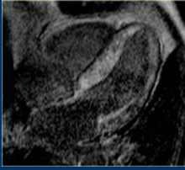
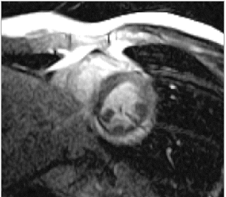
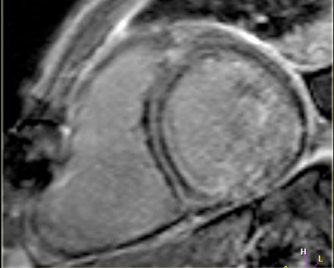
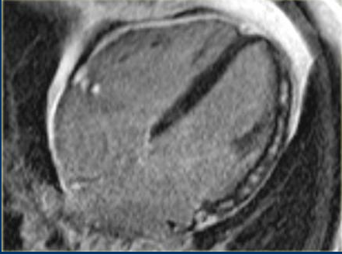
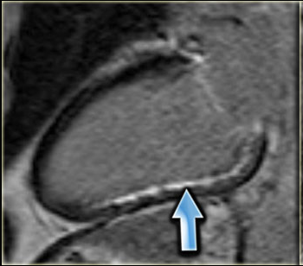
The Differentials-
Cardiac Amyloidosis-
Cardiac Sarcoidosis-
Cardiac Interstitial fibrosis-
Myocarditis-
Ischemic CM
Supepicardial/mid-myocrdial enhancement, predominantly involving lateral wall
Subendocardial or transmural enhancement.
(Inf wall RCA territory )
Diffuse-subendocardial delayed enhancement
Focal, Typically mid-wall and/or epicardial enhancement, sparing subendocardium
Longitudinal striae of mid wall enhancement

Slide 16
Conclusion
CMR shows early nulling of myocardium before blood pool in PSIR sequence with global sub-endocardial delayed gadolinium enhancement,
Cardiac Amyloidosis.

Slide 17
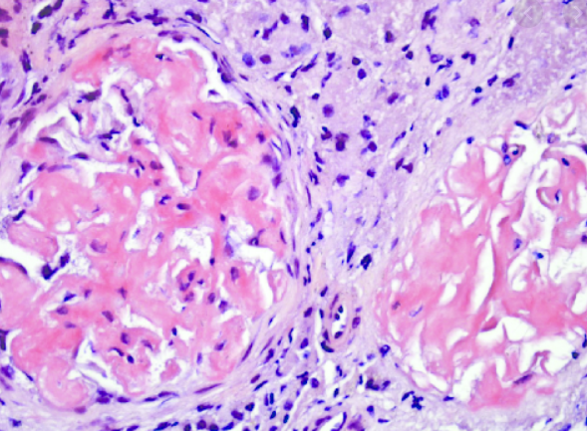
Representative image
In retrospective follow up, the patient was found to be
A biopsy proven case of Renal amyloidosis.

Slide 18
Cardiac amyloidosis
Significant source of morbidity with systemic amyloidosis.
Most common cause of restrictive cardiomyopathy.
Pathology : Extra-cellular deposition of insoluble fibrillar proteinaceous material.
AL and ATTR are two types of amyloidosis typically associated with the heart.
The gold standard for diagnosis of cardiac amyloid is considered to be cardiac biopsy.
Cardiac FDG positron emission tomography (PET)

Slide 19
WHY CARDIAC MR ?
MRI is the modality of choice for evaluating cardiac amyloidosis.
Non invasive.
No exposure to radiation. ( FDG PET)
Meta-analysis of GE–CMR showed that the diagnostic accuracy sensitivity of 90% and specificity of 92 % for cardiac amyloidosis
MRI has proven valuable in diagnosing a broad range of conditions, especially those involving the heart muscle( cardiomyopathy), cardiovascular anatomical anomalies (e.g. congenital heart defects), functional abnormalities (e.g. valve failure), tumors, and conditions related to coronary artery disease

Slide 20
References
1. Rapezzi C, Lorenzini M, Longhi S, Milandri A, Gagliardi C, Bartolomei I, Salvi F, Maurer MS. Cardiac amyloidosis: the great pretender. Heart Fail Rev. 2015;20:117–24. doi: 10.1007/s10741-015-9480-0. [PubMed] [CrossRef] [Google Scholar]
2. Sipe JD, Benson MD, Buxbaum JN, Ikeda S, Merlini G, Saraiva MJ, Westermark P. Amyloid fibril protein nomenclature: 2012 recommendations from the Nomenclature Committee of the International Society of Amyloidosis. Amyloid. 2012;19:167–70. doi: 10.3109/13506129.2012.734345. [PubMed] [CrossRef] [Google Scholar]
3. Gertz MA, Dispenzieri A, Sher T. Pathophysiology and treatment of cardiac amyloidosis. Nat Rev Cardiol. 2015;12:91–102. doi: 10.1038/nrcardio.2014.165. [PubMed] [CrossRef] [Google Scholar]
4. Mohty D, Damy T, Cosnay P, Echahidi N, Casset-Senon D, Virot P, Jaccard A. Cardiac amyloidosis. Updates in diagnosis and management. Arch Cardiovasc Dis. 2013;106:528–40. doi: 10.1016/j.acvd.2013.06.051. [PubMed] [CrossRef] [Google Scholar]

Slide 21
Thank You !!!

Slide 22
Targeted cancer treatment (TACE)
Acute Stroke
Aortic aneurysms
Biliary Stenting PTBD
TIPS
Lower Limb Angioplasty
Brain Aneurysms & AVMS
Interventional Radiology
We treat many conditions ...
Here are just a few
Dialysis Access & AVF Salvage
Internal Bleeding
Fibroids & PPH
Varicose veins
Vascular
malformations
RFA Ablation
Thrombolysis Arterial & Venous

